Slide 1
Service Brokers
Implementing a Managed Service
Additional Line 18 Point Arial

Slide 2

Roadmap
Custom Services using Service Brokers
Writing a Custom Service Broker

Slide 3
Managed Services
Service Broker
Managed services must implement the Service Broker API
  Appear in the “Marketplace”
The service-broker can do anything
  Whether a service is actually managed by PCF depends on the implementation

Slide 4
Creating and Binding a Service
Service
credentials
DB
CLI
create service (HTTP)
Cloud Controller
create service (HTTP)
Service
Broker
reserve resources
Data
Service
Router
bind service (HTTP)
bind service (HTTP)
obtain connection data
Cloud Foundry
Runtime (PaaS)

Slide 5
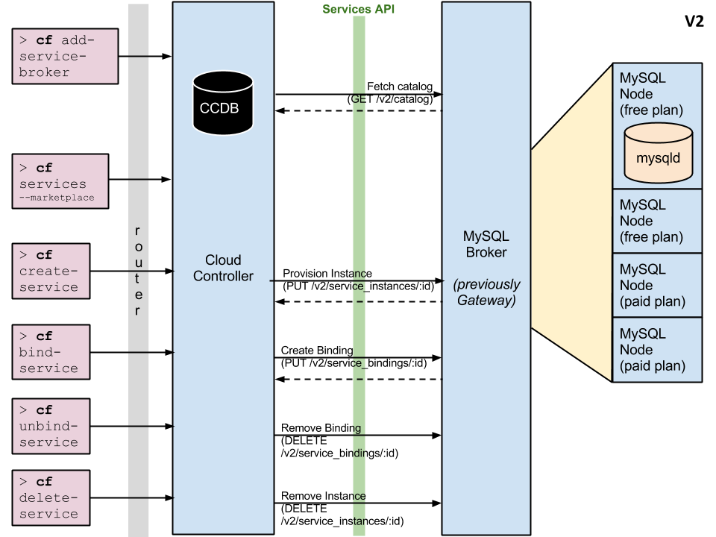
Service Broker Example (MySQL)
Service Broker
cf create-
service-
broker
* Upgrade (PATCH)
not shown

Slide 6
Service Broker API
REST based API over HTTP
  So Service Brokers can run anywhere
  Although they are often PCF-deployed applications

Slide 7
Service Broker API Summary
API Endpoints are *
  Catalog Mgmt – describe the plans offered by the service
  Provision – create a service instance
  Deprovision – delete a service instance
  Bind – create a binding between an app and service instance
  Unbind – delete binding
  Change plan – upgrade the plan of an existing service
* Not a complete list

Slide 8
Server Broker API
Service Broker
GET /v2/catalog
  List services and plans available from this broker.
PUT /v2/service_instances/:instance_id
  Create a new service instance.
PUT /v2/service_instances/:instance_id/service_bindings/:id
  Create a new binding to a service instance.
DELETE /v2/service_instances/:instance_id/service_bindings/:id
  Unbind from a service instance.
DELETE /v2/service_instances/:instance_id
  Delete a service instance
PATCH /v2/service_instances/:instance_id
  Update service to different plan

Slide 9
What should I provision?
Provision anything you want

Slide 10
Provision Sequence
CLI
Cloud Controller
CC_DB
Service Broker
MongoDB
(1) Create Service

Slide 11
Provision Sequence
CLI
Cloud Controller
CC_DB
Service Broker
MongoDB
(1) Create Service
(2) Provision

Slide 12
Provision Sequence
CLI
Cloud Controller
CC_DB
Service Broker
MongoDB
(1) Create Service
(2) Provision
(3) Reserve Resources

Slide 13
Binding
Provide unique credentials per binding
  Made available to application via VCAP_SERVICES
  Stored in CCDB for future use

Slide 14
Bind Sequence
CLI
Cloud Controller
CC_DB
Service Broker
MongoDB
(1) Bind Service
(2) Bind Service

Slide 15
Bind Sequence
CLI
Cloud Controller
CC_DB
Service Broker
MongoDB
(1) Bind Service
(2) Bind Service

Slide 16
Bind Sequence
CLI
Cloud Controller
CC_DB
Service Broker
MongoDB
(1) Bind Service
(2) Bind Service
(3) Obtain credentials

Slide 17
Bind Sequence
CLI
Cloud Controller
CC_DB
Service Broker
MongoDB
(1) Bind Service
(2) Bind Service
(3) Obtain credentials
(4) Store Credentials

Slide 18
Roadmap
Custom Services using Service Brokers
Writing a Custom Service Broker

Slide 19
Service Broker Implementation
Service Broker
Service implementation is up to the service provider/developer
Cloud Foundry only requires that the service provider implement the service broker API
Broker can be implemented
  As a separate application
  By adding required http endpoints to an existing service
Deploy using cf create-service-broker
  Need administrator privileges to make generally available
  A developer can enable a broker for a specific space

Slide 20
Service Instance Provisioning Examples
For a MySQL service, provisioning could result in:
  An empty dedicated mysqld process running on its own VM
  An empty dedicated mysqld process running in a lightweight container on a shared VM
  An empty dedicated mysqld process running on a shared VM
  An empty dedicated database, on an existing shared running mysqld
For any of the above provisioning could also provide a
  A database with business schema already there
  A copy of a full database, for example a QA database that is a facsimile of the production database
For non-data services
  Provisioning could just mean getting an account on an existing system

Slide 21
Service Broker Deployment Models
Many deployment models are possible:
  Entire service packaged and deployed by BOSH alongside Cloud Foundry (Ops Manager Tile)
  Broker packaged and deployed by BOSH alongside Cloud Foundry
    rest of the service deployed and maintained by other means
  Broker (and optionally service) pushed as an application to Cloud Foundry user space
  Entire service, including broker, deployed and maintained outside of Cloud Foundry by other means

Slide 22
Custom Service Broker
Spring Cloud Service Broker project
  http://cloud.spring.io/spring-cloud-cloudfoundry-service-broker

Slide 23


Register New Service
Register your new service-broker
  cf create-service-broker
    and other similar commands
For more information see
  http://docs.cloudfoundry.org/services/managing-service-brokers.html
Service Broker

Slide 24
Summary
We have learned about
Custom Services using Service Brokers
Writing a Custom Service Broker

Slide 25
Lab
Service Brokers

