Slide 1
Continuous Delivery
Ready to deploy any time
Natural fit with Cloud Foundry

Slide 2
Agenda
Define Continuous Delivery
Strategies for Success
How Pivotal Cloud Foundry Enables Continuous Delivery

Slide 3
What is Continuous Delivery?
“How long would it take in your environment to push a single line of code to production?”
  Mary Poppendiek

Slide 4
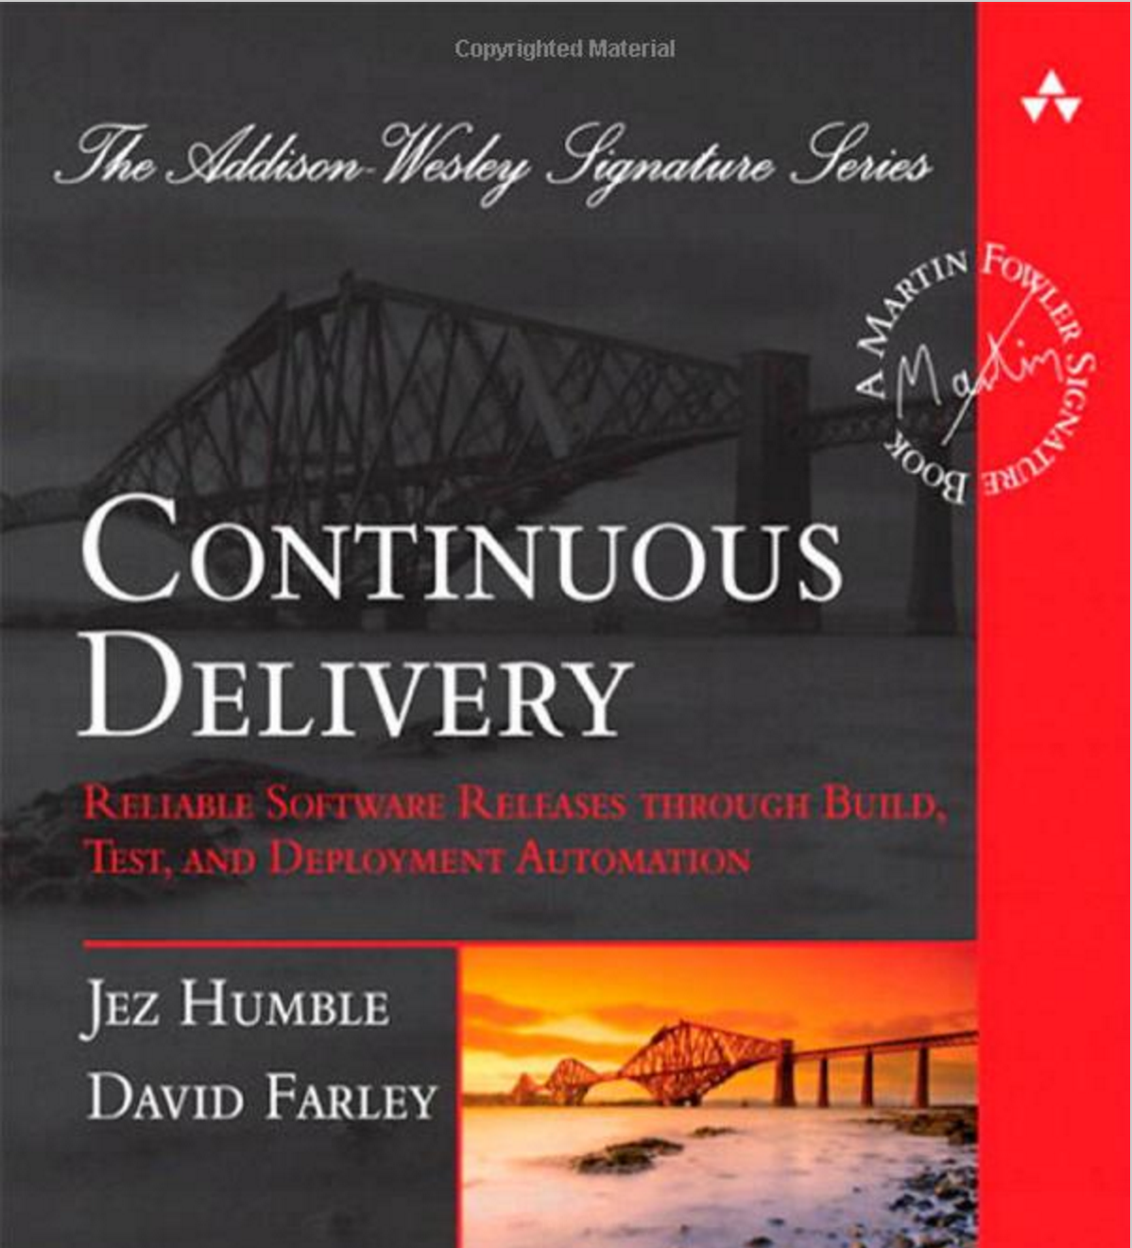
Continuous Delivery
Build software so that it can be released to production at any time

Slide 5
Continuous Deployment
Continuous Deployment
!=
Continuous Delivery
Notes:
Continuous deployment is complete end-to-end process from idea to production. Most companies are not willing to go that far.
Continuous delivery stops just before the productions step. There is always a running version of the software ready for deployment as and when (next slide)

Slide 6



Who Decides When to go to Production?
The business
  BUT: Technical teams should be ready!

Slide 7

Waterfall Application Delivery
Risk
Time

Slide 8
Waterfall Application Delivery
High risk. Low feedback.
Risk
!
Time

Slide 9
Application Delivery with Continuous Delivery
Several smaller deployments reduce risk but increase feedback.
!
!
!
Time

Slide 10
Agenda
Define Continuous Delivery
Strategies For Success
Pivotal Cloud Foundry Enables Continuous Delivery

Slide 11
Continuous Delivery Strategies – DOs
Do implement continuous integration
Do externalize environment specific configuration
Do recreate app environments frequently
Do ensure that database changes are automated
Do deploy less more frequently
Do automate all testing where test failures would prevent a production release from occurring
Do try to use tools that support the process
Notes:
Point 4: having the knowledge and confidence that you can create the app environment from scratch.
Point 8: Try to use tools that support the process. Meaning – Don’t get too caught up in the tools, and pick tools that are a good fit with your process. Example: You could use subversion instead of git – the point is to use an SCM tool.

Slide 12
Continuous Delivery Strategies – DON’Ts
Do not assume existing processes are right
Do not create environment specific packages
Do not use a different process for different environments
Notes:
The processes we have done in the past as well as the current ones are not necessarily right. Question everything.

Slide 13
Continuous Delivery Strategies
Blue-Green deployments can be used with a continuous delivery pipeline.
Before
After
Live Traffic
App 1.0
App 1.0
App 1.1
Live Traffic
App 1.1

Slide 14
Implications of Continuous Delivery
Software is deployable throughout its lifecycle
Prioritize keeping the software deployable over working on new features
Can get fast, automated feedback on the production readiness of a system whenever it is changed
Can perform “push-button” deployments of any version of the software to any environment on demand
http://martinfowler.com/bliki/ContinuousDelivery.html
Notes:
The current deployment version of the software can be deployed into production at a moment’s notice

Slide 15
Continuous Delivery Sequence (Development)
Repo
CD Provider
Binary Repo
Environment
(Dev)
(1) Push to repo

Slide 16
Continuous Delivery Sequence (Development)
Repo
CD Provider
Binary Repo
Environment
(Dev)
(1) Push to repo
(2) Poll for changes

Slide 17
Continuous Delivery Sequence (Development)
Repo
CD Provider
Binary Repo
Environment
(Dev)
(1) Push to repo
(2) Poll for changes
(3) Run build
and tests

Slide 18
Continuous Delivery Sequence (Development)
Repo
CD Provider
Binary Repo
Environment
(Dev)
(1) Push to repo
(2) Poll for changes
(3) Run build
and tests
(4) Start feedback loop

Slide 19
Continuous Delivery Sequence (Development)
Repo
CD Provider
Binary Repo
Environment
(Dev)
(1) Push to repo
(2) Poll for changes
(3) Run build
and tests
(4) Start feedback loop
(5) Push artifact

Slide 20
Continuous Delivery Sequence (Development)
Repo
CD Provider
Binary Repo
Environment
(Dev)
(1) Push to repo
(2) Poll for changes
(3) Run build
and tests
(4) Start feedback loop
(5) Push artifact
(6) Pull artifact

Slide 21
Continuous Delivery Sequence (Development)
Repo
CD Provider
Binary Repo
Environment
(Dev)
(1) Push to repo
(2) Poll for changes
(3) Run build
and tests
(4) Start feedback loop
(5) Push artifact
(6) Pull artifact
(7) Push artifact

Slide 22
Continuous Delivery Sequence (Development)
Repo
CD Provider
Binary Repo
Environment
(Dev)
(1) Push to repo
(2) Poll for changes
(3) Run build
and tests
(4) Start feedback loop
(5) Push artifact
(6) Pull artifact
(7) Push artifact
(8) Run more tests

Slide 23
Continuous Delivery Sequence (Development)
Repo
CD Provider
Binary Repo
Environment
(Dev)
(1) Push to repo
(2) Poll for changes
(3) Run build
and tests
(4) Start feedback loop
(5) Push artifact
(6) Pull artifact
(7) Push artifact
(9) End Feedback loop
(8) Run more tests

Slide 24
Continuous Delivery Sequence (Production)
CD Provider
Binary Repo
Environment
(Prod)
(1) Trigger Prod deployment

Slide 25
Continuous Delivery Sequence (Production)
CD Provider
Binary Repo
Environment
(Prod)
(1) Trigger Prod deployment
(2) Start feedback loop

Slide 26
Continuous Delivery Sequence (Production)
CD Provider
Binary Repo
Environment
(Prod)
(1) Trigger Prod deployment
(2) Start feedback loop
(3) Pull artifact

Slide 27
Continuous Delivery Sequence (Production)
CD Provider
Binary Repo
Environment
(Prod)
(1) Trigger Prod deployment
(2) Start feedback loop
(3) Pull artifact
(4) Push artifact

Slide 28
Continuous Delivery Sequence (Production)
CD Provider
Binary Repo
Environment
(Prod)
(1) Trigger Prod deployment
(2) Start feedback loop
(3) Pull artifact
(4) Push artifact
(5) Run more tests

Slide 29
Continuous Delivery Sequence (Production)
CD Provider
Binary Repo
Environment
(Prod)
(1) Trigger Prod deployment
(2) Start feedback loop
(3) Pull artifact
(4) Push artifact
(5) Run more tests
(6) End feedback loop

Slide 30
Agenda
Define Continuous Delivery
Strategies
Pivotal Cloud Foundry Enables Continuous Delivery

Slide 31
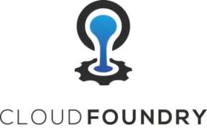
PCF Enabling Continuous Delivery
Get a new application environment in seconds
Enables complete consistency between environments
A consistent API to automate deployments
Inject environment specific configuration
Promote applications through environments with the same process

Slide 32
Lab
Continuous Delivery using Jenkins

