Slide 1
Unified Memory Experiments – Calculate Pi
SBEL
Felipe Gutierrez

Slide 2
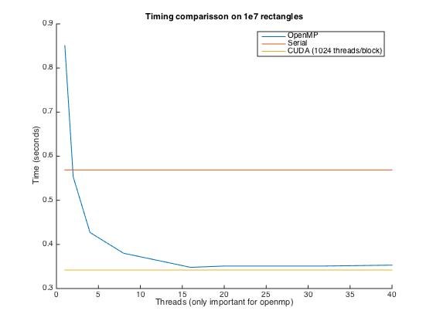

Slide 3
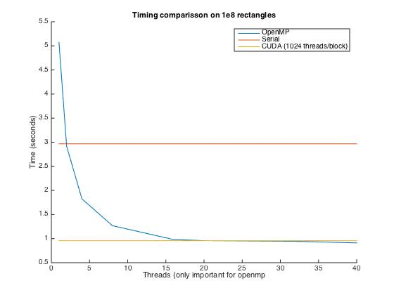

Slide 4
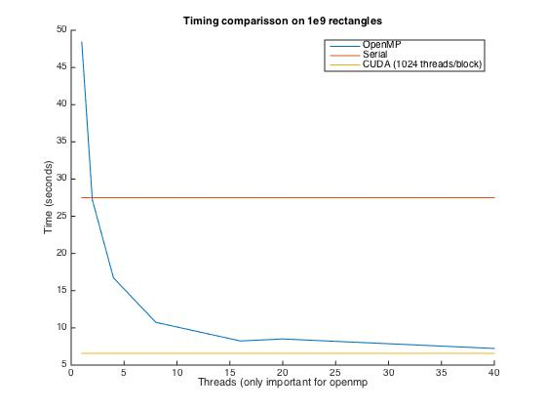

Slide 5
