Slide 1

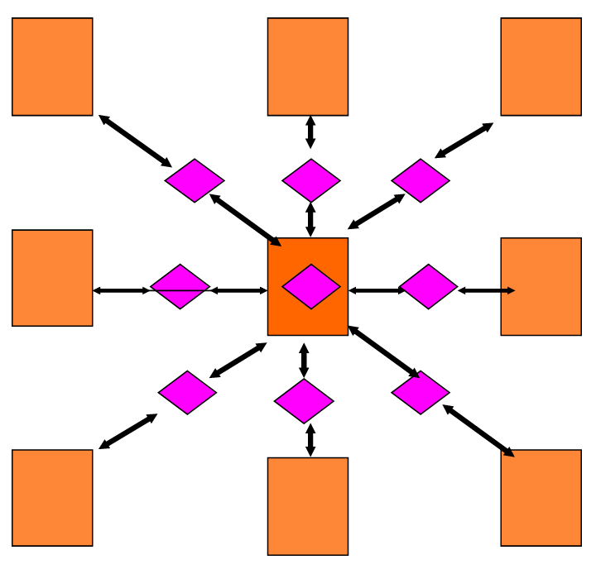
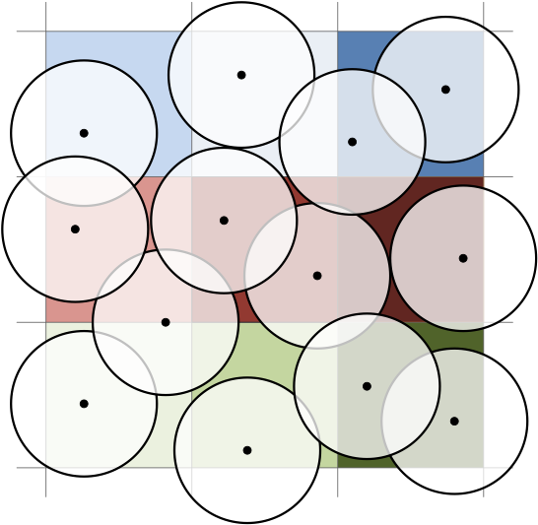
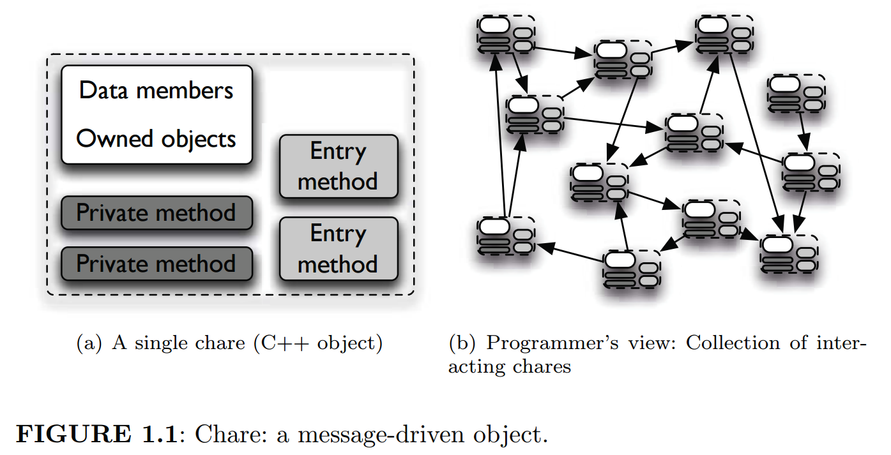
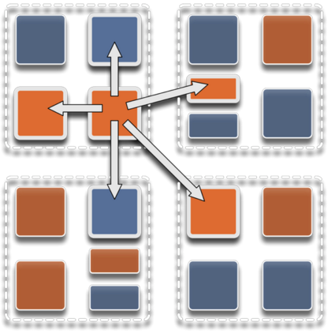
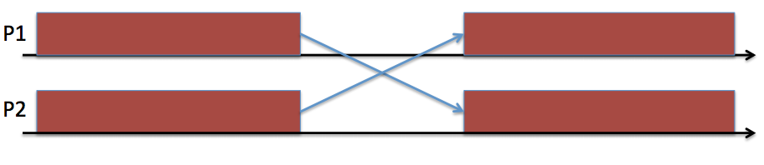
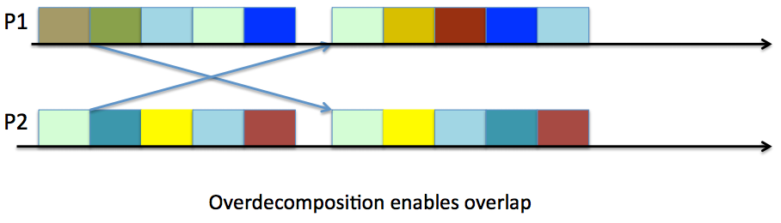
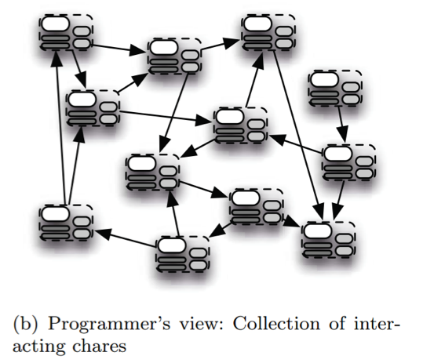


Leveraging Charm++ for meshless fluid simulations on distributed memory architectures
Felipe Gutierrez, Arman Pazouki, and Dan Negrut
University of Wisconsin-Madison
Objective
Design and develop a smoothed particle hydrodynamics (SPH) engine using the Charm++ object-oriented asynchronous message passing parallel programming paradigm.
Why Charm++ for SPH? Why not CUDA or MPI?
Adaptive Runtime System: Dynamic load-balancing, communication optimization, fault-tolerance, etc.
Proven success in molecular dynamics with NaMD. Runs on 500,000+ cores at Blue Waters.
CUDA is SIMD vs. Charm++ can be MIMD.
CUDA is a shared memory model.
Example: Naive Domain decomposition
The Charm++ Programming Paradigm
Object-Oriented: Chare Objects.
Overdecomposition
Figure 4: Hybrid decomposition: cell chares (orange) and compute chares (pink) (left). Particle grouped by cell, showing the interaction radius (right).
Figure 1: Single Chare Object (left). Overdecomposition; multiple chares in each execution unit exchanging data (right).
Figure 5: Example SPH setup.
Figure 3: Compute idle time in MPI (top). Reduced idle times due to overdecomposition (bottom).
References
[1] PPL at UIUC. “Charm++”. http://charmplusplus.org.
[2] N. Jain. “LeanMD”. http://charm.cs.illinois.edu/gerrit/benchmarks/leanmd.git
[3] L. Kale, et al. “Charm++ for productivity and performance”. PPL Technical Report, 2011.
Migratability
Asynchrony: Message-driven execution.
Charm-based SPH Engine Design
SPH: Particle-based meshless approach.
Hybrid decomposition: Spatial + Force decomposition. NaMD inspired.
Cell /Bin Chare: Contains data. Takes care of force reduction, time integration and particle migration to neighbor cells.
Compute Chare: Compute interactions within a Cell or between neighbor cells.
Acknowledgements
This project was sponsored by US Army TARDEC under Rapid Innovation Fund (RIF) grant W56HZV-14-C-0254.
Figure 2: Programmers view of a collection of interacting chares.
Organized by
December 8-9, 2015
Notes:
Programming Paradigm: A design strategy of writing an application
Charm++ is a general approach to write parallel applications. Alternative to MPI, UPC, etc, not to C/C++.
Charm++ is also the runtime system and the overall ecosystem of the application.
Chare Objects: Work and data units
Contain data
Send and receive data
Perform some task upon receiving data (execute a special member function called entry methods)
Overdecomposition
When writing an application for a distributed memory system we are already decomposing our data and work depending on the number of nodes/cores. Overdecomposition just means that the number of work/data units will be greater than the number of execution units.
Migratability:
We want to allow Chares to be migratable at runtime (either by the programmer or RTS).
Now the RTS keeps track where each unit is located, the programmer does not have to care.
Note: In MPI migratability is all up to the programmer.
Asynchrony:
Now: Multiple units on each processor and each of them is addressed through a logical names.
Work Scheduling: Message-driven
Let the work-unit that has data available to work on execute next.
RTS selects who goes next, the programmer can influence this choice through priorities.
Putting it all together:
Overdecomposed chares.
Each chare will have a set of “entry” methods that can be called by remote chares
Chares can be organized into indexed collections (nDimensional arrays).
Communication occurs through asynchronous method invocation.
Method is invoked. Execution continues normally until the data is needed. If the data hasn’t arrived when it is needed then the RTS will give the execution unit to another chare who has data ready to work on.
Why charm++?
The RTS is aware of how much work is being done in each execution unit so it can make decisions on where to put the chares with the most data and most work and the chares with the least data and least work.
The RTS is aware of which chares are communicating with each other so it can optimize the communication speed by strategically placing these chares.
Fault-tolerance thanks to migratability of objects.
CUDA is SIMD vs. Charm++ can be MIMD→ CUDA relies on data parallelism.

