Slide 1
Data Pre-processing – II
Tahar Kechadi
School of Computer Science & Informatics
University College Dublin

Slide 2
Learning Outcomes
Data cleaning
  Fill in missing values
  Identify outliers and smooth out noisy data
  Correct inconsistent data
Data Transformation
Data Reduction and Discretisation

Slide 3
Data Mining Process
Knowledge
Pattern Evaluation
Data Mining
Task-relevant Data
Data Warehouse
Selection
Data Cleaning
Data Integration
Databases

Slide 4
Data Mining Process
Problem
definition
_x0004_Data gathering
& preparation
Data access
Data sampling
Data transformation
_x0004_Model building
& evaluation
Create model
Test model
Evaluate model
Interpret model
Knowledge
deployment
Apply model
Custom reports
External applications

Slide 5
Why Data Pre-processing?
Data in the real world is dirty
  Incomplete: lacking attribute values, lacking certain attributes of interest, or containing only aggregate data
  Noisy: containing errors or outliers
  Inconsistent: containing discrepancies in codes or names
No quality data, no quality mining results!
  Quality decisions must be based on quality data
  Data warehouse needs consistent integration of quality data

Slide 6
Major Tasks in Data Pre-processing
Data cleaning
  Fill in missing values, smooth noisy data, identify or remove outliers, and resolve inconsistencies
Data integration
  Integration of multiple databases, data cubes, or files
Data transformation
  Normalization and aggregation
Data reduction
  Obtain reduced representation in volume but produces the same or similar analytical results
Data discretization
  Part of data reduction but with particular importance, especially for numerical data

Slide 7

Forms of data pre-processing

Slide 8
Missing Values
Data is not always available
  E.g., many tuples have no recorded value for several attributes, such as customer income in sales data
Missing data may be due to
  equipment malfunction
  inconsistent with other recorded data and thus deleted
  data not entered due to misunderstanding
  certain data may not be considered important at the time of entry
  no register history or changes of the data
Missing data may need to be inferred

Slide 9
How to Handle Missing Data?
Ignore the tuple: not effective when the percentage of missing values per attribute varies considerably
Fill in the missing value manually: tedious + infeasible?
Use a global constant to fill in the missing values: e.g., “unknown”, a new class?!
Use the attribute mean to fill in the missing values
Use the attribute mean for all samples belonging to the same class to fill in the missing value: smarter
Use the most probable value to fill in the missing value: inference-based such as Bayesian formula or decision tree

Slide 10
Practical: P1
Consider the dataset “S & S data anonymised.xls”
  The dimension “Age at time of check” contains missing values. Can you identify them?
  Calculate the percentage of the missing values
  Do you think the percentage is very important?
  What would be the best way to deal with these missing values?
  Use Rapid Miner to extract the missing values
  Use Rapid Miner and choose a technique to process these missing values
Perform the same operations with
  Dimension “Officer Defined Ethnicity”

Slide 11
Noisy Data
Noise: random error or variance in a measured variable
Incorrect attribute values may due to
  faulty data collection instruments
  data entry problems
  data transmission problems
  technology limitation
  inconsistency in naming convention
Other data problems which requires data cleaning
  duplicate records
  incomplete data
  inconsistent data

Slide 12
How to Handle Noisy Data?
Binning method
  first sort data and partition into bins (buckets)
  then one can smooth by bin means, smooth by bin median, smooth by bin boundaries, etc.
Combined computer and human inspection
  detect suspicious values and check by human
Clustering
  detect and remove outliers
Regression
  smooth by fitting the data into regression functions

Slide 13
Binning Methods
Equal-width (distance) partitioning
  It divides the range into N intervals of equal size: uniform grid
  if A and B are the lowest and highest values of the attribute, the width of intervals will be: W = (B - A)/N
  But outliers may dominate presentation
  Skewed data is not handled well
Equal-depth (frequency) partitioning
  It divides the range into N intervals, each containing approximately the same number of samples
  Good data scaling
  Managing categorical attributes can be tricky

Slide 14
Binning Methods: Example
Sorted data for price (in €)
  4, 8, 9, 15, 21, 21, 24, 25, 26, 28, 29, 34
Partition into (equi-depth) bins
  Bin 1: 4, 8, 9, 15
  Bin 2: 21, 21, 24, 25
  Bin 3: 26, 28, 29, 34
Smoothing by bin means
  Bin 1: 9, 9, 9, 9
  Bin 2: 23, 23, 23, 23
  Bin 3: 29, 29, 29, 29
Smoothing by bin boundaries
  Bin 1: 4, 4, 4, 15
  Bin 2: 21, 21, 25, 25
  Bin 3: 26, 26, 26, 34

Slide 15
Practical: P2
Consider the dataset “S & S data anonymised.xls”. Assume that the dimension “Age at time of check” contains noise.
  What would be the noise, in this case?
  Use the binning method to categorize the data into 5 classes
  Use Rapid Miner to perform the binning method
If you have more than one method, compare them

Slide 16
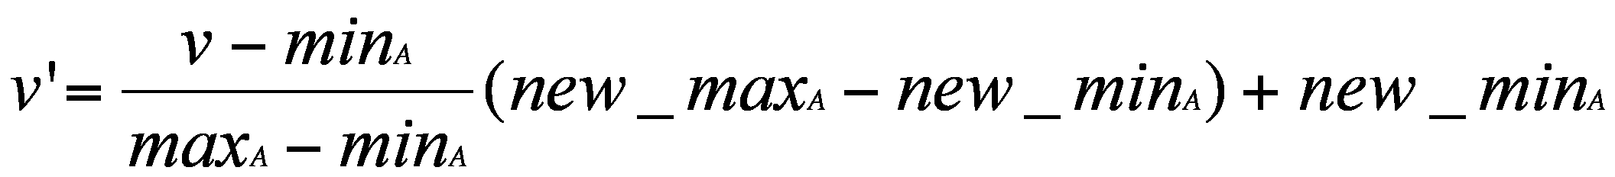

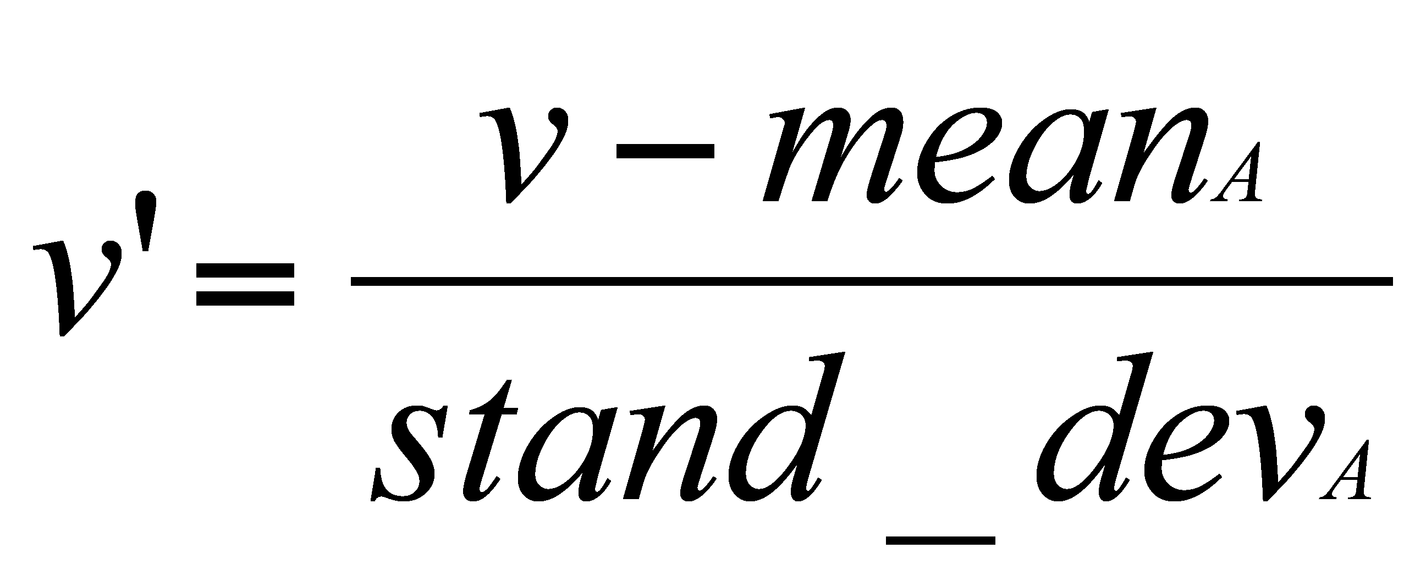
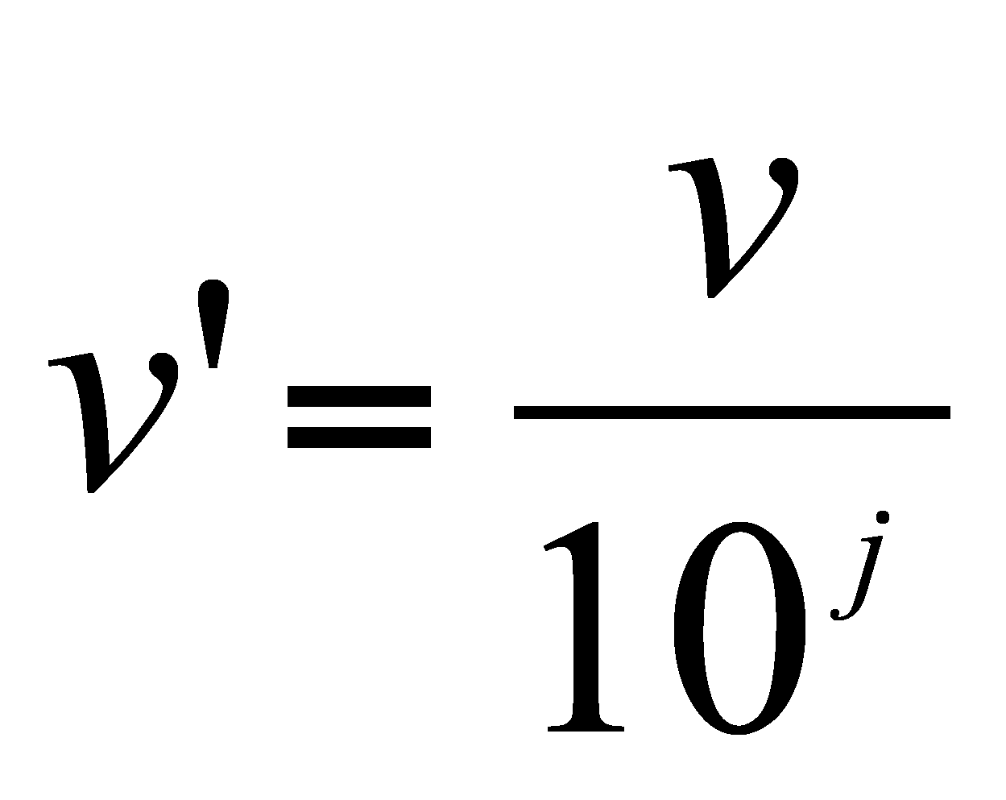
Data Transformation: Normalization
min-max normalisation
z-score normalisation
normalisation by decimal scaling
Where j is the smallest integer such that Max(|v’|)<1

Slide 17
Practical: P3
Consider the dataset “S & S data anonymised.xls”. Use Rapid Miner to normalize the following dimensions:
  Dimension “Juvenile”
  Dimension “Search Reason”
  Dimension “Police area”
    Perform the operation without the missing values
    Perform the operation after you have solved the missing values
Use various normalization techniques on
  Dimension “Juvenile”
  Dimension “Search Reason”

