Slide 1
FeedBack set in digraphs

Slide 2
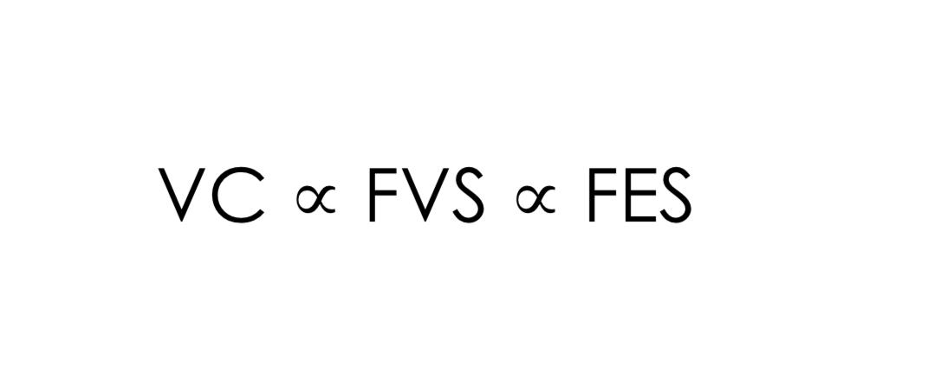
Feedback set in digraphs

Slide 3
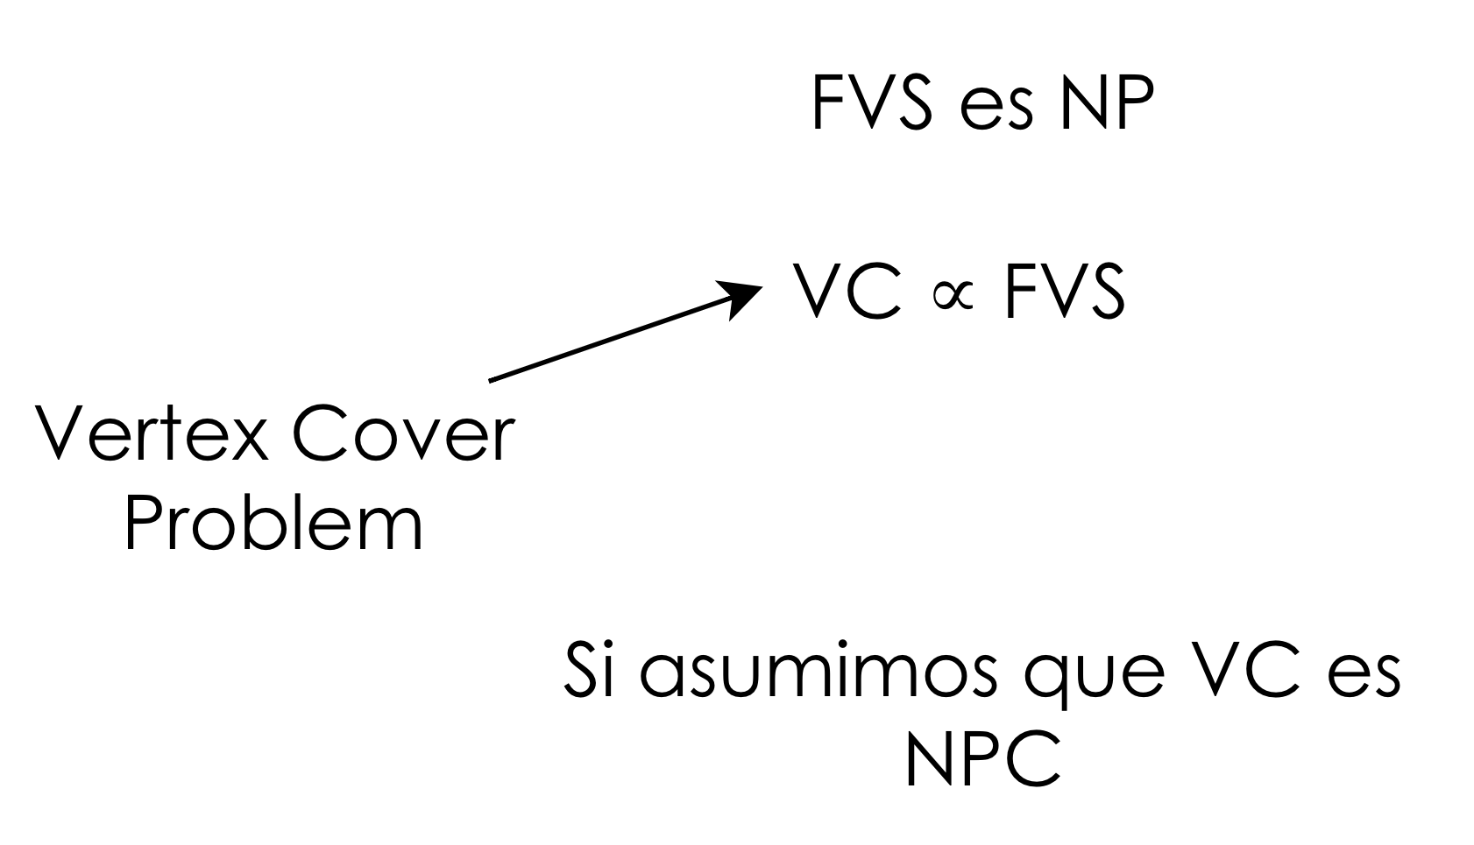
Feedback Vertex Set in Digraphs

Slide 4
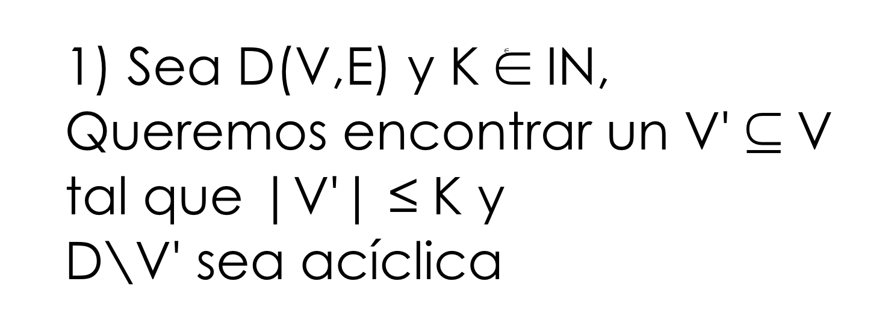
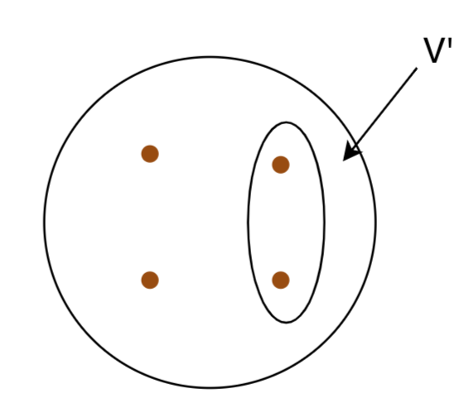
Feedback Vertex Set in Digraphs

Slide 5
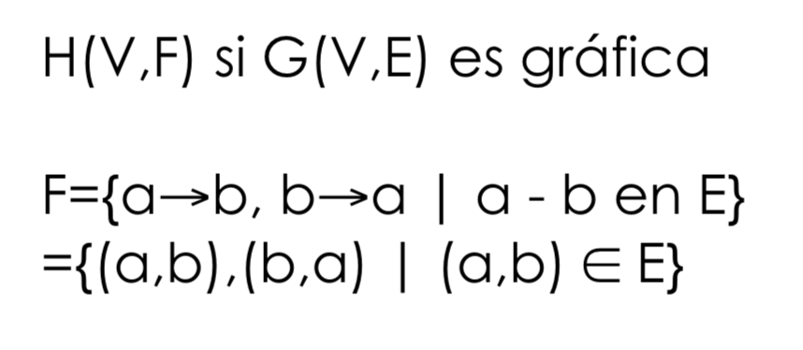
Feedback Vertex Set in Digraphs

Slide 6
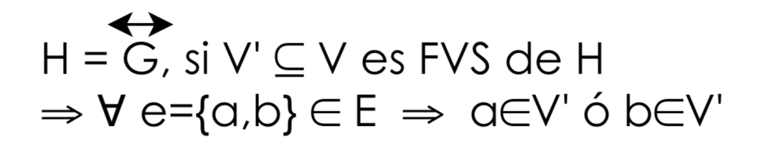
Feedback Vertex Set in Digraphs

Slide 7
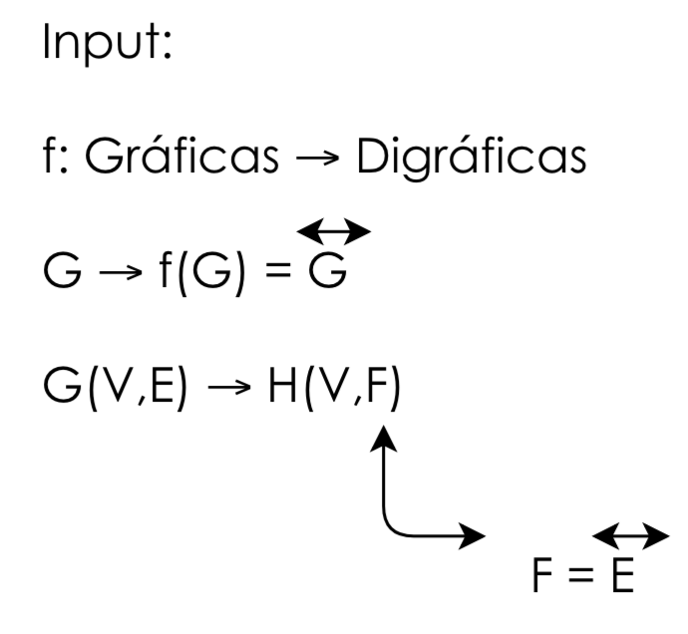
Feedback Vertex Set in Digraphs

Slide 8
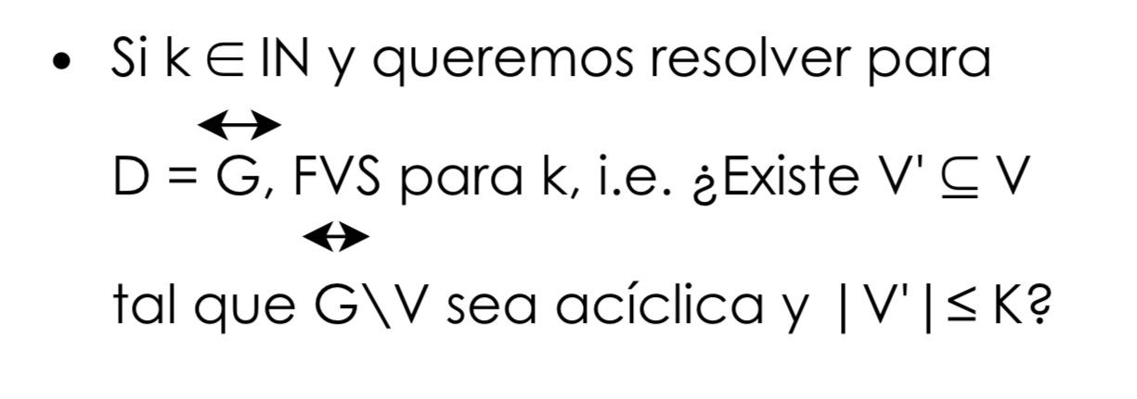
Feedback Vertex Set in Digraphs

Slide 9
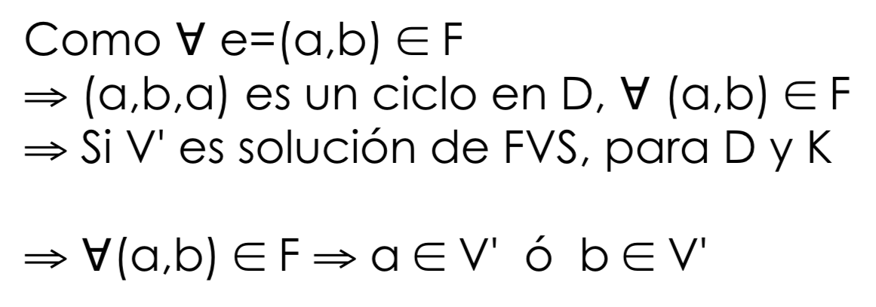
Feedback Vertex Set in Digraphs

Slide 10
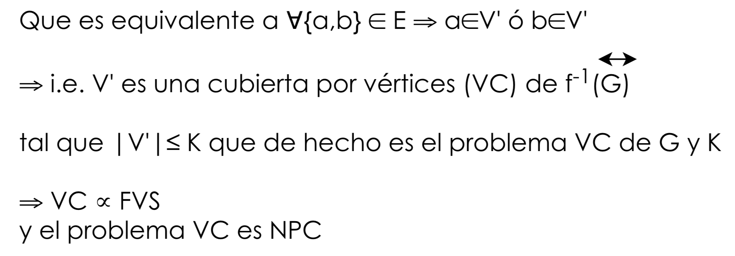
Feedback Vertex Set in Digraphs

Slide 11
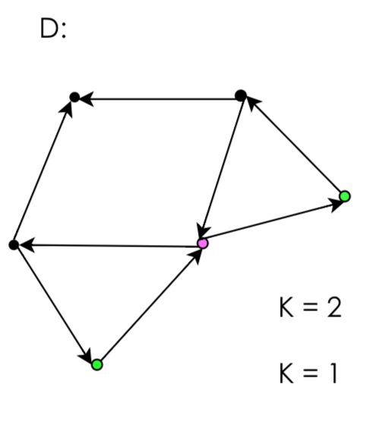
Feedback Vertex Set in Digraphs

Slide 12
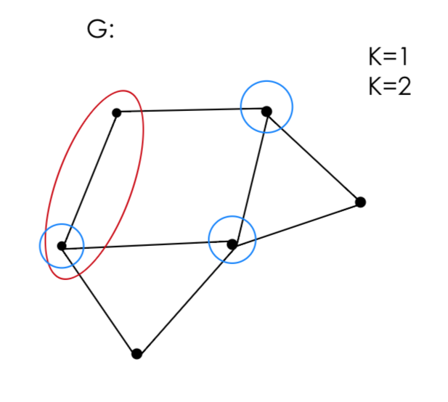
Feedback Vertex Set in Digraphs

Slide 13
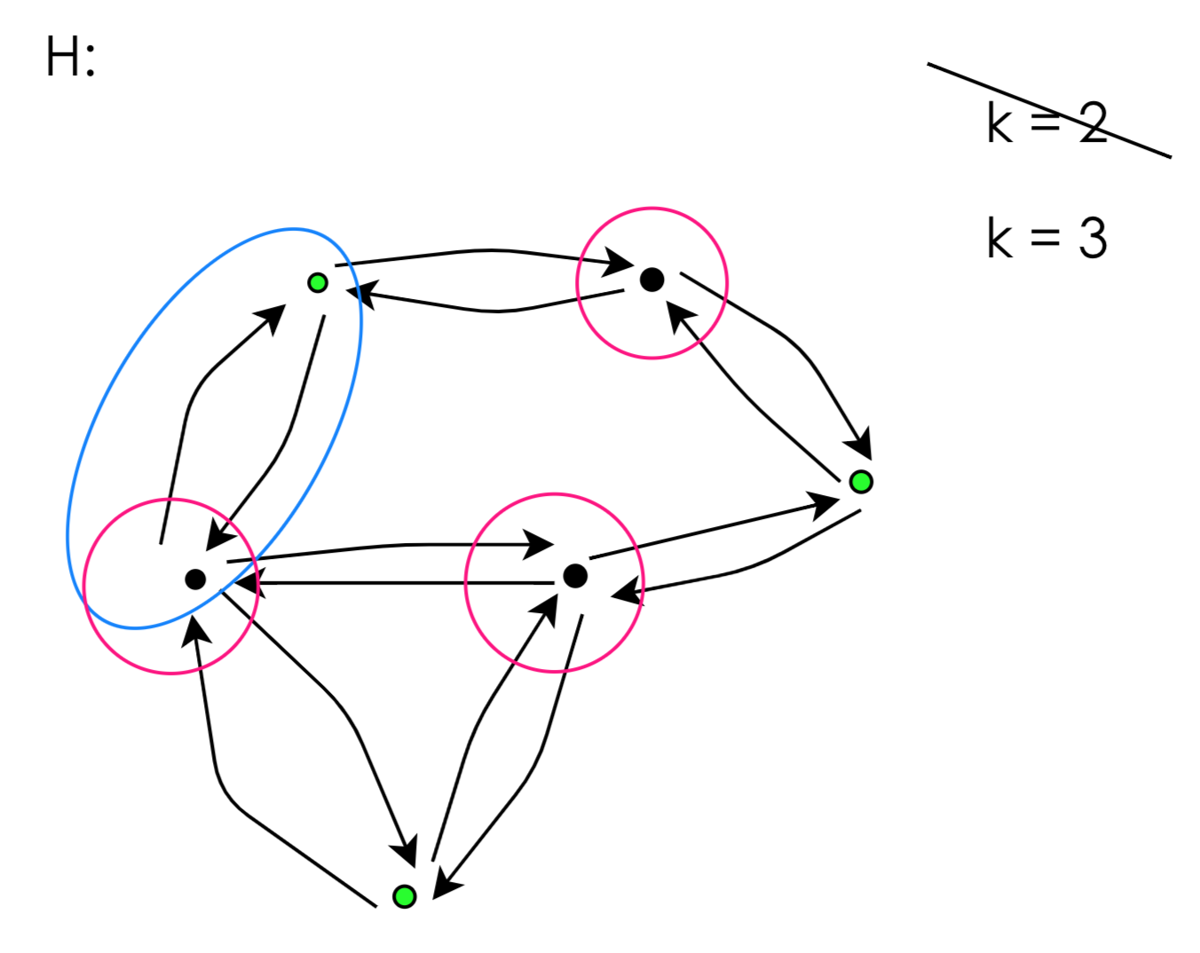
Feedback Vertex Set in Digraphs

Slide 14
Feedback Edge Set Problem

Slide 15
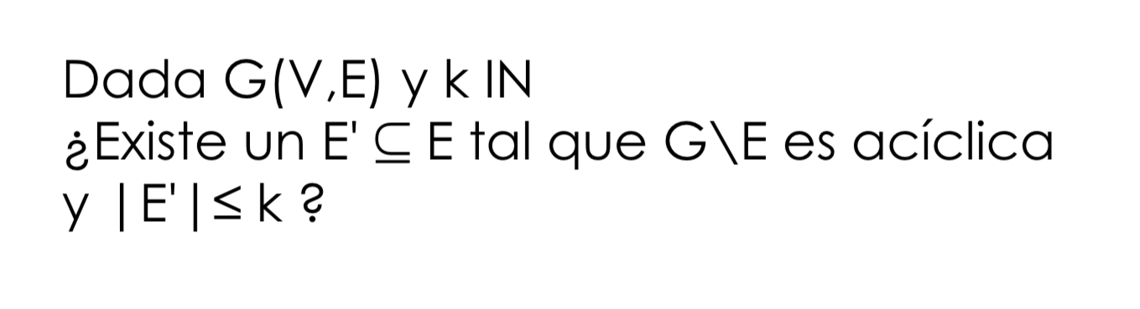
Feedback Edge Set in Digraphs

Slide 16
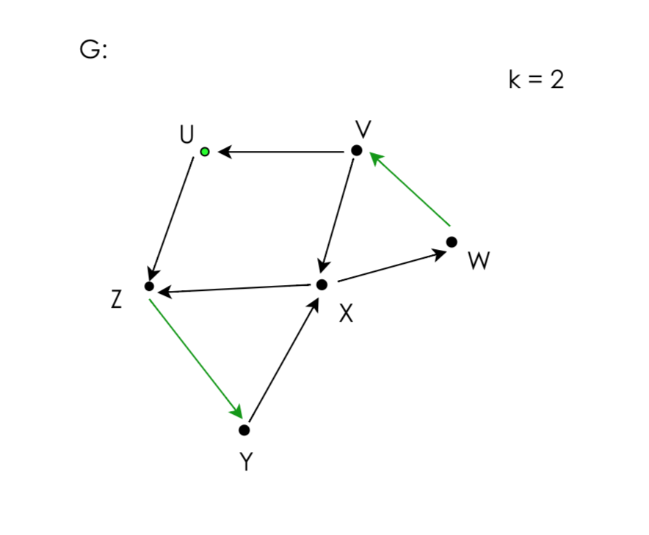
Feedback Edge Set in Digraphs

Slide 17
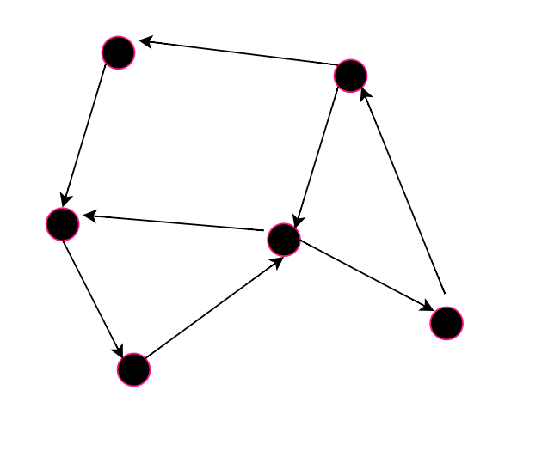
Aplicaciones

Slide 18
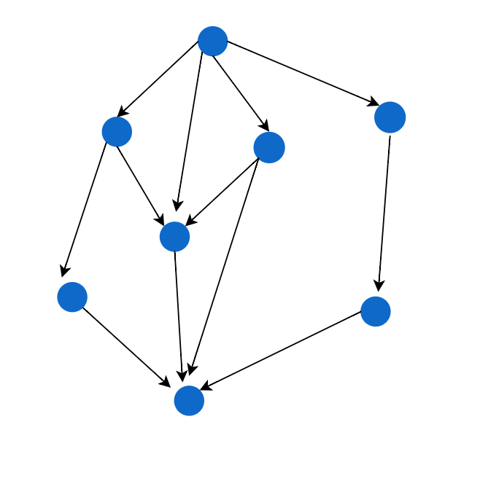
Aplicaciones

