Slide 1
Algorithm for Selecting LF Simulation Domains
Felipe Kuncar
18-08-2025
Notes:
Idea: agree on this approach and parameters

Slide 2
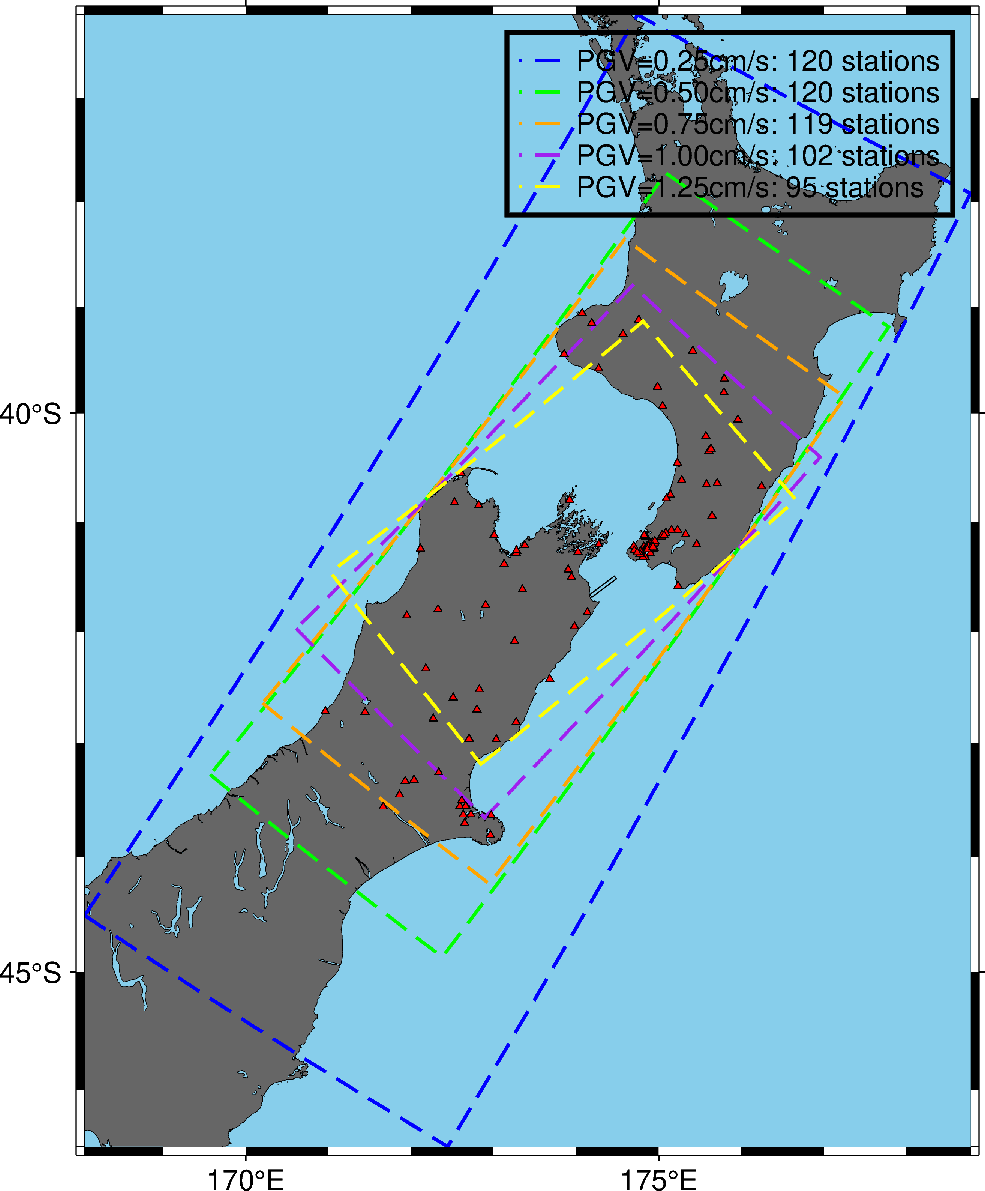
Problem
Selection of LF simulation domain
(= selection of target PGV)
Need for balancing computational demand (domain size) and amount of data (number of stations inside the domain)
Which target PGV would you select for the Cook Strait earthquake?
Manual selection can be tedious when considering a large number of simulations (e.g., >1000)
2013p543824 (Mw 6.6)
Notes:
Already have large number of stations with the smallest domain.
Largest domain is huge. Do not gain that much.
Select PGV=1.25 cm/s

Slide 3
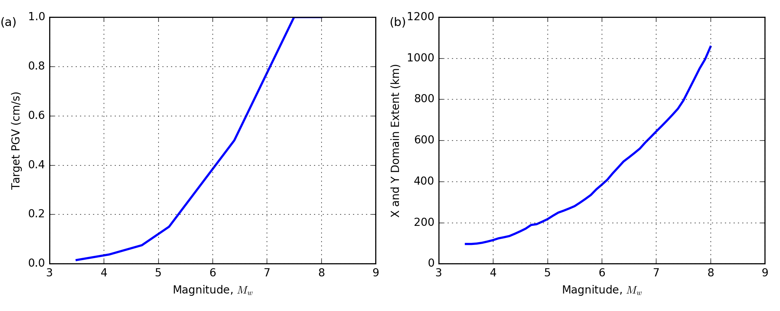
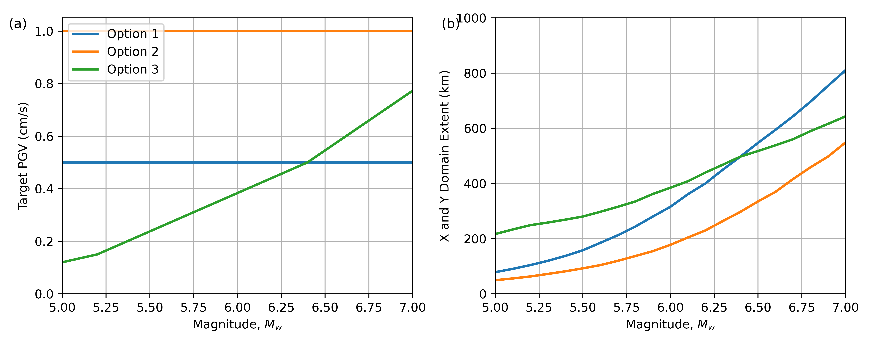
Previous Approach
Notes:
Curve calibrated to obtain a reasonable domain size.
If you use constant PGV (Option 1), very small domain for small magnitude and very large domain for lager magnitudes.

Slide 4
Previous Approach
Target PGV=1.25 cm/s seems sufficient
2013p543824 (Mw 6.6)

Slide 5
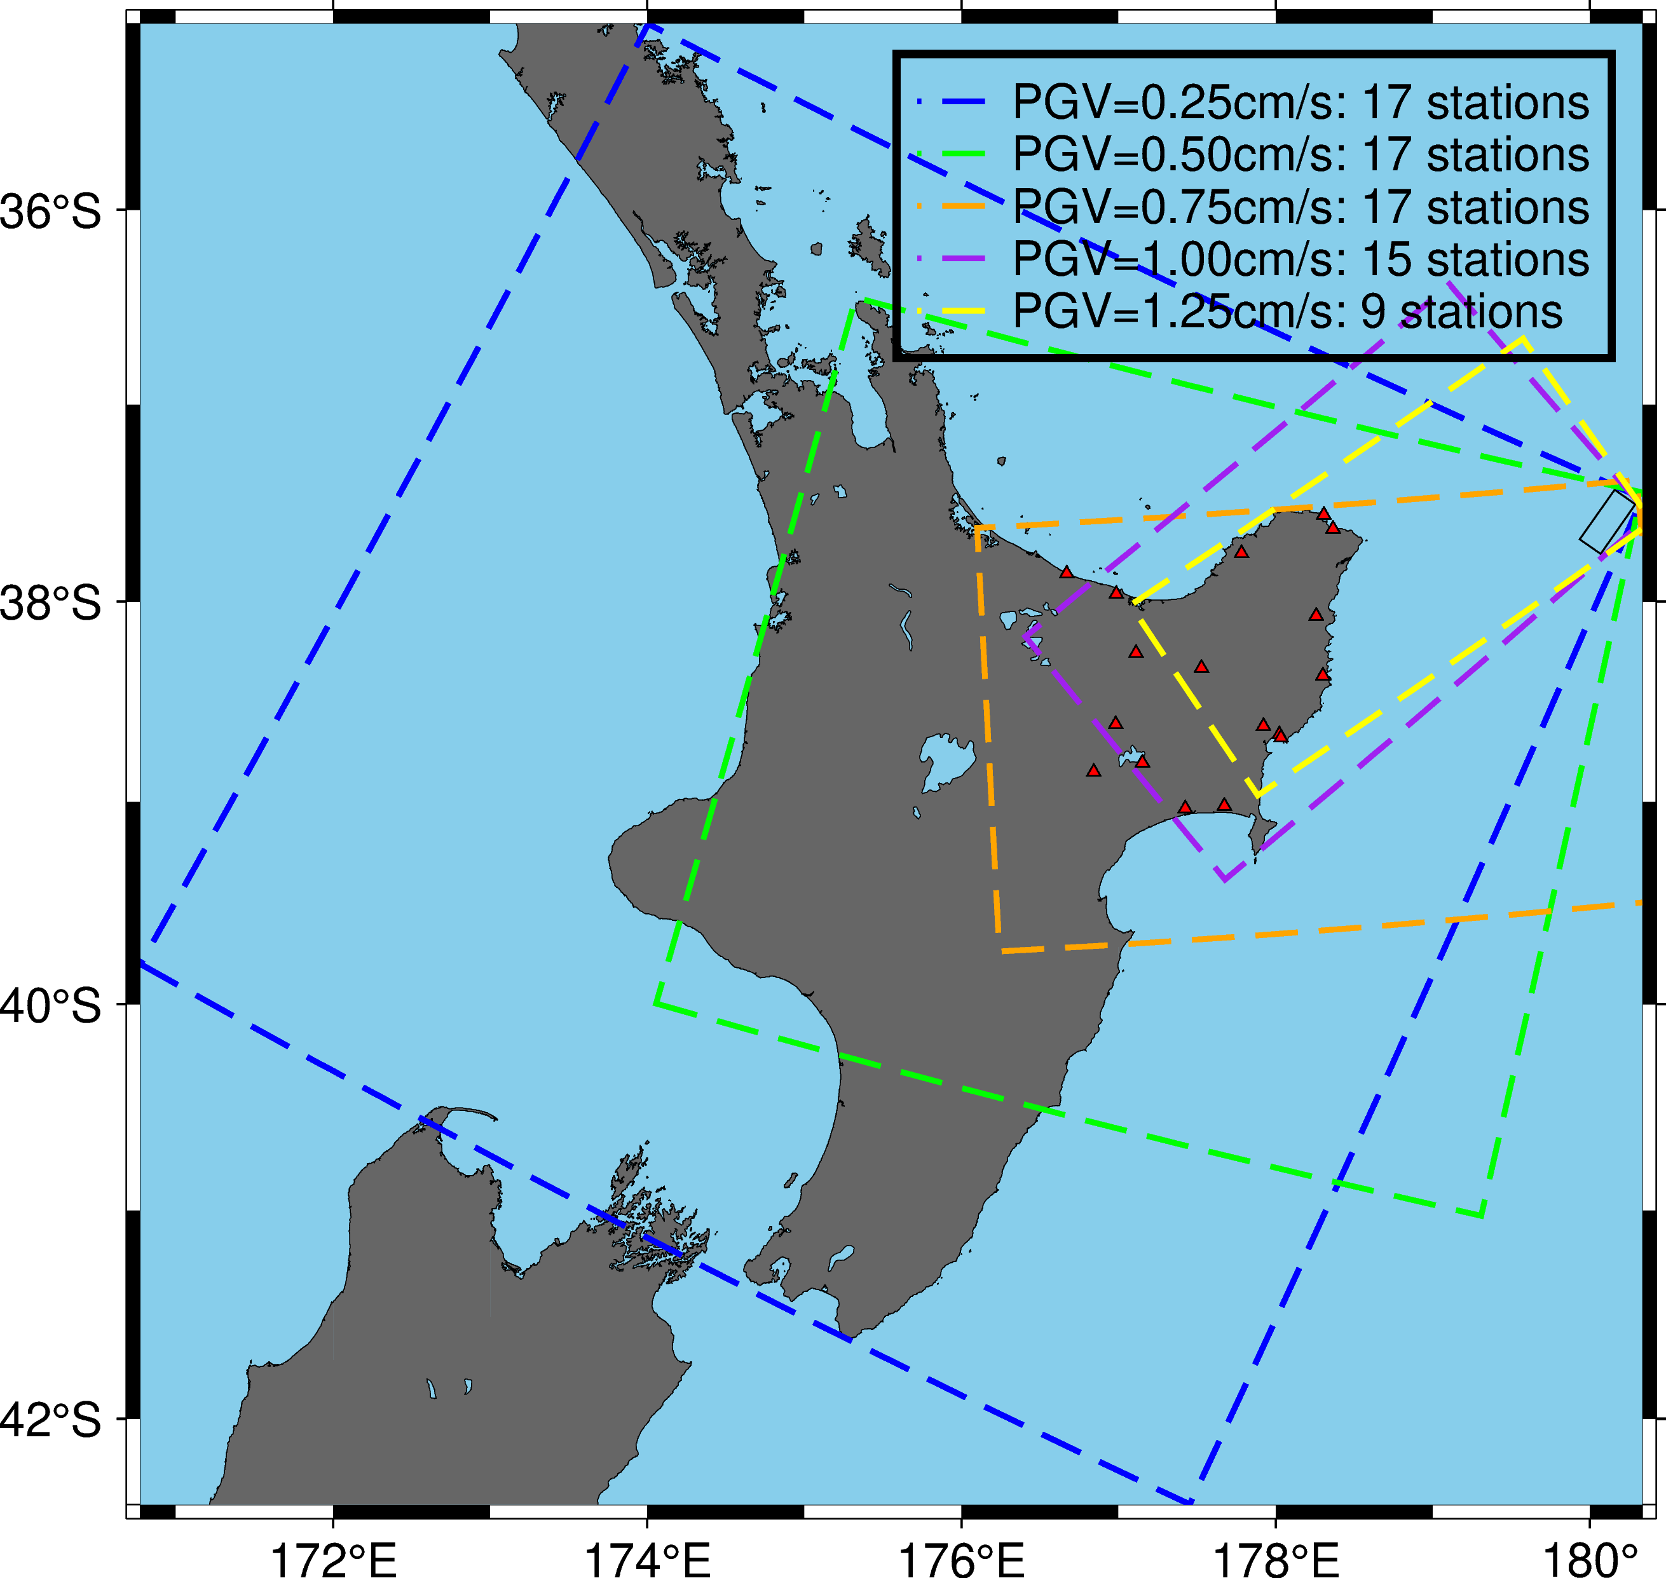
Previous Approach
Target PGV=1.00 cm/s seems sufficient
Previous approach doesn’t take into account the event location
2014p864702 (Mw 6.8)

Slide 6
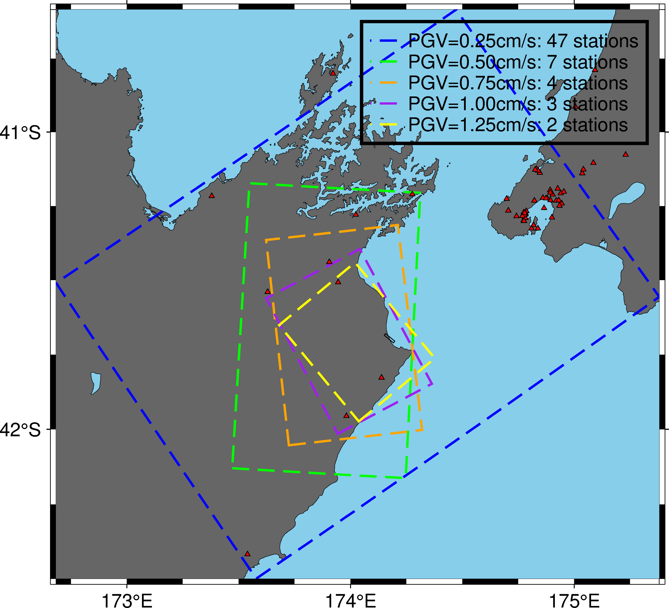
Previous Approach
Target PGV=0.25 cm/s seems sufficient
Previous approach doesn’t take into account clustering of stations
2013p613947 (Mw 5.2)

Slide 7
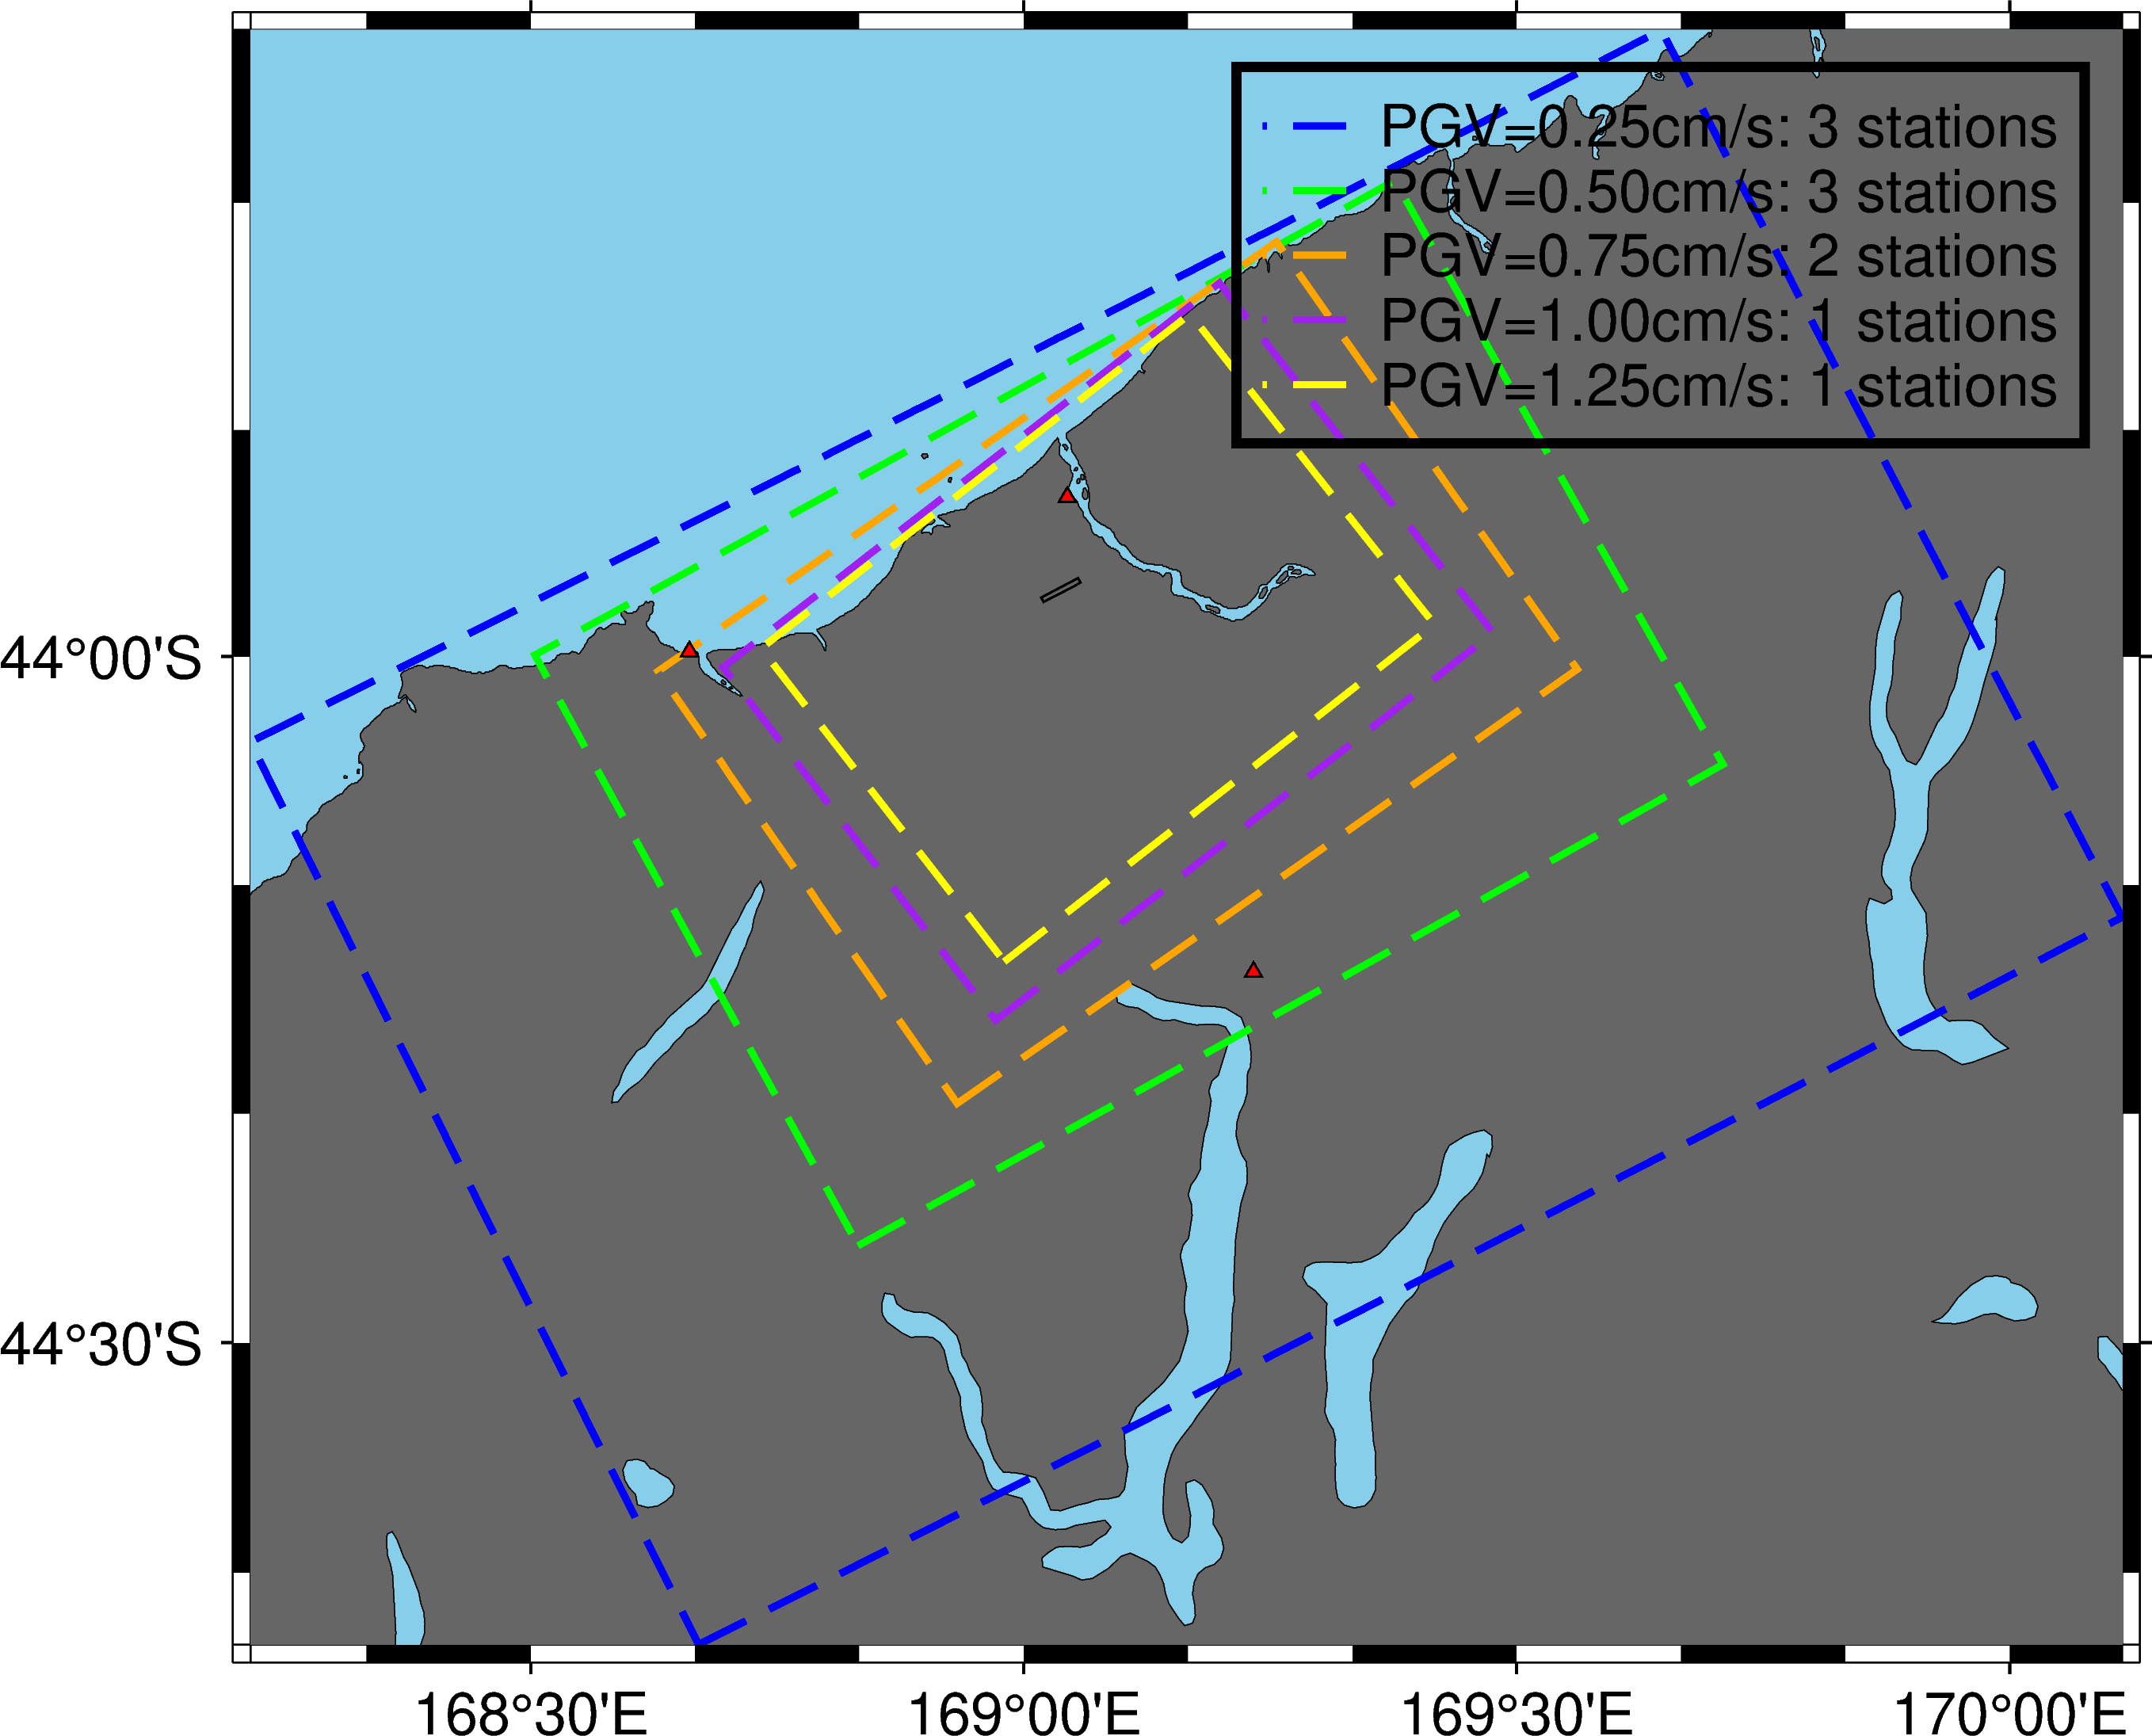
Previous Approach
Target PGV=0.50 cm/s is sufficient
Don’t obtain more stations by increasing the domain for PGA=0.25 cm/s
2626467 (Mw 5.0)

Slide 8
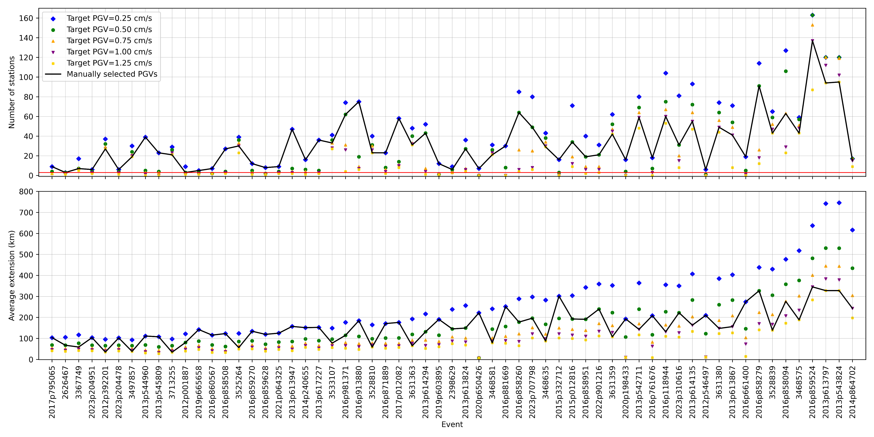
Manual selection for ~60 moderate-magnitude events

Slide 9
Proposed Approach: Automated Algorithm
For each event, it requires computing the number of stations with recordings inside the domain for target PGVs of 0.25, 0.50, 0.75, 1.00, and 1.25 cm/s:
target_pgv_array = [1.25, 1.00, 0.75, 0.50, 0.25]
Ex (2013p614294):
sta_num_array = [1, 4, 7, 43, 52]

Slide 10
Proposed Approach: Automated Algorithm
First remove all cases with less than 3 stations inside the domain:
target_pgv_array = [1.25, 1.00, 0.75, 0.50, 0.25]
Ex (2013p614294):
sta_num_array = [1, 4, 7, 43, 52]

Slide 11
Proposed Approach: Automated Algorithm
First remove all cases with less than 3 stations inside the domain:
target_pgv_array = [1.00, 0.75, 0.50, 0.25]
Ex (2013p614294):
sta_num_array = [4, 7, 43, 52]

Slide 12
Proposed Approach: Automated Algorithm
Then, establish the first value as the “current number of stations”
target_pgv_array = [1.00, 0.75, 0.50, 0.25]
Ex (2013p614294):
sta_num_array = [4, 7, 43, 52]
Idea of the algorithm: a set of rules that indicate if this “current number of stations” needs to be updated (increased) by extending the domain (i.e., decreasing the target pgv).

Slide 13
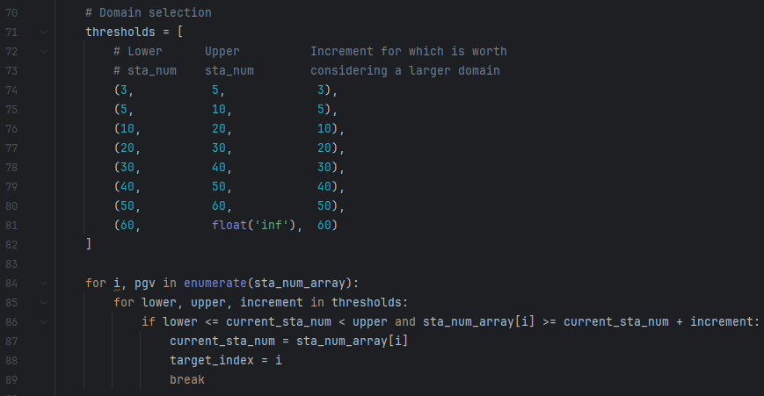
Proposed Approach: Automated Algorithm
Idea:
If the current number of stations is low, a small increase in stations motivates me to extend the domain.
If I currently have many stations, increasing the domain extension is generally not worth it (unless it provides a significantly larger number of stations)
Notes:
Idea:

Slide 14
Proposed Approach: Automated Algorithm
In our example:
target_pgv_array = [1.00, 0.75, 0.50, 0.25]
sta_num_array = [4, 7, 43, 52]

Slide 15
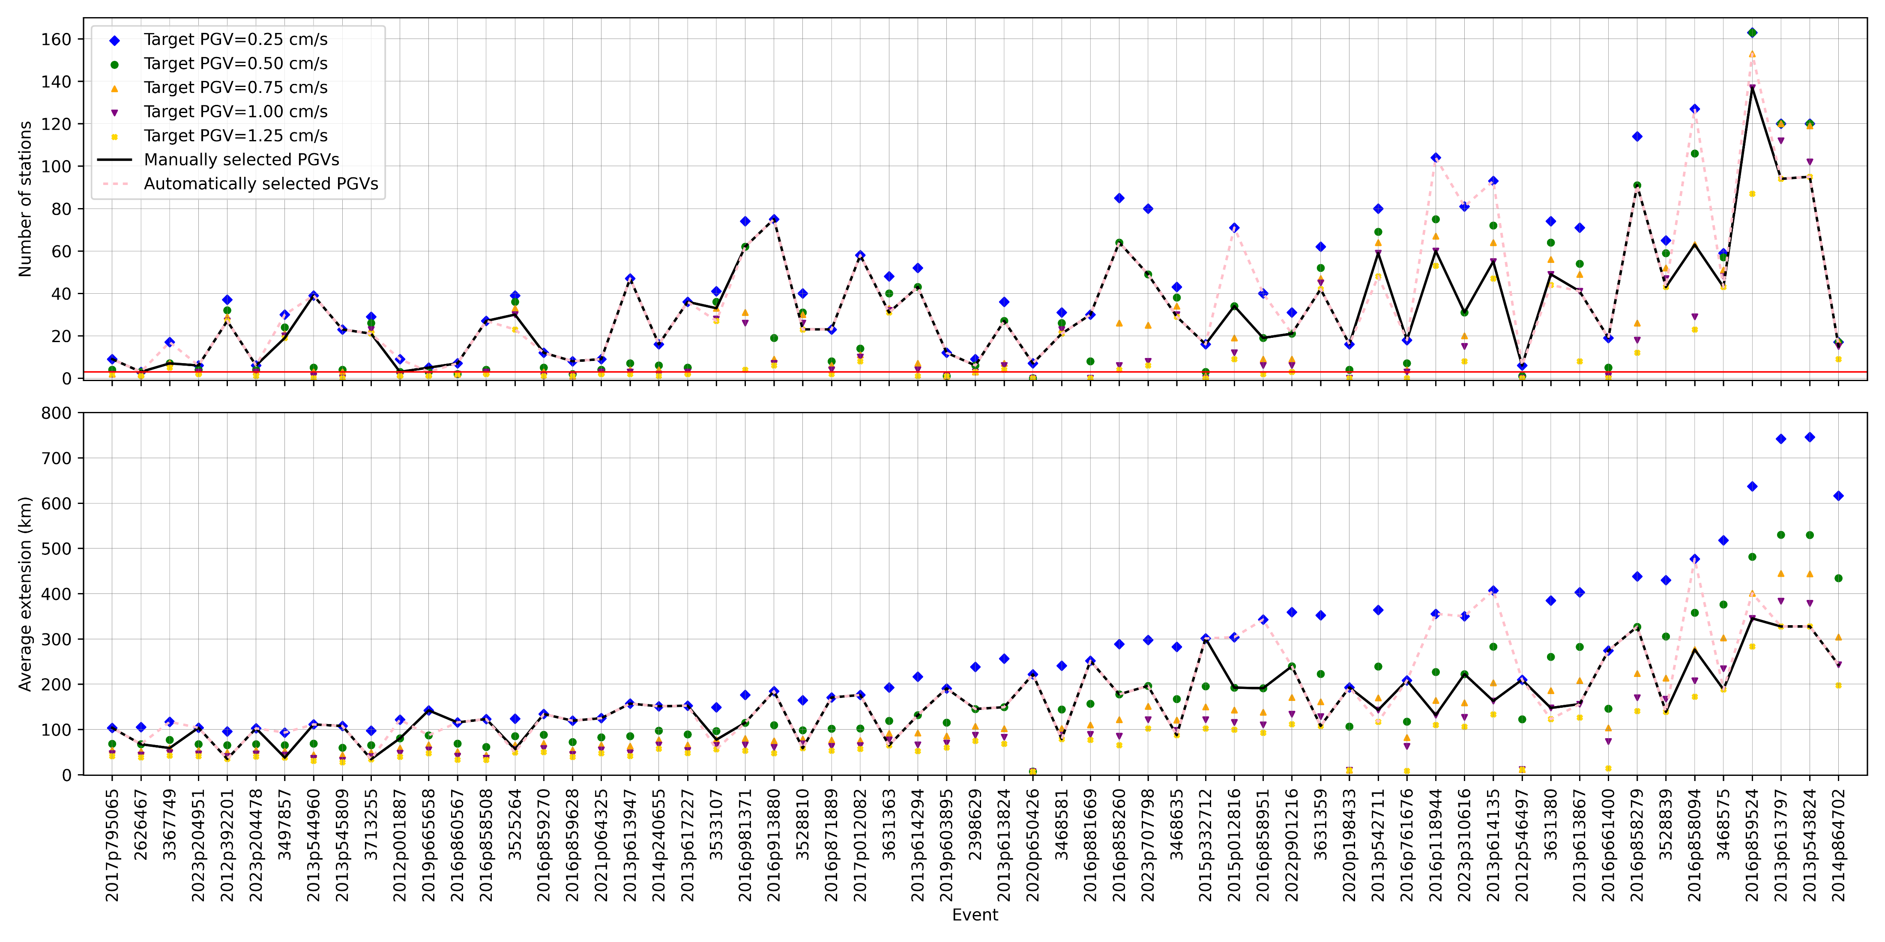
Manual vs Automated Approach

