Slide 1
Project #1 COVID-19: Data Research
TEC Monterrey Data Analytics Bootcamp

Slide 2
Overview
Motivation
Data-mining and wrangling
Data visualization and analysis
Conclusions

Slide 3
Motivation
Beginning at the end of 2019 and grossly picking up momentum in 2020, the world is currently facing a global COVID-19 pandemic caused by the SARS-CoV-2 virus. As of May 2020, COVID-19 has affected over 4 M people worldwide now claiming over 250 K lives.
Is this pandemic impacting nations indiscriminately or are there regions more affected than others? Should lower income countries be more exposed to COVID-19 cases and deaths?
Are there specific correlations between mortality rates and factors such as health expenditure, number of hospital beds, and GNI?
Are nations with high health expenditures and more hospital beds having lower mortality rates?
1

Slide 4
Data Mining
World Health Organization
COVID-19 cases per country (as of May 5, 2020)
Hospital Beds per 10,000 ppl
World Bank Organization
Health Expenditures
$USD spent
% of gross domestic product (GDP)
Gross national Income (GNI) per capita – i.e., measure of standard of living
REpresentational State Transfer (REST) Countries
ISO 3166-1 alpha-3 codes for country names
**Formats via CSV file imports and API
2

Slide 5
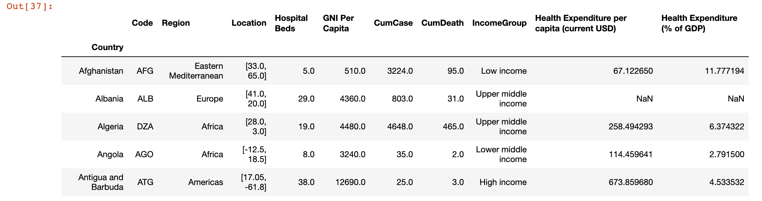
Data Wrangling
Employed two Jupyter Notebooks
Data mining and wrangling
Data visualization and analysis
Import raw data from CSV files and APIs
Extract points of interest and convert each data set into a DataFrame
Merge data to create a single master data file (CSV):
170 rows x 10 columns (indexed by = country)
Merging by country name was tricky → used 3-letter country codes for cleaner merge
3

Slide 6
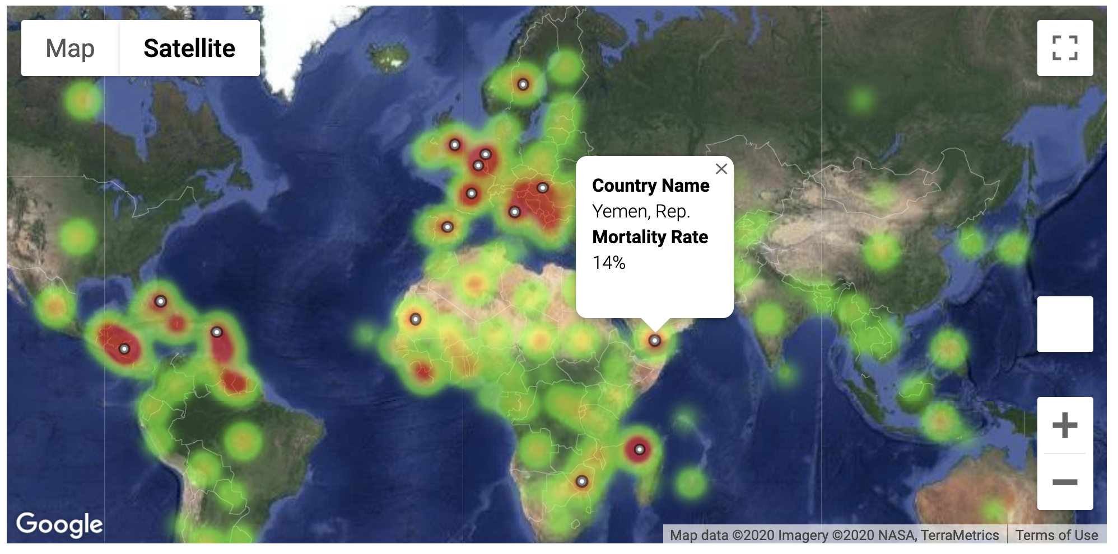
Mortality rate heat-map
With COVID mortality rate defined as (# of deaths)/(# of total cases), the map depicts the world’s hotspots with top 15 most mortal countries pin-pointed.
4

Slide 7
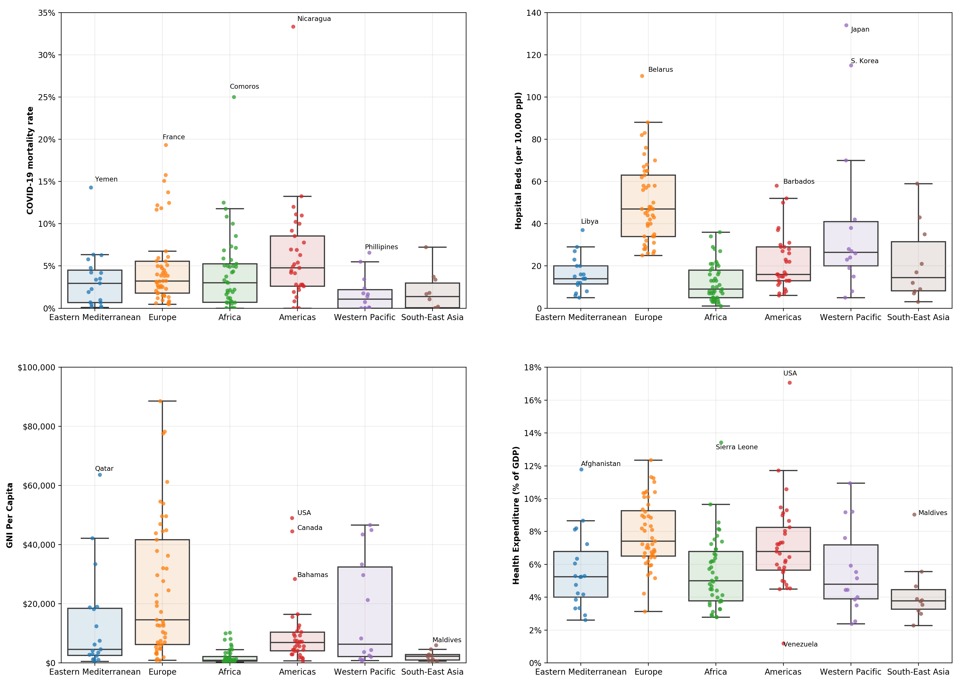
Boxplots per variable
Places like Nicaragua (21) and Comoros (4), have a small number of cases reported. So, any deaths blow up their mortality rate significantly
Countries like Belarus, Japan and S. Korea have been able to provide the most no. of hospital beds without undertaking higher health expenses
COVID-19 had polarizing effects in different European countries
Countries like Afghanistan and the U.S. have high health expenditures, that don’t necessarily translate into more hospital beds for their population
5

Slide 8
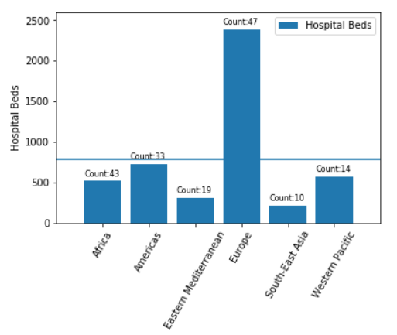
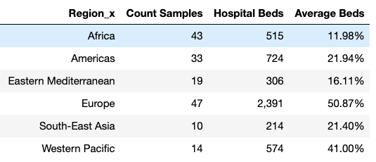
Hospital Beds per Region
6

Slide 9
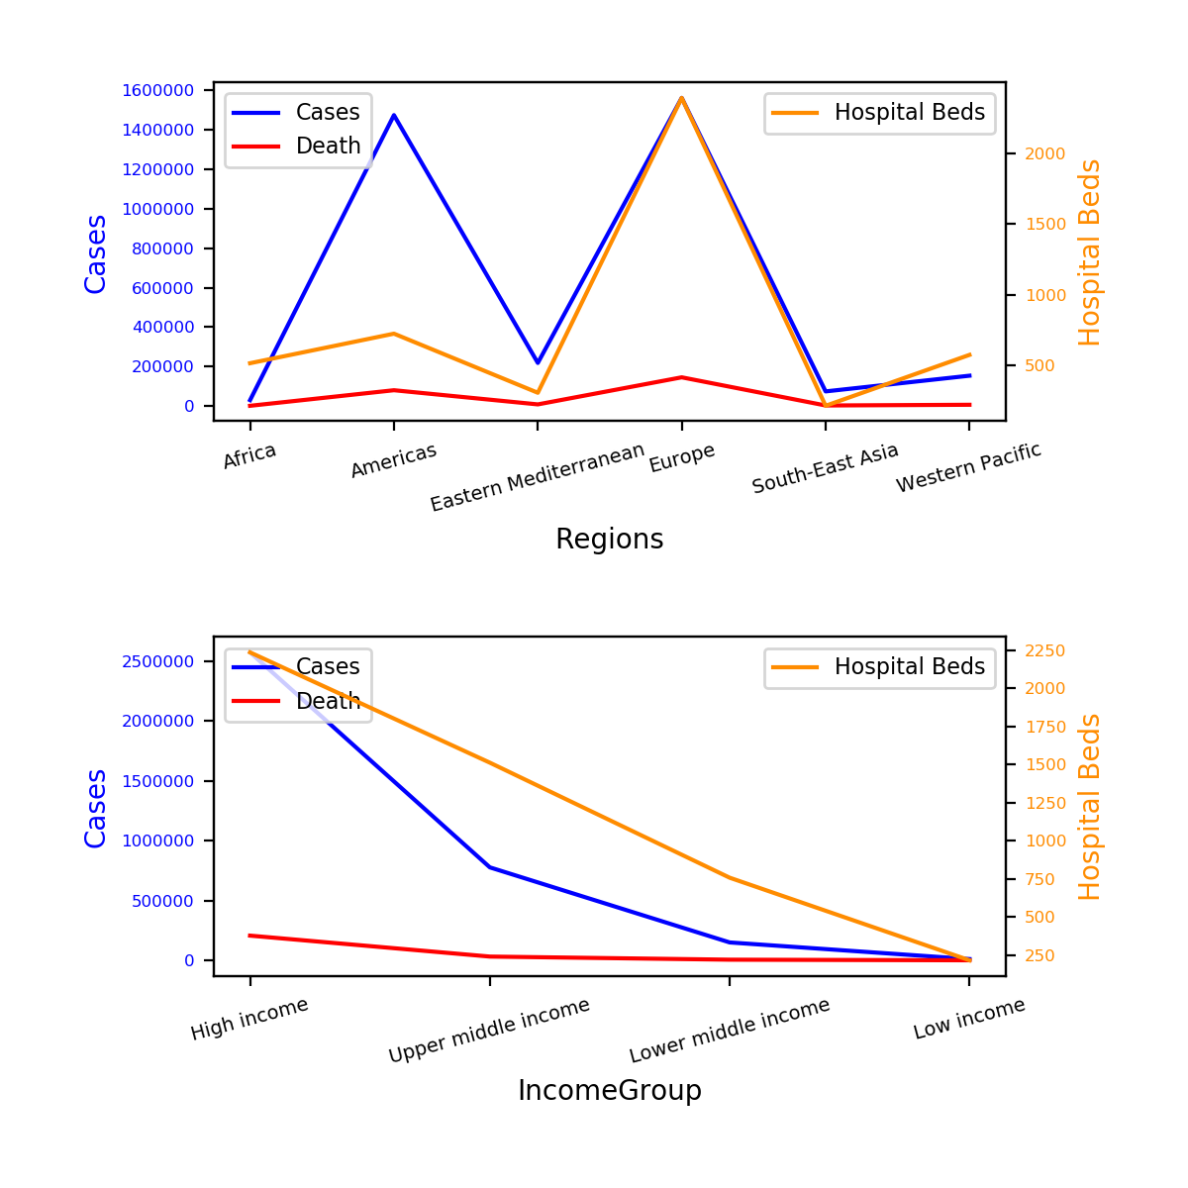
Hospital Beds vs Cases
3 out of 6 Regions had “enough” Hospital Beds
Low income to Lower Middle →0.08º →9%
Lower Middle to Upper Middle →29º →32%
Upper Middle to High Income →70º. →77%
7

Slide 10
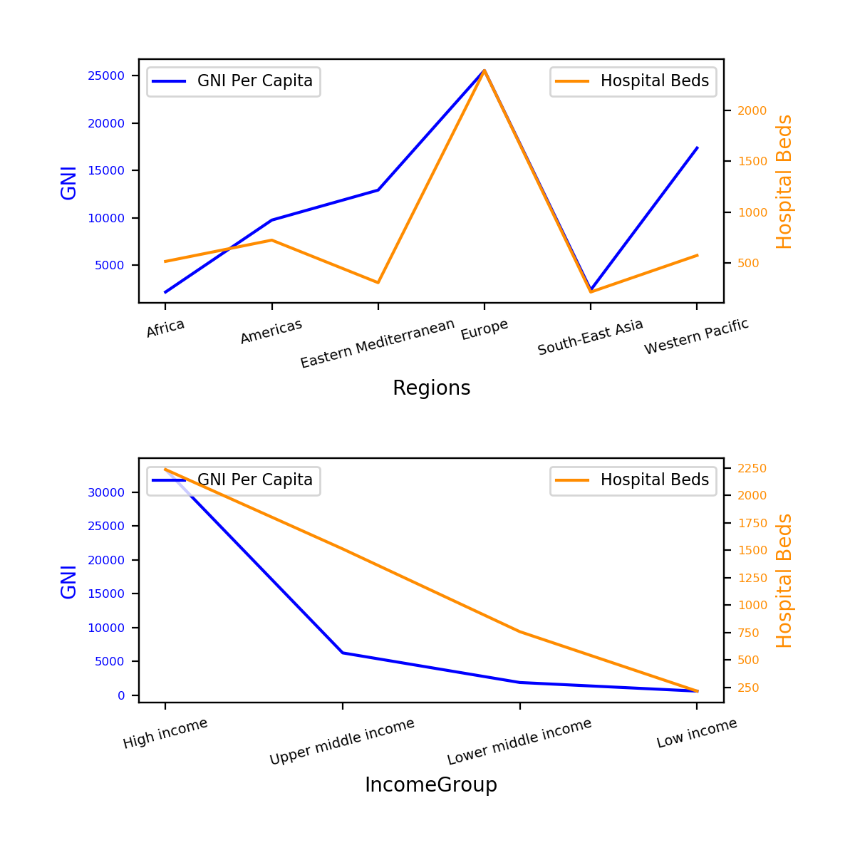
GNI vs Hospital Beds
2 Regions their GNI “matches” the hospital beds
Proportion.
Difference in GNI from High to Upper Middle is of 69%
8

Slide 11
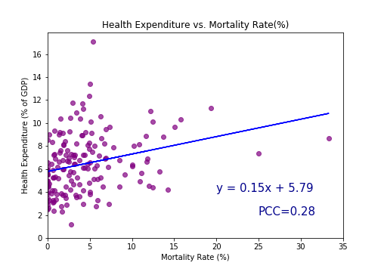
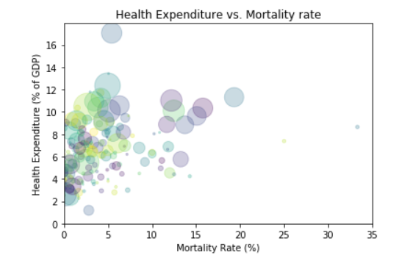
Health Expenditure
* Size of the bubble represents GNI
No significant correlation between Health Expenditure and Mortality Rate
In general, countries with the highest GNI spend more in health but do not necessarily have the lowest mortality rates
9

Slide 12
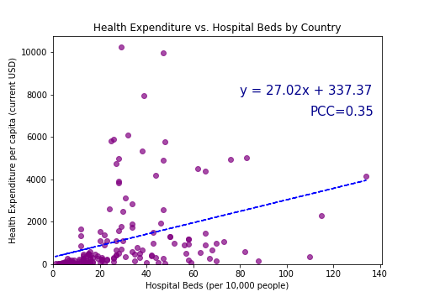
Health Expenditure (cont.)
There is a low correlation between Health Expenditure and Hospital Beds; a high expenditure in health does not necessarily translates into hospital beds.
10

Slide 13
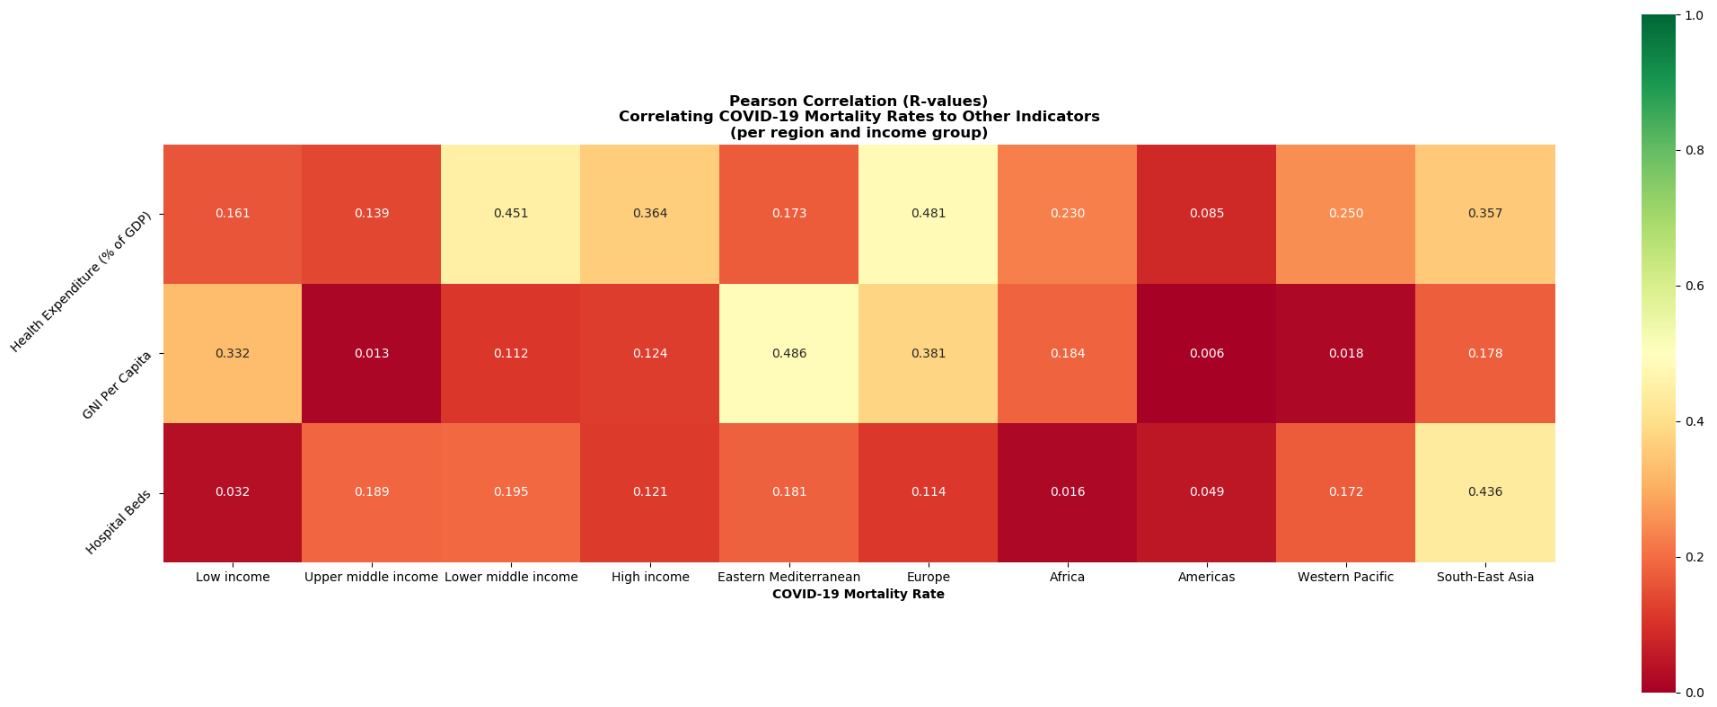
Correlation Matrix
Strength of Association Key:
r < 0.3 | None
r = [0.3,0.5] | Weak
r = [0.5,0.7] | Moderate
r >= 0.7 | Strong
11

Slide 14
Conclusions
COVID-19 has widely spread around the globe with variable impacts across countries but hard-hitting Europe and the US.
There is not high correlation between mortality rates and health expenditure, number of hospital beds and GNI, although we have some outliers per region and income bucket.
Countries with the highest health expenditures do not necessarily have the most number of beds, which translates in different mortality rates. For instance, France, Sweden, Belgium, Netherlands, UK, Spain, and Italy are amongst the highest expenditures as % of GDP but also show high mortality rates (above 10%).
No alarming mortality rates or high number of cases reported in low income countries (with also low health expenditures) which could be related to a) scarce information or b) lack of COVID tests ran in such geographies.
12

