Slide 1
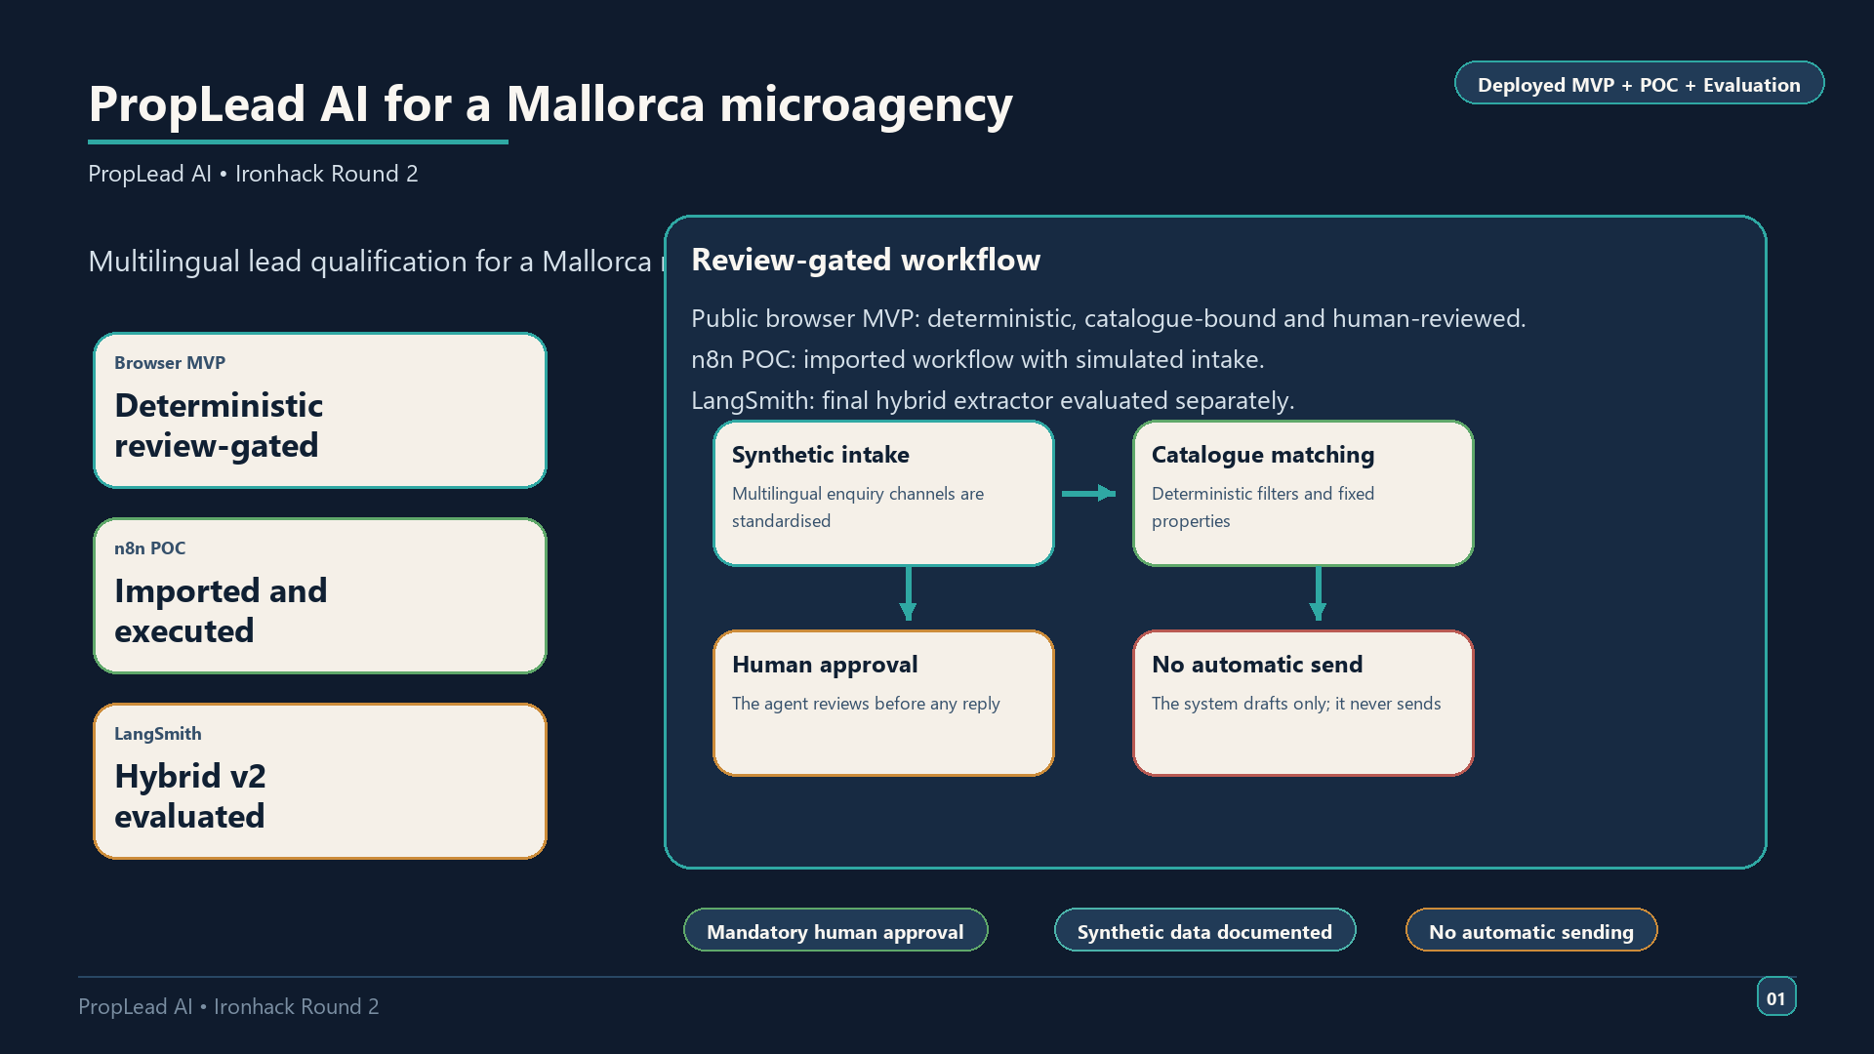
Notes:
PropLead AI solves a practical agency problem. A small Mallorca team receives enquiries in English, German and Spanish, often with incomplete details. The workflow helps the agent understand the request, check if the lead is ready, and prepare a safer reply. The important point is that the system supports the agent. It does not replace the agent.
What to show on screen:
- The browser MVP home screen or a filled lead review example
Approx. speaking time: 45–55 seconds
Recommended visual: - Full-screen screenshot of the live browser MVP review panel with a sample lead

Slide 2
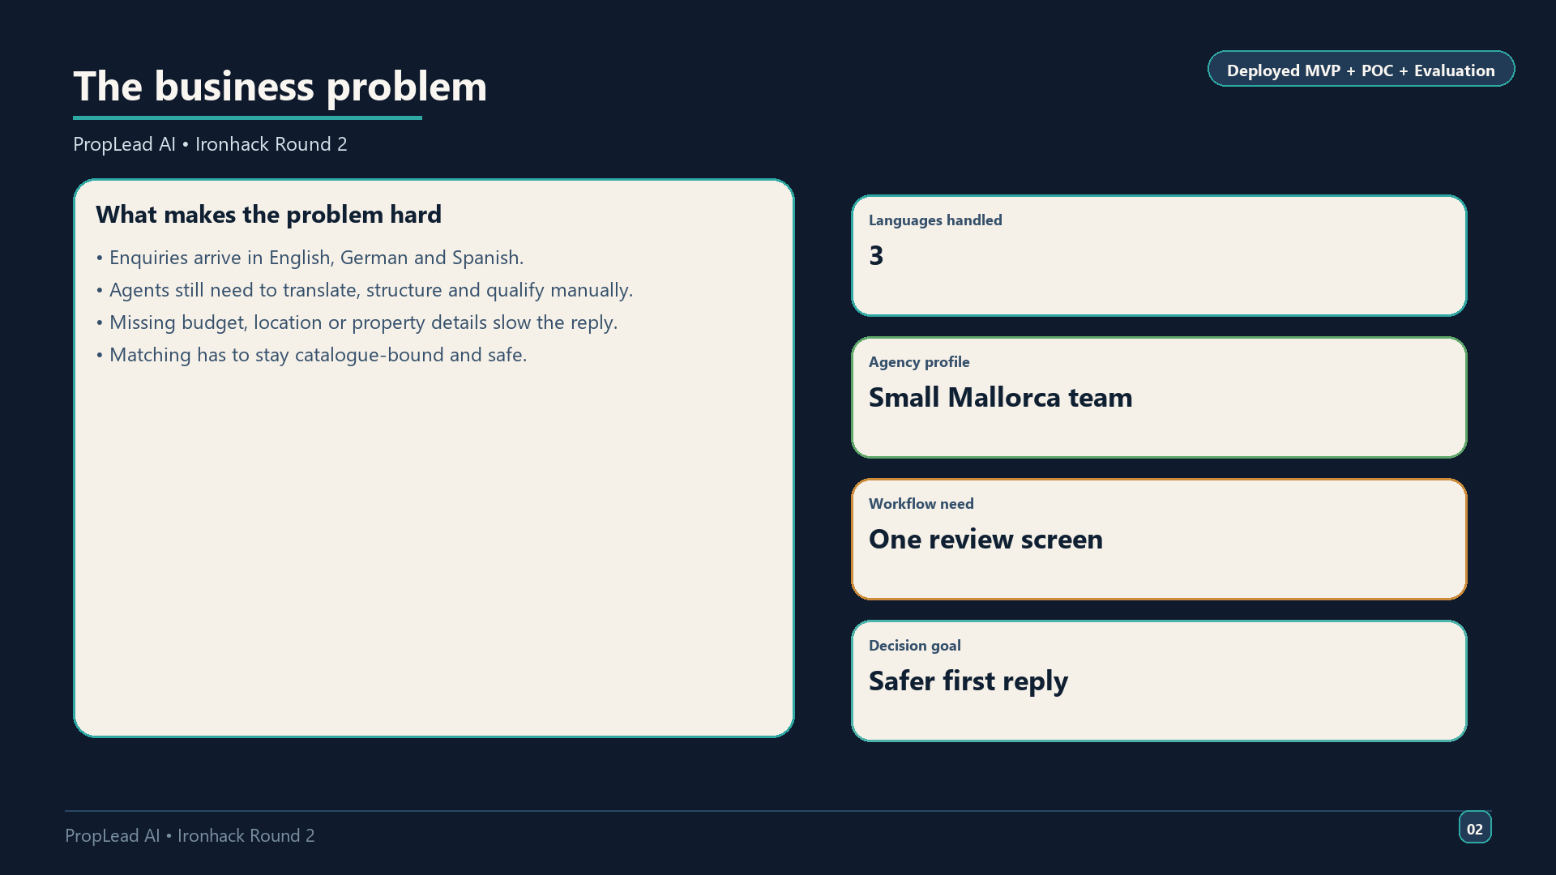
Notes:
Round 1 feedback did not kill the idea. It sharpened it. The project kept the same use case, but narrowed the scope so the evidence is clearer and the risks are lower. The biggest changes were stronger intake rules, clearer qualification logic, synthetic data documentation and a human approval gate on every response.
What to show on screen:
- `use_case_definition.md` open beside `round2_project_plan.md`
Approx. speaking time: 50–60 seconds
Recommended visual: - `use_case_definition.md` or a short before/after summary slide

Slide 3
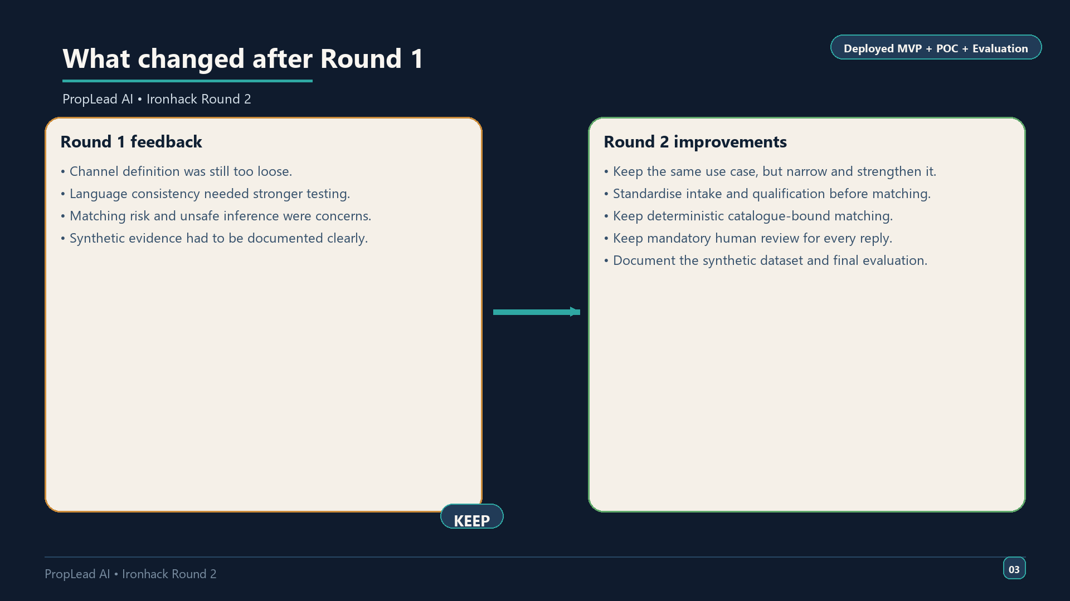
Notes:
The browser MVP is deterministic and local. It uses synthetic property data and a fixed catalogue. Its job is to structure the lead, identify missing information, and suggest catalogue-bound matches. It does not send customer messages automatically. That final approval always stays with the agent.
What to show on screen:
- Browser MVP with a selected multilingual enquiry and the review panel
Approx. speaking time: 55–65 seconds
Recommended visual: - `presentation/assets/mvp_live_demo.png` placed on the MVP slide, plus the review panel and approval controls

Slide 4
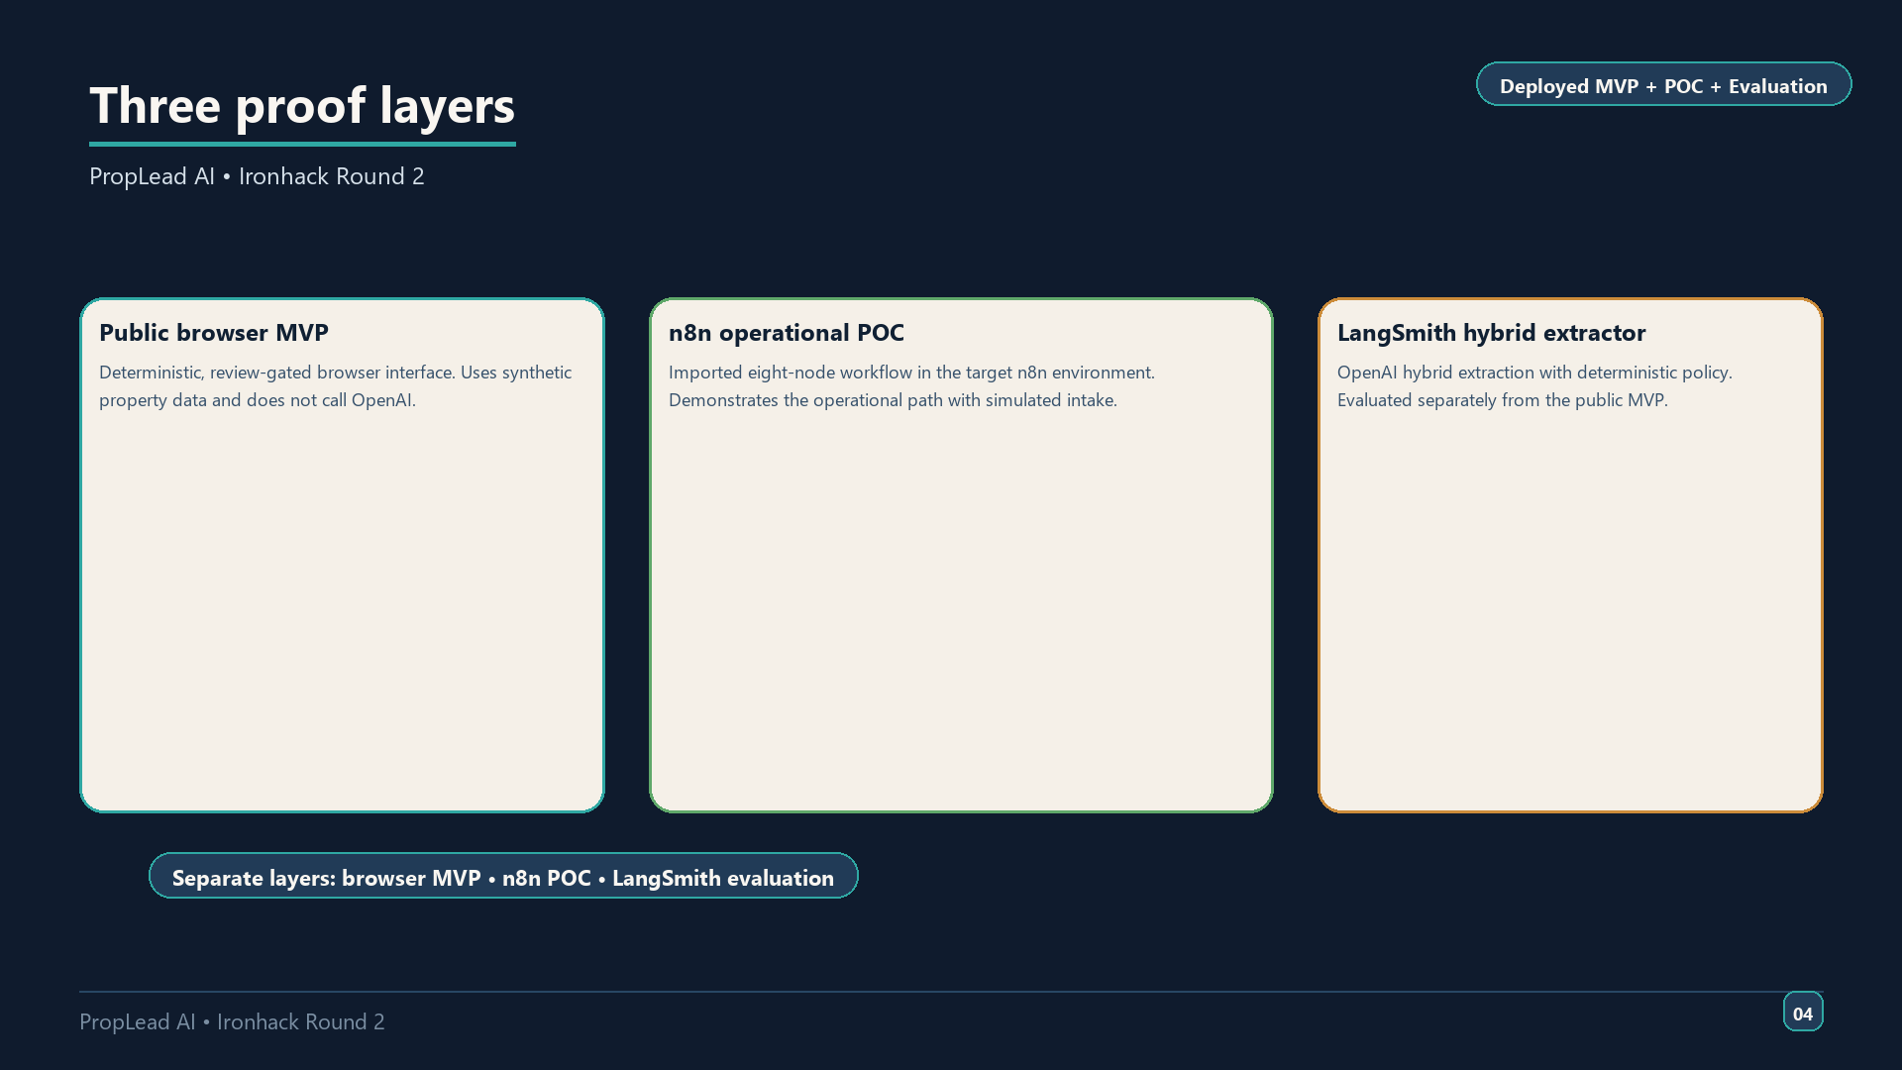
Notes:
The workflow is built around decision support. It normalises the incoming message, extracts only supported facts and applies a qualification gate. If the lead is not ready, the system asks for the missing information. If the lead is ready, it uses controlled catalogue matching. The reply is drafted in the same language as the lead and then waits for approval.
What to show on screen:
- The browser MVP fields and the approval buttons
Approx. speaking time: 60–70 seconds
Recommended visual: - Workflow diagram from `mvp_documentation.md` or `architecture/mvp_architecture.md`

Slide 5
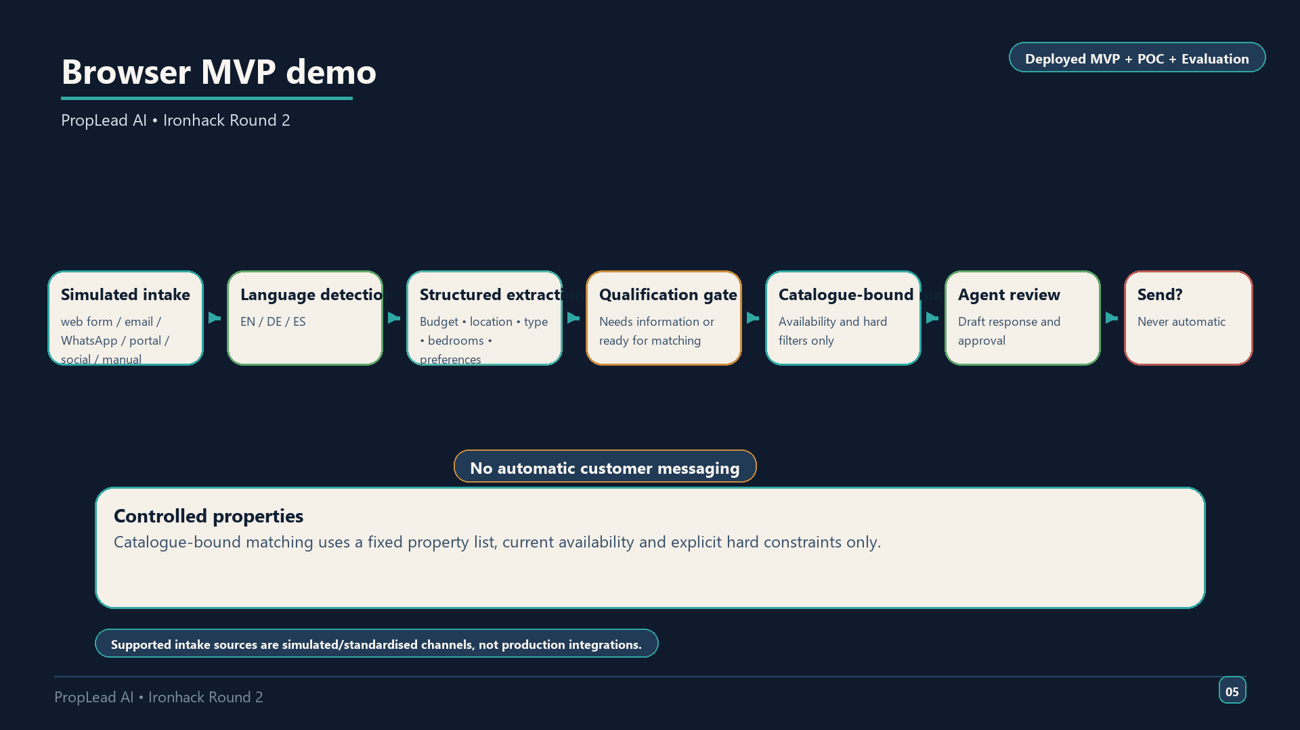
Notes:
This is the public MVP demo. First, briefly explain the workflow diagram from the previous slide so the audience sees the full decision path. Then switch to the deployed browser MVP. The demo shows the practical workflow without any live API dependency in the browser experience. The data is documented synthetic data, so the demo is safe for the capstone. I will enter one multilingual enquiry, show the extracted fields, the match result and the review state.
What to show on screen:
- Explain the workflow diagram first, then open the deployed MVP URL and the matched lead panel
Approx. speaking time: 75–90 seconds
Recommended visual: - Live `https://proplead-ai-round2-mvp.vercel.app/`

Slide 6
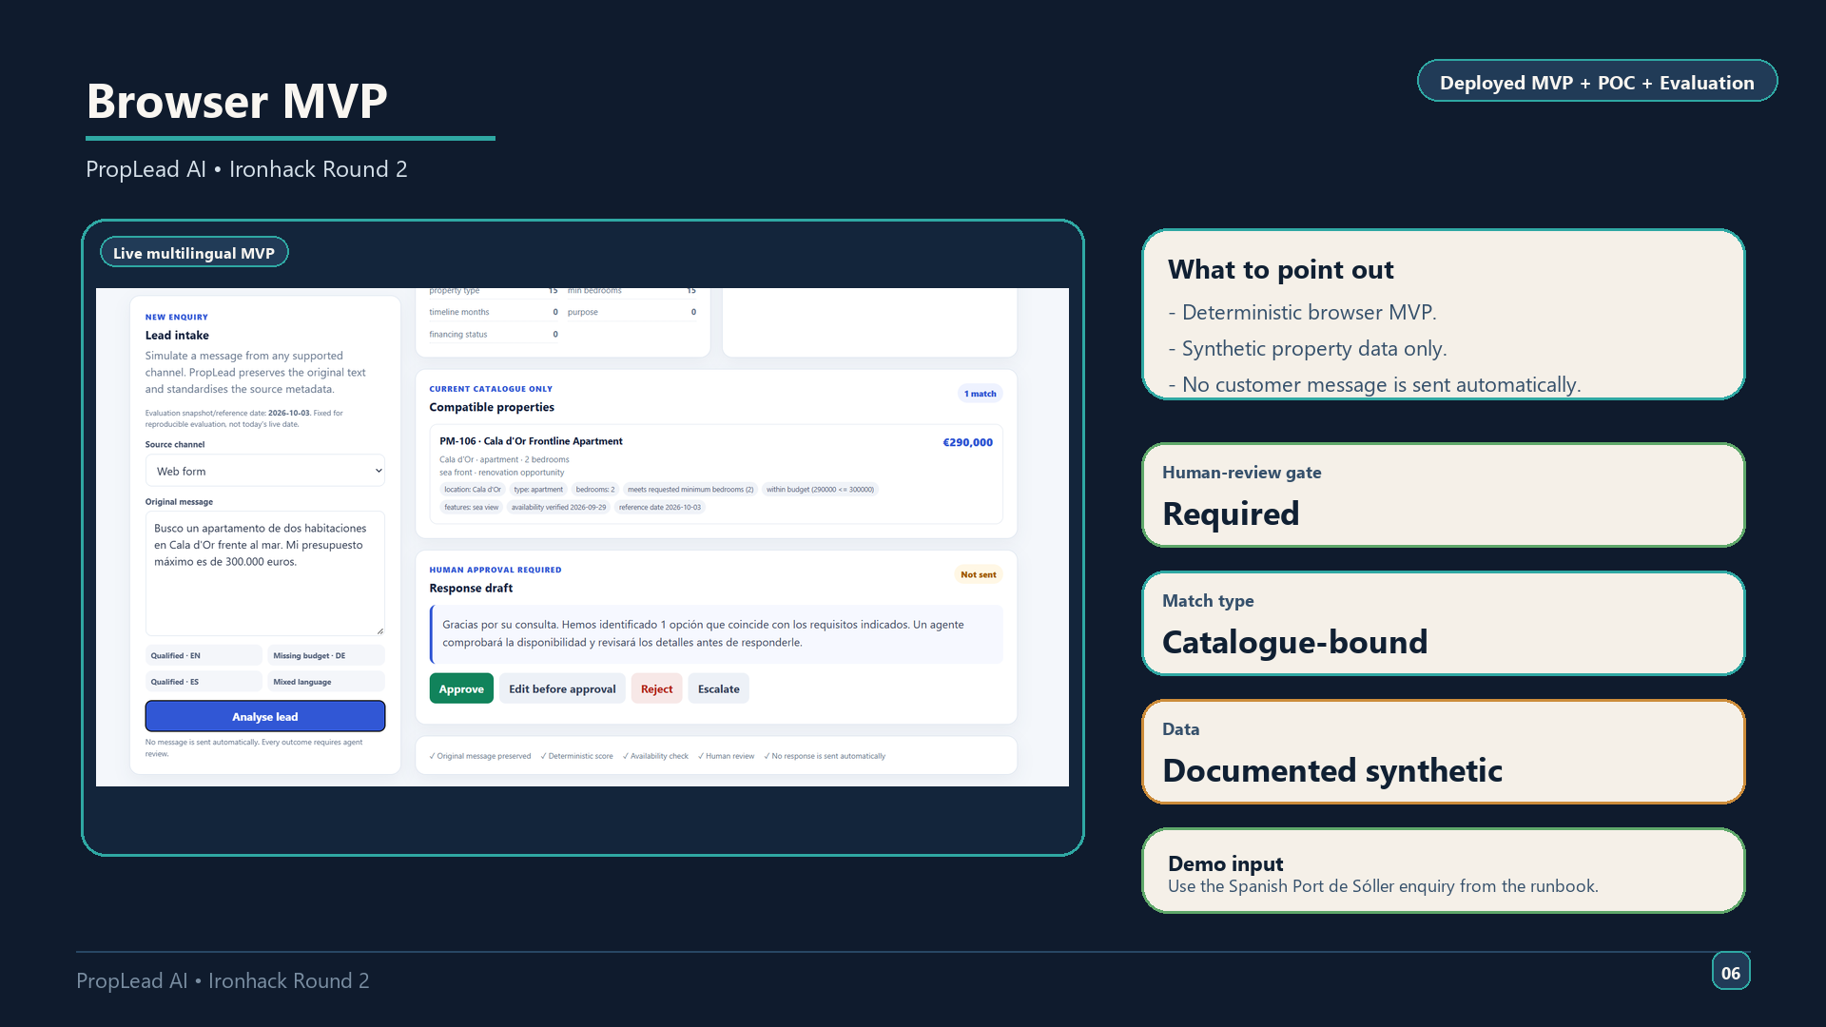
Notes:
This is the public browser MVP. It is deterministic, catalogue-bound and review-gated. It does not call OpenAI in the browser flow. The goal is to show the safe end-user experience: standardised intake, structured lead handling, a controlled property match and mandatory human approval.
What to show on screen:
- The live MVP URL and the browser review panel
Approx. speaking time: 45?55 seconds
Recommended visual: - `presentation/assets/mvp_live_demo.png` showing the live browser interface

Slide 7
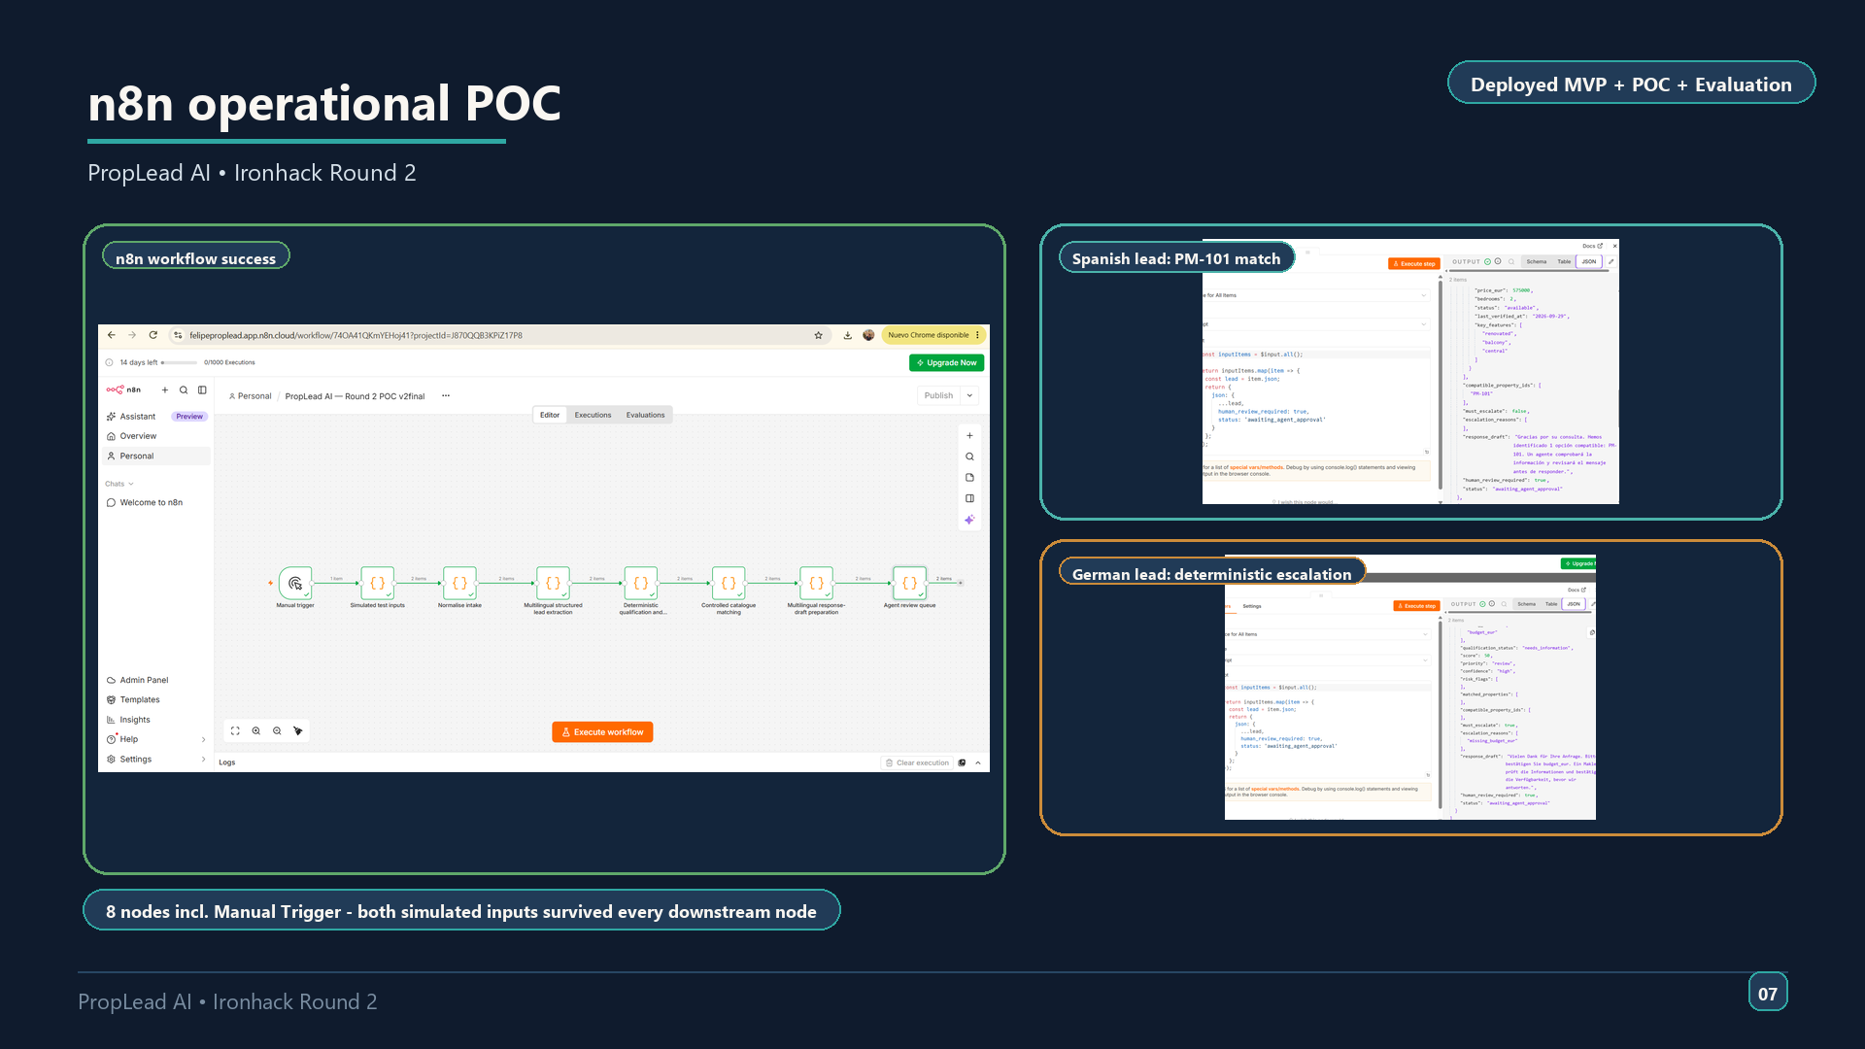
Notes:
The n8n proof of concept shows the operational flow. It is separate from the browser MVP and separate from the LangSmith extractor evaluation. It demonstrates that the eight-node workflow can run in n8n, but it does not mean live integrations are finished.
What to show on screen:
- `presentation/assets/n8n_workflow_success.png`, `presentation/assets/n8n_spanish_result.png`, and `presentation/assets/n8n_german_escalation.png`
Approx. speaking time: 55?65 seconds
Recommended visual: - `presentation/assets/n8n_workflow_success.png` with the Spanish and German result screenshots beside it

Slide 8
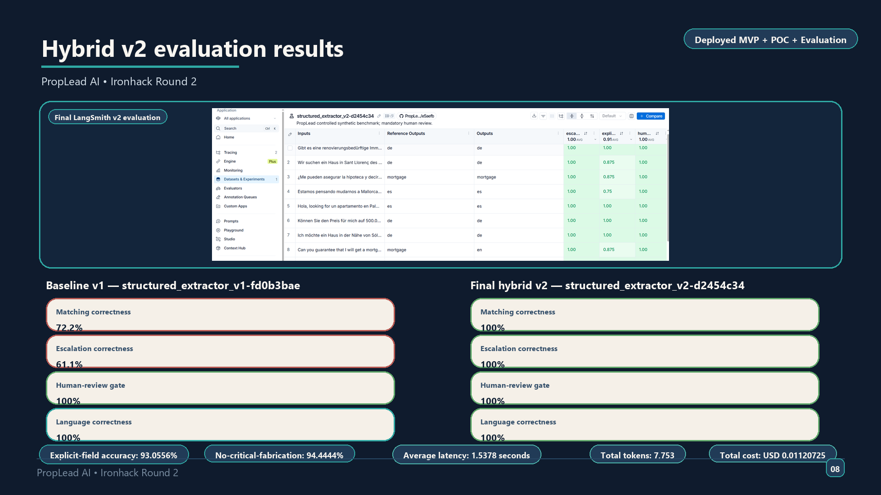
Notes:
The LangSmith evidence matters because it separates the extraction experiment from the browser MVP. The v1 run was useful as a baseline, but it showed weak escalation. The final hybrid v2 run fixed the matching path and delivered the best documented result in the repository: perfect matching, perfect escalation, perfect human-review gating and perfect language correctness. The run also records 93.0556% explicit-field accuracy and 94.4444% no-critical-fabrication. The remaining gap is explicit-field accuracy, which is good but not perfect.
What to show on screen:
- `evaluation/langsmith.md` with the final structured v2 section visible
Approx. speaking time: 75?90 seconds
Recommended visual: - `evaluation/langsmith.md` and `presentation/assets/langsmith_v2_results.png`

Slide 9
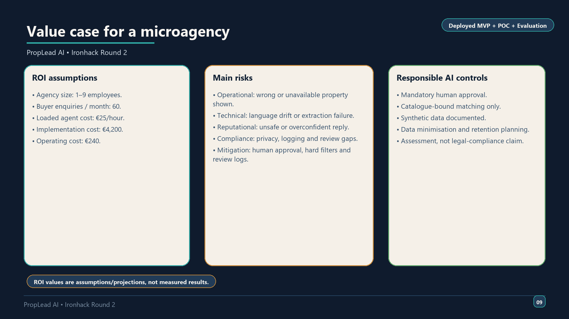
Notes:
The ROI section is a planning model, not a measured business result. It assumes a small agency and compares conservative, expected and optimistic scenarios. The key point is that the system only makes sense if it saves real agent time. The repository explicitly keeps assumptions separate from measured results.
What to show on screen:
- The monthly lead-volume scenario table and risk/control sections in `roi_risk_assessment.md`
Approx. speaking time: 50?60 seconds
Recommended visual: - `roi_risk_assessment.md` scenario table and control sections

Slide 10
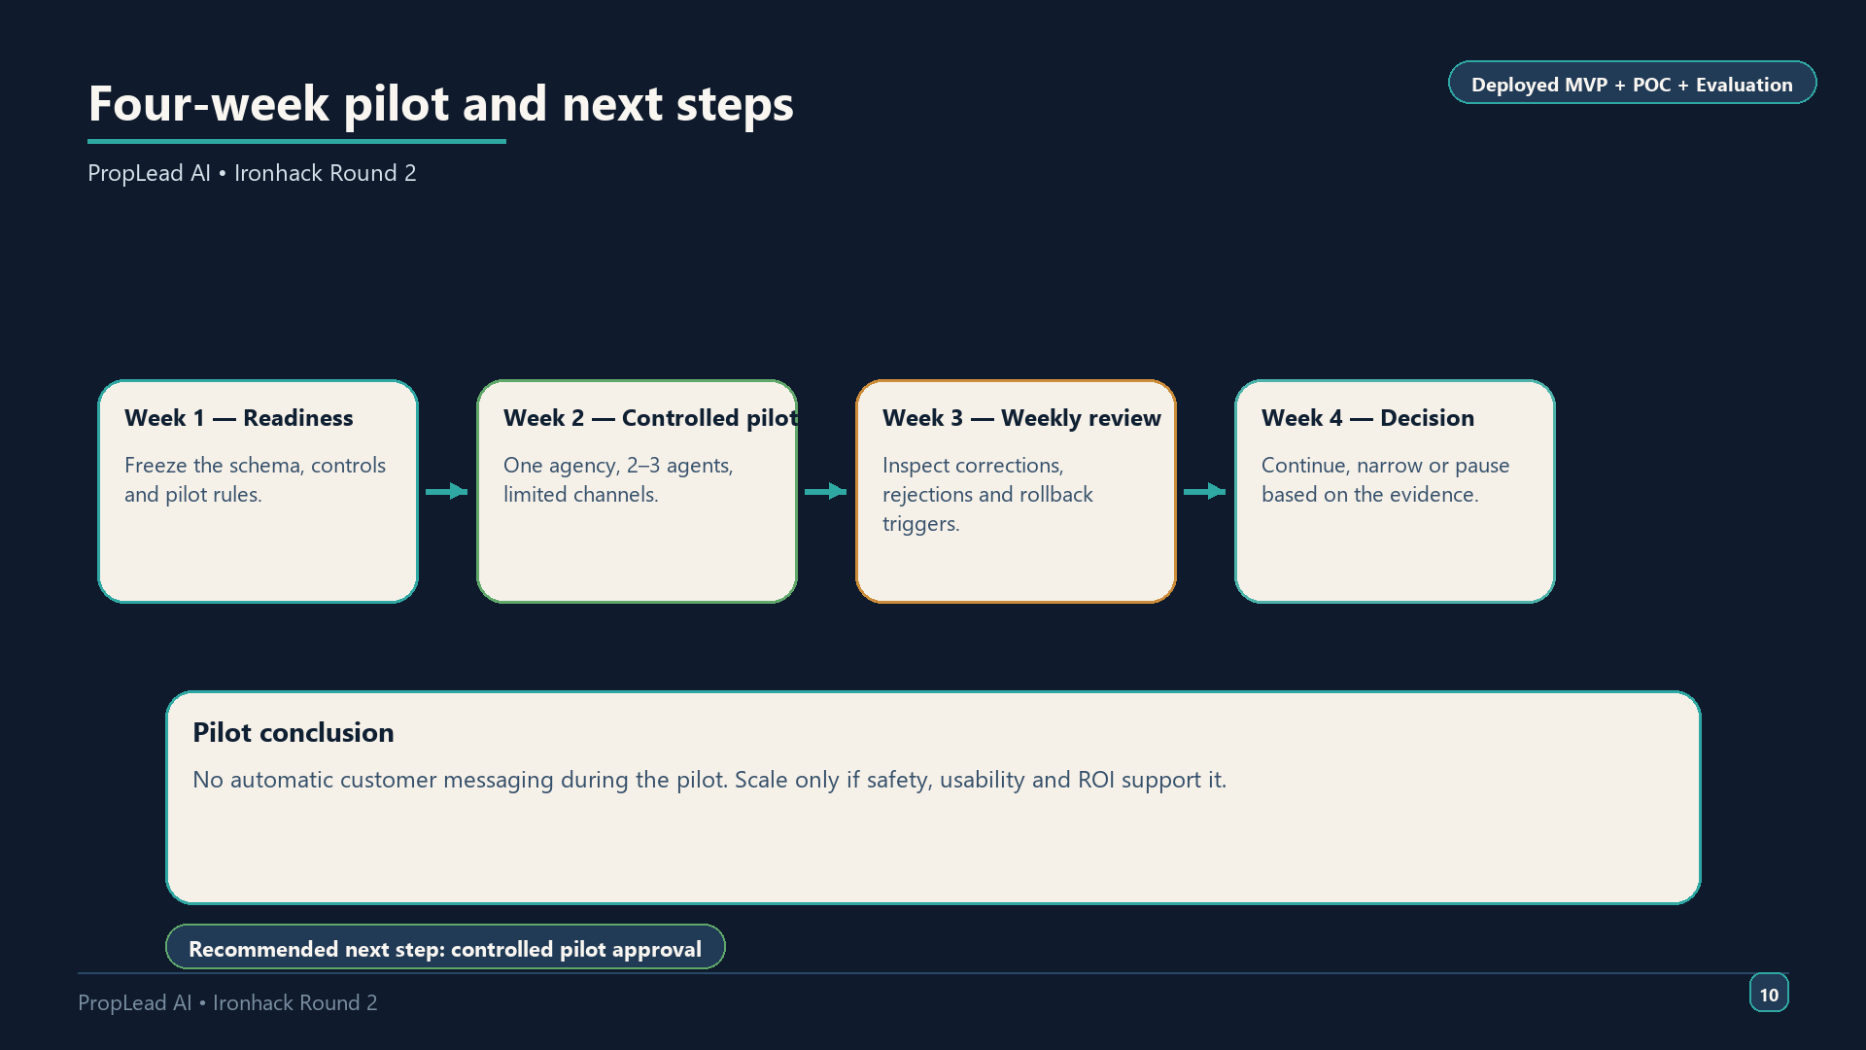
Notes:
The roadmap is intentionally conservative. The repository plans a four-week pilot with a small agent group and limited channels. The project only scales if the evidence supports it. If not, the scope can stay narrowed to multilingual intake and clarification. That is the safest way to move from capstone to real deployment.
What to show on screen:
- The strategic plan pilot section and the completion checklist
Approx. speaking time: 55–65 seconds
## Closing line
PropLead AI is a small, controlled, multilingual real-estate assistant for a Mallorca agency: useful enough to save agent time, narrow enough to stay review-gated, and documented enough to support a safe pilot.
Recommended visual: - `strategic_plan.md` pilot section and `round2_project_plan.md` checklist

