Slide 1
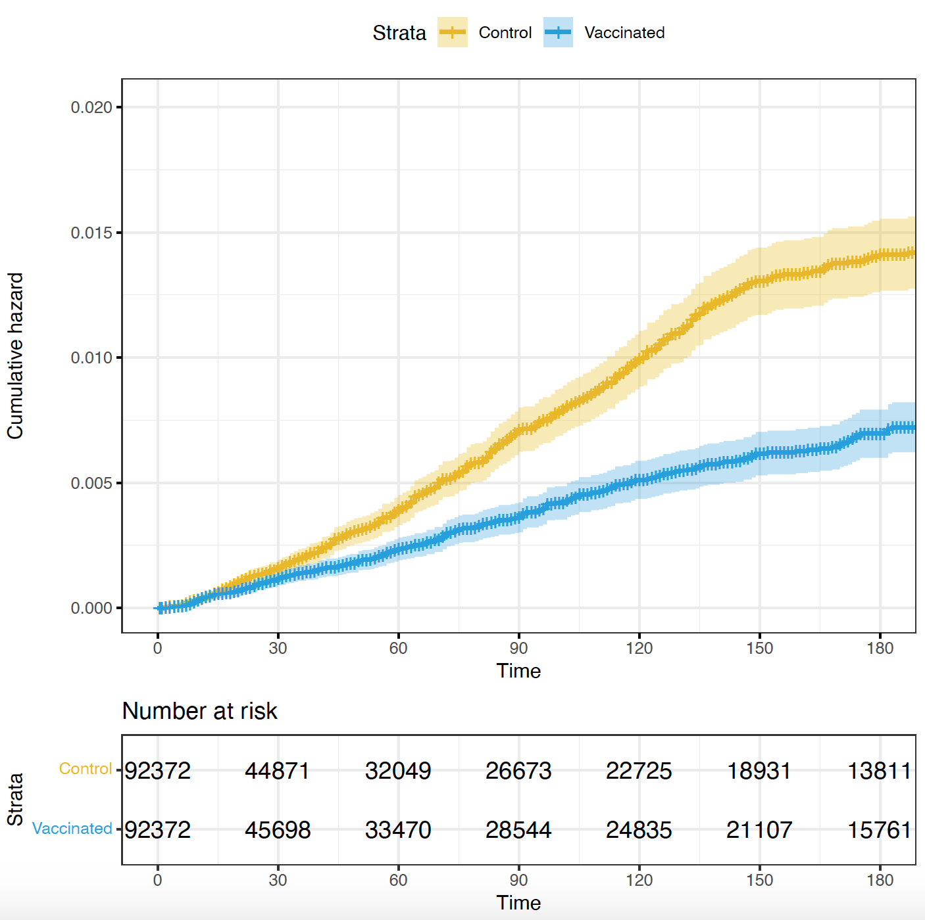
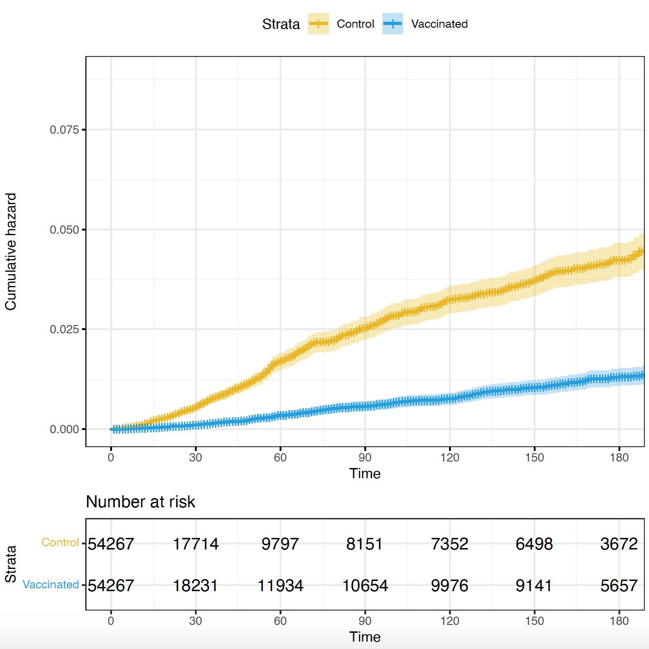
A. 1st and 2nd Dose Vaccination
B. 3rd Dose Vaccination

Slide 2
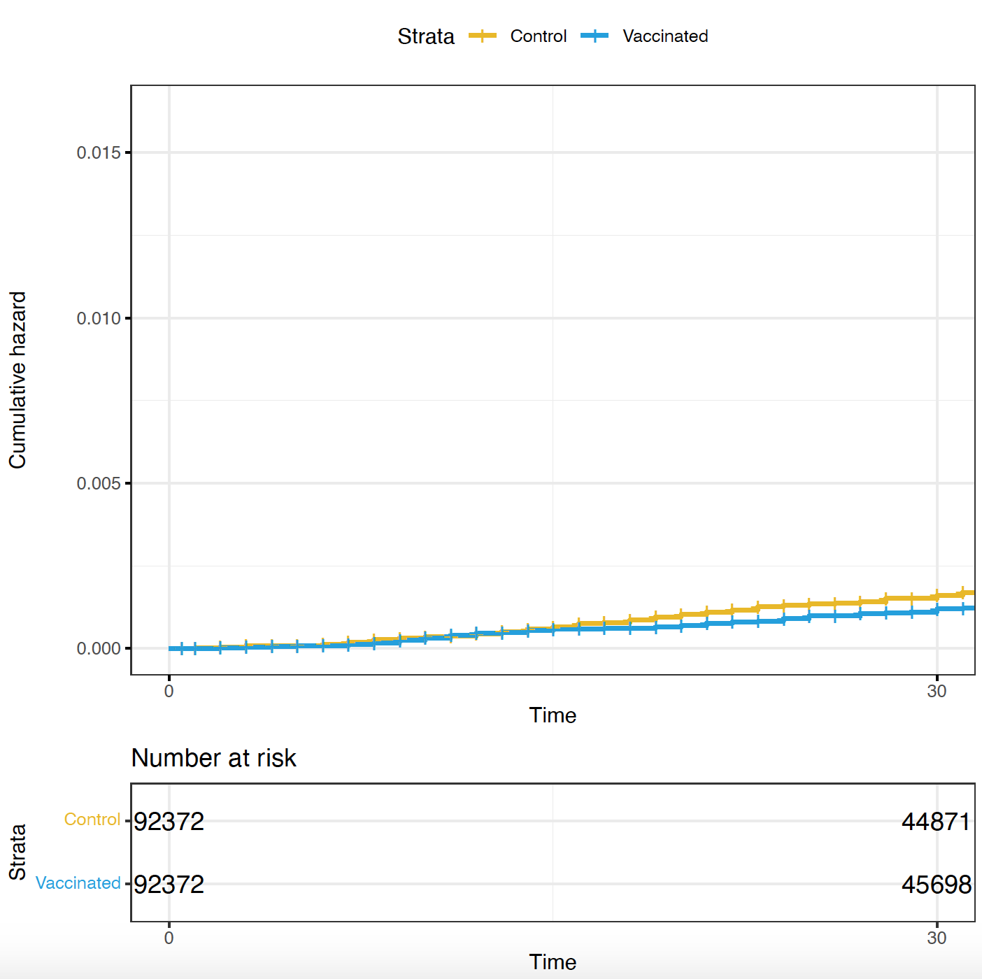
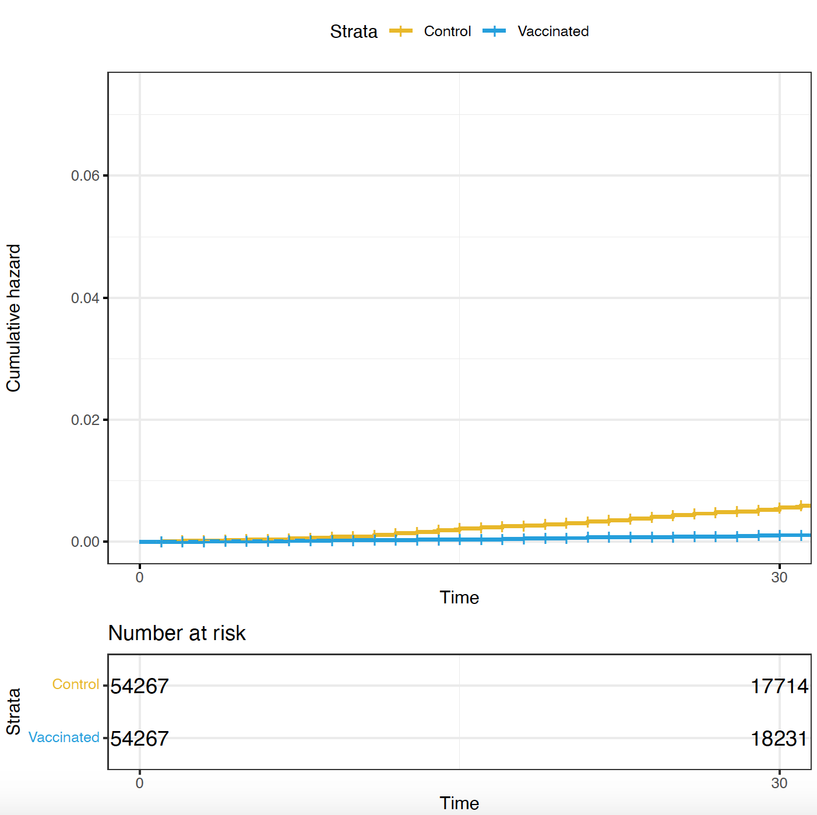
A. 1st and 2nd Dose Vaccination
B. 3rd Dose Vaccination

