Slide 1
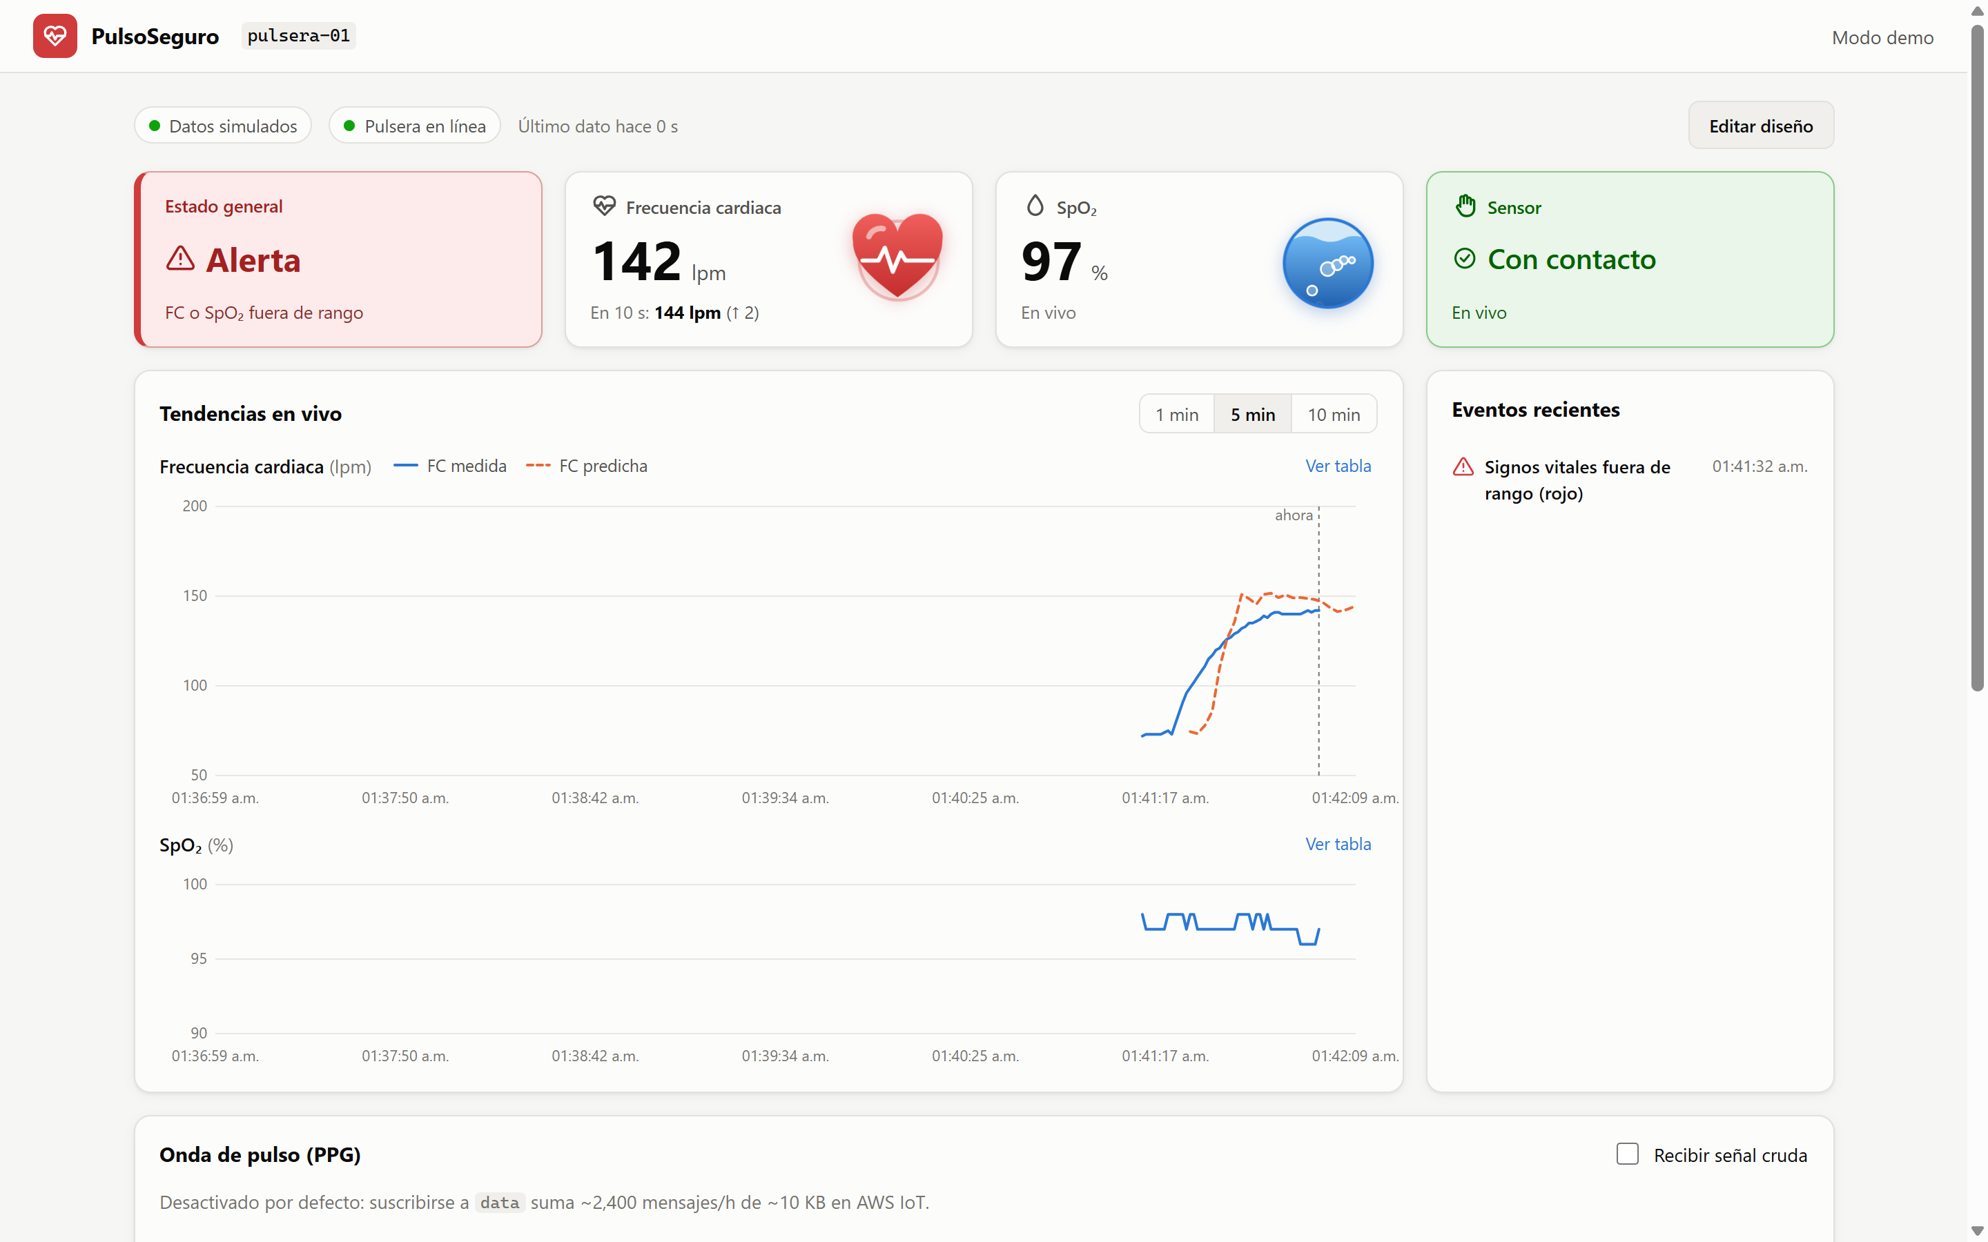
♥
PulsoSeguro
An IoT wristband that monitors heart rate, SpO₂ and falls — live, in the cloud.
Semester project delivery · 2026
[Team members]
Notes:
Welcome. PulsoSeguro is a wearable that watches three things in real time: heart rate, blood oxygen (SpO2) and falls. It sends its data to AWS, where we store it, train a model that predicts the heart rate 10 seconds ahead, and show everything live in a web dashboard. In this presentation I will walk through the architecture, the tools we used and how every piece connects to the next.

Slide 2
THE IDEA
What PulsoSeguro does
❤️
🚨
📈
💻
Heart rate & SpO₂
Fall detection
HR prediction
Live dashboard
Optical PPG sensor
100 samples / s
Accelerometer + gyro
alarm & panic button
Machine learning
+10 seconds ahead
Any browser
real-time over MQTT
PulsoSeguro · Semester project
2
Notes:
Four capabilities. One: the wristband measures heart rate and SpO2 with an optical sensor (MAX30102). Two: it detects falls with an accelerometer/gyroscope (MPU6050) and sounds an alarm. Three: it streams the raw signals to AWS so we can build a dataset and train a model that predicts heart rate 10 s ahead. Four: a web dashboard lets a caregiver see everything live from any browser.

Slide 3
BIG PICTURE
System architecture
WRISTBAND · ESP32
AWS · us-east-2
🔑 Cognito
login · temporary keys
🩺 Sensors
MAX30102 · MPU6050
☁️ AWS IoT Core
MQTT broker · topics bio/<thing>/…
MQTT/WSS
💻 Web dashboard
React · browser
⚙️ Core 1
falls · traffic light · TFT
cmd
pred
⚡ IoT Rule
bio/+/data
🎛️ control.py (PC)
start / stop + label
10 KB batches
data · status · cmd
📡 Core 0
MQTT / TLS task
🪣 S3 bucket
raw CSV files
λ Lambda
live prediction
🐍 Python (PC)
cargar_s3.py · modelo_fc.py
- - - planned (not built yet)
PulsoSeguro · Semester project
3
Notes:
This is the whole system. On the left, the wristband: an ESP32 reads the sensors; core 1 runs the safety logic and core 0 runs the network task. It talks MQTT over TLS with X.509 certificates to AWS IoT Core, the message broker. An IoT Rule copies every raw-data batch to an S3 bucket. On my PC, cargar_s3.py downloads those files into a pandas dataset and modelo_fc.py trains the heart-rate model. control.py sends start/stop commands to label each recording. On the right, the web dashboard: the user logs in with Amazon Cognito, receives temporary AWS credentials and subscribes to the same broker over a secure WebSocket — there is no custom backend. Dashed parts are planned: the firmware 'vitals' topic and a Lambda that publishes live predictions.

Slide 4
THE WRISTBAND
Hardware
❤️ MAX30102
PPG · HR & SpO₂
🖥️ TFT ST7789 2.8"
240×320 display
I²C 0x57
SPI
🧠 ESP32-WROOM-32
dual core · 240 MHz · Wi-Fi
🧭 MPU6050
accel + gyro
I²C 0x68
GPIO 27 · 13
🔔 Button + buzzer
cancel · panic · alarm
📶 Wi-Fi → AWS IoT
station mode · TLS
PulsoSeguro · Semester project
4
Notes:
The brain is an ESP32-WROOM-32, a dual-core microcontroller with Wi-Fi. Both sensors share one I2C bus: the MAX30102 (red + infrared light, gives the PPG signal for heart rate and SpO2) and the MPU6050 (accelerometer and gyroscope for falls). A 2.8-inch ST7789 TFT on SPI shows the values locally. A button cancels alarms or triggers panic, and a buzzer sounds the alarm. Wi-Fi in station mode takes the data to AWS.

Slide 5
ESP32 · FREERTOS
Firmware: safety never waits for the network
⚙️ Core 1 · wristband logic
📡 Core 0 · network
🧭 Read IMU every 10 ms
🔐 MQTT over TLS (X.509)
🚨 Fall detection (4 phases)
📤 Publish data · status
🚦 Health traffic light
📥 Receive start / stop
🖥️ TFT display · button · buzzer
🔁 Reconnects without blocking
Queue
5 × 10 KB ≈ 8 s
❤️ PPG at 100 Hz → CSV batch
PulsoSeguro · Semester project
5
Notes:
A TLS reconnection can block for 1 to 3 seconds, but fall detection must read the IMU every 10 ms. So we split the work: core 1 runs the wristband logic — fall detection, the health traffic light, the display, the button and the buzzer. It packs the 100 Hz samples into CSV batches of about 10 KB and drops them in a queue. Core 0 runs a FreeRTOS task that only does MQTT over TLS. If AWS is slow, the queue (5 batches, about 8 seconds) absorbs it; if it overflows we drop samples, and the sequence number records the gap. The wristband never freezes.

Slide 6
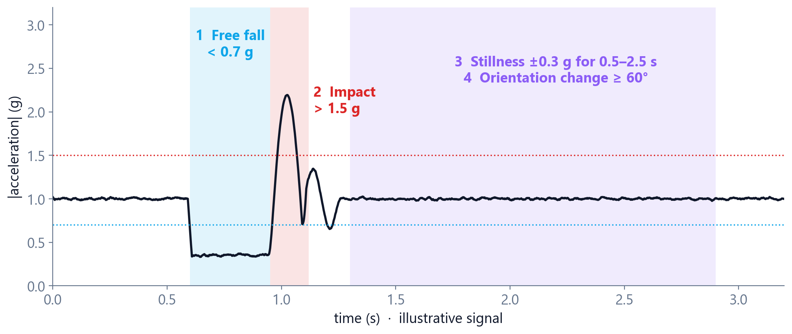
SAFETY
Fall detection in 4 phases
⏱️ 15 s to cancel, then alarm
🔘 Long press 3 s = panic
🧪 Tested: peaks 1.67–2.22 g
PulsoSeguro · Semester project
6
Notes:
A fall is only confirmed when four things happen in order: free fall (total acceleration below 0.7 g), an impact above 1.5 g, stillness within ±0.3 g for 0.5 to 2.5 seconds, and an orientation change of at least 60 degrees. Requiring all four avoids false alarms from jumps or quick arm movements — in tests, jumps changed orientation only 1–9 degrees while real falls changed it 70–87 degrees, with impact peaks of 1.67–2.22 g. After a fall the user has 15 seconds to cancel with a short press; otherwise the full alarm sounds. A 3-second press is a panic button. The chart is an illustrative signal, not a recording.

Slide 7
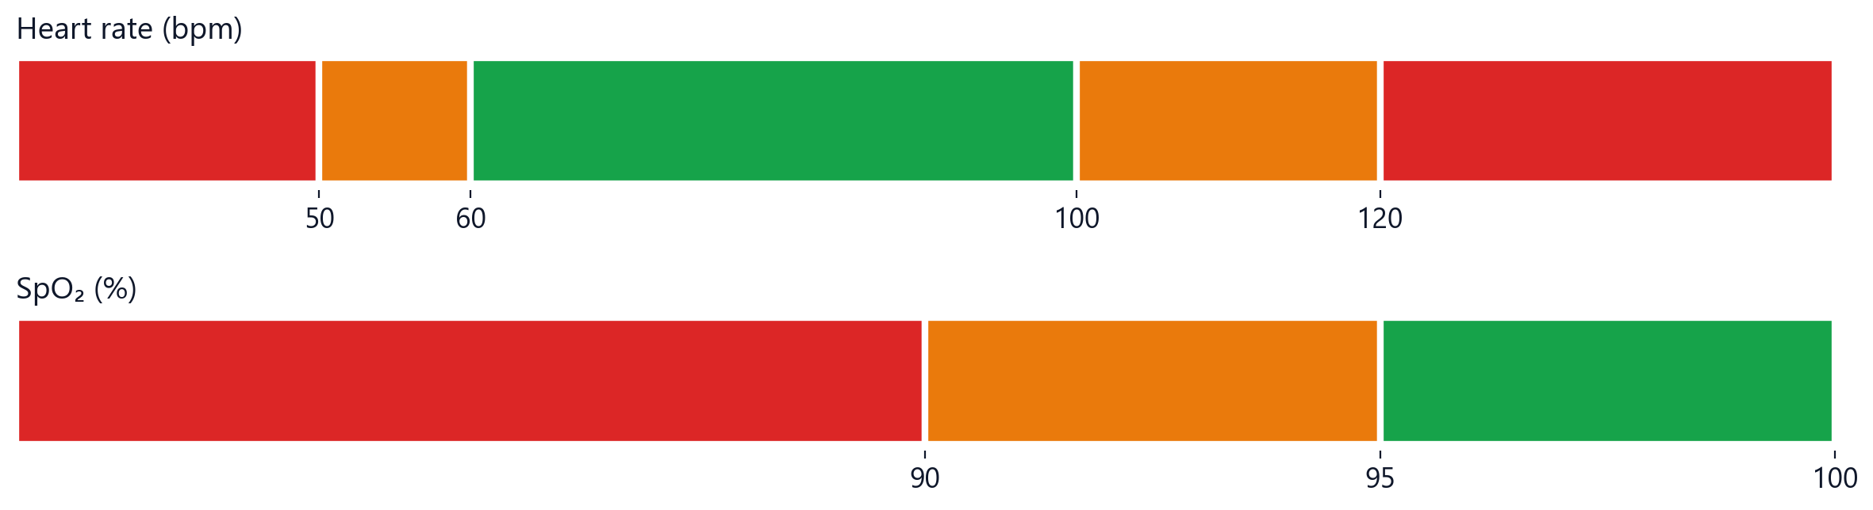
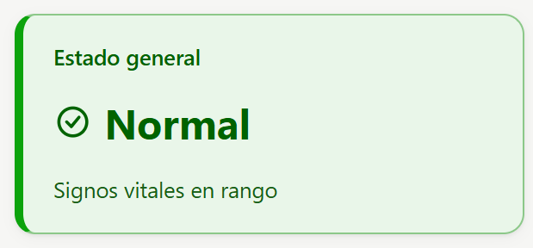
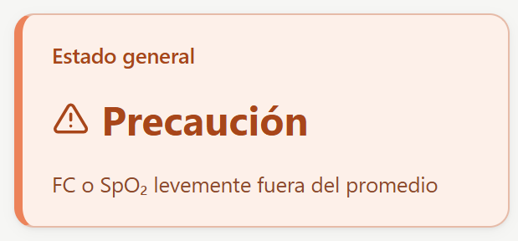
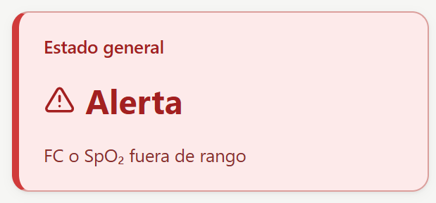
VITAL SIGNS
Health traffic light
PulsoSeguro · Semester project
7
Notes:
The ESP32 classifies heart rate and SpO2 into a traffic light: green when they are in the normal range, orange when they are slightly out of the average, red when they are out of range. Heart rate is green between 60 and 100 bpm and orange between 50 and 120; SpO2 is green at 95% or more and orange from 90%. The wristband decides the color and the dashboard only displays it, so both always agree. Below are the real dashboard cards for each state (the UI is in Spanish: Normal, Precaución, Alerta).

Slide 8
DATA PIPELINE
From the wrist to a dataset
❤️
📦
☁️
⚡
🪣
🐍
ESP32
CSV batch
IoT Core
IoT Rule
S3
dataset.csv
100 Hz samples
~10 KB · 1.5 s
MQTT/TLS
SELECT * …
raw/thing/date/
pandas
bio/<thing>/data · one batch
#20261110_222453,reposo,s01
seq,t_ms,red,ir,ax,ay,az,gx,gy,gz
0,51234,88213,110584,0.4120,-0.1031,9.7712,0.0012,-0.0040,0.0007
…
PulsoSeguro · Semester project
8
Notes:
This is how the raw data travels. The ESP32 samples the PPG at 100 Hz together with the latest IMU reading. Every ~1.5 seconds it publishes a CSV batch of about 10 KB on bio/<thing>/data. IoT Core bills in 5 KB blocks, so 10 KB batches are a good balance between cost and number of files. An IoT Rule with SELECT * FROM 'bio/+/data' writes each batch directly to S3, partitioned by device and hour. Firehose is not available on the new free plan, so we write directly. Then cargar_s3.py downloads everything in parallel with 16 threads, removes duplicates, orders by sequence number and produces dataset.csv for pandas. The first line of each file carries the session, activity label and subject, so every file explains itself.

Slide 9
CONNECTIONS
MQTT topics: how everything talks
data · status · vitals*
status · vitals · pred · data
⌚ Wristband
ESP32
☁️ AWS IoT Core
broker
bio/<thing>/…
💻 Dashboard
browser
cmd
cmd
🎛️ control.py
PC
cmd
pred*
λ Lambda
planned
data
🪣 S3
via IoT Rule
* planned topics · status is retained, with AWS Last Will = offline
PulsoSeguro · Semester project
9
Notes:
Everything communicates through topics on the AWS IoT Core broker, all under bio/<thing>/. The wristband publishes 'data' (raw batches, stored in S3) and 'status' (online/offline, retained; AWS publishes 'offline' automatically as a Last Will if the device disappears). It subscribes to 'cmd' to receive start and stop from control.py or from the dashboard. Two topics are designed for the live dashboard: 'vitals' — one JSON per second with HR, SpO2, contact, fall and traffic light — and 'pred', the predicted HR published by a Lambda. Devices never talk to each other directly; the broker decouples them.

Slide 10
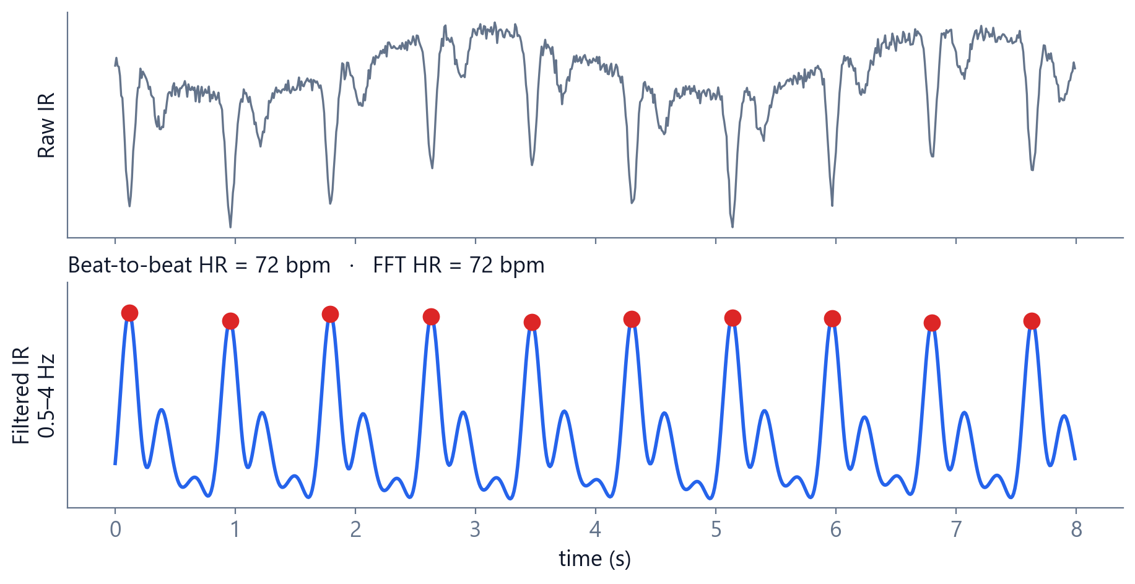
SIGNAL PROCESSING
Heart rate from the light signal
1
Band-pass 0.5–4 Hz
2
Peaks = beats
3
Check against FFT
4
Reject irregular windows
PulsoSeguro · Semester project
10
Notes:
The dataset has no ‘true’ heart rate, so we compute it from the infrared PPG. We band-pass filter between 0.5 and 4 Hz, find the peaks (each one is a beat) and take the median beat interval. To avoid counting the dicrotic notch as a beat, the FFT gives the expected period and peaks closer than 60% of it are rejected. A window is accepted only if the beat intervals are regular (variation < 0.15) and the peaks agree with the FFT within 10 bpm. This raised valid resting windows from 18–59% to 93–100%.

Slide 11
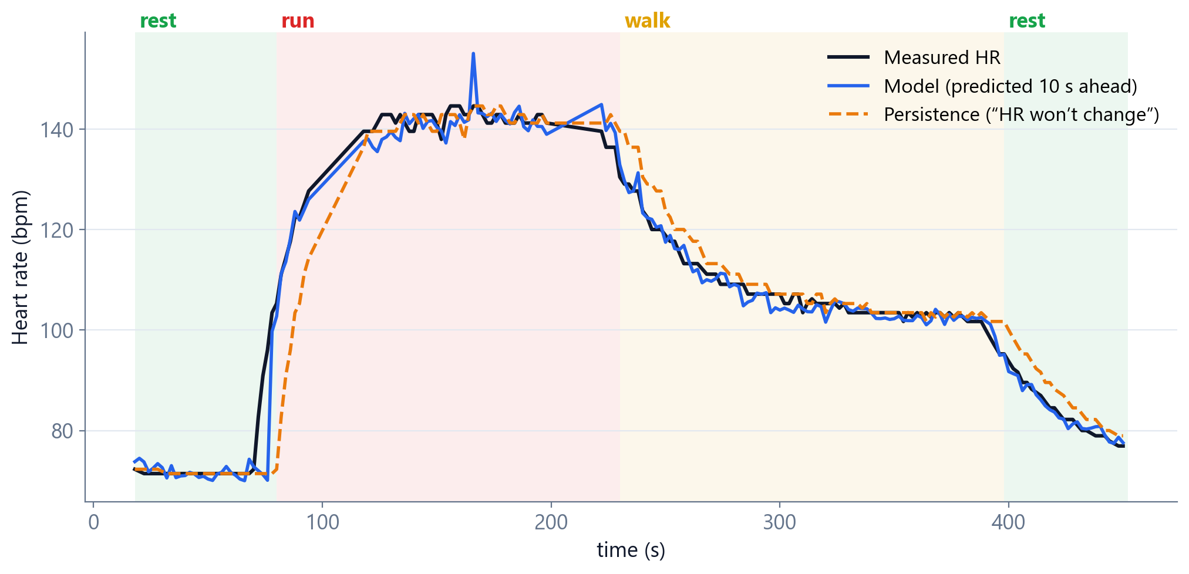
MACHINE LEARNING
Predicting heart rate 10 s ahead
8 s windows
›
Reference HR
›
HR + motion features
›
HistGradientBoosting
›
GroupKFold by session
PulsoSeguro · Semester project
11
Notes:
The model looks at 8-second windows, one every 2 seconds. For each window it uses the current heart rate and its history, the trend, how much the person is moving (accelerometer and gyroscope) and the perfusion. A HistGradientBoosting regressor from scikit-learn predicts the change in heart rate 10 seconds later. We validate with GroupKFold by session — never random rows, because consecutive windows are almost identical and would inflate the score. The chart uses synthetic data with activity changes: the blue line (model) anticipates the rise when running starts, while the orange persistence baseline lags behind.

Slide 12
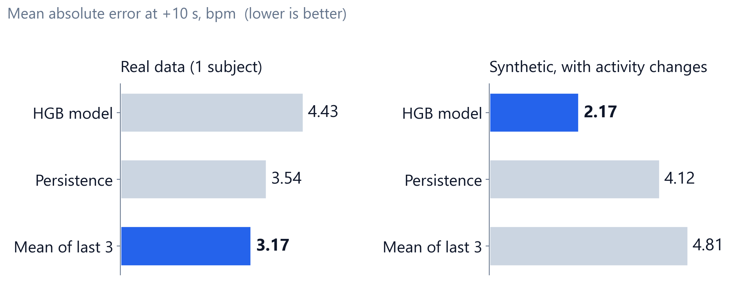
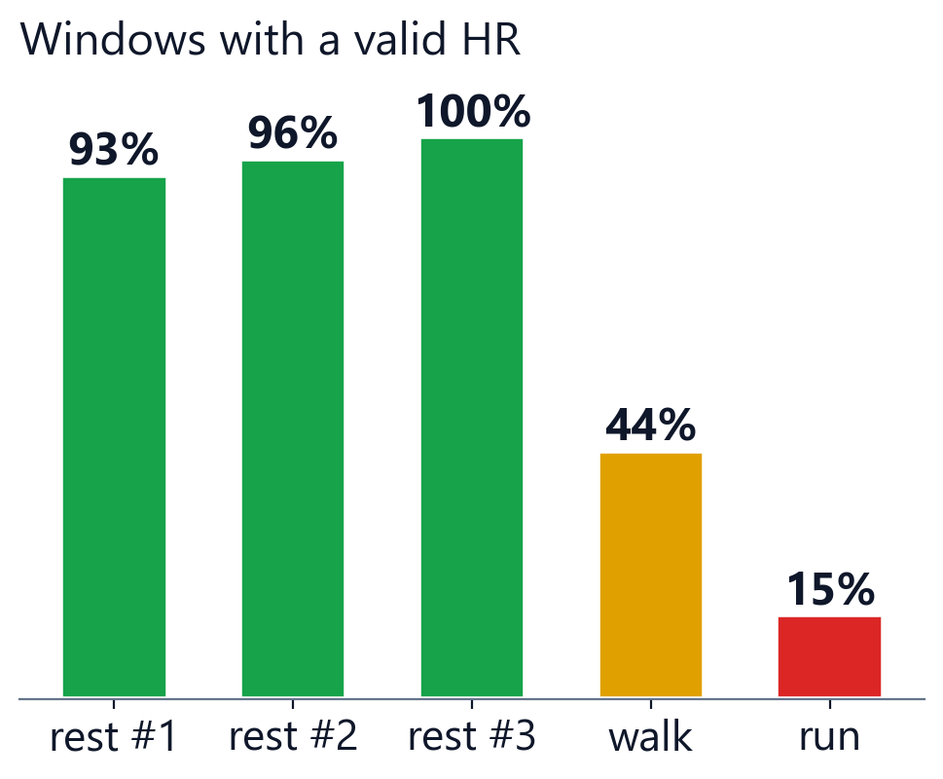
HONEST EVALUATION
Results so far
✅ Pipeline works
⚠️ Not enough real data
🎯 Next
47 % less error on synthetic data
65 windows, no activity changes
record rest → walk → run sessions
PulsoSeguro · Semester project
12
Notes:
First real dataset: one subject, five 60-second sessions, one activity each. At rest we get a valid heart rate in 93–100% of windows; walking and running drop to 44% and 15% because of motion artifacts — the sensor must be fixed to the body with constant pressure. On real data the model does NOT yet beat the simple baselines: at rest the heart rate only moves ±3 bpm, so there is nothing to anticipate, and with 65 windows there is no pattern to learn. On synthetic data with activity transitions the same pipeline cuts the persistence error by about 47%. That proves the pipeline works; the next step is recording real sessions with transitions.

Slide 13
REACT APP
Live web dashboard
🚦 Status traffic light
💓 Heart beats at real HR
🫧 SpO₂ bubbles
📈 Measured vs predicted
🔔 Event log
🧪 Demo mode
PulsoSeguro · Semester project
13
Notes:
This is the web dashboard during a simulated run. Top row: the general status (traffic light), heart rate with a heart that beats at the measured rate and the prediction for 10 seconds later, SpO2 with rising bubbles, and the sensor contact. Below: live trends of measured versus predicted heart rate, and the recent events list. There is also an optional PPG waveform, a capture-session panel that replaces control.py, and the prediction history. The demo mode simulates exactly the same MQTT messages, so we could build and test the whole UI before the firmware and the Lambda publish them.

Slide 14
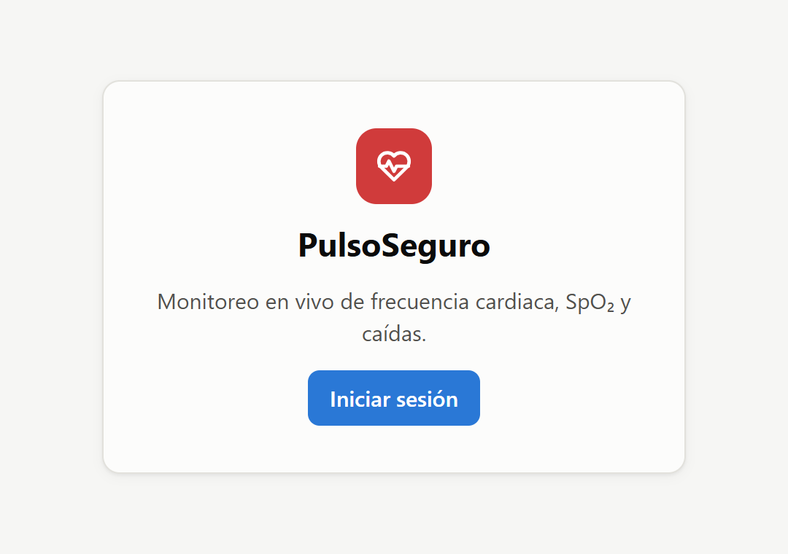
SECURITY FLOW
How the browser connects — no backend
👤
🔑
✍️
📡
1. Sign in
2. Temp keys
3. Sign URL
4. Subscribe
Cognito User Pool
OIDC → ID token
Cognito Identity Pool
IAM role
SigV4
wss://…/mqtt
mqtt.js → IoT Core
status · vitals · pred
Login screen
🚫 No AWS SDK, no backend
♻️ Keys renewed 5 min before expiry
🔁 Auto-reconnect with backoff
PulsoSeguro · Semester project
14
Notes:
The dashboard has no server of its own. Step 1: the user signs in on the Cognito managed login page (OpenID Connect, authorization code flow) and the app receives an ID token. Step 2: with that token it asks the Cognito Identity Pool for temporary AWS credentials, limited by an IAM role. Step 3: it signs the WebSocket URL with AWS Signature V4 — written by hand, without the AWS SDK, to keep the app small. Step 4: mqtt.js connects to IoT Core over WSS and subscribes to the topics of the selected wristband. Credentials are renewed 5 minutes before they expire, and the connection reconnects with exponential backoff. The browser never sees the ESP32 certificates.

Slide 15
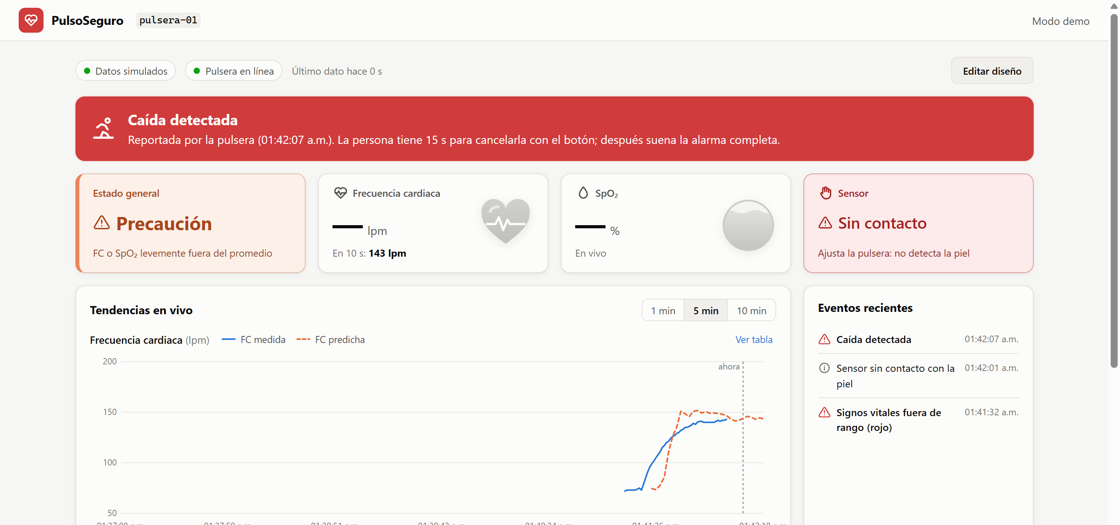
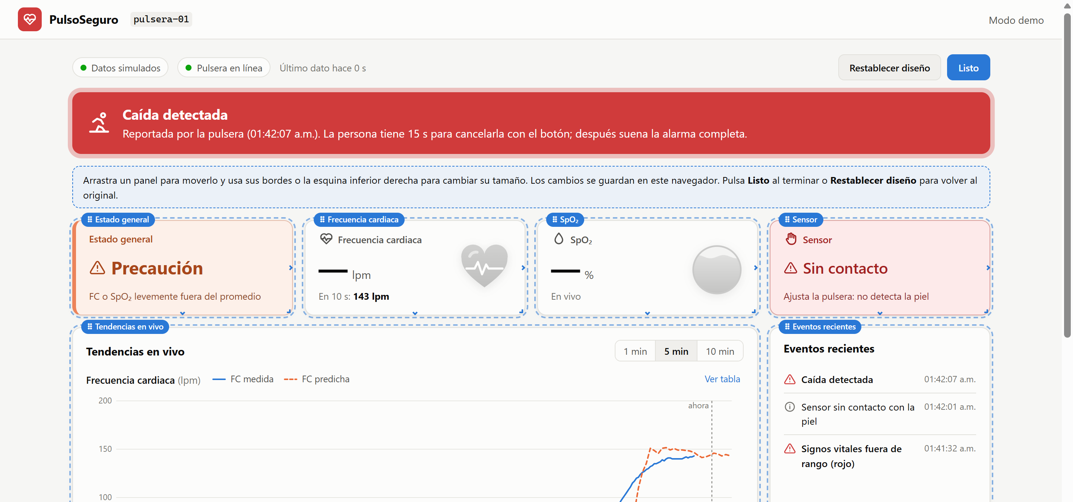
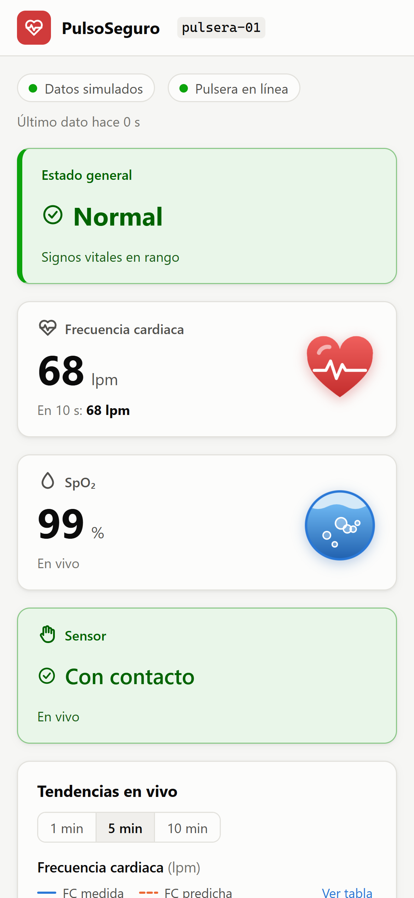
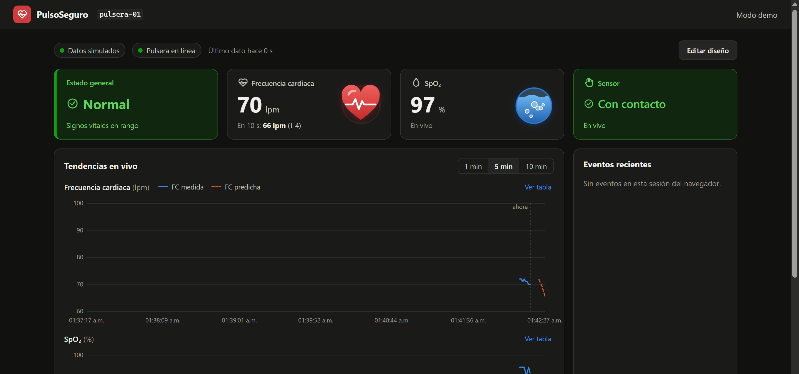
USER EXPERIENCE
Dashboard features
Fall alert + no contact
Drag & resize layout
Sensor without contact
Dark mode
Mobile
PulsoSeguro · Semester project
15
Notes:
Some features: a red banner when the wristband reports a fall, with the time it started; a warning when the sensor loses skin contact. In edit mode every card and panel can be dragged and resized, and the content adapts to its size; the layout is saved per user and can be reset. It supports dark mode automatically and works on mobile in a single column. Status colors always come with an icon and text, and every chart has a table view, for accessibility.

Slide 16
TECH STACK
Tools we used
⌚ Device
ESP32 · Arduino
FreeRTOS
PubSubClient
MAX3010x · Adafruit GFX
☁️ Cloud (AWS)
IoT Core
IoT Rules
S3
Cognito
IAM
🐍 Data & ML
Python
pandas · NumPy
SciPy
scikit-learn
matplotlib
boto3 · paho-mqtt
💻 Web
React 19
TypeScript
Vite
mqtt.js
react-oidc-context
react-grid-layout
🚀 Delivery
Docker
nginx
pnpm
Git · GitHub
PulsoSeguro · Semester project
16
Notes:
Device: Arduino IDE with the ESP32 core, FreeRTOS tasks, PubSubClient for MQTT, SparkFun MAX3010x and Adafruit display libraries. Cloud: AWS IoT Core, IoT Rules, S3, Cognito and IAM, all in us-east-2. Data and ML: Python with paho-mqtt and boto3 for capture, pandas, NumPy and SciPy for signal processing, scikit-learn for the model, matplotlib for figures. Web: React 19 with TypeScript and Vite, mqtt.js, react-oidc-context for login, react-grid-layout for the editable grid. Delivery: Docker with nginx, pnpm, Git and GitHub with pull requests.

Slide 17
DESIGN DECISIONS
Security & cost
🔒 Security
💲 Cost
📜 X.509 certificate per device
📦 10 KB batches = 2 billed messages
🎫 Temporary keys for the browser
⏱️ ~2,400 batches per hour → cents
🧱 Least-privilege IoT & IAM policies
🔔 1 USD AWS Budget alert
🙈 No secrets in Git · anonymous subjects
📴 Raw PPG off by default in the web
PulsoSeguro · Semester project
17
Notes:
Security: each device has its own X.509 certificate and an IoT policy that only lets it use its own client ID and the bio/ topics. The browser uses short-lived Cognito credentials restricted by an IAM role and an IoT policy. Secrets, certificates and .env files never go to Git. Physiological data is personal data, so subjects are anonymous IDs like s01. Cost: one hour of capture is about 2,400 batches; each counts as two IoT messages plus one S3 write — cents per hour, inside the free tier. We set a 1 USD AWS Budget alert, always send 'stop' after a session, and keep the raw PPG stream off by default in the dashboard because every subscriber multiplies messages.

Slide 18
ROADMAP
Status & next steps
✅ Done
🔧 In progress
🎯 Next
Firmware: falls · traffic light · TFT
Validate firmware v5 on board
Identity Pool + IoT policy for the web
Capture → IoT Core → S3
Record sessions with activity changes
Firmware topic 'vitals' (1 Hz)
HR reference from PPG
Beat the persistence baseline
Lambda → 'pred' + DynamoDB
Model pipeline + validation
Deploy the dashboard
Web dashboard + Cognito login
PulsoSeguro · Semester project
18
Notes:
Done: the wristband firmware with fall detection, traffic light and display; the capture pipeline to AWS and S3 with real data; the signal processing and the model pipeline; and the full web dashboard with Cognito login, working in demo mode. In progress: validating firmware v5 on the board and collecting real sessions with activity transitions. Next: configure the Cognito Identity Pool and IoT policy so the dashboard receives live data, add the 'vitals' topic to the firmware, and deploy a Lambda that publishes live predictions and stores them in DynamoDB.

Slide 19
♥
Thank you!
Questions?
ESP32 · AWS IoT Core · S3 · Python ML · React dashboard
Notes:
Thank you. I am happy to answer questions or show the dashboard live in demo mode.

