Slide 1
Flashing the BLDC Shield with custom software

Slide 2
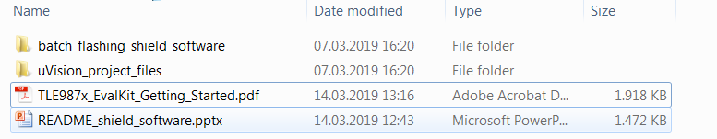
Toolchain
To install the necessary Toolchain for developing software for the BLDC Shield, follow the instructions in the TLE987x getting started guide
/03_shield_software/TLE987x_EvalKit_Getting_Started.pdf

Slide 3
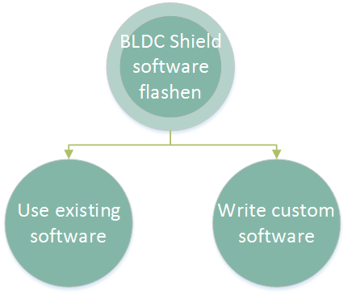
Keil uVision and writing software for the TLE987x

Slide 4
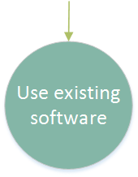
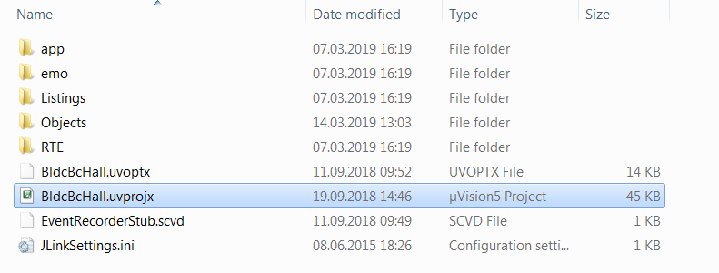
Use existing software
Go to /03_shield_software/uVision_project_files and choose one of the four projects and open its folder (Bootloader, HALL, FOC, BEMF)
Open the *.uvprojx project file in Keil uVision
Here the Hall project is shown

Slide 5
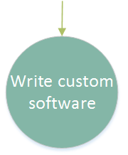
Write custom software
Follow instructions on how to develop software for the TLE987x EvalKit
/03_shield_software/TLE987x_EvalKit_Getting_Started.pdf

Slide 6
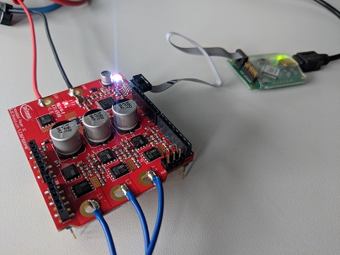
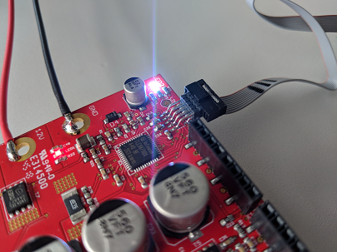
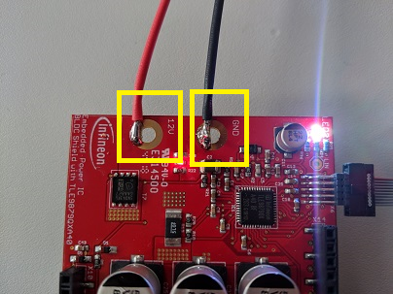
Connect Hardware
Connect a Segger J-Link device with the Shield (here a J-Link lite Cortex-M was used)
Connect the J-Link to your PC via USB
Connect the Shield to a 12V power supply
The Shield should not be connected to the Arduino when flashing

Slide 7
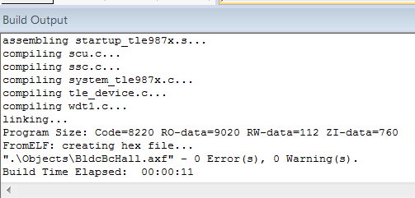
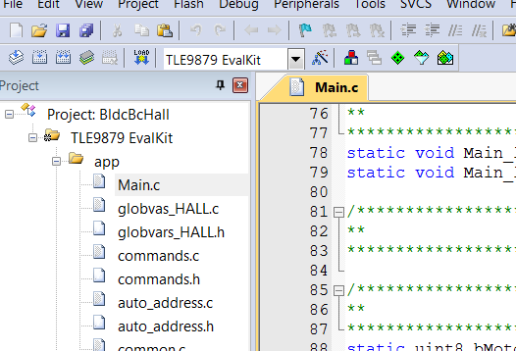
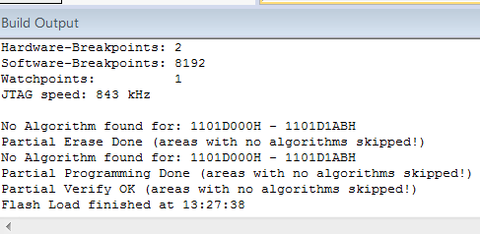
Build and flash software
Build the project and flash it to the BLDC Shield
Build
Flash project
Build project
Flash

Slide 8
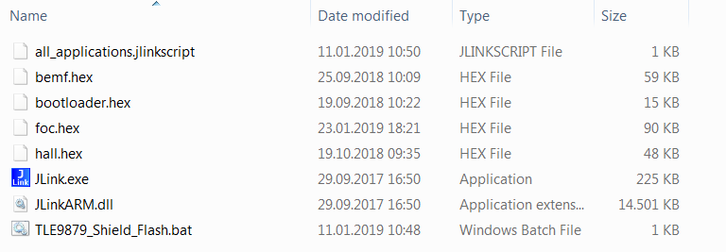
Using the batch flasher
The file TLE9879_Shield_Flash.bat in /03_shield_software/batch_flashing_shield_software/ flashes the four *.hex files to the Shield
The *.hex files are from the projects in the /03_shield/uVision_project_files/ folder
Use the batch flasher in case you want to factory reset the Shield software

