Slide 1



Adventure Times
Aleksandar Hadzhizev
Felix Morenc

Slide 2

Agenda
Scenario
Research
Demo

Slide 3
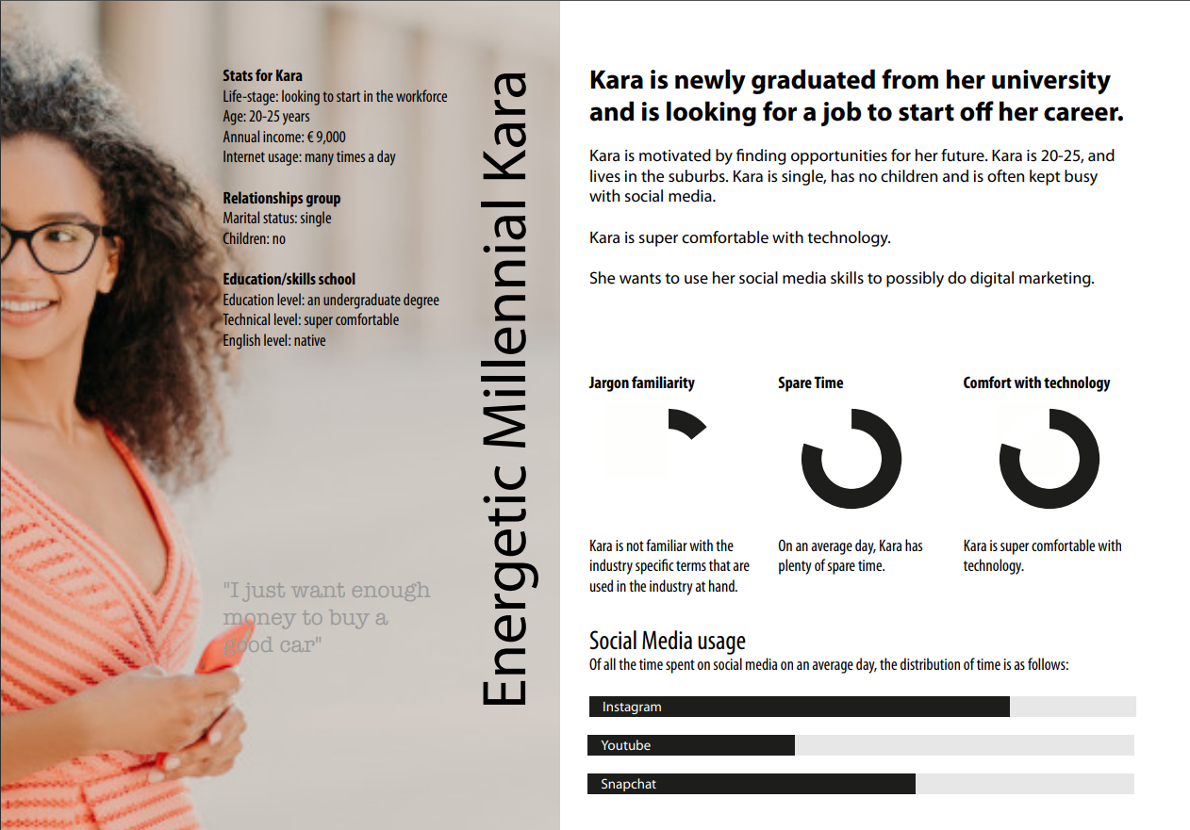
Scenario

Slide 4
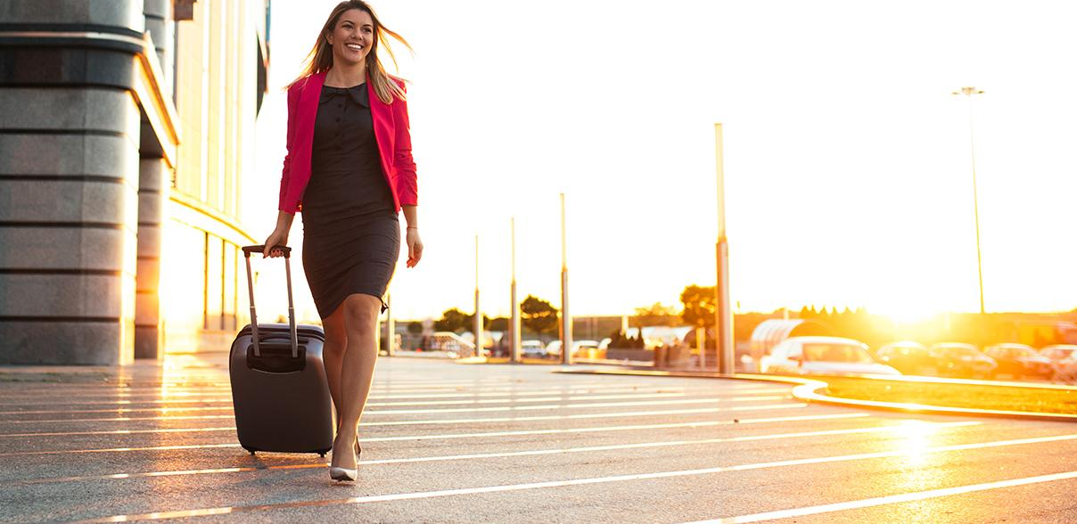
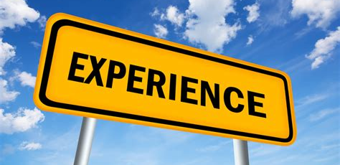
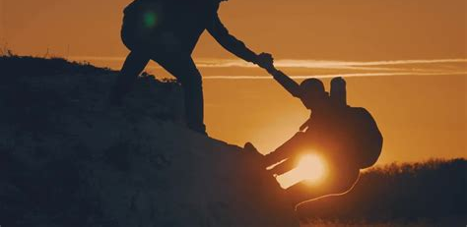
Scenario
Kira is regular traveller
She wants to experience a new way of exploring a city
Here is where we come at hand

Slide 5
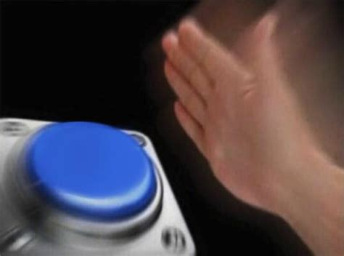


Scenario
She downloads the app
Starts a challenger game
Succeeds in finding the location
Download

Slide 6
Research
Thoughts on travelling
Colours
Existing apps
A lot of feedback – (target group and teachers)

Slide 7

Demo

Slide 8
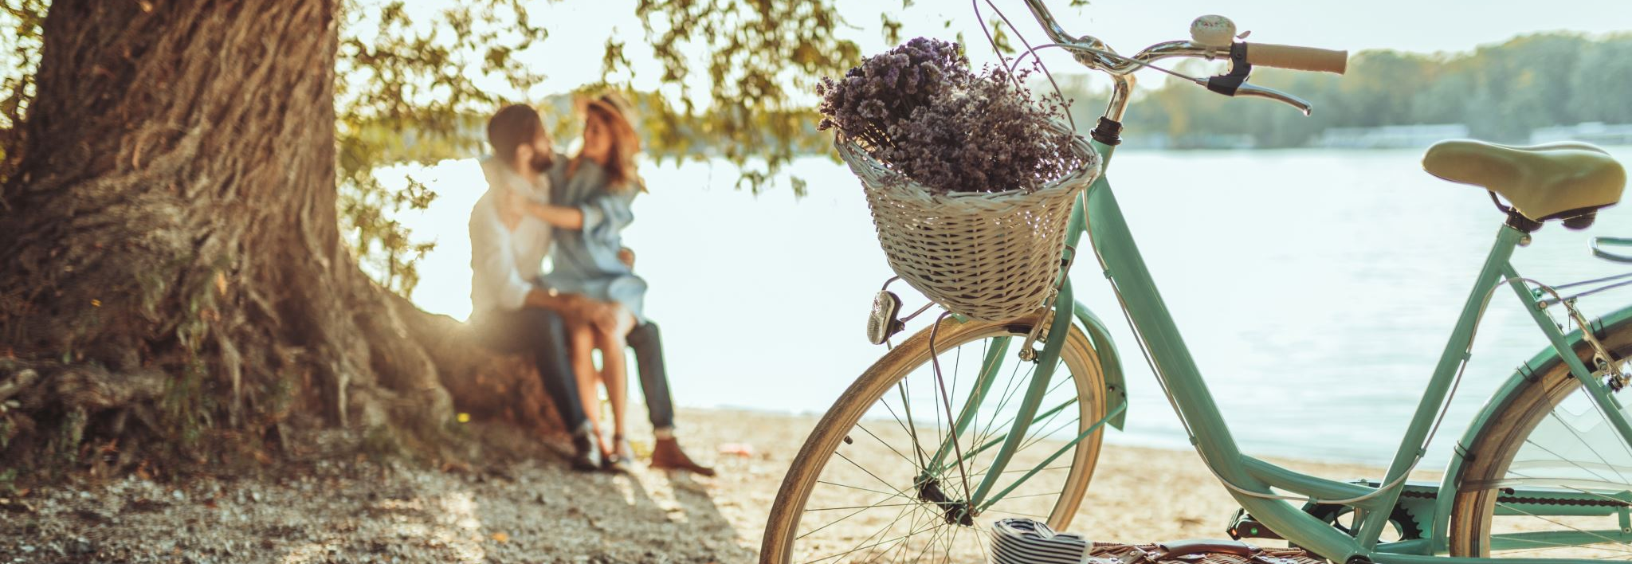
Thank you for your time ☺

