Slide 1
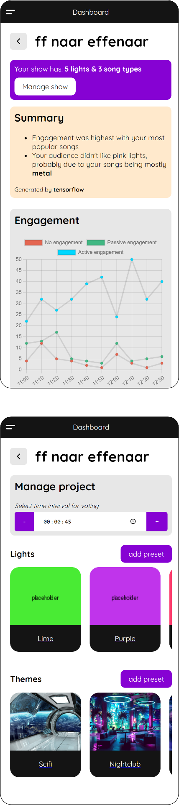
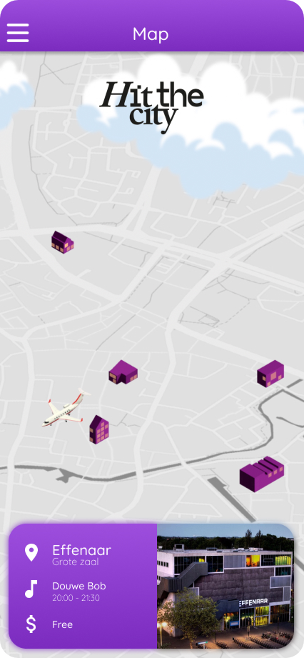
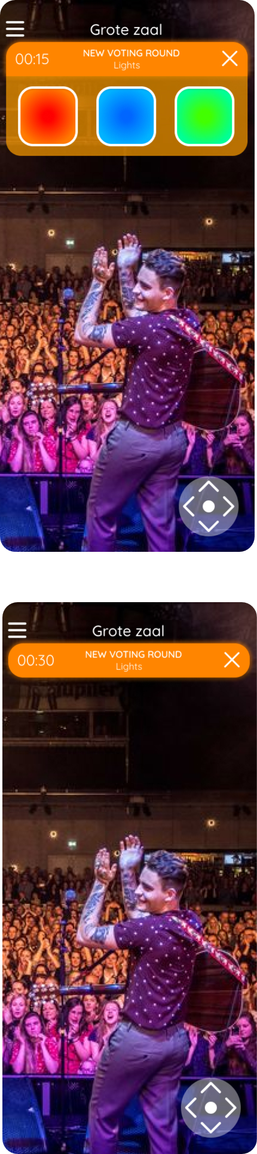
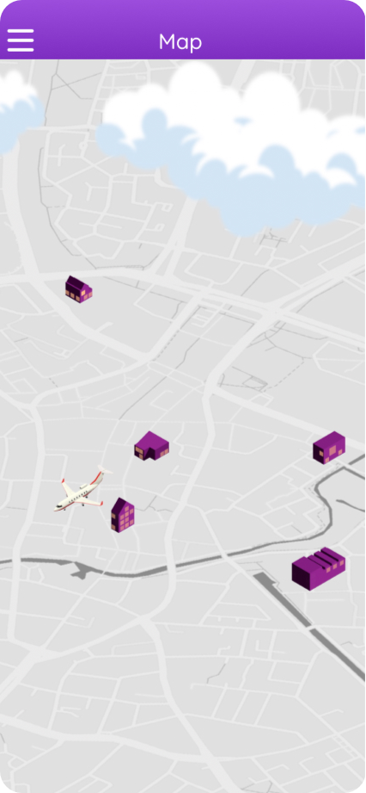
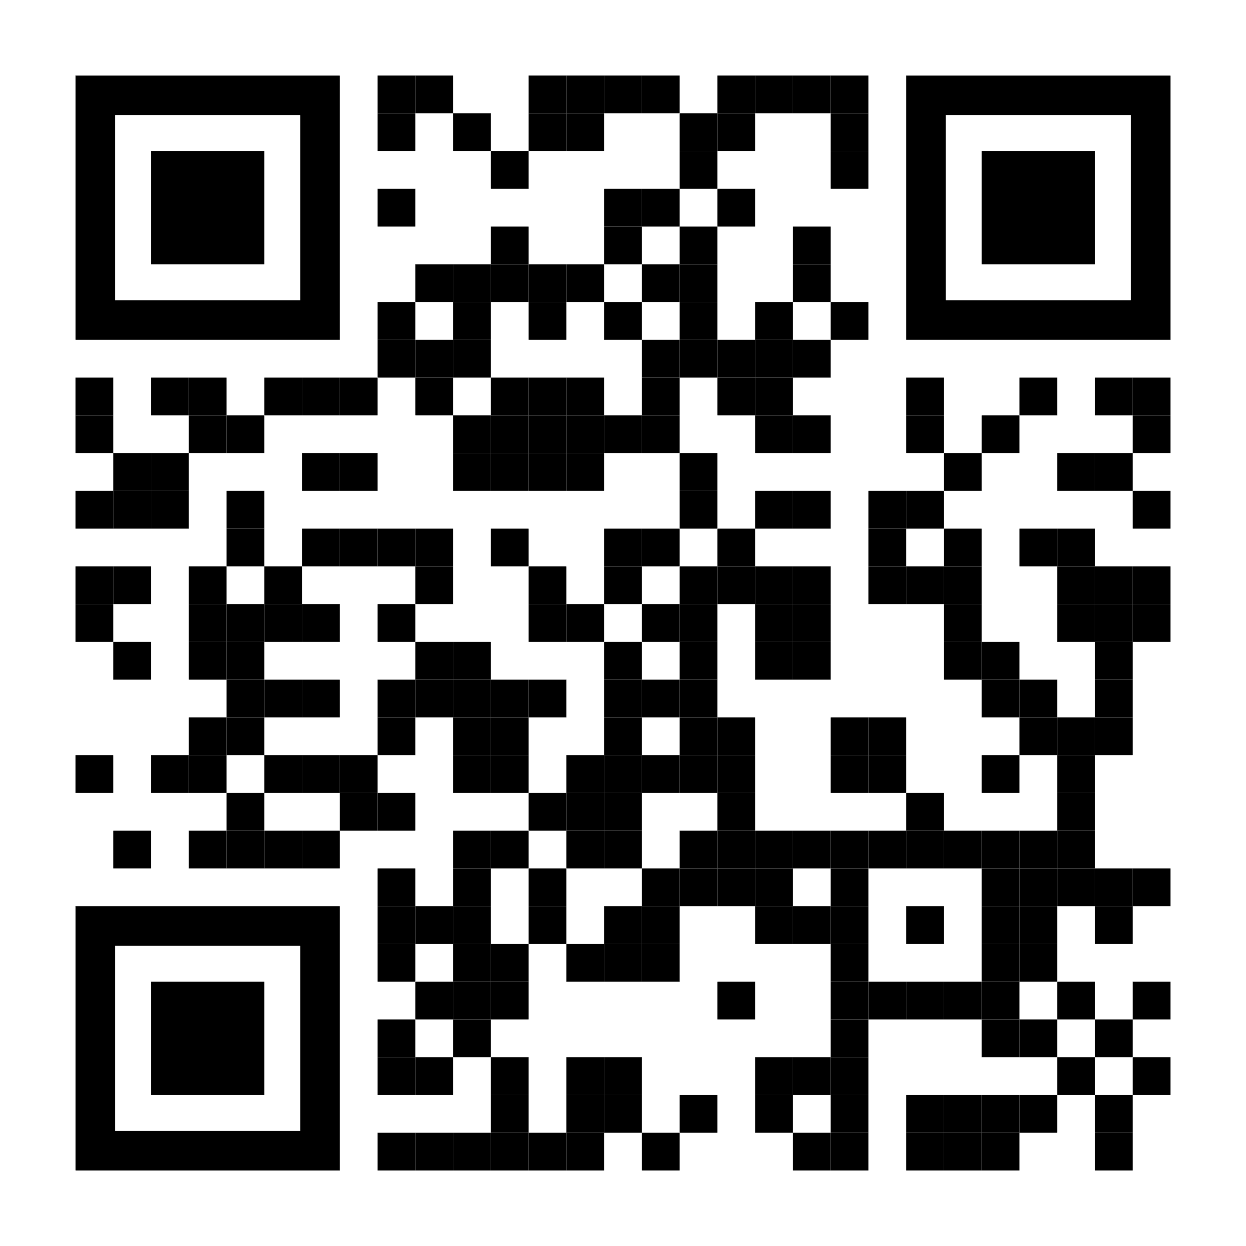
EFFENAAR APP

Slide 2
EFFENAAR APP

Slide 3
EFFENAAR APP
The festival experience from home

Slide 4
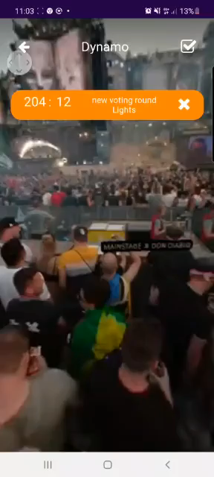
EFFENAAR APP
The festival experience from home

Slide 5
EFFENAAR APP
Join the crowd in XR

Slide 6
TRY IT OUT
Join the crowd in XR

