Slide 1
Empirical Evidence of excess profits in european stock markets ex-ante monetary policy decisions by the ECB
SE Bachelor Thesis in Economics or Economic Psychology
Felix Reichel

Slide 2
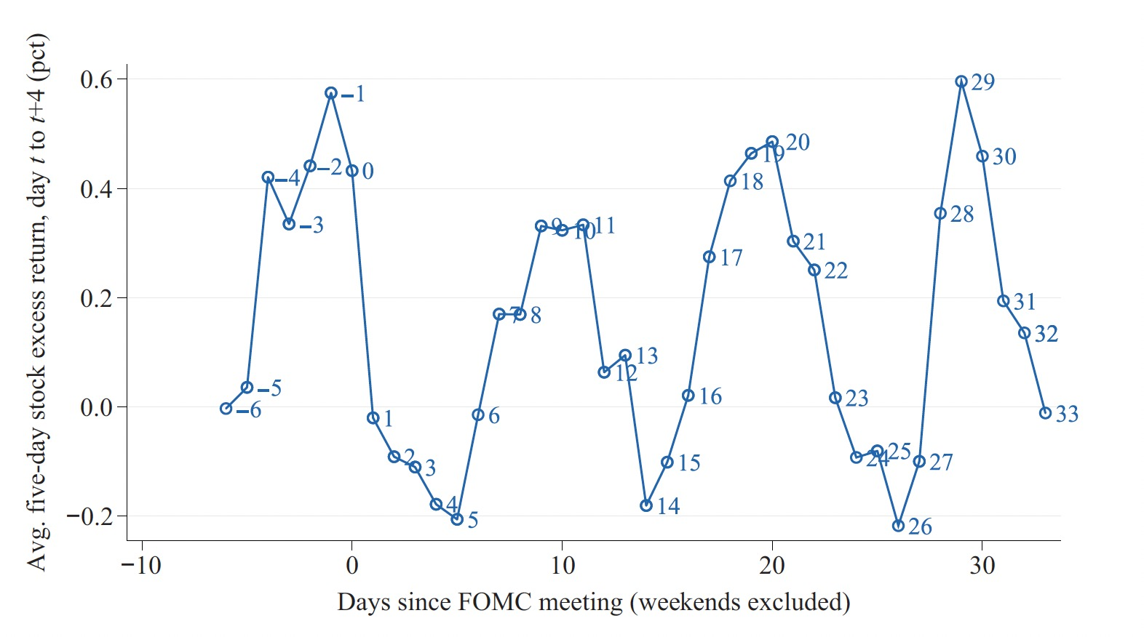
Stock Returns over the FOMC cycle. Cieslak et al. (2019)
The FOMC (= Federal Open Market Committee) meets approx. 8 times per annum (~ 6.5 weeks)
Figure:
Y-Axis: Average 5-day stock excess return, from day t to t+4 in percent.
X- Axis: Days since FOMC meeting: usually -1 to 33. (7 weeks * 5 days = 35)
Profitability of Various Trading Strategies, 1994 to 2016 (Cieslak et al.)
Portfolio A: Hold stocks throughout all weeks within FOMC cycles: 1$ -> 7.68$
Portfolio B: Hold stocks in even weeks (0, 2, 4, 6) only: 1$ -> 15.22$
Portfolio C: Hold stock in odd weeks (-1, 1, 3, 5) only: 1$ -> 0.51$

Slide 3


The Economics of the Fed Put. Cieslak et al. (2021)
Fed Put
Textual analysis of FOMC meeting transcripts
Moral hazard effects
Seal of the Federal Reserve System
Jerome H. Powell, 16th Chair of the Federal Reserve

Slide 4
(Prelimary) Research Questions
Does the effect that stock excess return are mainly achieved in FOMC even weeks (0,2,4,6) from 2016 onwards still persist? (occurance of many unscheduled FOMC meetings due to the corona-crisis in 2020)
In the euro-zone the ECB makes policy interest rate decision. Is there empirical evidence for a similar effect when considering only the Euro-Zone and Euro-Zone stock returns.
Does it imply an equivalent of the Fed Put in the Euro-Zone? Why/why not?

Slide 5
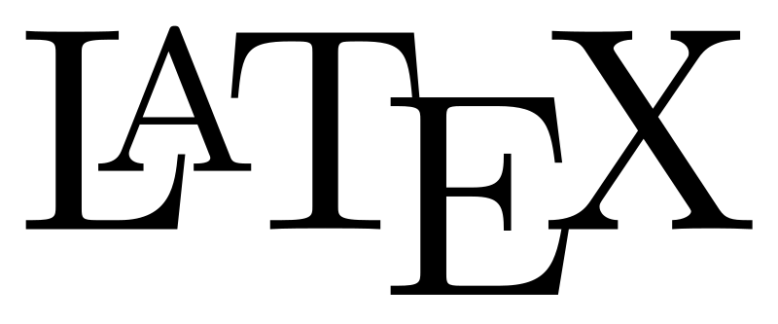
Used Data, Technology and Tools
Dummie coding/generation using R (Statistical Programming Language)
Fama/French US Research Data 3-Factors for calculation of stock market excess returns according to Cieslak et al.
Calculation:
“Risk free” market stock returns (Mkt.RF) over “risk free” (30 day-)treasury bill returns (RF):
Daily excess returns = 100 * ((Mkt.RF + RF)/100 + 1) – (RF/100 + 1))
STATA for estimation of MLR model with binary dummy variables
as typesetting for writing the thesis

Slide 6
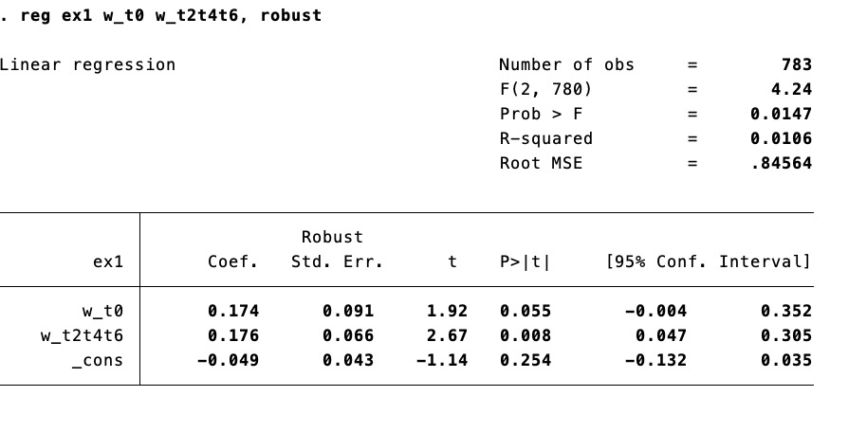
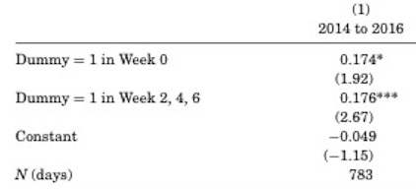
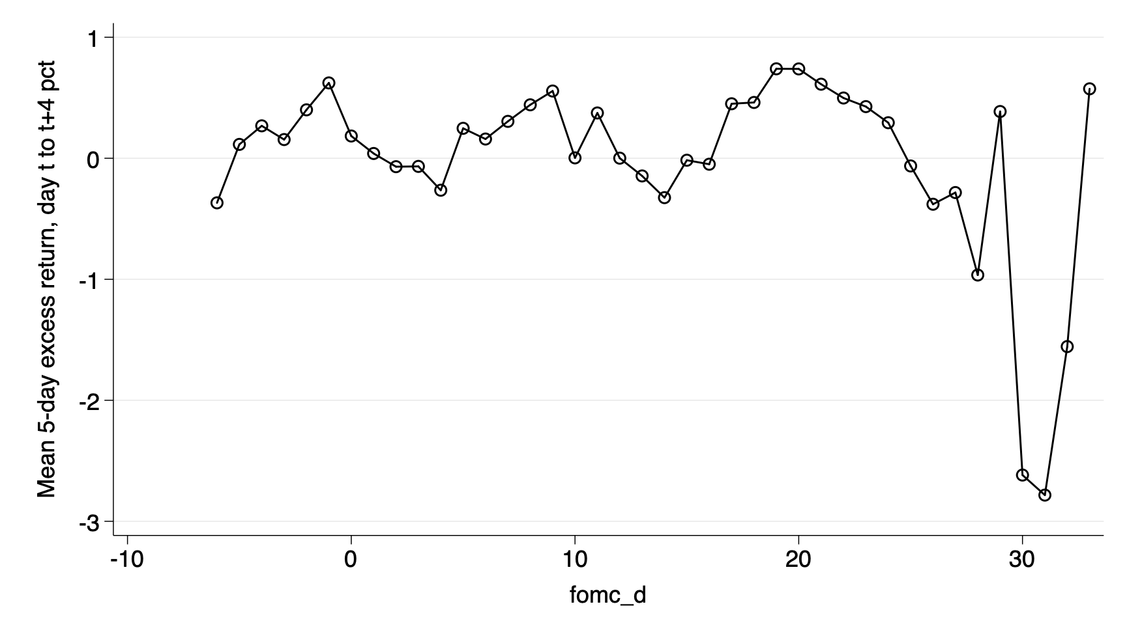
Partial replication results of Cieslak et al. (2019)
Replication with own coded dummies in R and excess return on stock over T-Bills using Fama/French Research Data Factors according to Cieslak et al. Table I PANEL B (1):
Avg. 5 day stock access returns, day t to t+4 (in percent) 1994 – 2016 (left) vs.
2014 – 2016 (right)

Slide 7

Approach (MLR model)
Replace with excess returns in European Stock Markets using Fama/French European 3-Factors for Developed Market Factors and Returns
Replace with monetary policy meetings of the Governing Council of the ECB. (approx. every 6 weeks, similar to the FOMC meeting schedule)
(Re-)Estimate:

