Slide 1
Empirical Evidence of excess profits in european stock markets prior to ECB monetary policy decisions
SE Bachelor Thesis in Economics or Economic Psychology
Felix Reichel

Slide 2
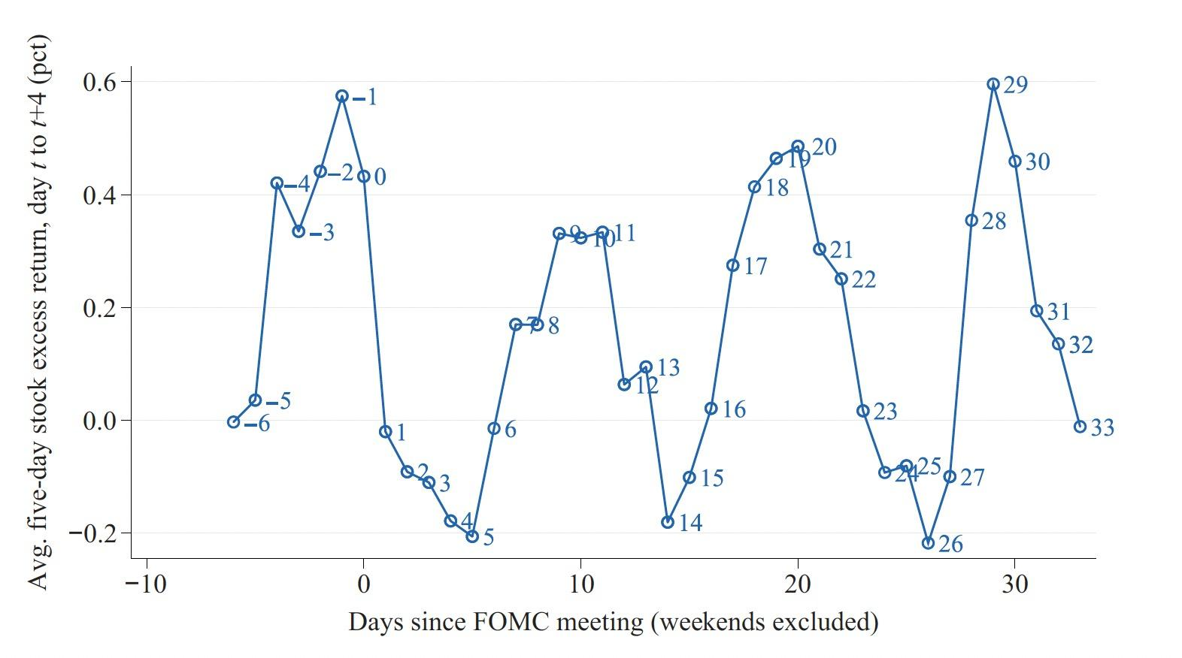
Stock Returns over the FOMC cycle. Cieslak et al. (2019)
The FOMC (= Federal Open Market Committee) meets approx. 8 times each year. (~ 6.5 weeks)
Figure:
y-axis: Average 5-day stock excess return, from day t to t+4 in percent.
x-axis: Days since FOMC meeting: usually -1 to 33. (7 weeks * 5 days = 35)
Profitability of Various Trading Strategies, 1994 to 2016 (Cieslak et al., 2019)
Portfolio A: Hold stocks on all days: 1$ -> 7.68$
Portfolio B: Hold stocks in even weeks (0, 2, 4, 6) only: 1$ -> 15.22$
Portfolio C: Hold stocks in odd weeks (-1, 1, 3, 5) only: 1$ -> 0.51$

Slide 3


The Economics of the Fed Put. (Cieslak et al., 2021)
Fed Put
Textual analysis of FOMC meeting transcripts
Moral hazard effects
Seal of the Federal Reserve System
Jerome H. Powell, 16th Chair of the Federal Reserve, 2018 - 2026

Slide 4
(Preliminary) Research Questions
Does the stylized fact of stock excess returns are mainly achieved in FOMC even weeks (0,2,4,6) from 2016 onwards still persist? (Complicated by many unordinary scheduled FOMC meetings due to the COVID-19 pandemic)
In the eurozone, interest-rate decisions are in the hands of the ECB. Is there empirical evidence for a similar effect when considering only the eurozone and euro-zone stock returns. Does it imply an equivalent of the Fed Put in the Euro-Zone? Why/why not?

Slide 5
Data, Technologies and Tools
Dummy coding/generation using R
Fama/French US Research Data 3-Factors for calculation of stock market excess returns as in Cieslak et al., 2019
Calculation:
“Risk free” market stock returns (Mkt.RF) over “risk free” (30 day-)treasury bill returns (RF):
Daily excess returns = 100 * ((Mkt.RF + RF)/100 + 1) – (RF/100 + 1))
STATA for estimation of MLR models with binary dummy variables

Slide 6
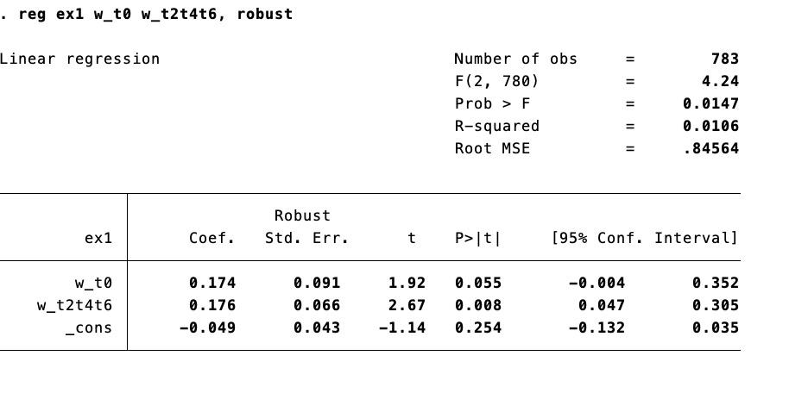
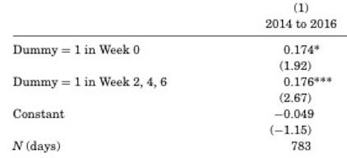
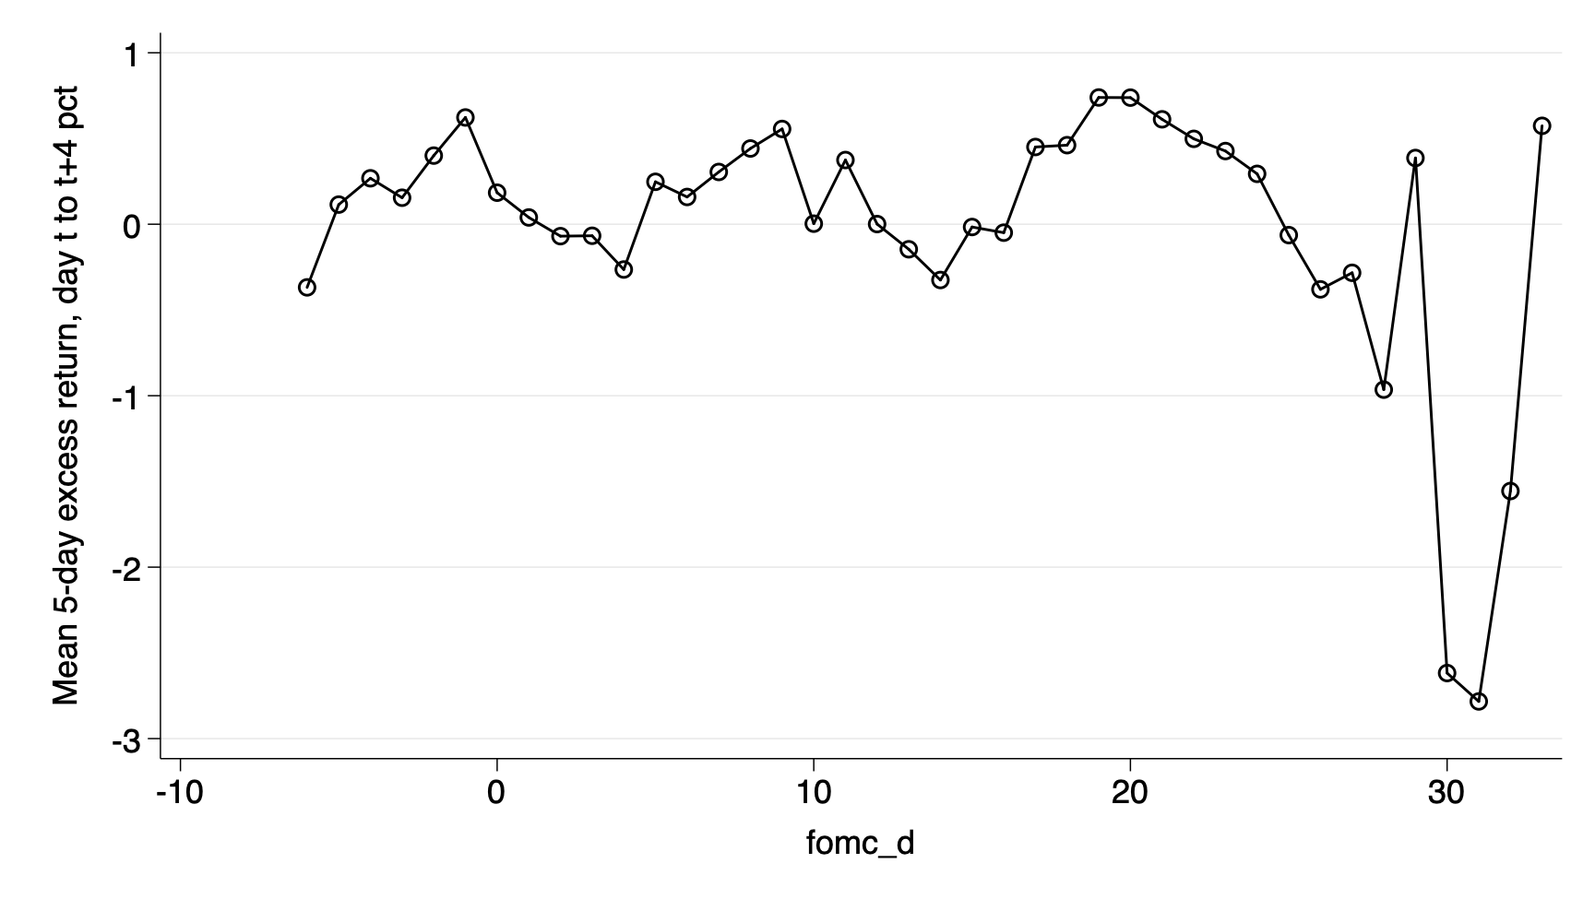
Partial replication of the results in Cieslak et al. (2019)
Replication with own coded dummies in R and excess return on stock over T-Bills using Fama/French Research Data Factors as in Cieslak et al., 2019 Table I PANEL B (1):
Avg. 5 day stock excess returns, day t to t+4 (in percent) 1994 – 2016 (left) vs.
2014 – 2016 (right)

Slide 7

Approach (MLR model)
Replace with excess returns in European stock markets using Fama/French European 3-Factors for Developed Market Factors and Returns
Replace with monetary policy meetings of the Governing Council of the ECB. (approx. every 6 weeks, similar to the FOMC meeting schedule)
(Re-)Estimate:

