Slide 1
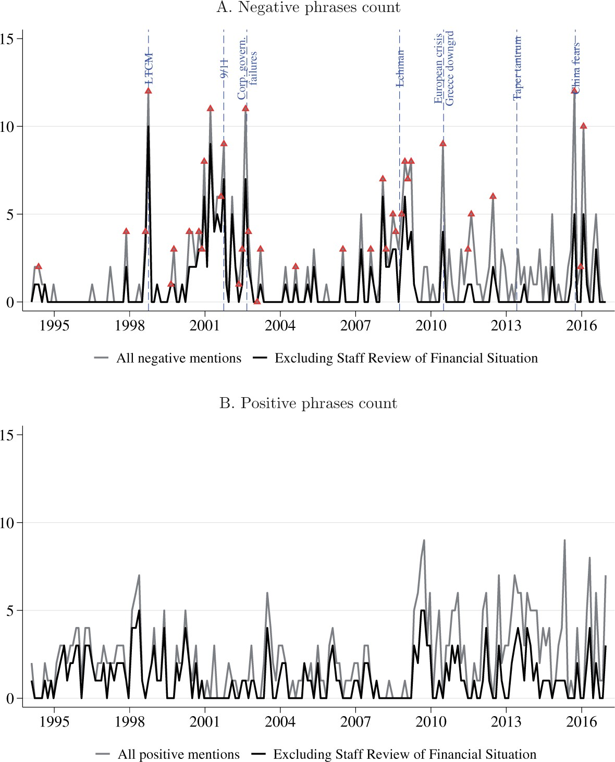

Figure 5 Time series of positive and negative stock market phrases in FOMC minutes The figure presents the time series ...
Notes:
Figure 5 Time series of positive and negative stock market phrases in FOMC minutes The figure presents the time series of negative and positive stock market phrases in FOMC minutes based on human coding. We present the overall counts as well as excluding the counts in the Staff Review of the Financial Situation (minutes’ section 2). The sample period is 1994–2016. The triangles in panel A represent FOMC meetings that were preceded by intermeeting stock market returns in the lowest quintile.
Unless provided in the caption above, the following copyright applies to the content of this slide: © The Author(s) 2020. Published by Oxford University Press on behalf of The Society for Financial Studies. All rights reserved. For permissions, please e-mail: journals.permissions@oup.com.This article is published and distributed under the terms of the Oxford University Press, Standard Journals Publication Model (https://academic.oup.com/journals/pages/open_access/funder_policies/chorus/standard_publication_model)

