Slide 1
Guardian for Auth
How-to and How-not-to-do
github.com/felix-starman/how_to_guardian_talk

Slide 2

Peter Mueller github.com/felix-starman twitter.com/felix_starman

Slide 3
What is Guardian?
https://github.com/ueberauth/guardian
Quick way to handle token-based authentication
Comes with JWT out of the box, and “behaviours” for writing your own
Great for APIs
but can be used anywhere

Slide 4
What is a JWT (JSON Web Token)?
Standard for representing “claim tokens” meant to be exchanged
IETF RFC 7519 and IETF RFC 7520
Often used for Authentication
Powers OAuth2, OpenID Connect, and most “delegated auth/identity”
Can be just “signed” (JWS) or “signed and encrypted” (JWE/JOSE)
Payload of a JWS (JSON Web Signature)
Encoded, but NOT encrypted by default
Notes:
It’s “the way” you do things more complicated putting the user_id in the session

Slide 5
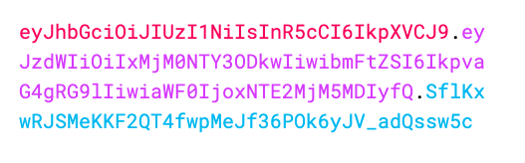
What does a JWT look like?
https://jwt.io/
Made up of 3 sections
Header
Payload (the data)
Signature (for security)
from jwt.io

Slide 6
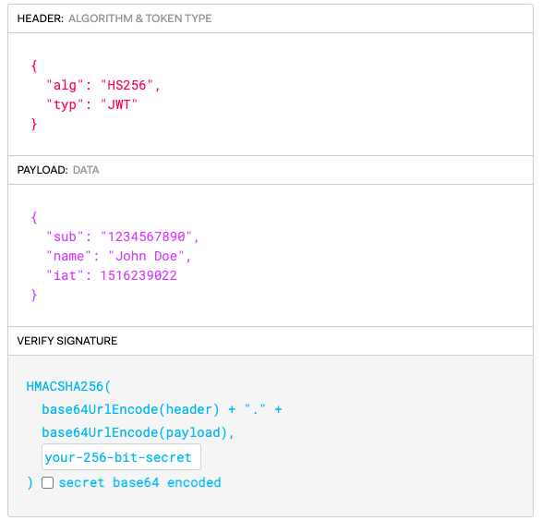
What does a JWT look like?
Header
Base64Url encoded
How to read/verify/decrypt
Can contain other headers
more advanced
aka “JOSE Header”
from jwt.io
Notes:
JOSE = JSON Object Signing and Encryption

Slide 7
What does a JWT look like?
Payload (the data)
Base64Url encoded
”claims”
"iss" (Issuer)
"sub" (Subject)
"aud" (Audience)
"exp" (Expiration Time)
"nbf" (Not Before)
"iat" (Issued At)
"jti" (JWT ID)
Other and/or custom
Readable by everyone unless encrypted
from jwt.io

Slide 8
What does a JWT look like?
Signature (for security)
Generated by the “Issuer” w/ a key
“digest” of header & payload
Tamper-resistant
Can be verified by others if using certain key-signing algorithms
Guardian does not do as the default
from jwt.io

Slide 9
When not to use Guardian, maybe?
When you just need “out-of-the-box w/ a little more”
Consider phx_gen_auth generators then customize
When you need “Log in with…”
Consider ueberauth and the many published “strategies”
“federating” your users w/ one or more ”identity services”
Google, Microsoft, Facebook, …
SAML or OAuth2 Identity providers: AWS Cognito, Auth0, Okta
When doing other forms of 2-stage SSO (CAS)
Can later add on Guardian

Slide 10
When should I use Guardian?
Quickly use JWTs
To issue “custom” tokens (Guardian.Token)
When you have multiple paths of authenticating that you want to abstract
Headers (Bearer Auth),
Session-cookie (and all the different approaches)

Slide 11
When should I use Guardian?
When you are the “identity service” (more complex)
They want use your app for SSO in other systems/sites (not suggested)
As a stepping stone to ex_oauth2_provider or samly

Slide 12
Why Guardian can be tough
JWTs are confusing and best practices can be confusing
Documentation
glosses over things, or missing
Naming
some modules don’t do what you’d think
Easy to accidentally start adding Authorization logic
Testing (we’ll get to this in a bit)

Slide 13
Why do I care?
Guardian is trying build your JWT and verify its integrity later
The rest is up to you to implement with callbacks
Customizing incorrectly can be very dangerous
Help understand if you even need JWT
When to use something else

Slide 14
Ok, ok, how do I actually do this…
Demo time…

Slide 15
Testing endpoints with Guardian
WARNING! WARNING!
It’s very easy to circumvent your auth’n

