Slide 1
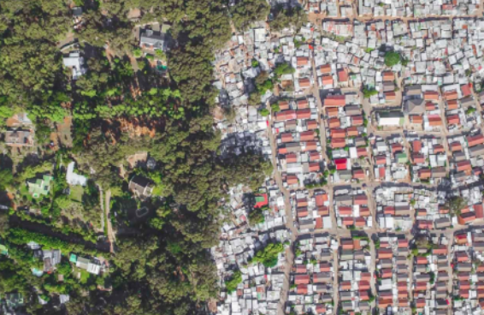
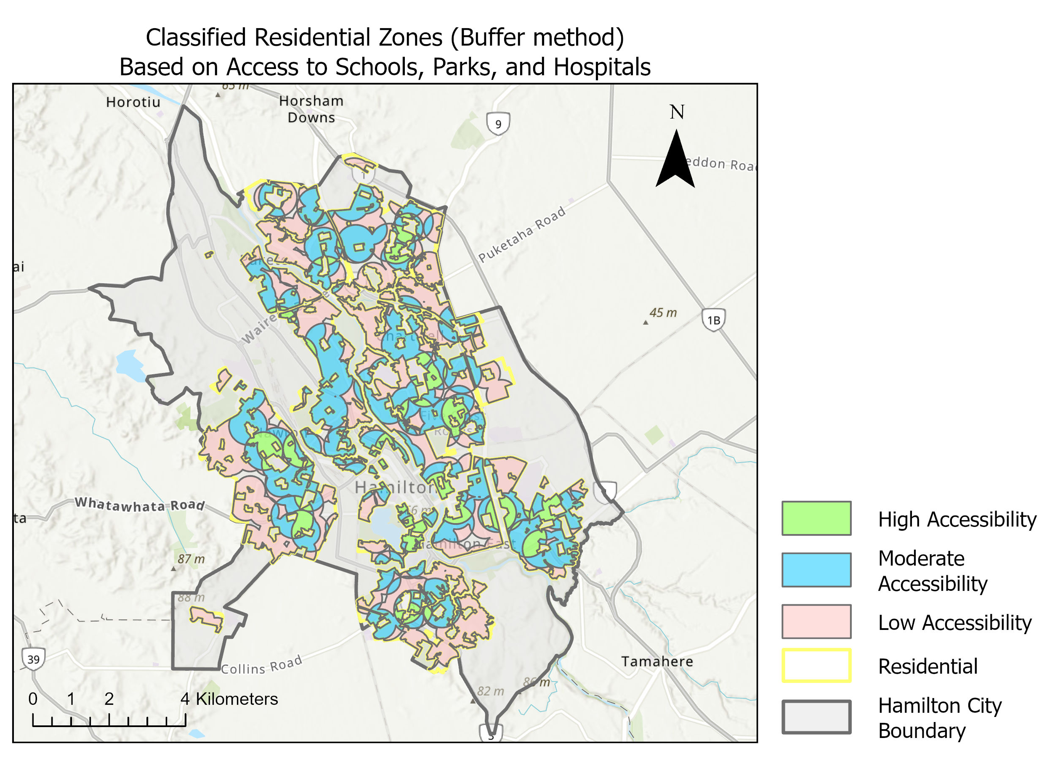
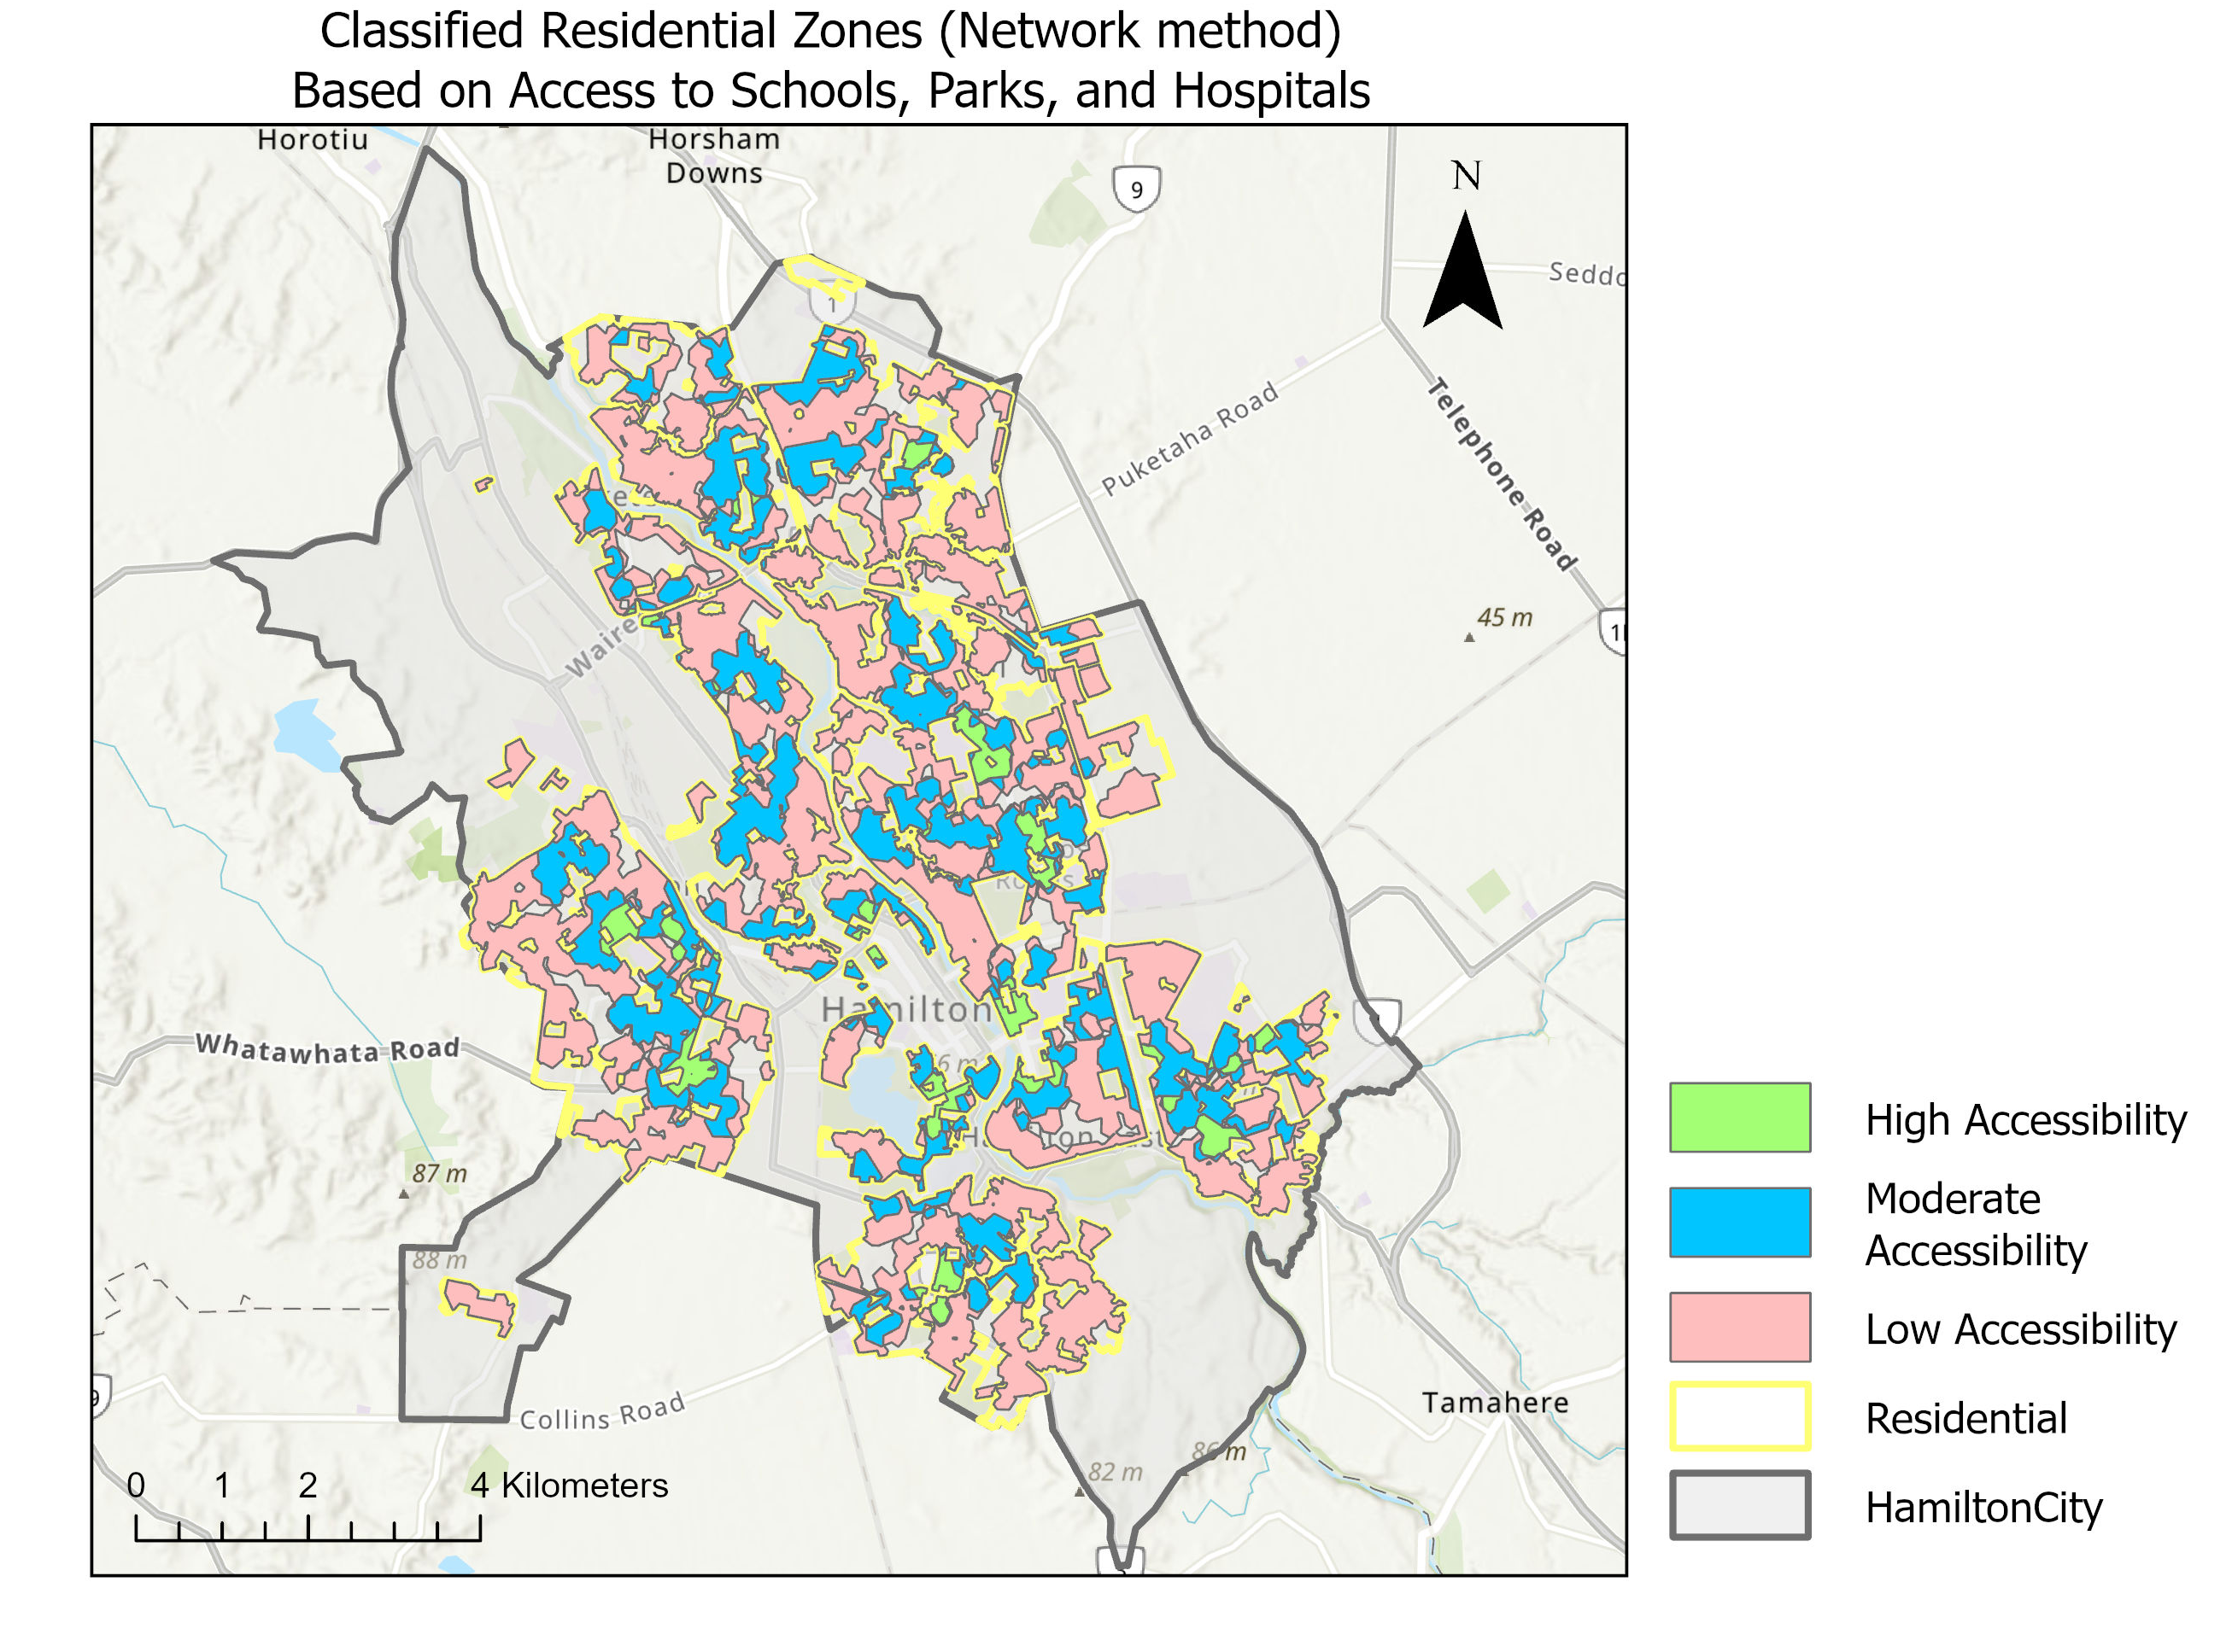
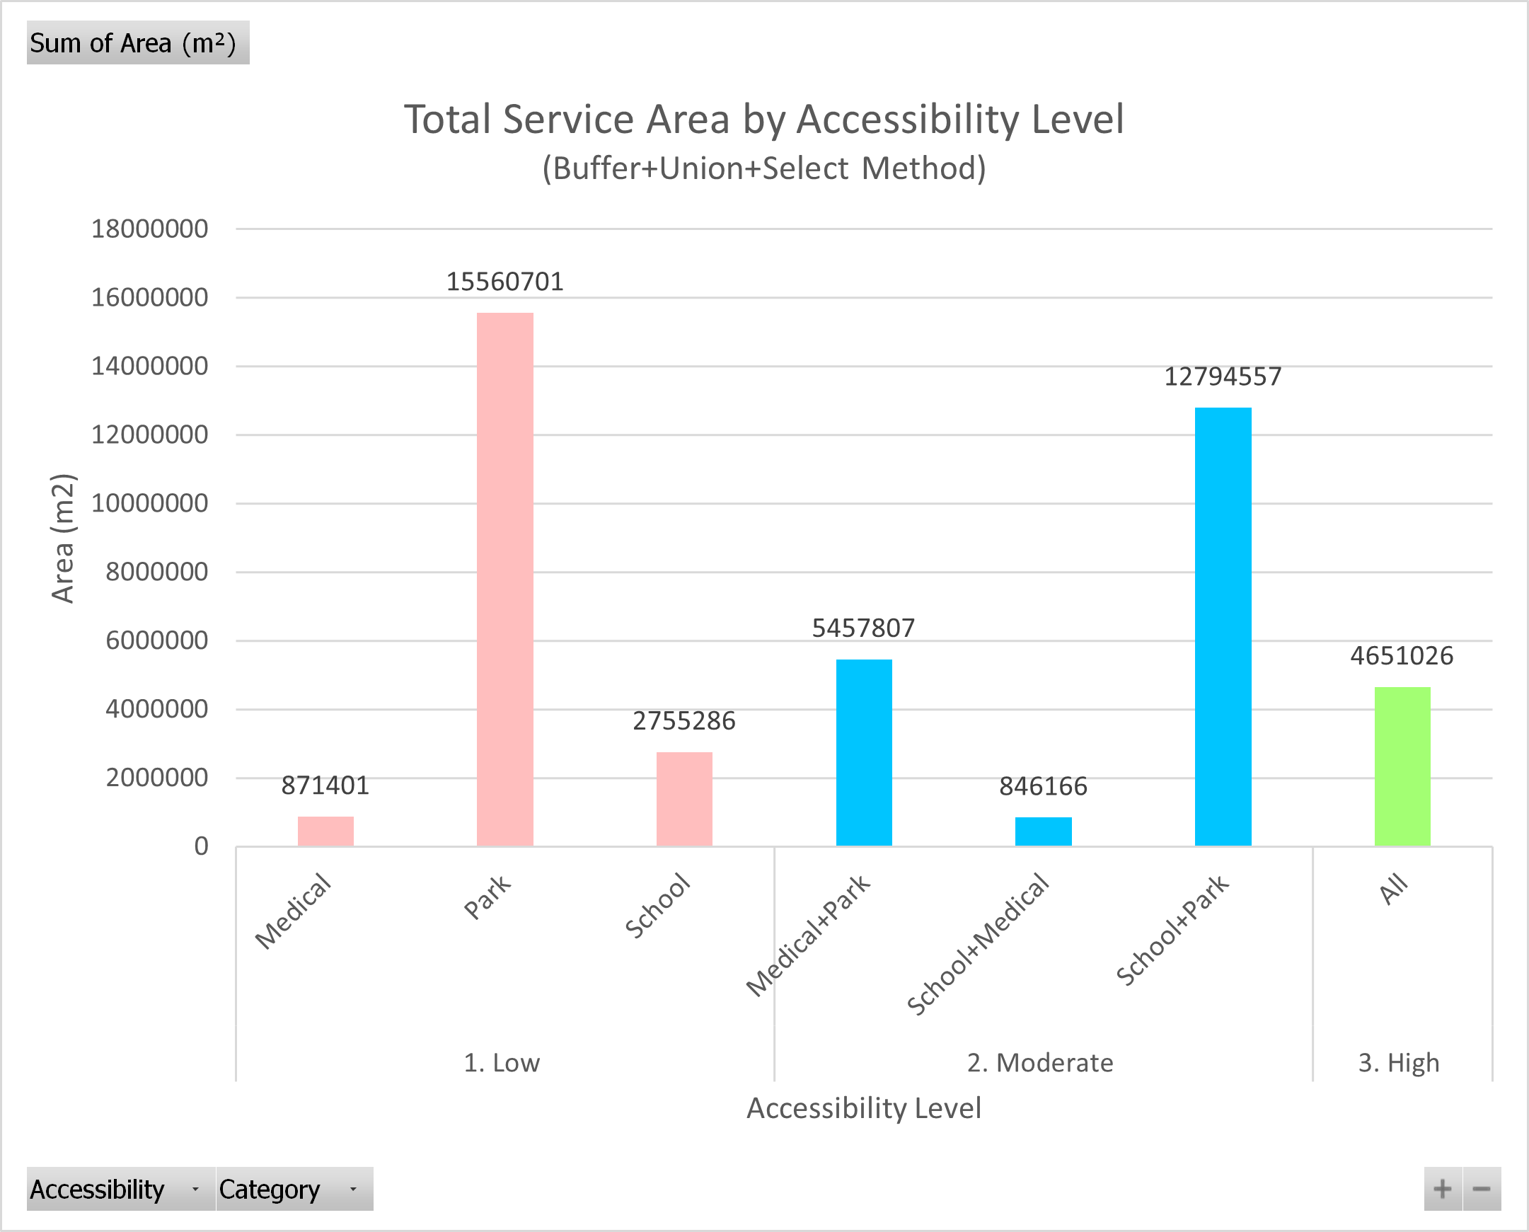
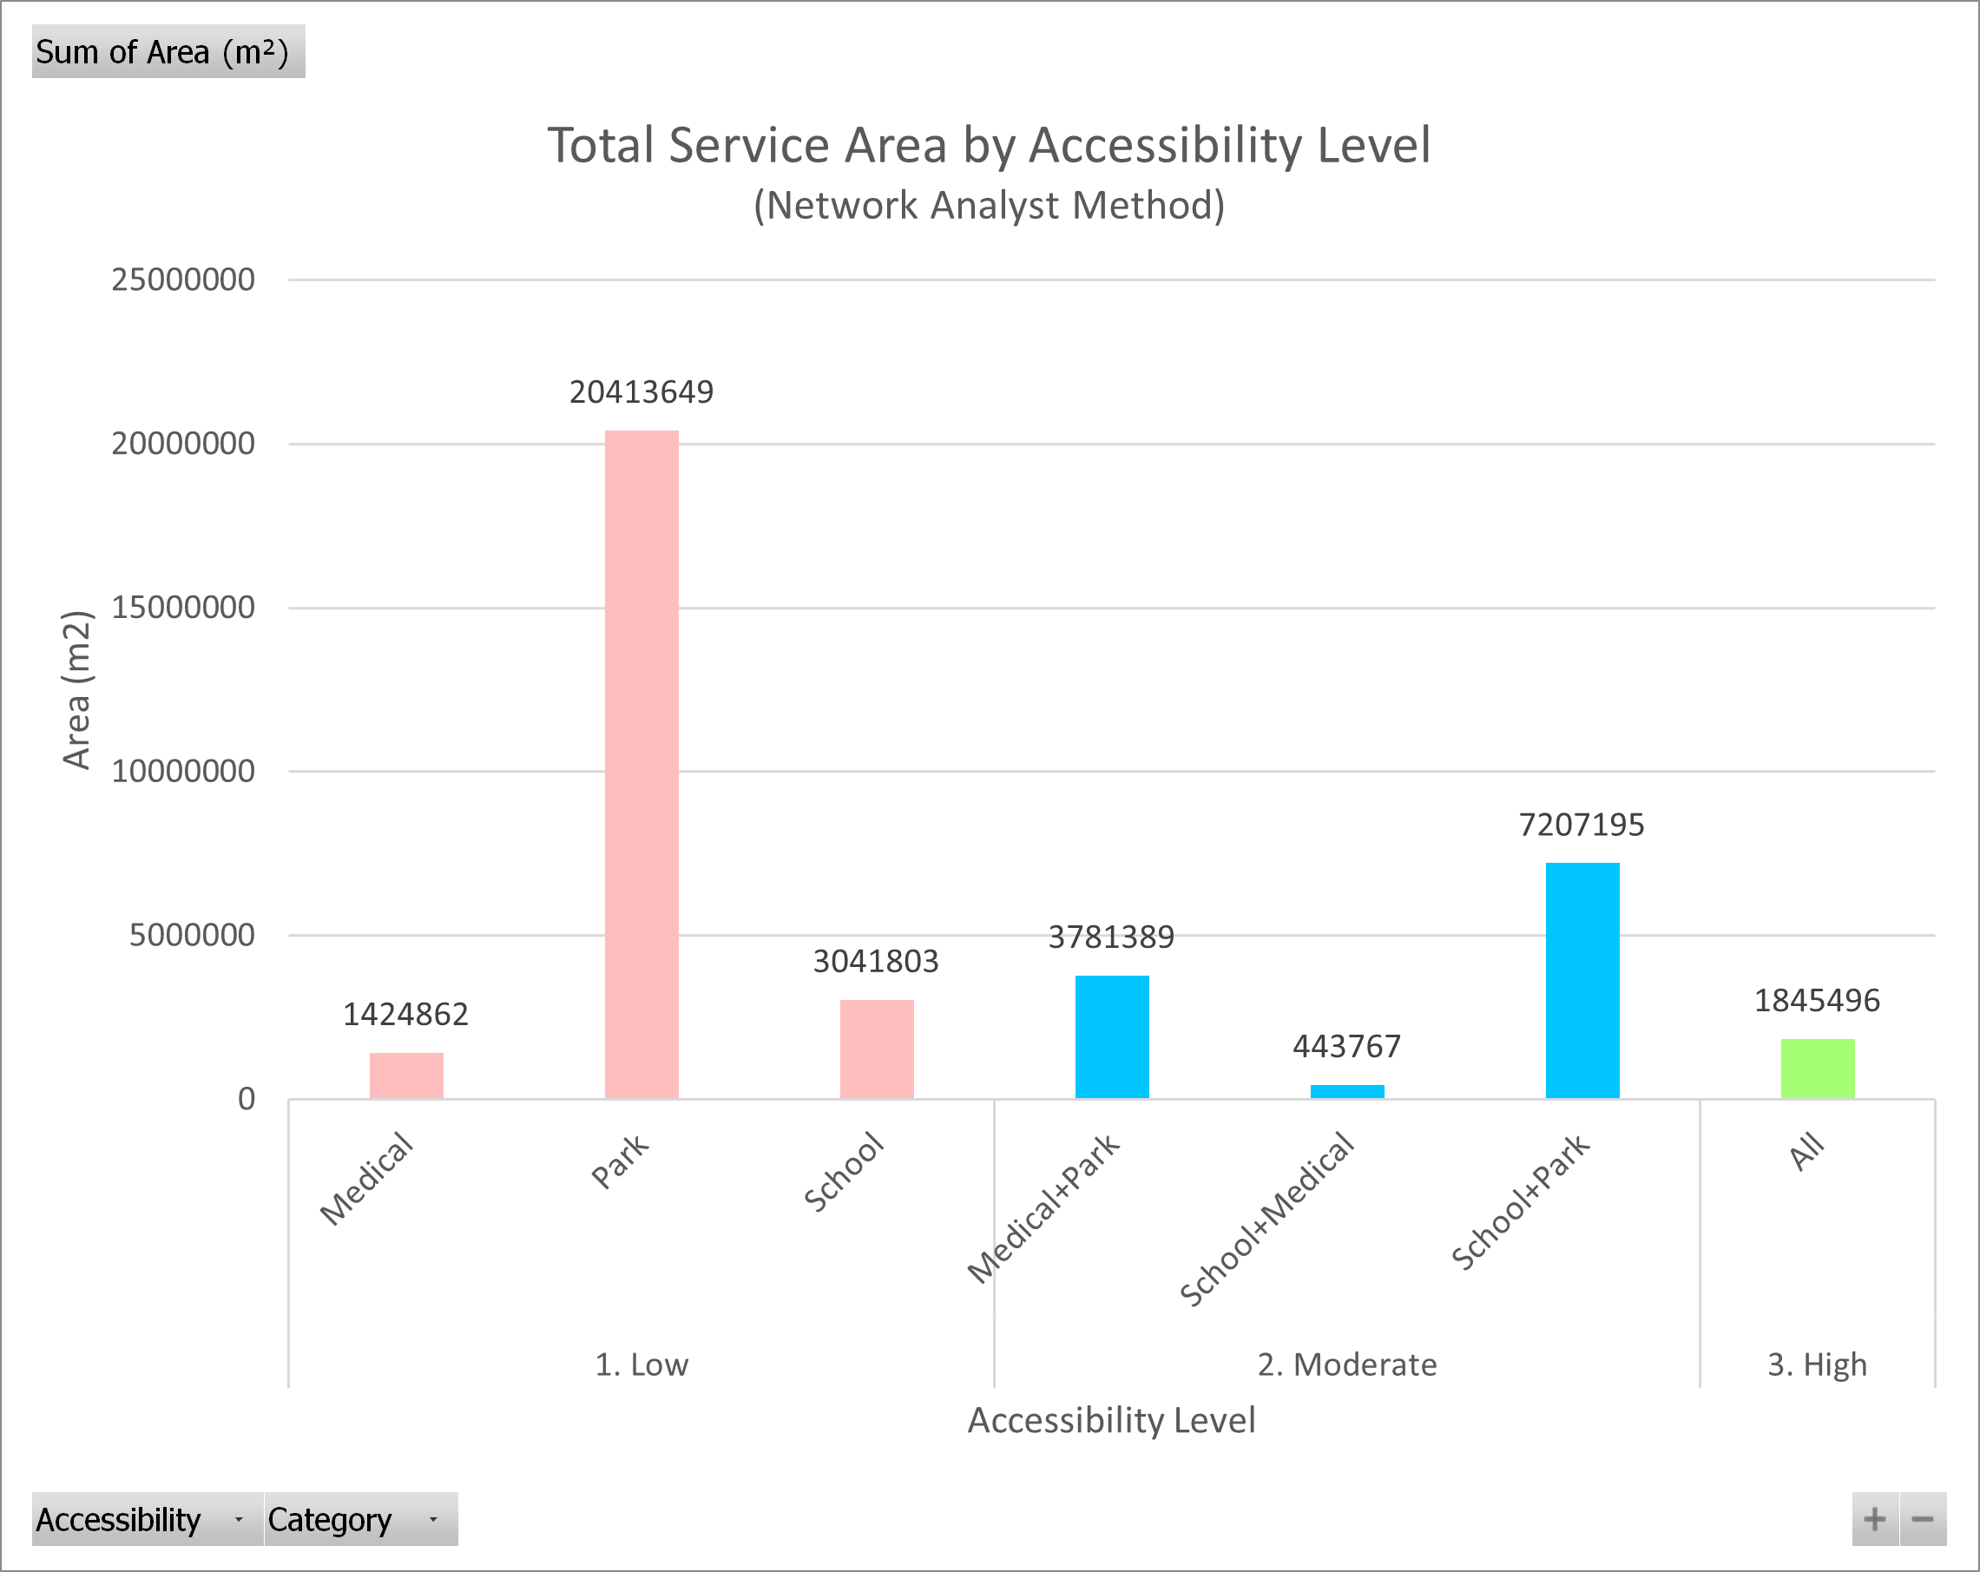
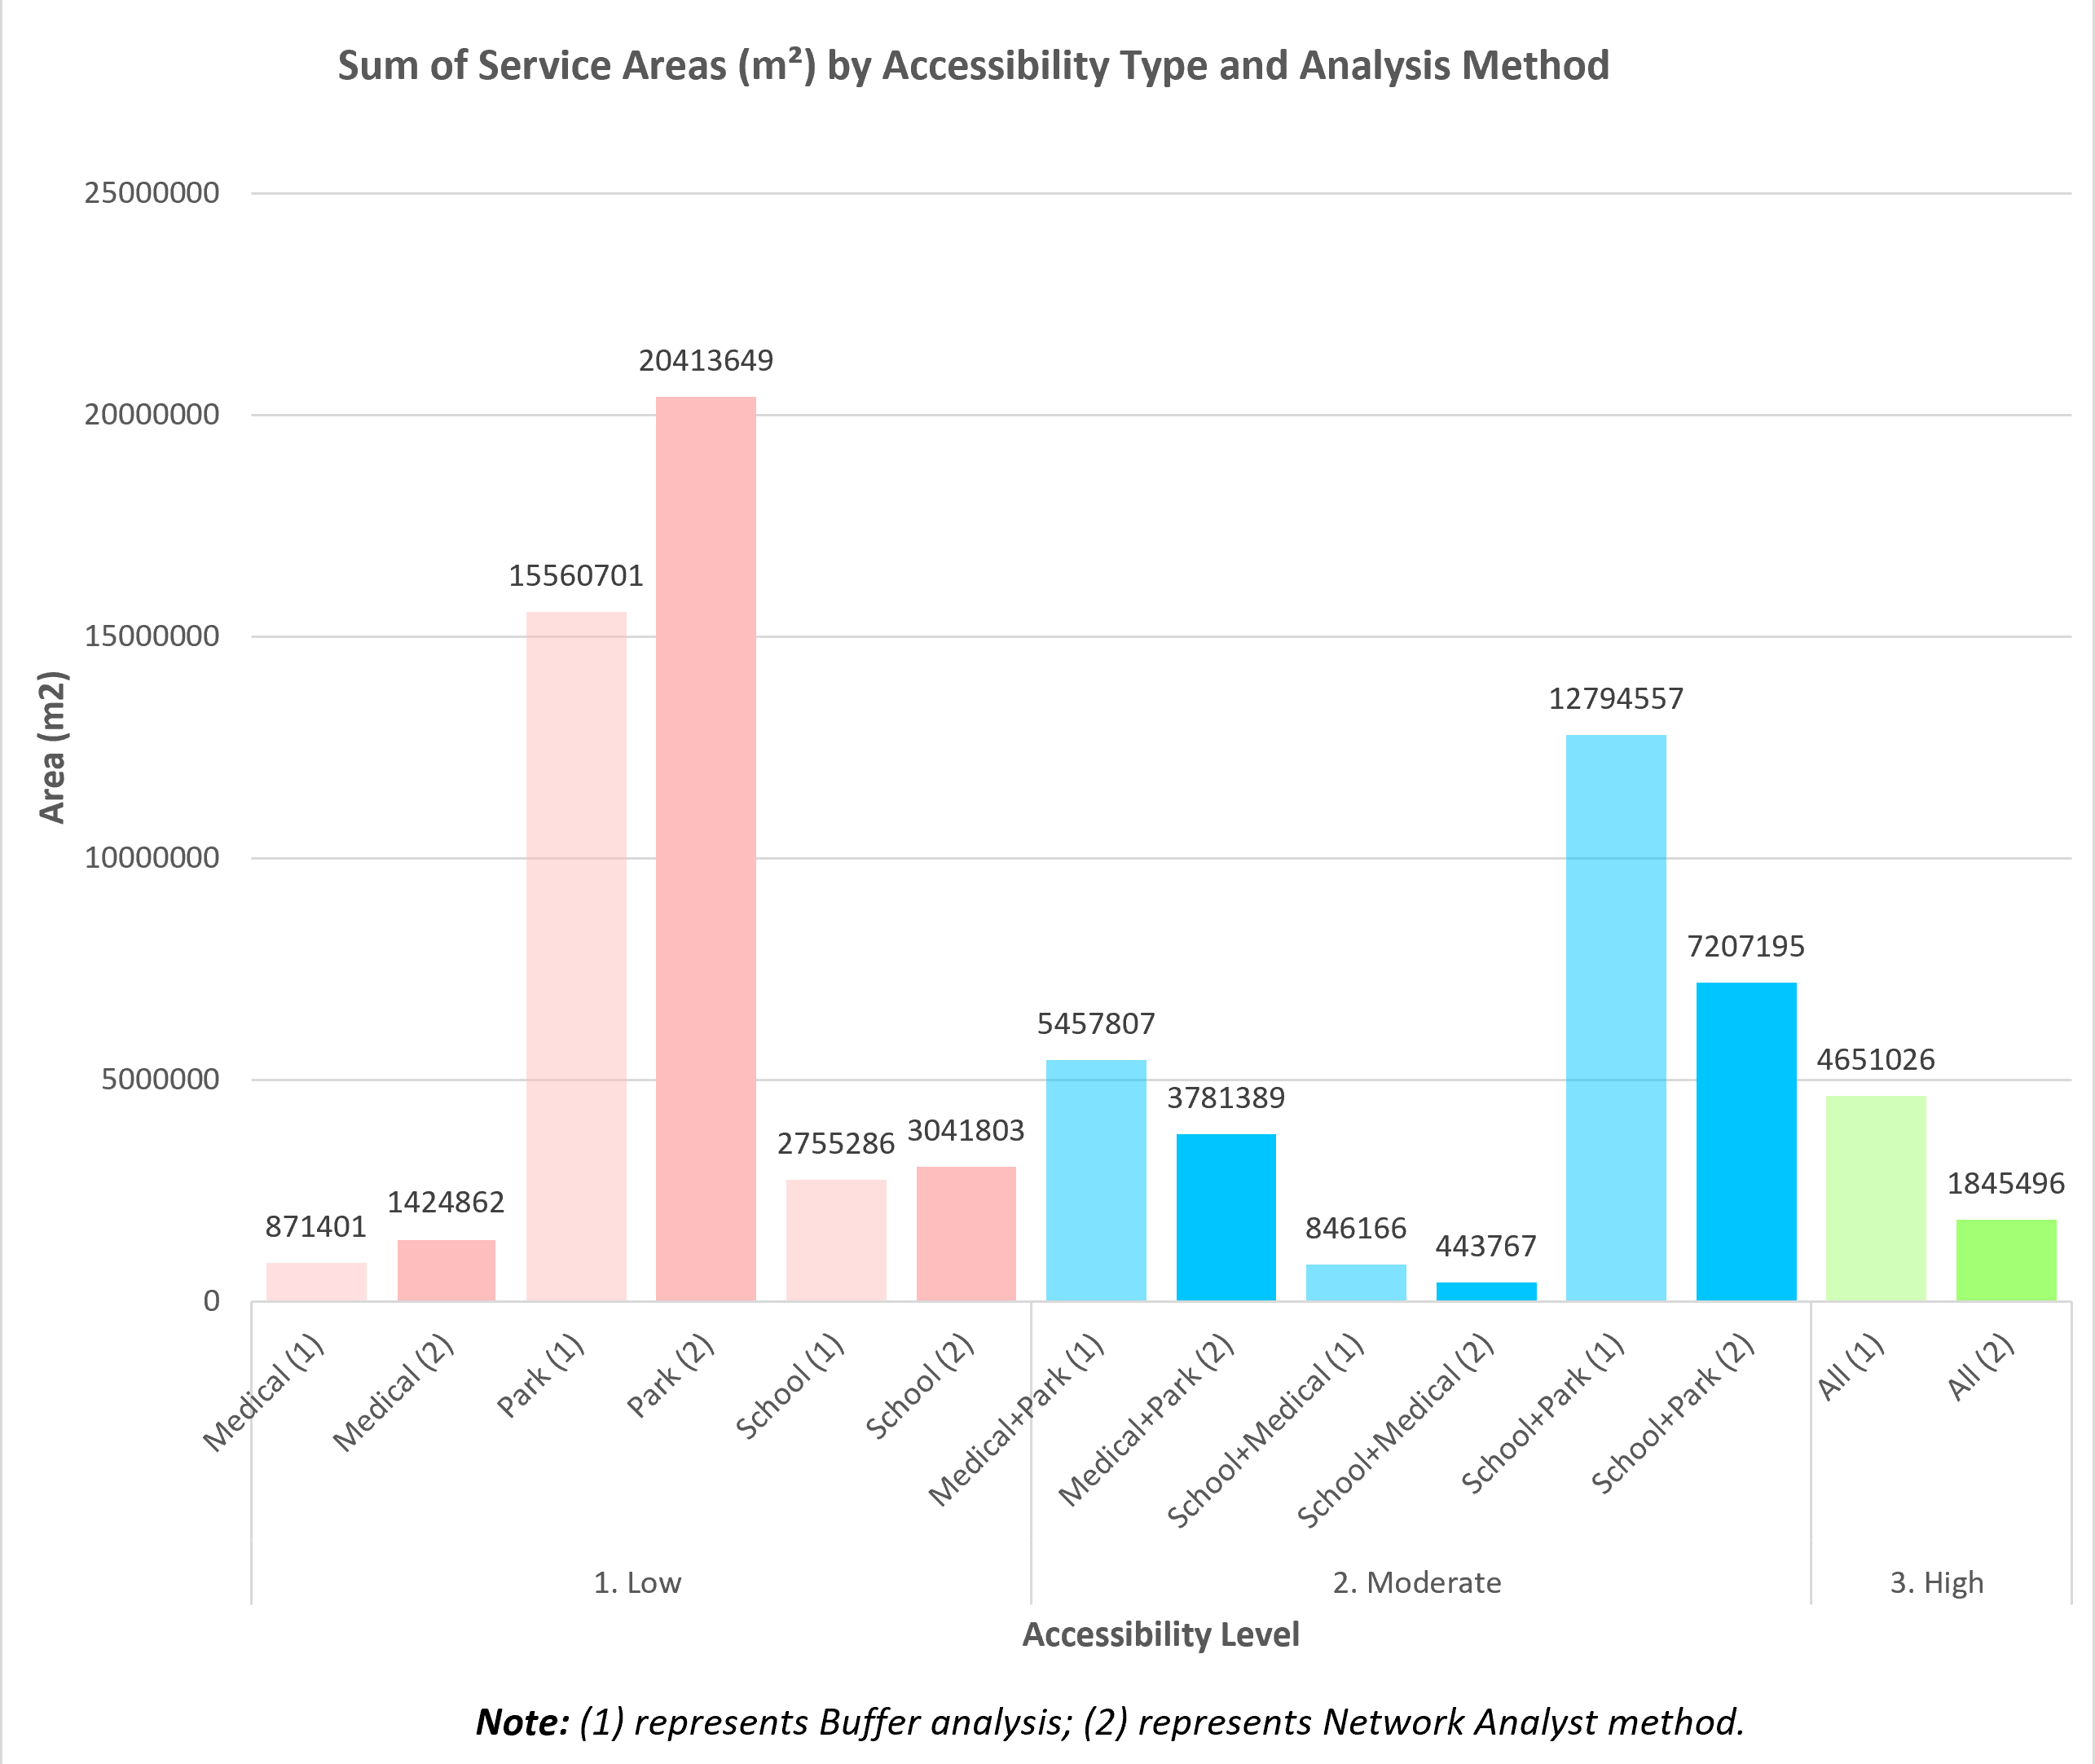
Spatial Accessibility Analysis of Public Facilities in Hamilton City
Which residential areas in Hamilton City are currently underserved by public facilities?
Introduction
Equitable access to essential public services—such as healthcare, education, and green spaces—is vital for urban well-being, especially for vulnerable populations like seniors and individuals with limited mobility. In Hamilton City, the spatial distribution of hospitals, schools, and parks is uneven, potentially leading to disparities in service accessibility across residential areas.
This project addresses the central question: Which residential areas in Hamilton City are underserved by public facilities?
To answer this, spatial analysis techniques—both Buffer and Network-based—are applied to assess accessibility patterns citywide. This project evaluates how well public facilities (schools, medical services, parks) serve residential areas in Hamilton City using Buffer and Network-based accessibility analysis.
Methodology
This project assessed accessibility to schools, hospitals, and parks using two spatial methods: Buffer and Network Analysis.
Step 1: Data Collection & Preparation
Downloaded boundary and facility datasets (schools, reserves, residential zones)
Manually geocoded hospital data from Healthpoint
Clipped all layers to Hamilton City boundary
Converted polygons (schools, reserves) to points for consistency between methods
Step 2: Accessibility Analysis • Method 1: Buffer-Based Service Area
Generated 500m Euclidean buffers for each facility type
Merged buffers using Union, and used Select by Attributes to classify zones:
Low: access to 1 facility
Moderate: 2 facilities
High: all 3 facilities
• Method 2: Network-Based Service Area
Used ArcGIS Network Analyst to create 500m network-based service areas
Followed the same post-processing steps as Method 1:
Both methods use Union + Select to define accessibility categories; the only difference lies in how the service areas are generated (Euclidean vs. Network-based).
Step 3: Result Comparison
Compared both methods in terms of area coverage and spatial distribution of accessible residential zones
Map Visualization
Map 1. Classified Residential Zones (Buffer Method)
Map 2. Classified Residential Zones (Network Method)
Limitations
No population data considered: Accessibility is measured by distance only, without accounting for population distribution or service demand.
No travel time analysis: Network results are based on distance, not actual travel time or traffic conditions.
General facility categories: No differentiation among facility levels (e.g., primary vs. secondary schools).
Previous Research
Equitable access to services like healthcare, education, and green space enhances quality of life and reduces social inequality (Wood et al., 2025; Lotfi & Koohsari, 2009; Nicoletti et al., 2022). GIS-based studies commonly apply two approaches to evaluate accessibility.
The first is buffer-based analysis, which uses fixed-distance zones to identify underserved areas. Though it lacks travel realism, it is practical for broad assessments and forms the basis for the Buffer + Union + Select method used here (Yhee et al., 2021).
The second is network-based analysis, which models actual travel paths and constraints. Studies such as Chen et al. (2022) show that this method better reflects real-world accessibility by accounting for road networks and barriers.
To balance efficiency and accuracy, this project combines both methods, providing a comparative and comprehensive understanding of public facility accessibility in Hamilton City.
Future Work
Integrate population or demand models to reflect service coverage more realistically.
Apply travel time or public transport-based network analysis.
Refine facility classification and include more facility types.
Results
Buffer Method (Figure 1): • Parks have the widest reach (15.56M m²), but high-accessibility zones only cover 4.65M m²
Network Method (Figure 2): • Real paths reduce accessible areas—high-accessibility zones drop to 1.85M m²
Comparison (Figure 3): • Network results are more conservative, reflecting real travel constraints • Largest discrepancy in medium- and high-accessibility categories
Figure 1. Accessibility Level (Buffer Method)
Figure 2. Accessibility Level (Network Method)
Figure 3. Accessibility Level (Comparison)

