Slide 1
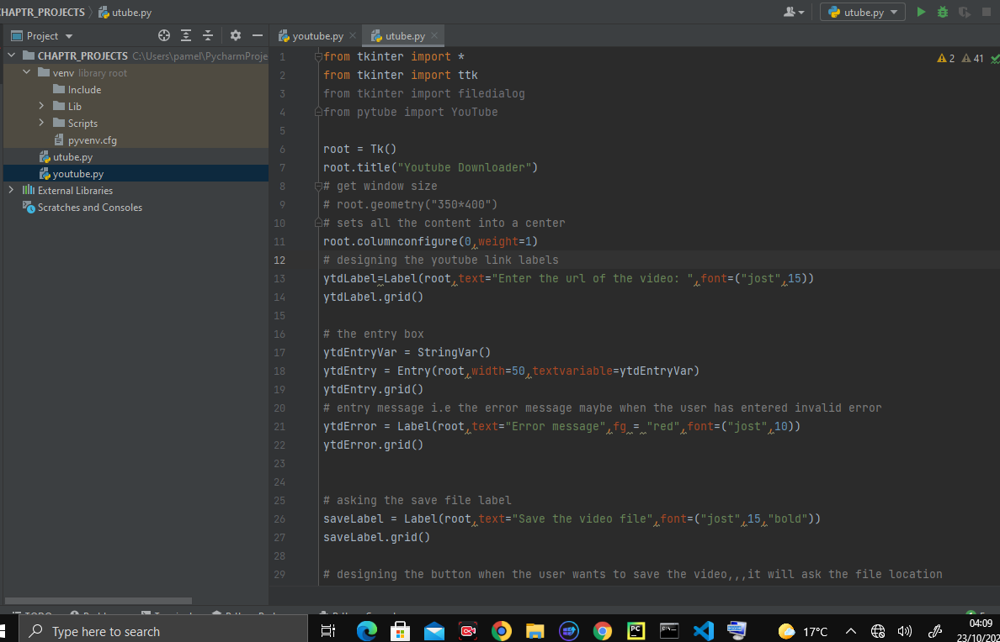

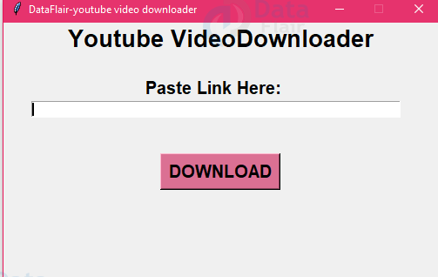


Slide 2
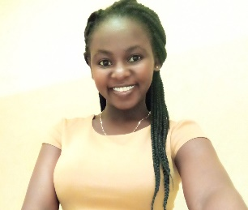

TEAM
LUCY ODHIAMBO
FELIX ONGERA MANYARA

Slide 3
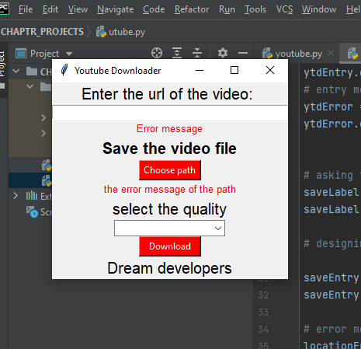
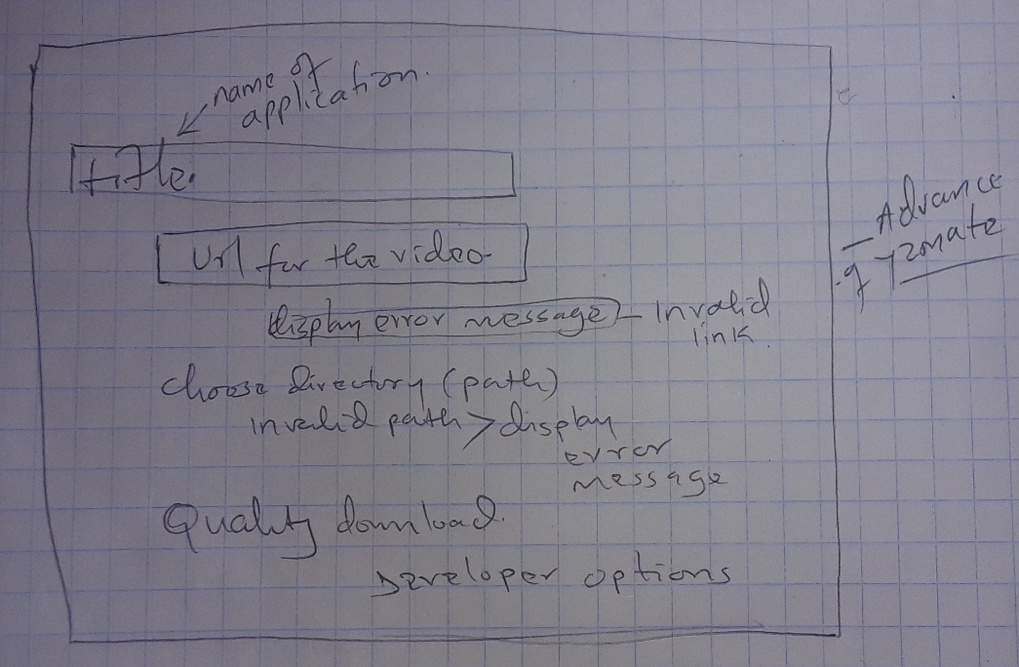

Slide 4
TECHNOLOGY USED
PYTHON LIBRARIES
TKINTER-is a standard GUI library and it is one of the easiest ways to build a GUI application.
PYTUBE- used for downloading videos from YouTube.

Slide 5
CHALLENGES
Installation of the python libraries on Vs Code editor and also on wing
SSL ERROR….while importing and installing of pytube and tkinter.

Slide 6
APPRECIATION
WE THANK THE ENTIRE CHAPTR TEAM FOR THE SUPPORT YOU SHOWED TO US TO IMPROVE ON OUR VARIOUS PROJECTS:

Slide 7


Slide 8


