Slide 1
ARNGREN.NET
REDESIGN PRESENTATION
From Chaos to Clarity: Transforming Norway's Premier DIY Destination
Presented by Aboubakar Felix Amadou

Slide 2
THE ORIGINAL SITE
arngren.net
Critical Issues Identified
15+ min
Chaotic visual layout with no hierarchy
No responsive/mobile design (70% users are mobile)
No search functionality for 200+ products
No clear navigation or category structure
No trust signals or professional branding
Average time-to-product: 15+ minutes
Average time to find a product
0%
Mobile optimization

Slide 3

TARGET AUDIENCE
Demographics
Budget: €5,000/year for DIY projects
70% mobile browsing, 30% desktop
Research sessions: 2-4 hours before purchase
Values & Needs
Quality, sustainability, and precision
Detailed technical specifications
Quick product discovery and comparison
Quote
"I'm an engineer—I need specifications, not sales pitches."
LA
Lars Andersen
38 | Civil Engineer | Bergen, Norway

Slide 4
MOOD BOARD & COPY DIRECTION
Precision
Craftsmanship
Modern
Sustainable
Purposeful
Copy Editing Approach
Visual Direction
Clear, technical product descriptions
Specifications-first content hierarchy
Norwegian/English bilingual considerations
Sustainability messaging integrated naturally
No marketing fluff- data-driven language
Scandinavian minimalism with warmth
Clean white spaces (75% of design)
Workshop-inspired earth tones
Technical precision meets craft aesthetic
8 curated mood board images

Slide 5
ART DIRECTION: COLOR PALETTE
Sustainable Teal
CTAs, eco badges (3%)
#23A792 | RGB(35, 167, 146)
Craftsman Tan
Section backgrounds (2%)
#AE9A81 | RGB(174, 154, 129)
Precision Blue
Links, interactive (5%)
#3193DA | RGB(49, 147, 218)
Workshop Charcoal
Text, headers (15%)
#413B2D | RGB(65, 59, 45)
Clean White
Primary background (75%)
#FEFEFE | RGB(254, 254, 254)

Slide 6
ART DIRECTION: TYPOGRAPHY
Headlines
36-72px
Aa Bb Cc Dd 0123
Poppins Bold
21% scan efficiency improvement
Body Copy
16px / 1.6 line
Aa Bb Cc Dd 0123
Inter Regular
414 billion Google Fonts accesses
Technical Specs
14-15px / 2.0 line
Aa Bb Cc Dd 0123
Roboto Mono
Distinguishes 1/l/I and 0/O

Slide 7
SKETCHES TO WIREFRAMES
1
2
3
4
→
→
→
Hand-Drawn
Sketches
Digital
Wireframes
Prototype
Links
Full-Color
Mockup
Pencil & paper
rough layouts
Figma with
UI kit components
Interactive
page navigation
Final design
with real content
7 pages created in Figma: Homepage | Search Results | Electric Vehicles | Product Detail | Shopping Cart | Checkout | About Us

Slide 8
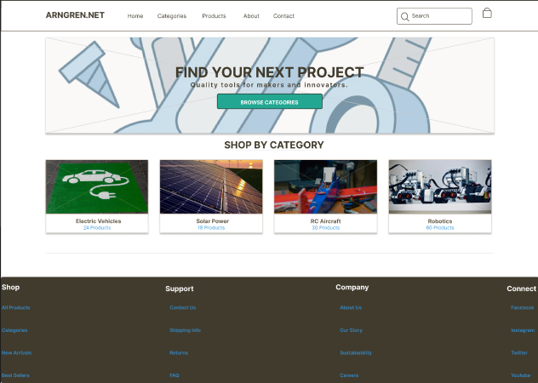
FINAL DESIGN: DESKTOP

Slide 9
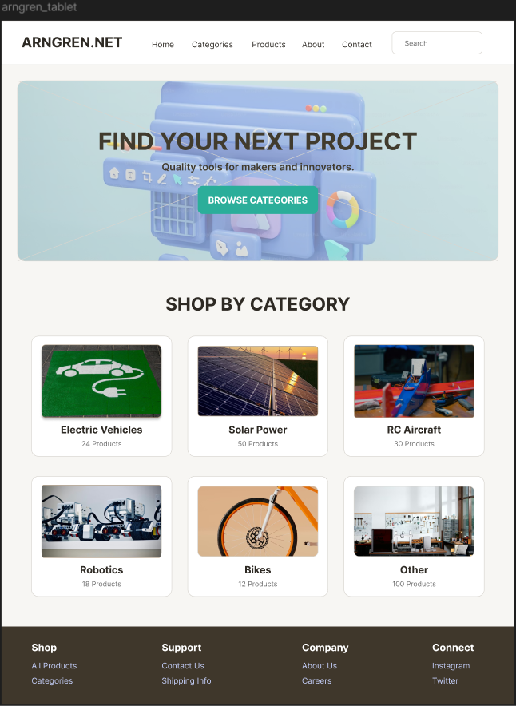
FINAL DESIGN: TABLET
Key Tablet Adaptations:
Categories: 3x2 grid (vs 4 across)
Footer: 3 columns (vs 4 desktop)
Touch targets: 44px minimum

Slide 10
USER INTERFACE & AUDIENCE
1
Prominent Search
2
Technical Specs
3
Filter Sidebar
Lars needs speed; search bar is front and center on every page
Roboto Mono displays specs (750W/48V) for engineer comparison
Supports Lars's 2-4 hour research sessions with Price/Power/Battery filters
4
Mobile-First Grid
5
Eco-Friendly CTAs
6
White Space (75%)
70% of browsing is mobile, responsive grid adapts from 4-col to single-col
Teal buttons signal sustainable choices, aligning with Lars's values
Scandinavian clarity reduces cognitive load from current chaotic site

Slide 11
BEFORE vs. AFTER
BEFORE
AFTER
Chaotic layout, no visual hierarchy
No mobile responsiveness
15+ minutes to find products
No search or filters
No branding or trust signals
No checkout flow
Clear 3-level visual hierarchy
Responsive: Desktop + Tablet + Mobile
Under 3 minutes to find products
Search + filter sidebar with specs
Professional 5-color brand palette
Full cart-to-checkout user flow

Slide 12
FINAL THOUGHTS
The Arngren.net redesign transforms a chaotic product catalog into Norway's premier DIY destination. By centering every decision around our target user Lars, his need for speed, technical specifications, and sustainable values, we created a design system that is both beautiful and functional.
The 5-color palette, 3-font hierarchy, and 8-point grid system ensure consistency across all devices while reflecting Scandinavian design principles of clarity and purposeful simplicity.
Ready for development approval.
Arngren.net | Aboubakar Felix Amadou | 2026

