Slide 1
Crowds In A Polygon Soup
Next-Gen Path Planning
David Miles
3/23/2006
Copyright 2006 BabelFlux LLC

Slide 2
“Large-Scale Fluid AI Navigation in Complex, Changing Worlds”
Build a “usable free space” nav graph
Update graph for dynamic obstacles
Use graph for fluid navigation

Slide 3
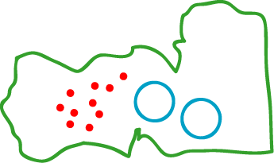
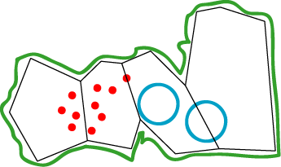
1. Building the Nav-Graph
Automated Build Process
Large, Complex Worlds
Polygon Soup Mesh
Multiple Unit Sizes

Slide 4
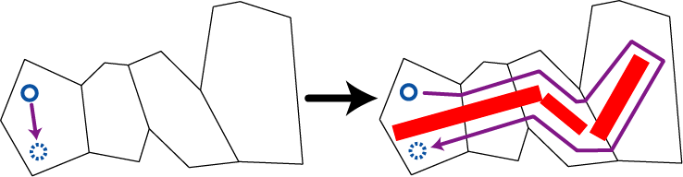
2. Dynamic Obstacle Updates
Obstacles reconfigure the world
Dynamic areas replace static areas
Underlying algorithms work exactly as before

Slide 5
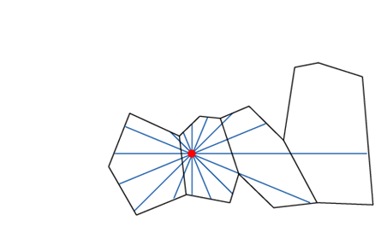
3. Fluid AI Navigation
Fast ray casts
Edge detection
Potential Fields
Path Following

Slide 6
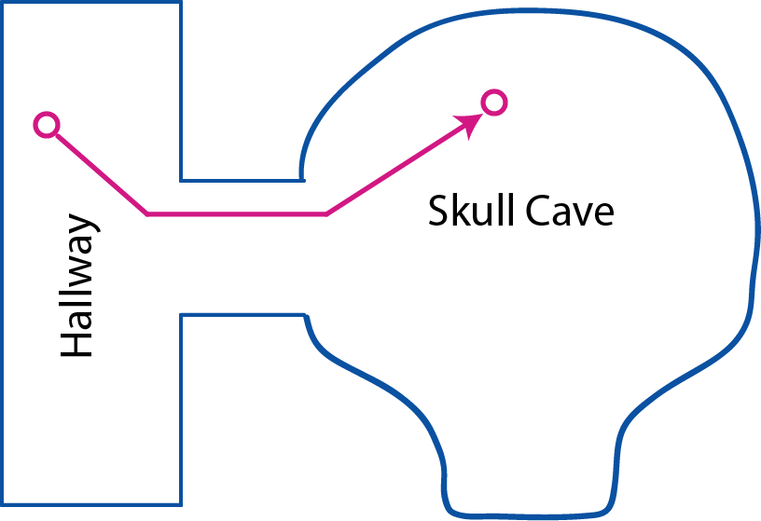
Automated Build Process

Slide 7
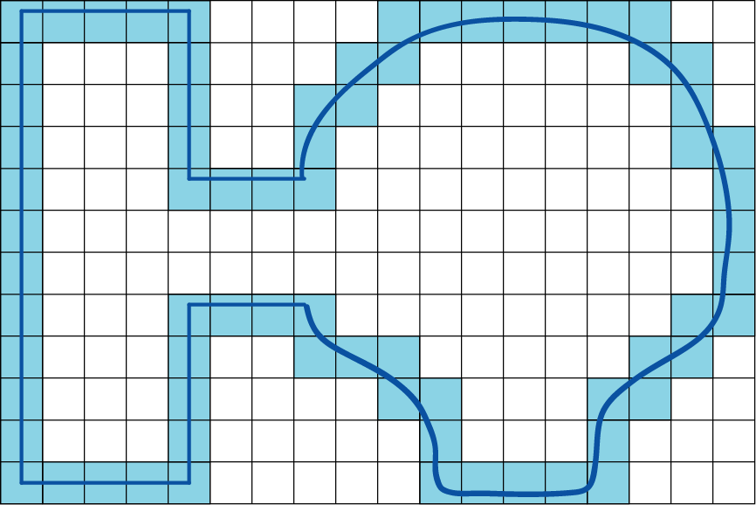
1. Voxelize Polygon Soup

Slide 8
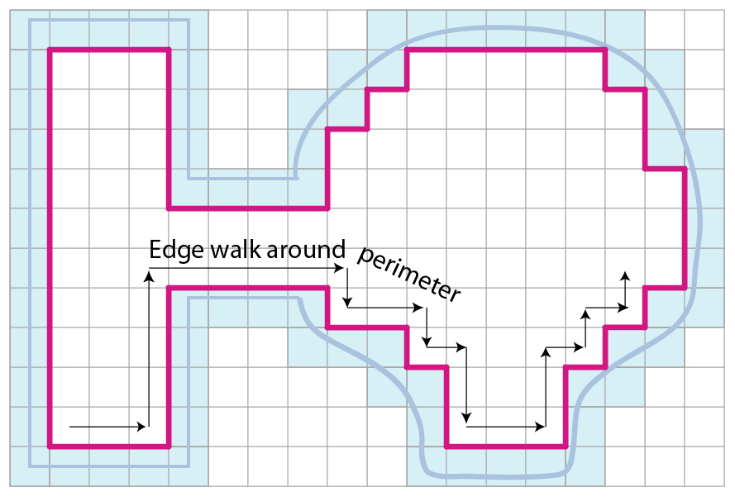
2. Extract Edge

Slide 9
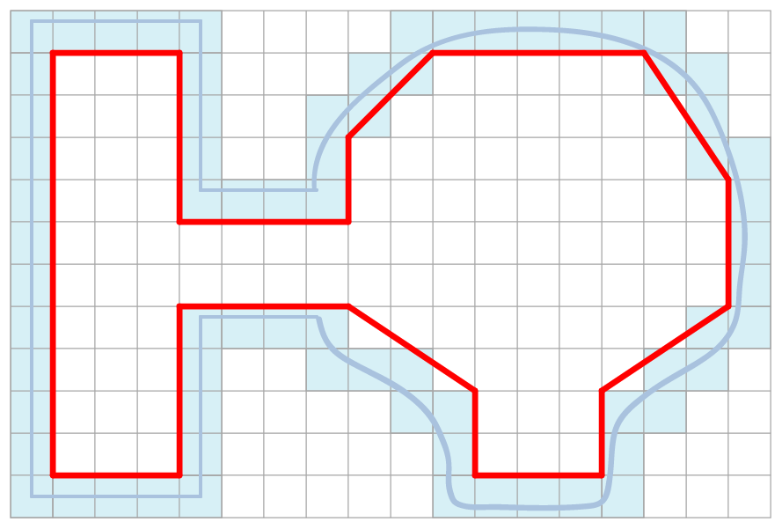
3. Simplify Polygon

Slide 10
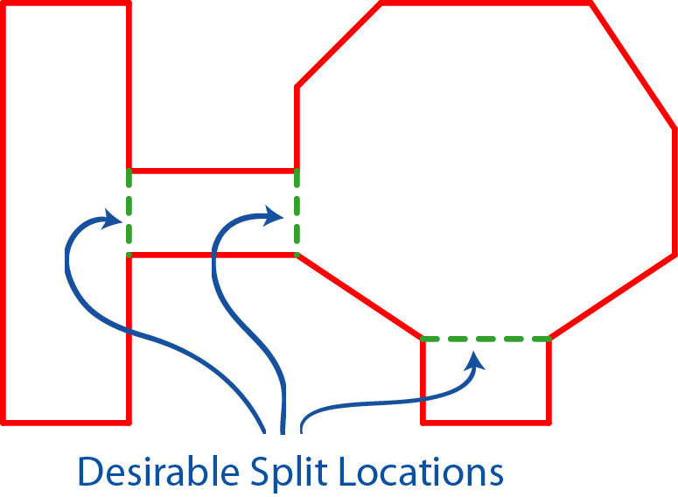
4. Partition Into Convex Areas

Slide 11
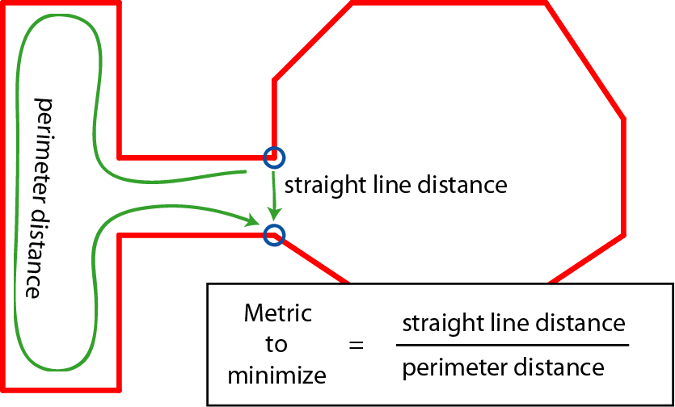
Convex Partitioning

Slide 12
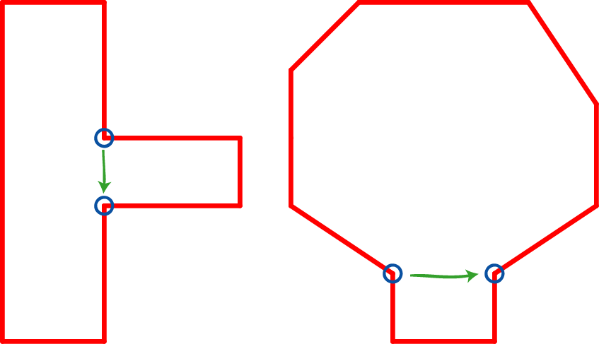
Recursively Partition

Slide 13
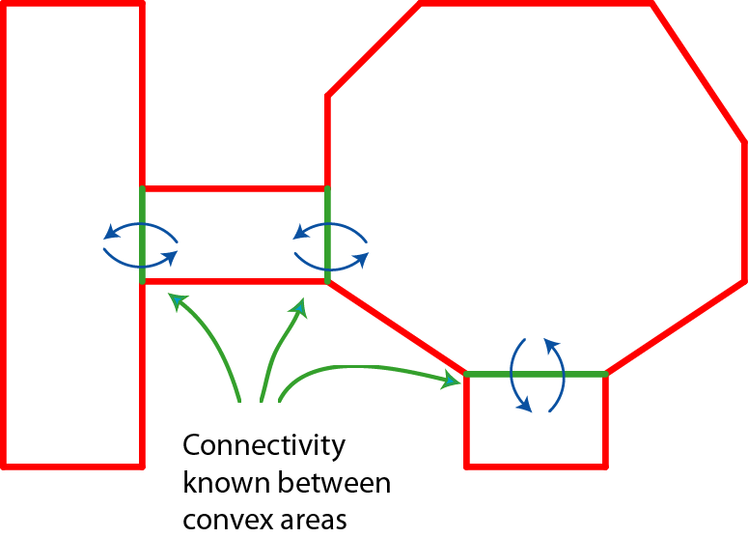
Convex Area Graph Complete

Slide 14
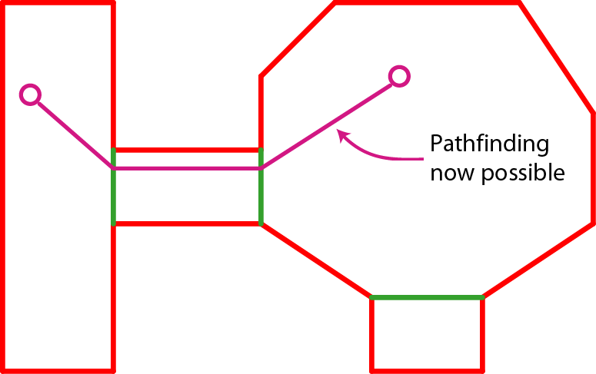
Pathfinding

Slide 15
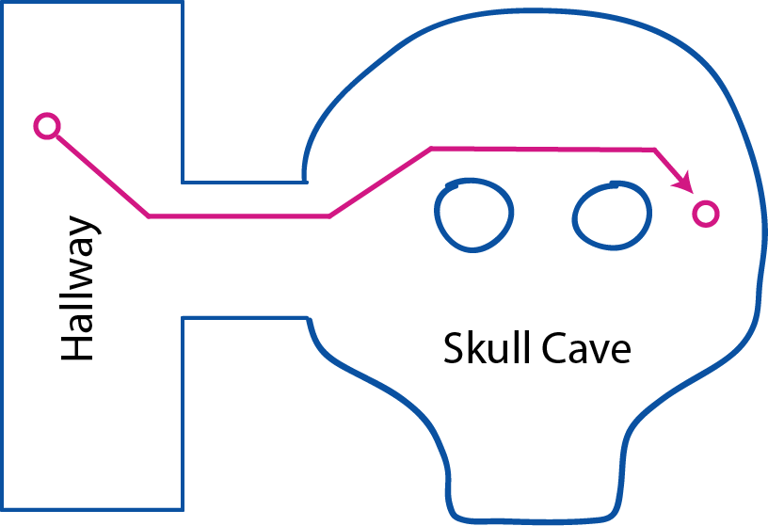
Holes in the Free-Space

Slide 16
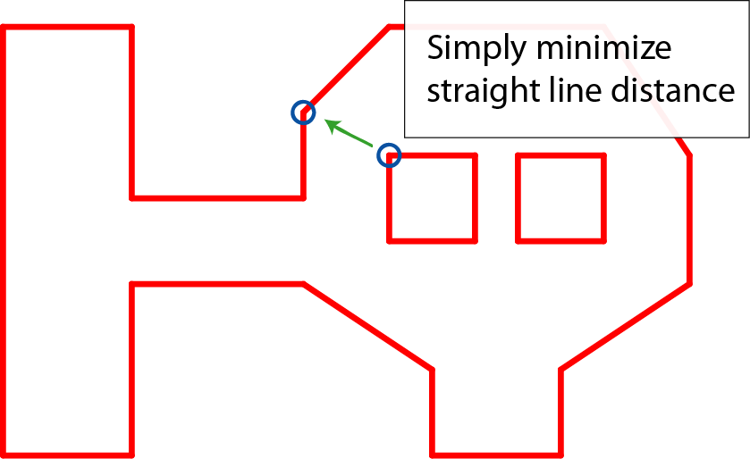
Splice Location

Slide 17
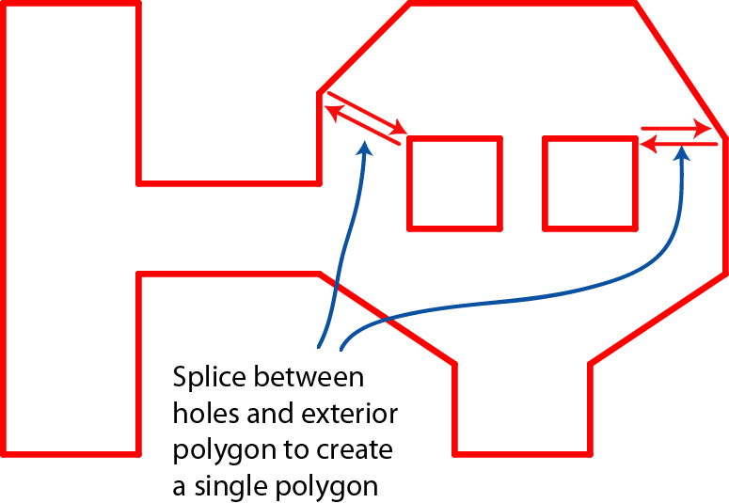
Add Splice Segments

Slide 18
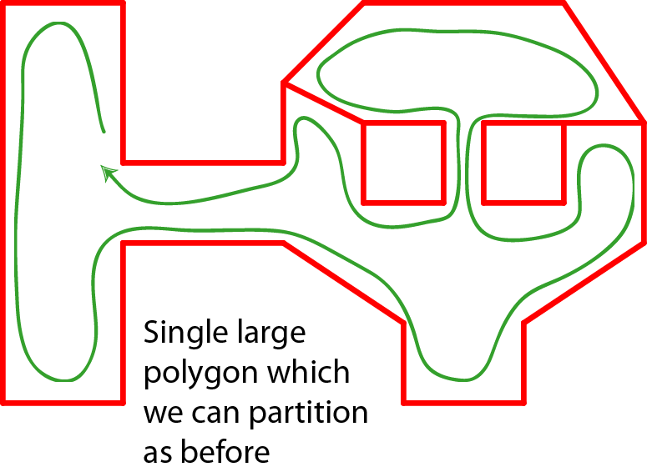
Single Polygon Surface

Slide 19
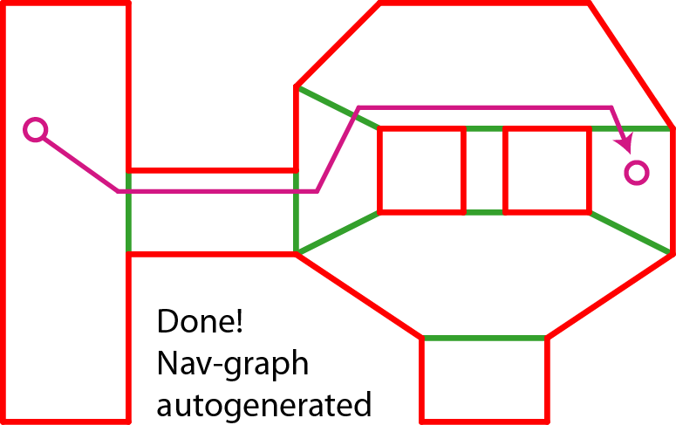
Convex Area Graph Complete

Slide 20
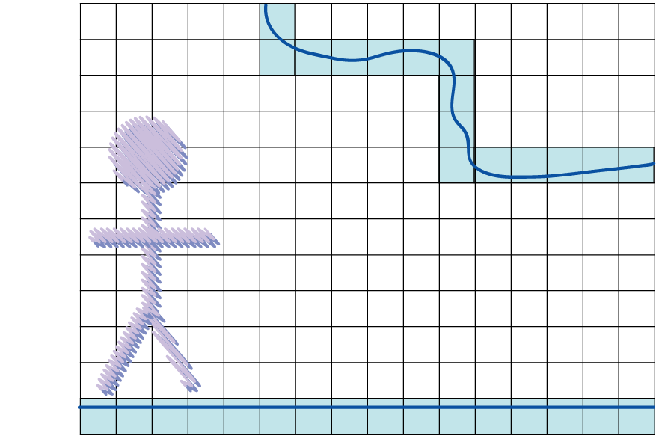
Overhead Obstacles

Slide 21
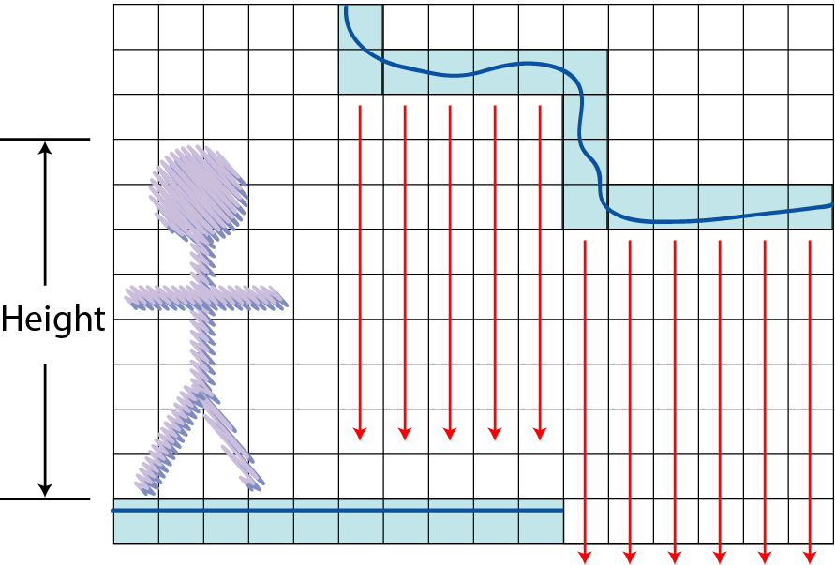
Walkable Surface Removal

Slide 22
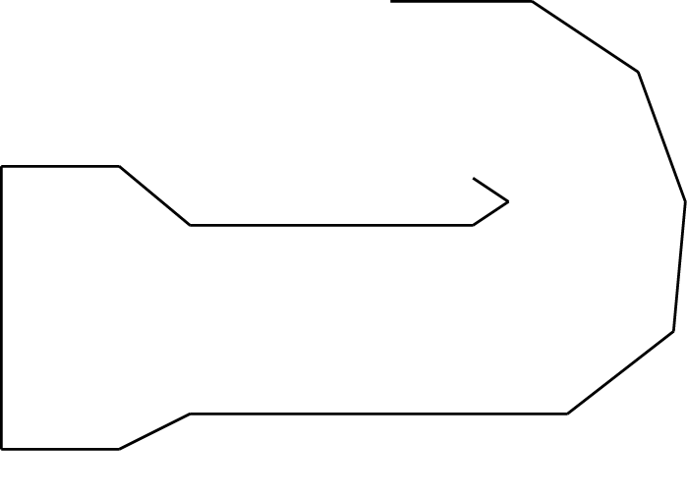
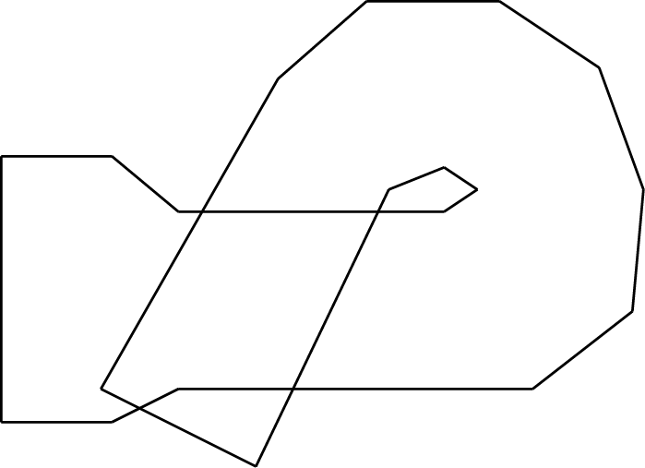
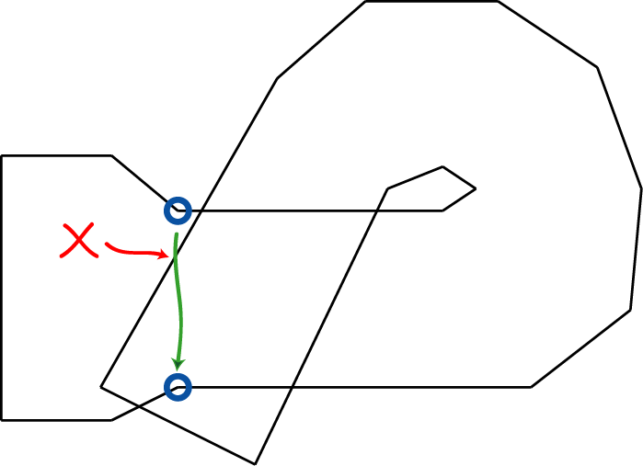
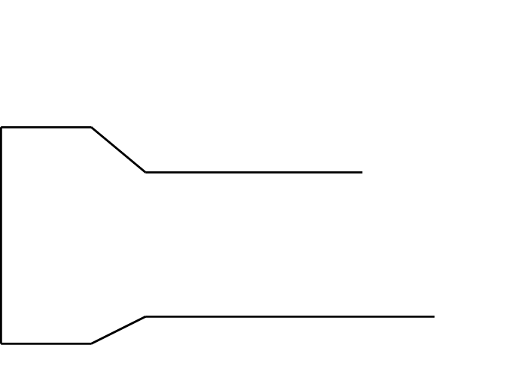
3d overlap

Slide 23
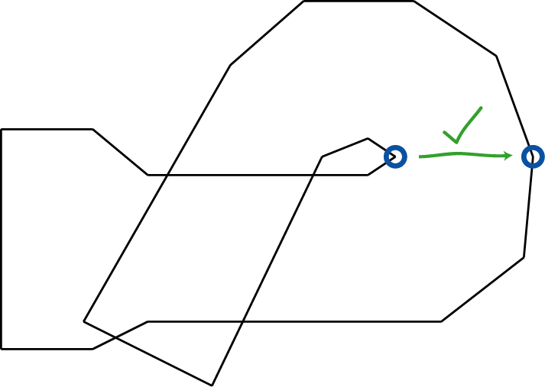
3d Partitioning

Slide 24
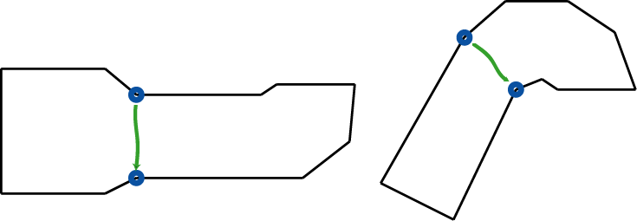
3d Partitioning
After initial split, overlap no longer exists

Slide 25
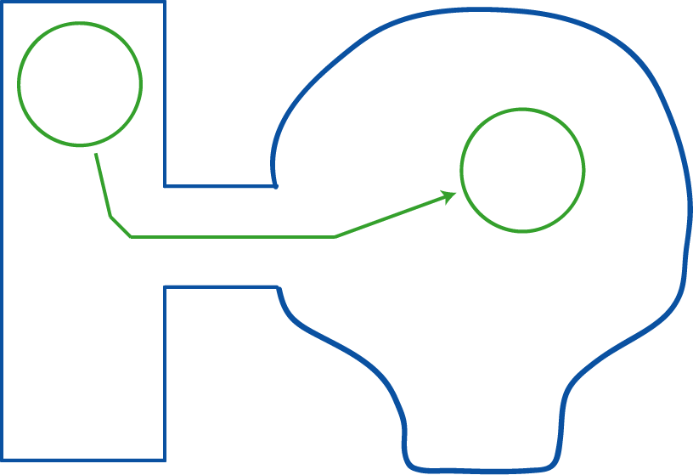
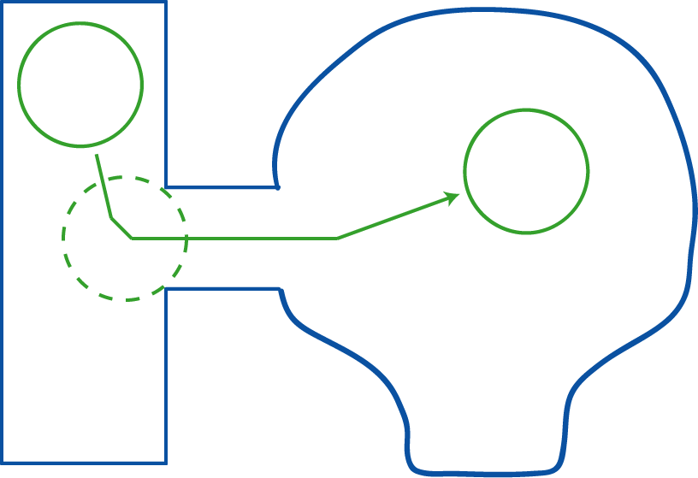
Different Creature Shapes

Slide 26
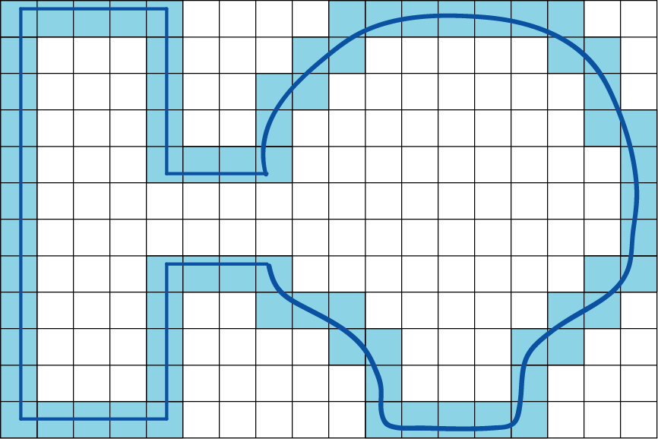
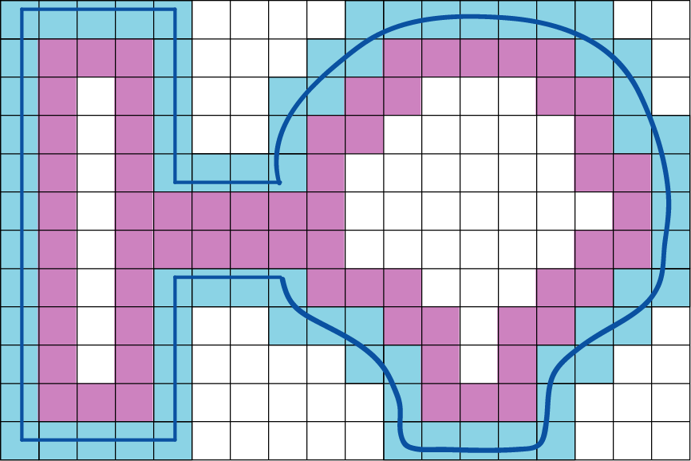
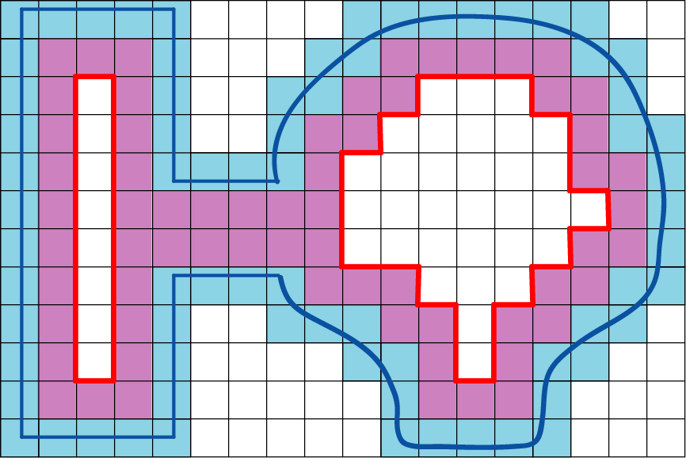
Different Creature Shapes

Slide 27
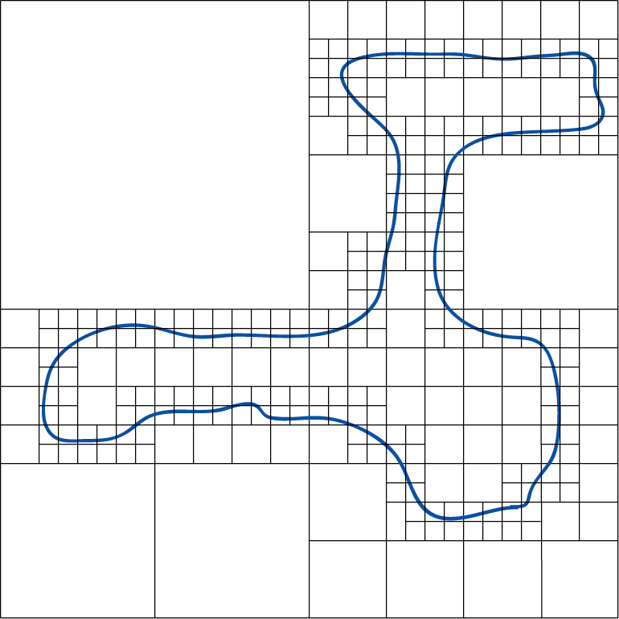
Non-Uniform Voxelization

Slide 28
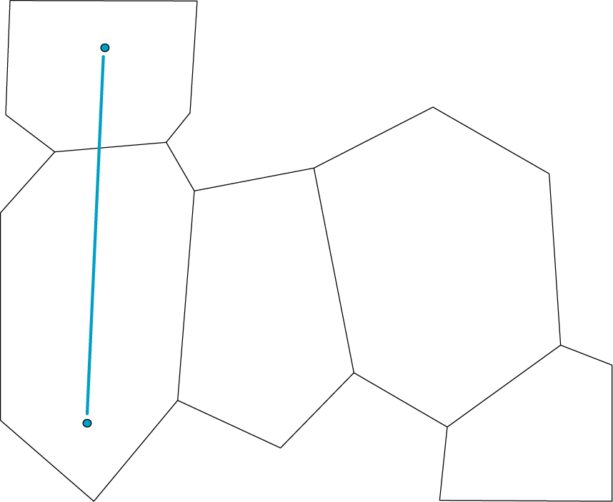
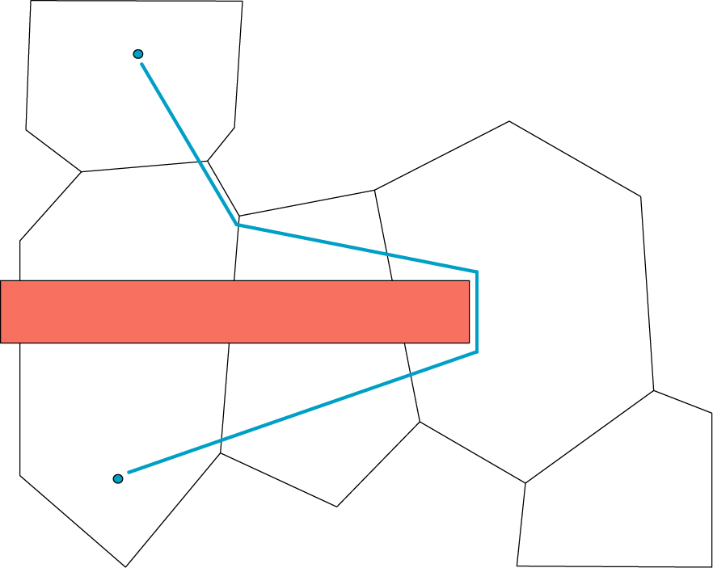
Part2: Dynamic Obstacles
Dynamic obstacles reconfigure world
Underlying algorithms unchanged

Slide 29
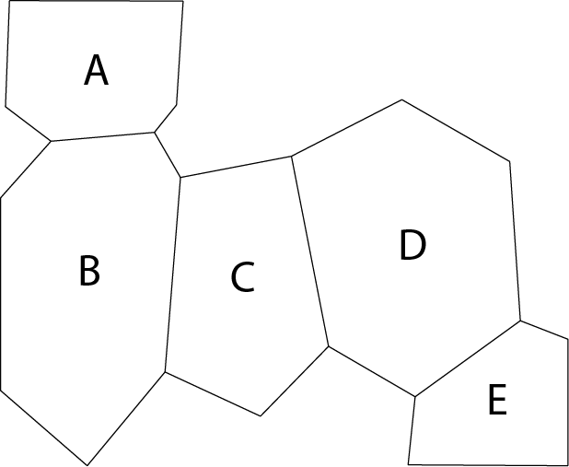

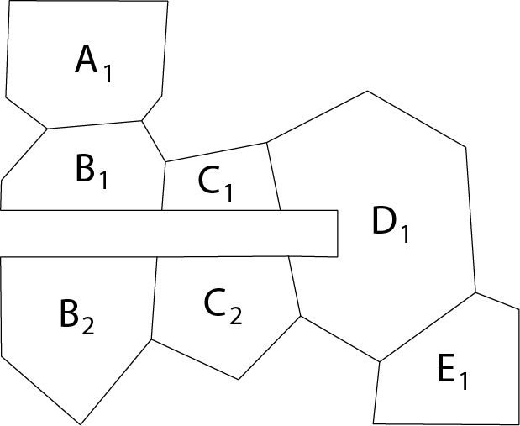
Boolean Subtract
-
=

Slide 30
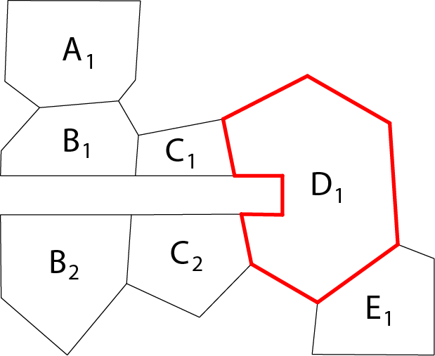
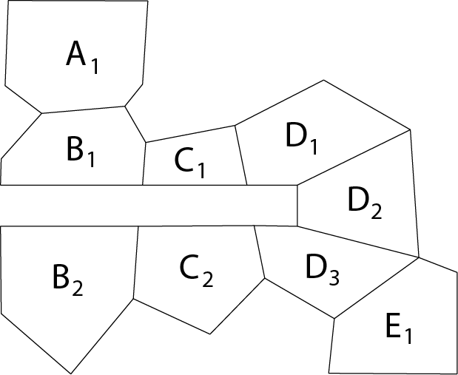
Partition Non-Convex Areas

Slide 31
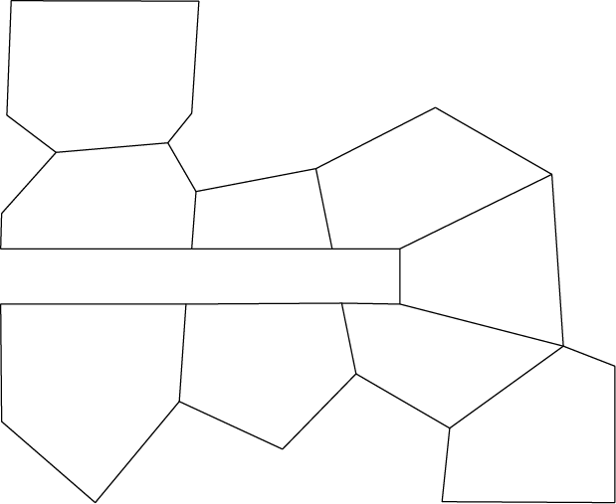
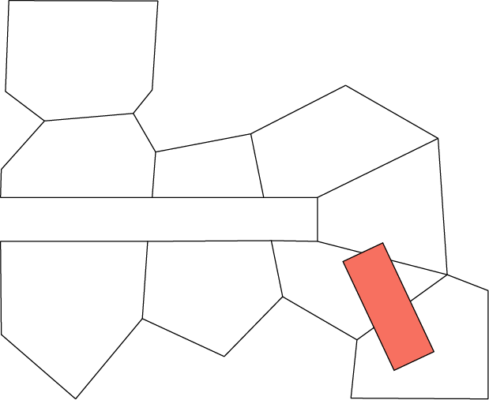
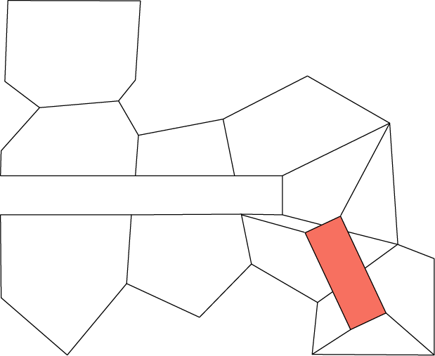
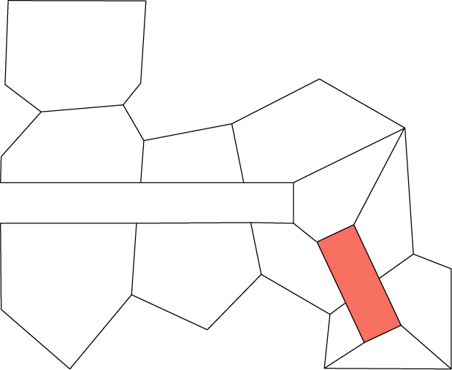
Multiple Obstacles

Slide 32
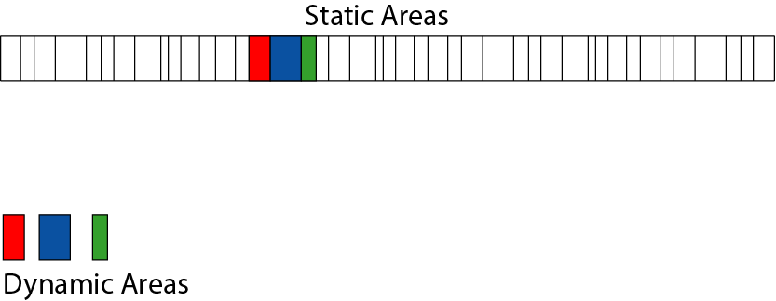
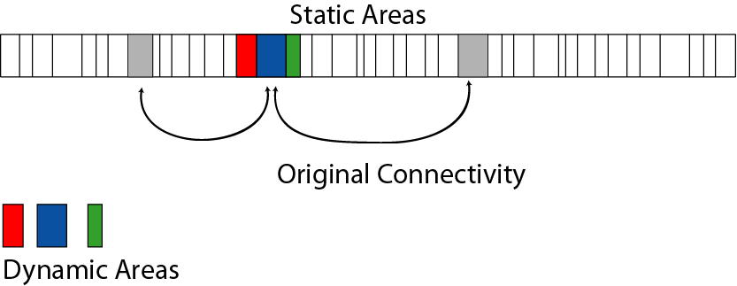
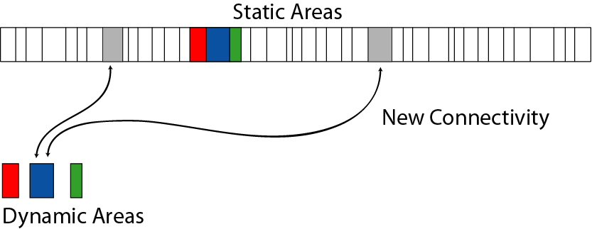
Memory Layout

Slide 33
Part3: Fluid AI Navigation
What can I do with my convex area graph?
  Very fast navigational ray-casts
  Distance to edge queries
  Repulsion fields on edges
  Smart path following

Slide 34
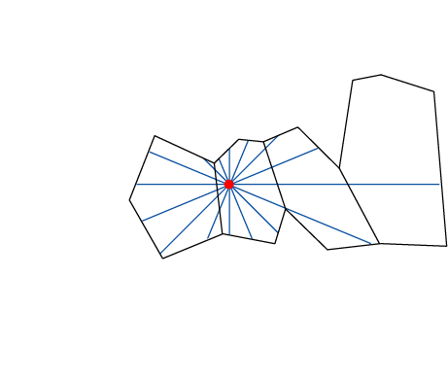
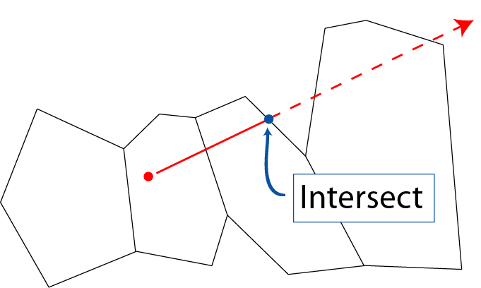
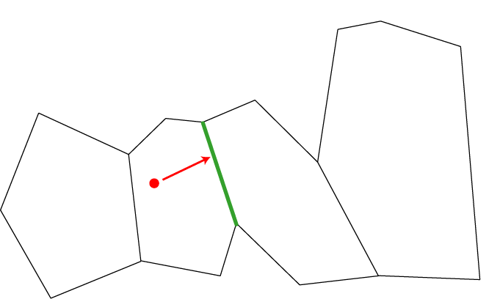
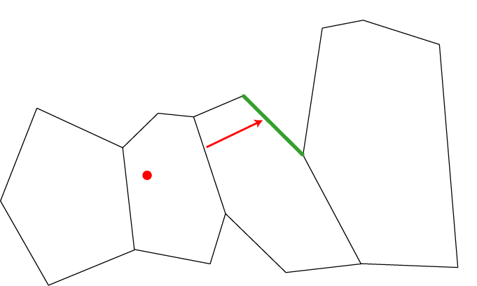
Ray Casts

Slide 35
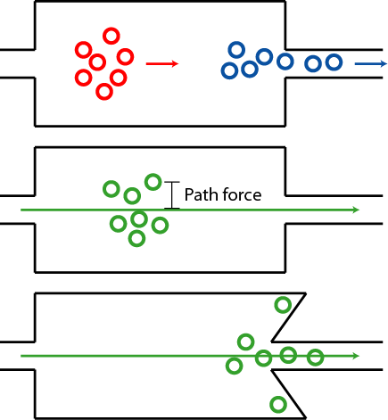
Smart Path Following
Desired flocking behavior
Common approach attracts each flock member to the minimum distance path. Does not adapt to available freespace.
Repulsion from edges can easily trap individuals in local minima.

Slide 36

For The Pathing Connoisseur
Unneeded return to
the original path
annoys the pathing
connoisseur
Ahhh, much better

Slide 37

Next Corner
Each member of the flock steers left
or right to head towards the “next corner”.

Slide 38

Finding the Next Corner

Slide 39

“Portals” Between Areas

Slide 40

Initializing the Loop

Slide 41

First Iteration, Left Side

Slide 42

First Iteration, Right Side

Slide 43

First Iteration Complete

Slide 44

Second Iteration, Left Side

Slide 45

Second Iteration, Right Side

Slide 46

Second Iteration Complete

Slide 47

Third Iteration, Left Side

Slide 48

Final Output

Slide 49
“Next Corner” Summary
Easy to compute from convex graph
< 2 cross-products per iteration
Can limit iterations
Never explicitly create min-dist path
Fluid path following even with large disturbances

Slide 50
Conclusions
Automated build of convex area graph
  efficiently represents the usable free space
  operates on polygon soup mesh
  settable enemy size and shape
Dynamic obstacles update graph
  no speed overhead once updated
Fluid AI navigation using the graph
  Many useful queries performed rapidly

Slide 51
Special Thanks
Meilin Wong
Hong Park and David Modiano
Crystal Dynamics
dmiles@navpower.com
www.navpower.com

