Slide 1
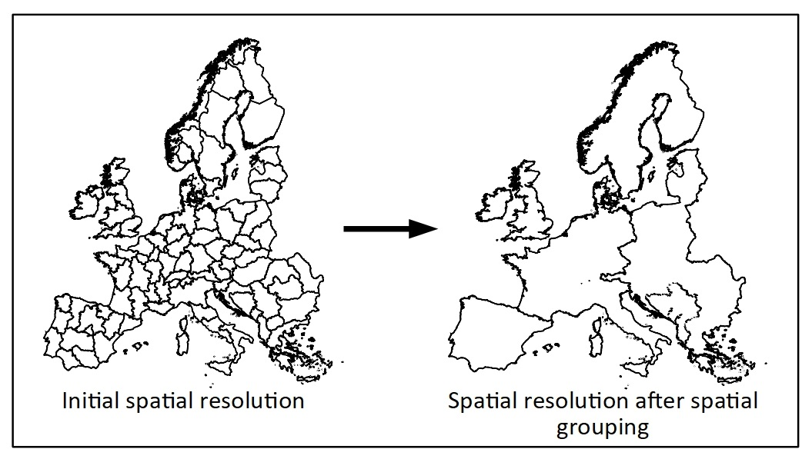
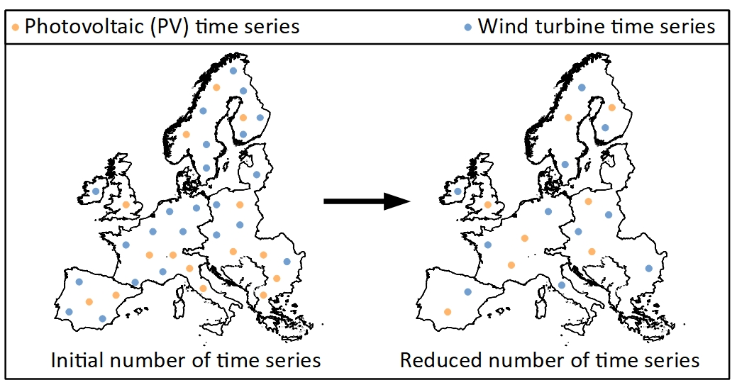
Introduction to FINE spatial_aggregation branch [ SPAGAT ]
Grouping
SPAGAT - Toolchain to spatially aggregate the regions and the supply time series
within each region, now being embedded into FINE
Two parts – Spatial grouping and spatial representation
Status Quo of the Code - In FINE spatial_aggregation branch
Grouping
Representation
Input | Option
region IDs ['01_es', '02_es', '01_de', '02_de', '03_de'] | String-based
Centoids of each region geometry (Coordinates) | Distance-based
Xarray dataset [has 1 wind turbine, 1 PV.. In each region] | Data-based
Dict from grouping results Xarray dataset [has 1 wind turbine, 1 PV.. In each region] | Aggregates data within each newly formed region group (Uses simple techniques like mean, sum, etc.,) | Aggregated Xarray dataset
OUTPUT FROM GROUPING: Dict showing merged regions list
Status Quo of the Code – Representation of RE time series
Xarray dataset
Several wind turbine and PV time series per region
Representation
Xarray dataset
Several (but reduced number of) wind turbine and PV time series per region
Input
Output
07.12.2020 | SHRUTHI PATIL

