Slide 1
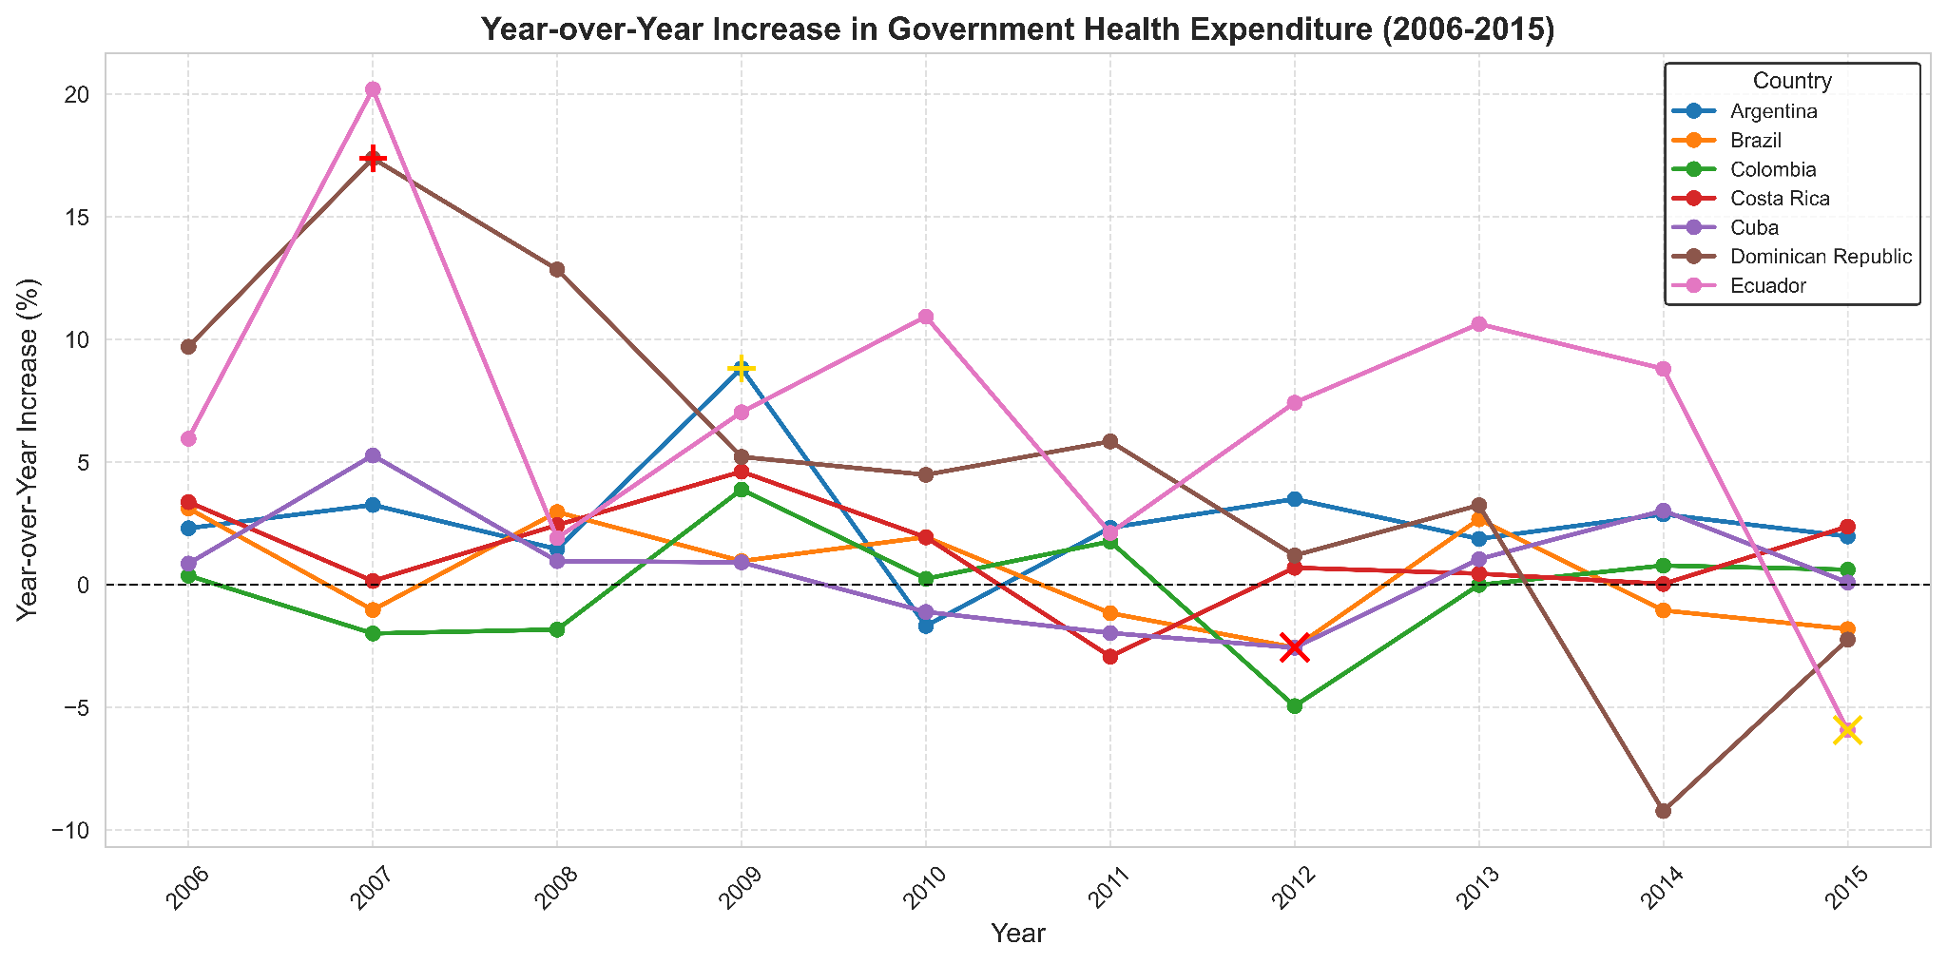
Government Health Expenditure Trends in Latin America & the Caribbean
Growth patterns vary significantly among countries.
2010, 2014-2015 show declining trends in multiple countries.
Government health spending is influenced by economic shifts and policy changes.
Stable trends (e.g., Argentina, Colombia) suggest more consistent policy approaches.
Highest Growth (red plus): Dominican Republic (2007, +17.38%)
Most Significant Growth (yellow plus): Argentina (2009, +8.82%)
Largest Decline (red cross): Ecuador (2015, -5.93%)
Most Negative Growth (yellow cross): Brazil (2012, -2.56%)

