Slide 1

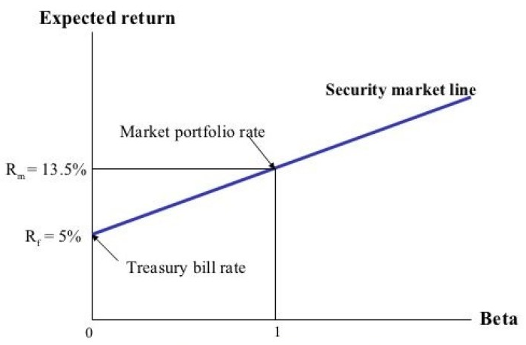
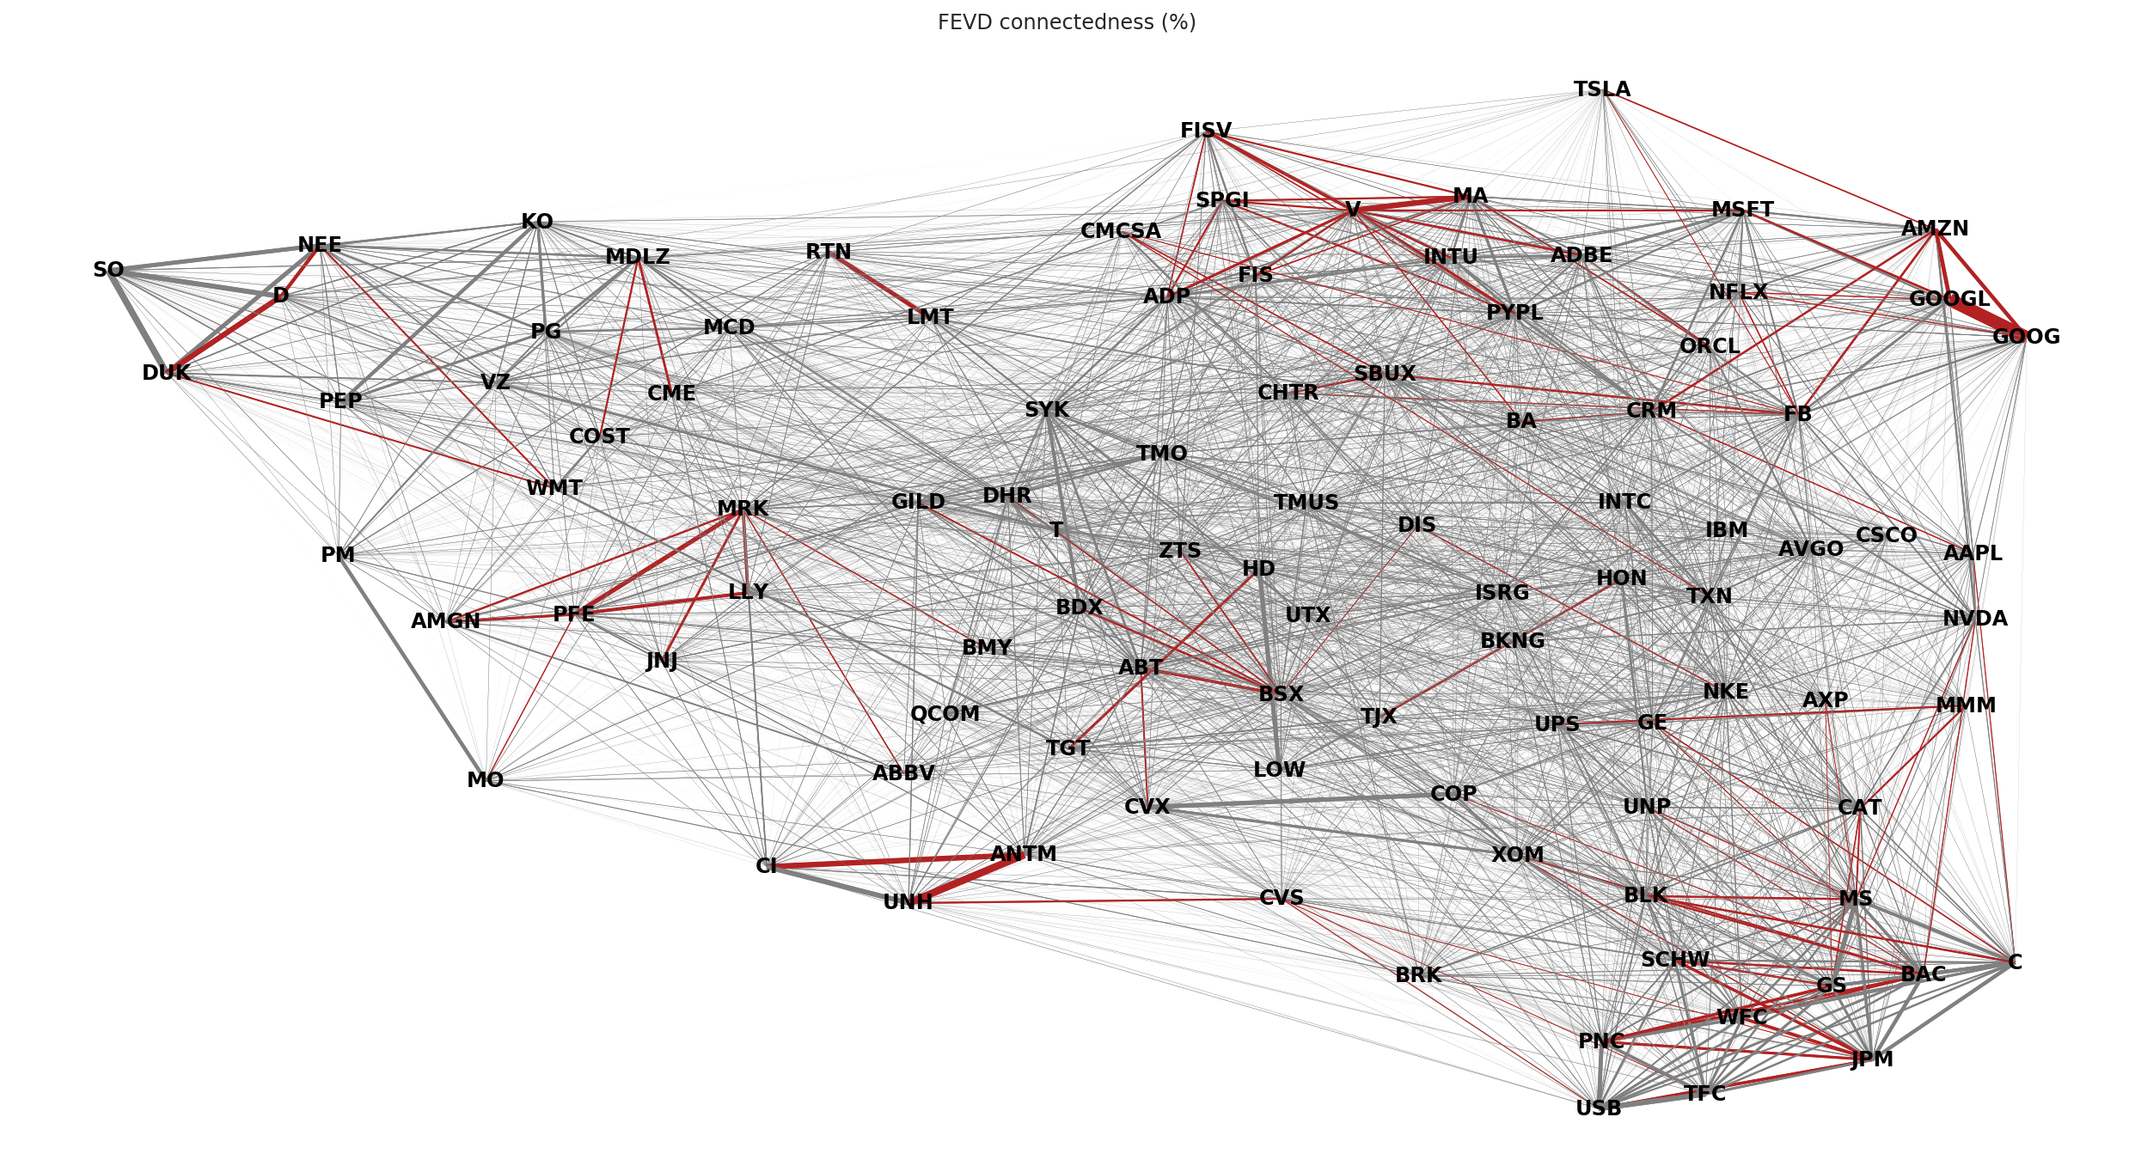

I. Data Source
II. Sampling
III. Factor Model
IV. Total Variance Decomposition
V. VAR Estimation
VI. Covariance Estimation
VII. Network construction
VIII. Empirical Analysis
Data flow
fundamentals
intraday variance
raw data
Idiosyncratic variances
daily returns
VAR residuals
Network data
CRSP daily
Compustat fundamentals
100 largest
betas
Covariance estimates
VAR coefficients
CAPM timeseries regressions (OLS)
Forecast error variance decomposition
Adaptive Elastic Net
12-fold cross-validation
Forecast assessment
Asset pricing tests
Estimate flow
Adaptive threshold estimation
12-fold cross-validation
Stock-Watson decomposition
Data sampling
Preprocessing
Network Estimation
Analysis

Slide 2
I. Data Source
II. Sampling
III. Factor Model
IV. Total Variance Decomposition
V. VAR Estimation
VI. Covariance Estimation
VII. Network construction
VIII. Empirical Analysis
prices & fundamentals
D A T A
intraday variance
raw data
daily returns
idiosyncratic variances
VAR residuals
P R O C E S S I N G
CRSP daily
Compustat fundamentals
100 largest by market capitalisation
CAPM timeseries regressions (OLS)
Stock-Watson decomposition
Adaptive Elastic Net
12-fold cross-validation
Adaptive threshold estimation
12-fold cross-validation
Forecast error variance decomposition
Forecast assessment
Asset pricing tests
betas
VAR coefficients
covariance estimates
network estimates
E S T I M A T E S
Data sampling
Preprocessing
Network Estimation
Analysis

Slide 3
I. Data Source
II. Sampling
III. Factor Model
IV. Total Variance Decomposition
V. VAR Estimation
VI. Covariance Estimation
VII. Network construction
VIII. Empirical Analysis
prices & fundamentals
D A T A
intraday variance
raw data
daily returns
idiosyncratic variances
VAR residuals
P R O C E S S I N G
CRSP daily
Compustat fundamentals
100 largest by market capitalisation
CAPM timeseries regressions (OLS)
Stock-Watson decomposition
Adaptive Elastic Net
12-fold cross-validation
Adaptive threshold estimation
12-fold cross-validation
Forecast error variance decomposition
Forecast assessment
Asset pricing tests
betas
VAR coefficients
covariance estimates
network estimates
E S T I M A T E S
Data sampling
Preprocessing
Network Estimation
Analysis

