Slide 1
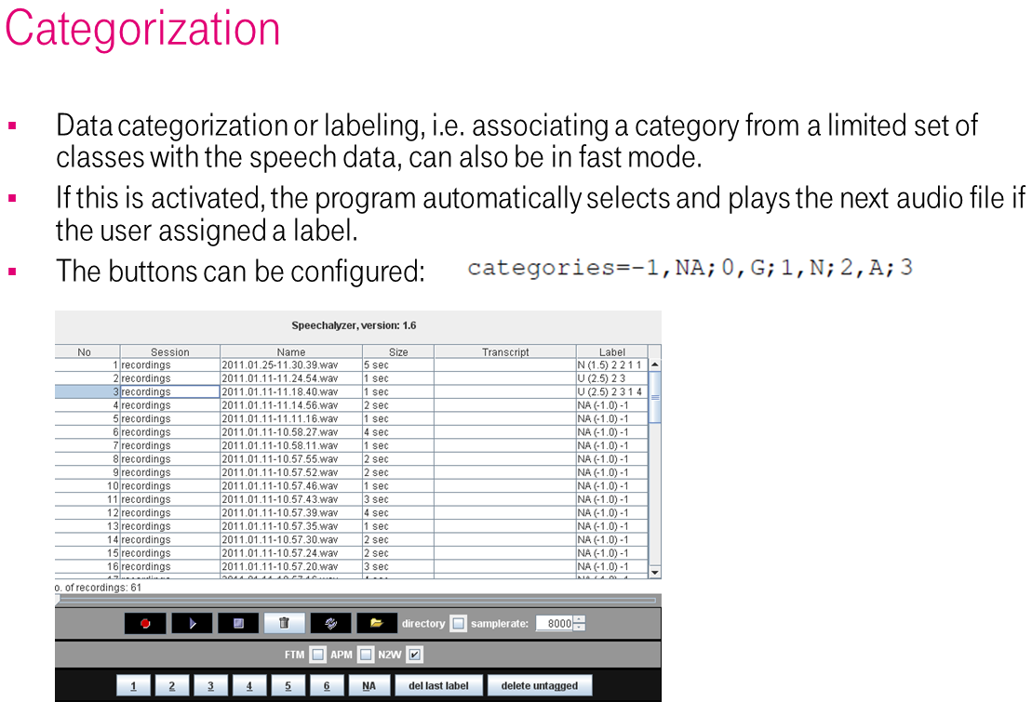
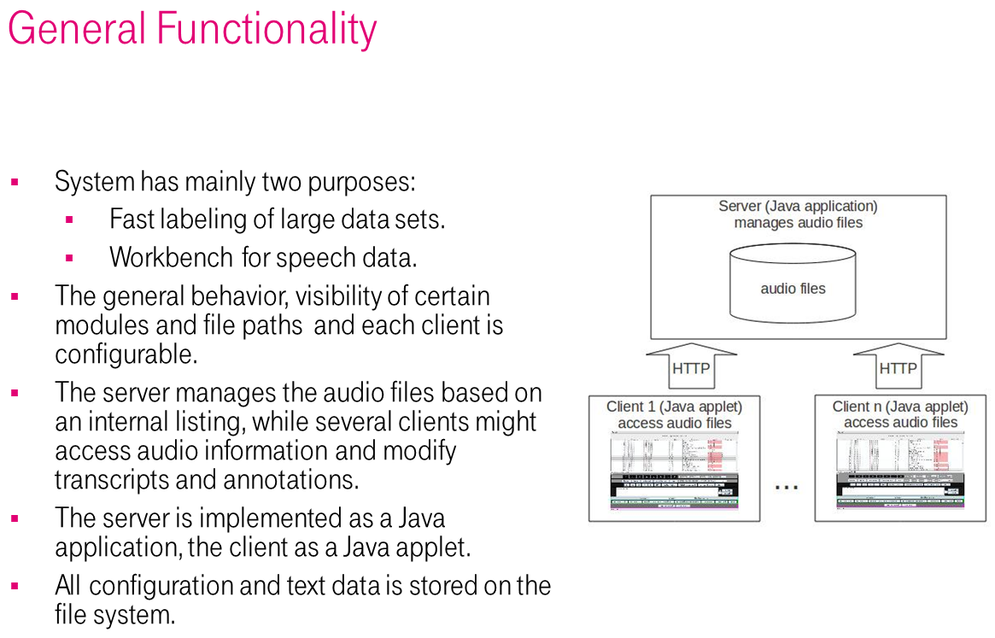
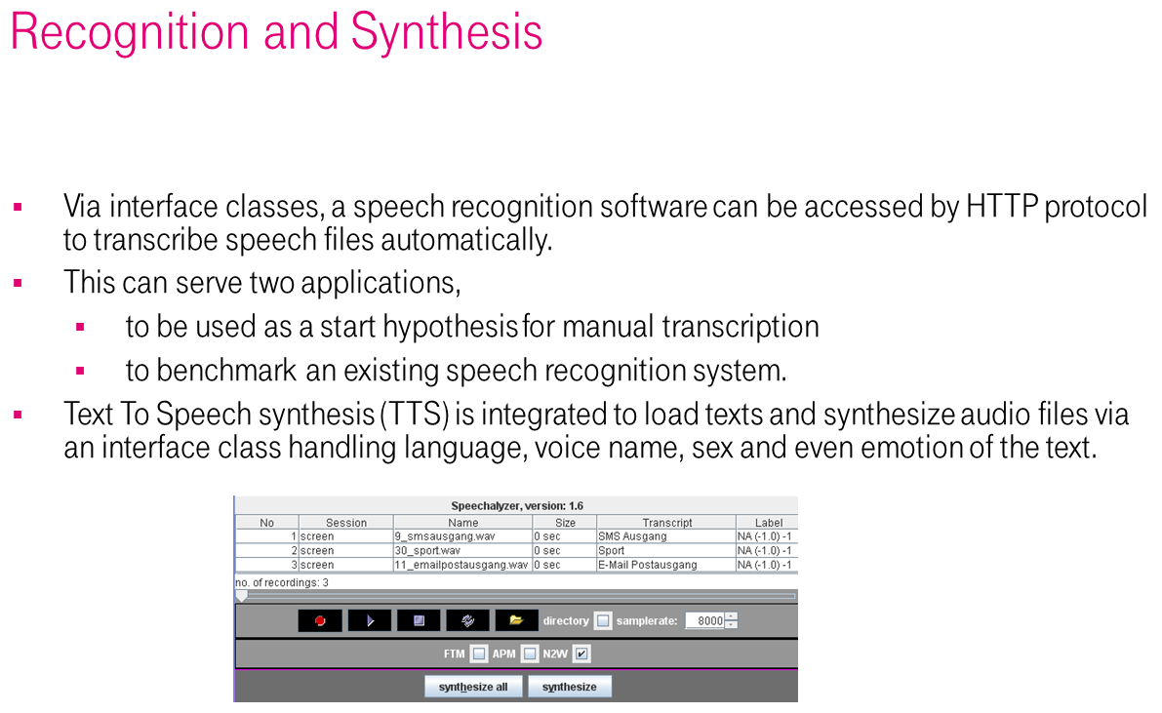
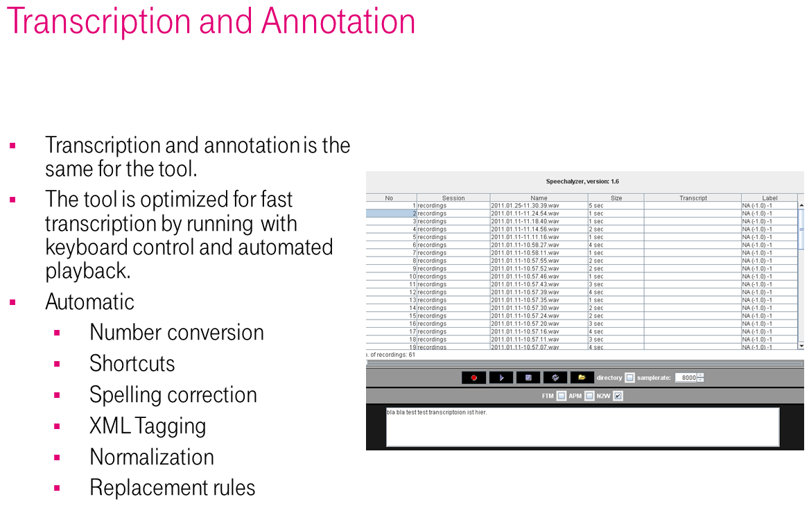
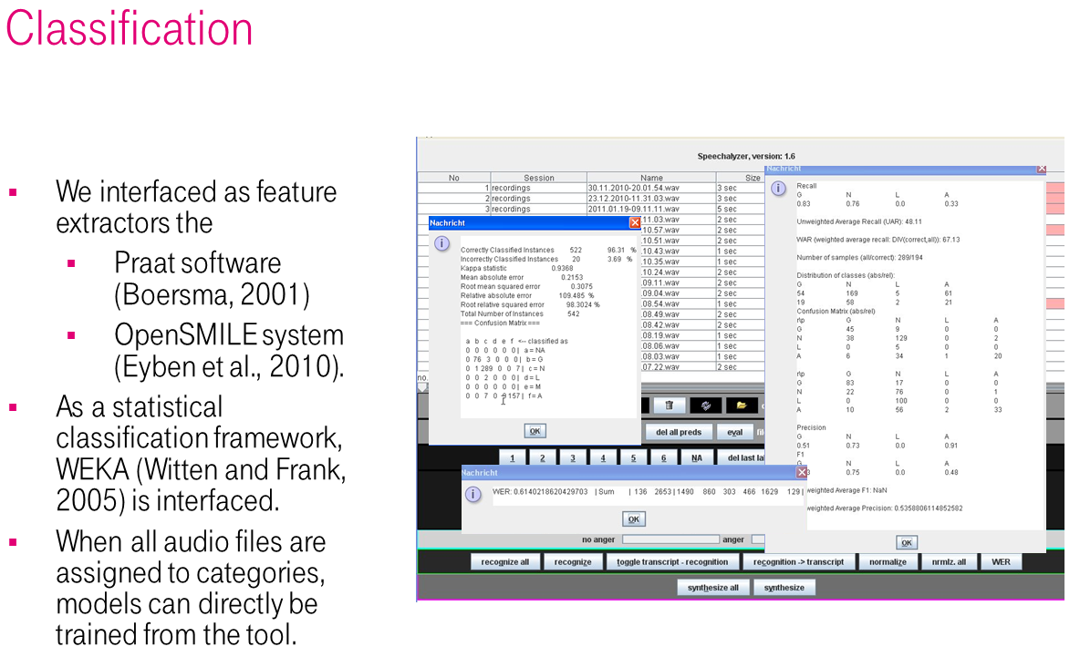
Fast Labeling and Transcription with the Speechalyzer Toolkit
Felix Burkhardt
Abstract
We describe a software tool named “Speechalyzer” which is optimized to process large speech data sets with respect to transcription, labeling and annotation.
It is implemented as a client server based framework in Java and interfaces software for speech recognition, synthesis, speech classification and quality evaluation.
The application is mainly the processing of training data for speech recognition and classification models and performing benchmarking tests on speech to text, text to speech and speech categorization software systems.
For further information
Please contact Felix.Burkhardt@telekom.de. More information on this and related projects can be obtained at www.telekom.de/laboratories..
Telekom Innovation Laboratories
An-Institut der Technischen Universität Berlin

