Slide 1
King County Housing
Exploratory data analysis for a budget buyer
Client: Thomas Hansen
Analyst: Felix
Date: 29.5.26
Felix — EDA Project — King County Housing
1 / 9

Slide 2
The client
Thomas Hansen — buyer
Five children
Low budget
Wants: family home in a nice, social neighborhood
Felix — EDA Project — King County Housing
2 / 9

Slide 3
The data
King County, Washington (Seattle and surroundings)
21,420 home sales
May 2014 – May 2015
70 zip codes
Per sale: price, size, bedrooms, bathrooms, condition, grade, location, year built, renovation history
Felix — EDA Project — King County Housing
3 / 9

Slide 4
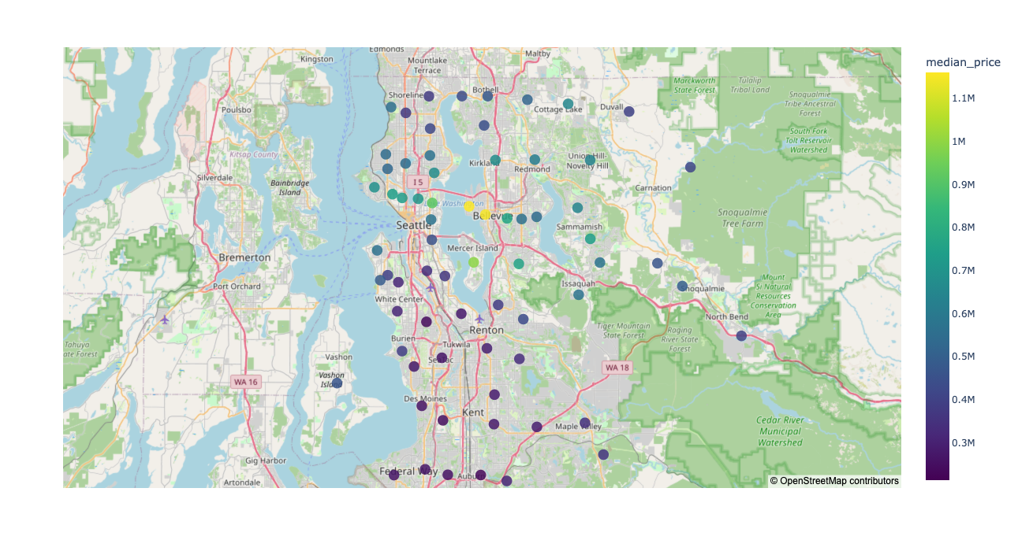

Slide 5
Three hypotheses
Price differs a lot between regions / zip codes
Cheaper regions do not necessarily have worse-condition or lower-grade houses
Renovated houses sell above un-renovated ones
Felix — EDA Project — King County Housing
4 / 9

Slide 6
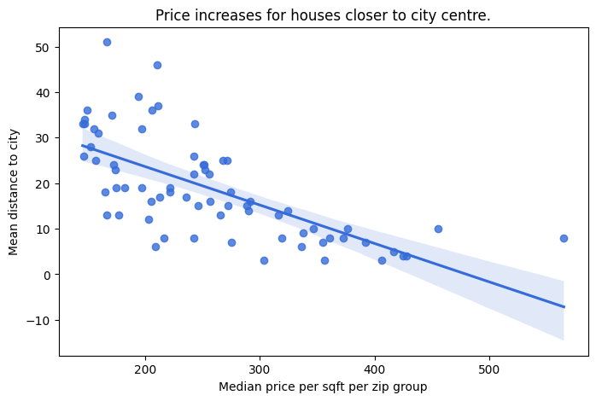
1. Location drives price
Median price per sqft varies 3.9× between the cheapest and priciest zip code
Median price per zip varies 8.1× between the cheapest and priciest zip code
Cheaper neighborhoods sit farther from downtown Seattle (clear distance-to-price gradient)
Felix — EDA Project — King County Housing
5 / 9

Slide 7
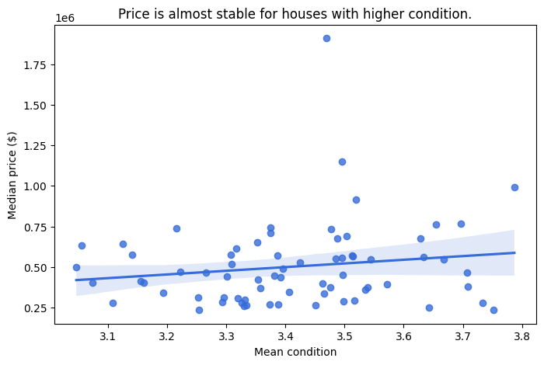
2. Affordable ≠ run-down
Condition is essentially flat across price tiers (mean 3.42 / 3.38 / 3.52)
Grade rises with price tier (mean 7.25 / 7.79 / 8.67)
Cheap neighborhoods are not worse-maintained
Felix — EDA Project — King County Housing
6 / 9

Slide 8
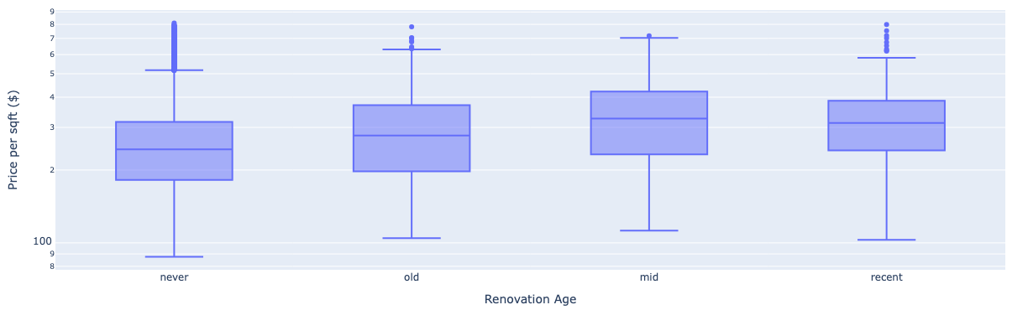
3. Renovation increases prices
Median $/sqft: never-renovated $244 · old $278 · mid $326 · recent $313
But: Sample sizes small, ~240 homes per renovation bucket vs. 20,680 never-renovated
Felix — EDA Project — King County Housing
7 / 9

Slide 9
Insights
Location is the dominant price driver — up to 8× variation between zip codes
Affordable does not mean run-down
Renovation increases value of house
Felix — EDA Project — King County Housing
8 / 9

Slide 10
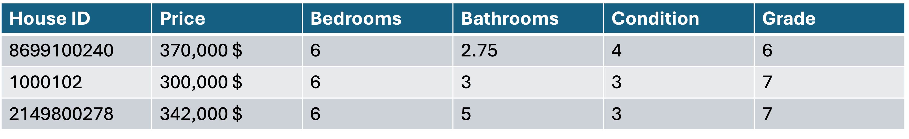
Recommendations for Thomas
Where: southern King County — zip codes 98002, 98056, 98118 (most affordable family-sized homes)
Recommendations for 98002:
Felix — EDA Project — King County Housing
9 / 9

Slide 11
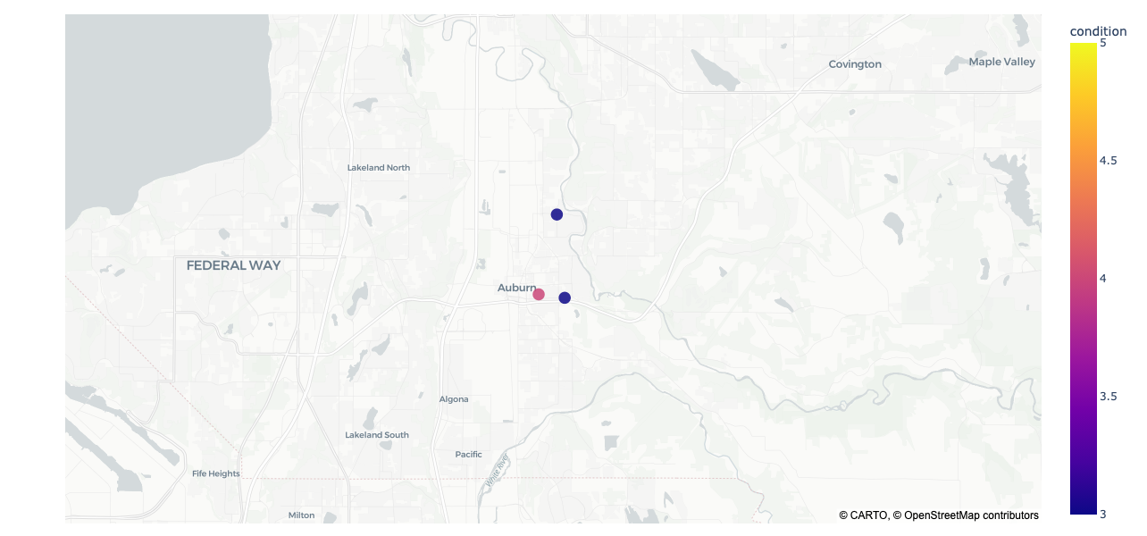
Recommendations for Thomas
Felix — EDA Project — King County Housing
9 / 9

Slide 12
Thank you for your attention!

