Slide 1

Final Year Project Presentation.
BSc Computer Science
Student: Leandro Felix
Id: w1846312
Supervisor: George Charalambous

Slide 2
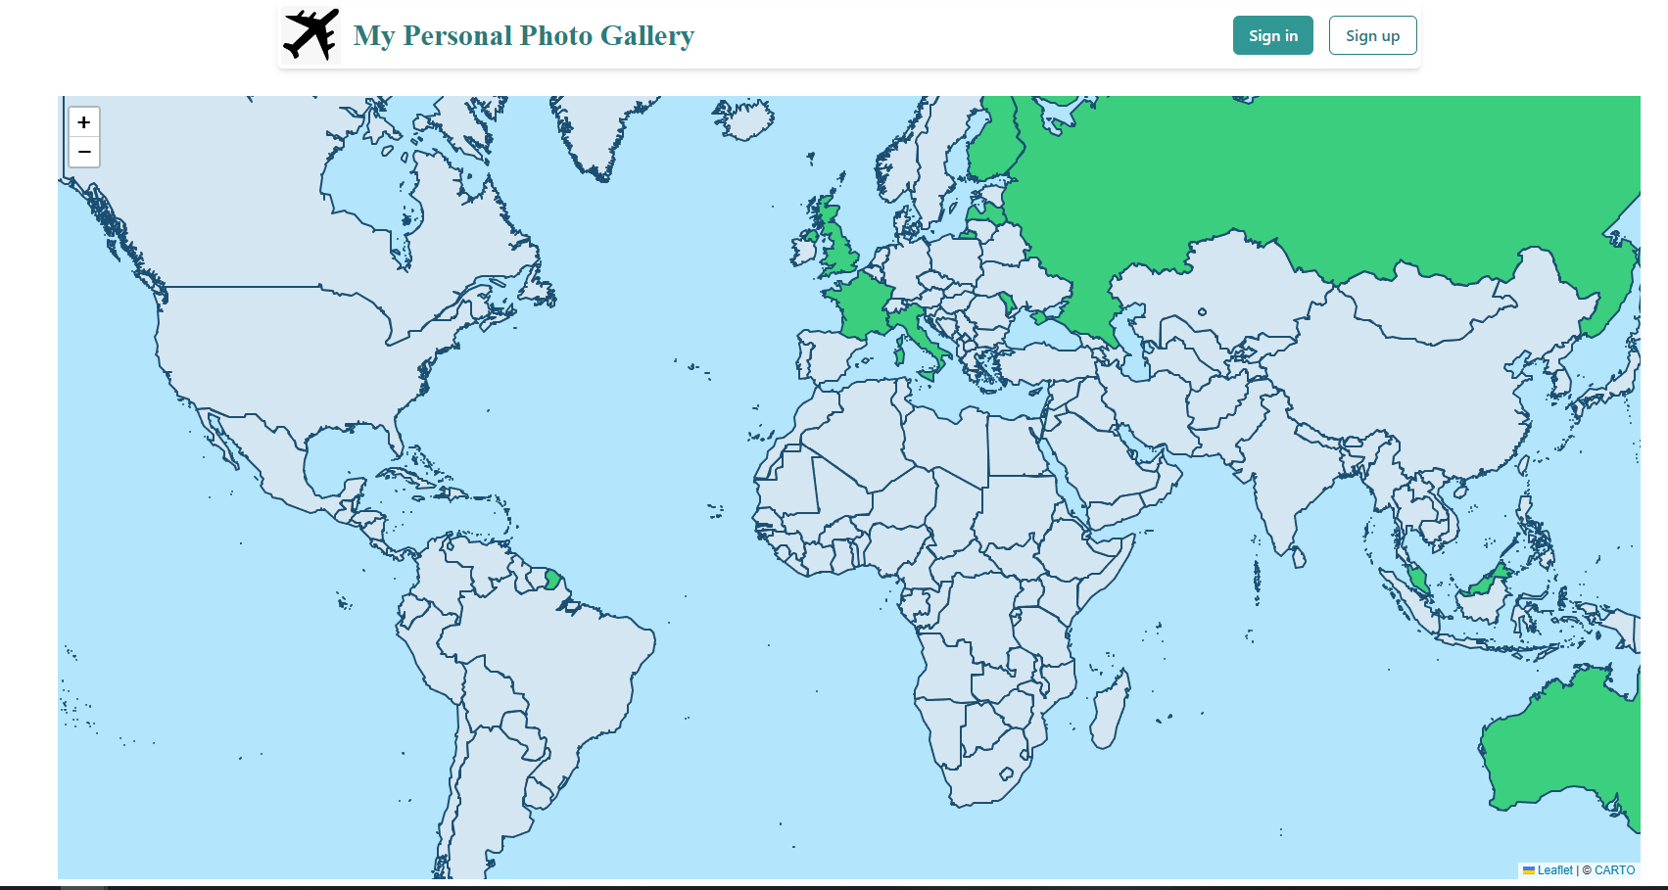
Photo Map App
Learn and Travel.

Slide 3
Project Overview
Create an intuitive platform for users to:
Visualize travel experiences geographically
Enrich knowledge of countries visited
Inspire cultural exploration.

Slide 4
Project Objectives
Develop Interactive Map with Timeline Integration
Create user-friendly map to view photos by year.
Supports efficient geographic and temporal photo filtering.
2. Comprehensive Photo Management System
Upload, search, sort, delete photos by year.
Efficient handling of photo libraries (10,000+).
3. Educational Content Integration
Displays flags, languages, currencies, and capitals for each country.
Provides accurate information on 195+ countries.
4. Backend Scalability and Performance
Supports 1,000+ concurrent users.
Optimized photo rendering for smooth experience.
5. Security Best Practices
Data encryption and authentication for user protection.
100% compliance with security tests.
Ensures secure access for all users.
Robust login system with JWT for data privacy.

Slide 5
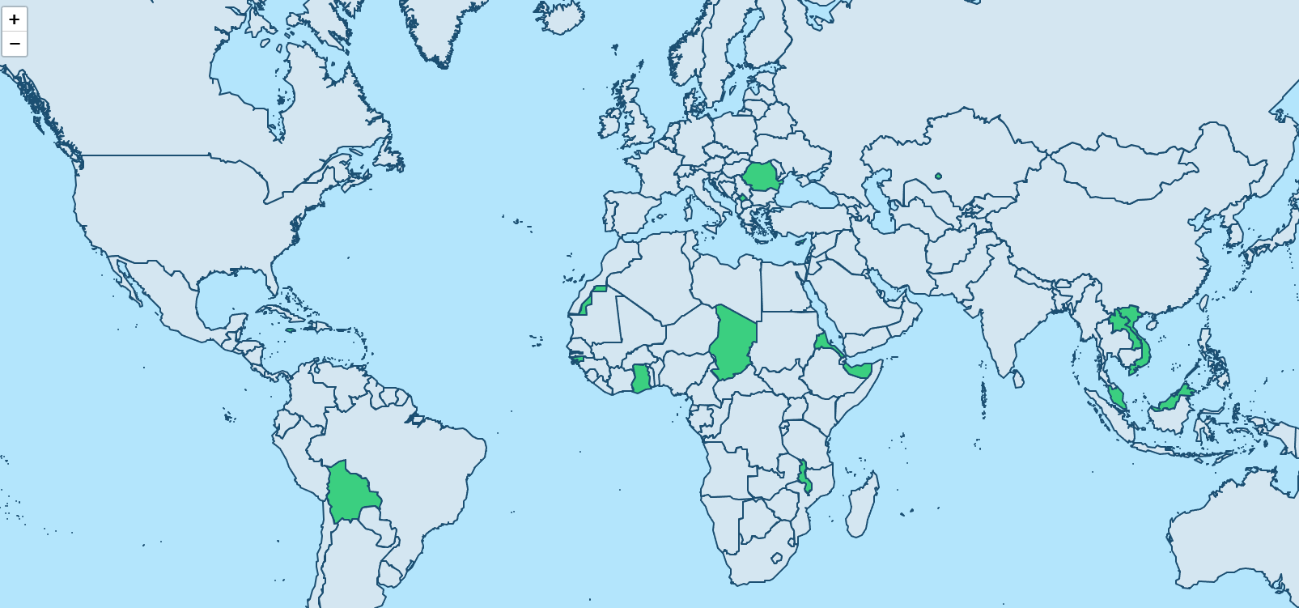
Background
Advancements in Digital Technology & Geolocation:
Integrating interactive maps with personal data, such as photos, enhances user experience by adding spatial context, making memories more meaningful and engaging.
Studies highlight educational potential, promoting geographic awareness and cultural understanding by connecting personal experiences with specific locations (Smith & Jones, 2020; Doe et al., 2019).
Gaps in Current Applications::
Lack of user-friendly interfaces to associate photos with geographic locationsAdvanced Photo Editing: No in-app photo-editing tools.
Mobile Development: Focus on web-based application only.

Slide 6
Innovations
Innovations:
Photo and Map Integration: Allows users to link photos to countries they’ve visited.
User-Friendly Design: Emphasizes simplicity, making it accessible to all ages
Educational Enhancements: Displays each country's flag, official language, currency, and capital.
Comparison with Similar Applications:
MyTravel Map: Offers an interactive map but lacks photo upload and educational content..
Travellerspoint: Allows photo uploads but has a complex interface and limited photo-map integration.

Slide 7
Tools
Visual Studio Code: Utilized for front-end development
IntelliJ IDEA: Employed for back-end development
PostgreSQL: Acting as the database management system
Docker: Used to create consistent environments for development and deployment
Additional Tools:
Postman: Employed for API testing
JUnit: Used for testing
Git: Implemented for version control

Slide 8
User interactions
New User can register
User can login
User can interact with map:
View countries educational information such as: Flag, Capital, Language, Currency and Capital
Add photos to a country visited or living.
Manage photos / Favourite photos
User can logout

Slide 9
Time Management
Phase 1
Requirements gathering and analysis
1
Phase 2
System design and architecture planning
2
Phase 3
Frontend development
3
Phase 4
Backend development
4
Phase 5
Deployment Preparation
5
Phase 6
Testing
6
Phase 7
Final Deployment
7

Slide 10
Conclusion
Photomap’s Unique Value: Integrates photos with geolocation, enriching user experience beyond traditional galleries.
Educational Impact: Promotes global awareness by providing cultural details about each country.
User-Friendly & Secure: Intuitive interface and robust security ensure accessibility and safety.
Future Potential: Lays groundwork for additional features, expanding its educational and personal value.
Final Thought: Photomap is more than a photo gallery—it’s a dynamic platform that connects memories with the world, fostering exploration and cultural curiosity in a secure environment.

Slide 11
References:
Smith, A. & Jones, B. (2020). Enhancing User Engagement through Geolocation in Digital Media. Journal of Interactive Media, 15(3), pp. 145-160.
Doe, J., Miller, C. & Lee, R. (2019). The Role of Interactive Maps in Cultural Awareness and Education. Geography Education Review, 10(4), pp. 212-225.

