Slide 1
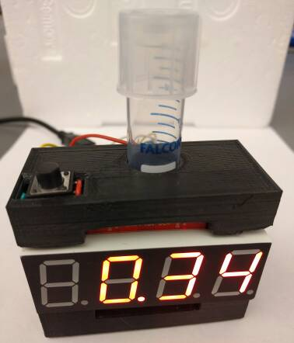
The RODD: A Low Cost Culture Tube Spectrophotometer
Brian Landry, Felix Ekness
Notes:
Felix

Slide 2
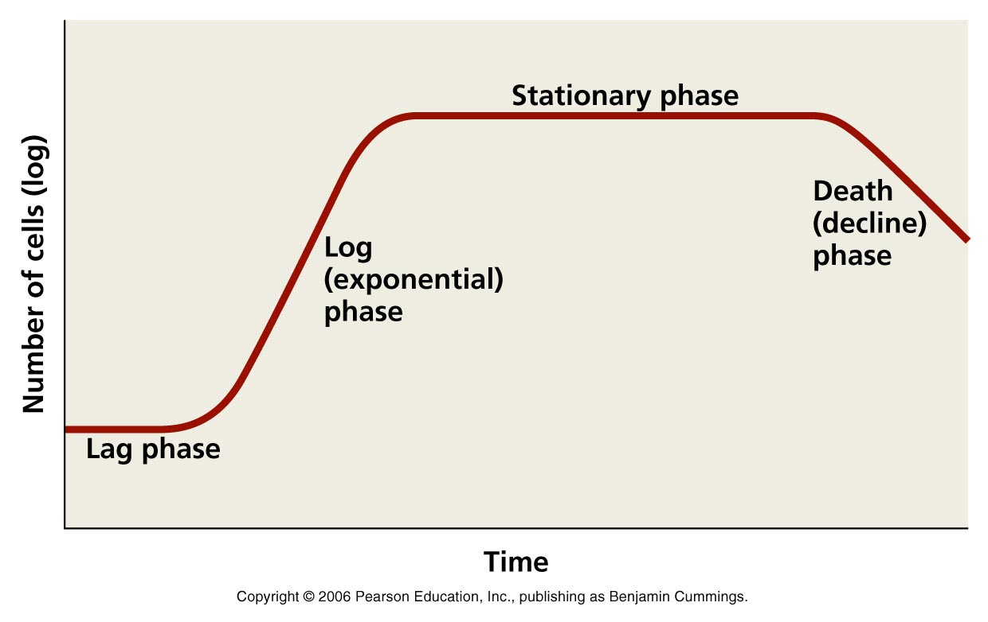
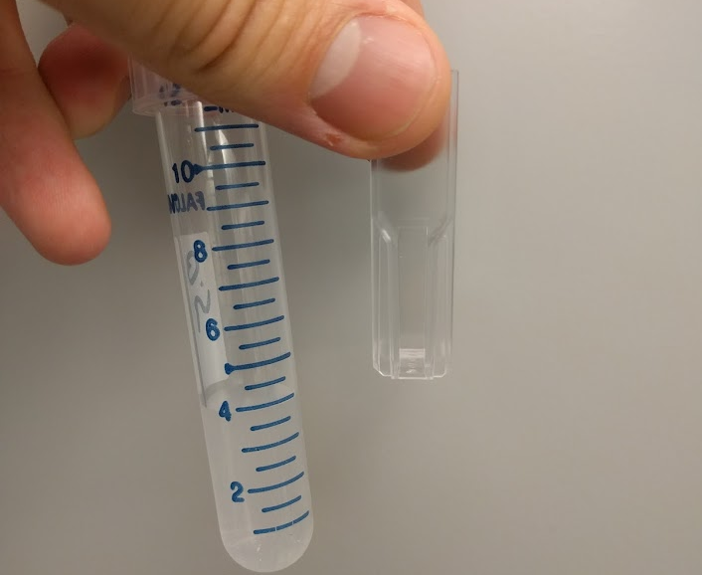
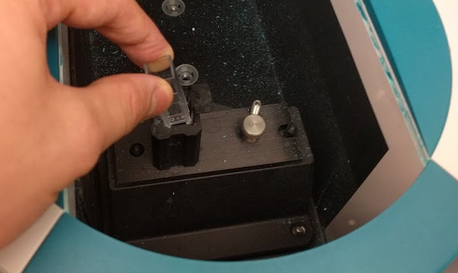
Counting Bacteria in a Culture Tube
Cannot monitor density of bacteria in standard culture tube
Volume required to use spectrophotometer is too much
Tube doesn’t work with spectrophotometer
Notes:
Felix

Slide 3
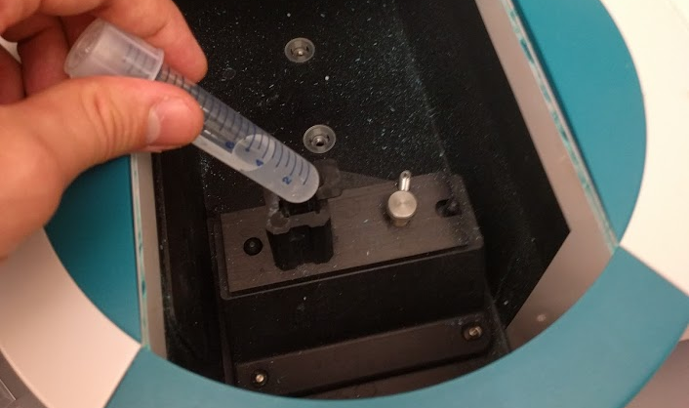
Counting Bacteria in a Culture Tube
Cannot monitor density of bacteria in standard culture tube
Volume required to use spectrophotometer is too much
Tube doesn’t work with spectrophotometer
Notes:
Felix

Slide 4
Proposed Solution: The RODD
Property | Specification
Measurement Range | 0.05-0.5 OD600
Precision | <0.02 OD600
Portability | Can be located next to an incubator but can still use a wall outlet for power
Measurement rate | > 10 Samples/minute
Visual Readout | Contains at least 2 significant figures
Durability | Capable of being roughly handled and occasionally dropped
Ease of use | Requires minimal interaction and promotes quick use
Cost | <$50
A Rapid Optical Density Detector (RODD)
A mini spectrophotometer which will sit next to a lab incubator to monitor many bacterial cultures simultaneously
Should be easy, quick and intuitive to use
Needs to be precise enough to allow us to experiment on bacteria in correct growth range
Notes:
Felix

Slide 5
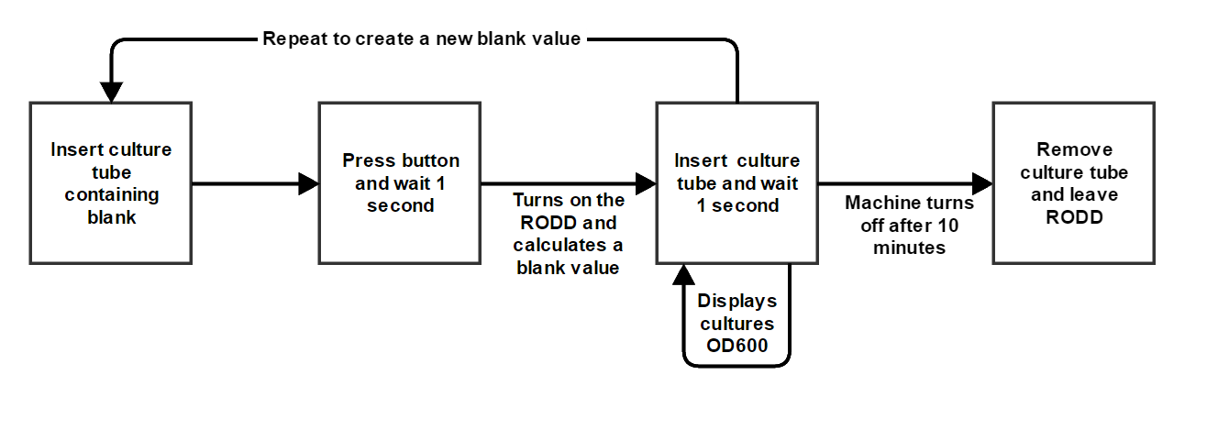
Property | Specification
Portability | Can be located next to an incubator but can still use a wall outlet for power
Measurement rate | > 10 Samples/minute
Visual Readout | Contains at least 2 significant figures
Durability | Capable of being roughly handled and occasionally dropped
Ease of use | Requires minimal interaction and promotes quick use
Notes:
Brian

Slide 6
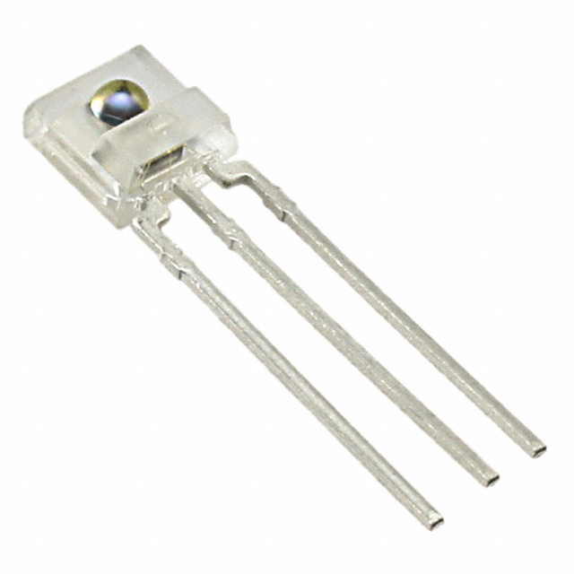
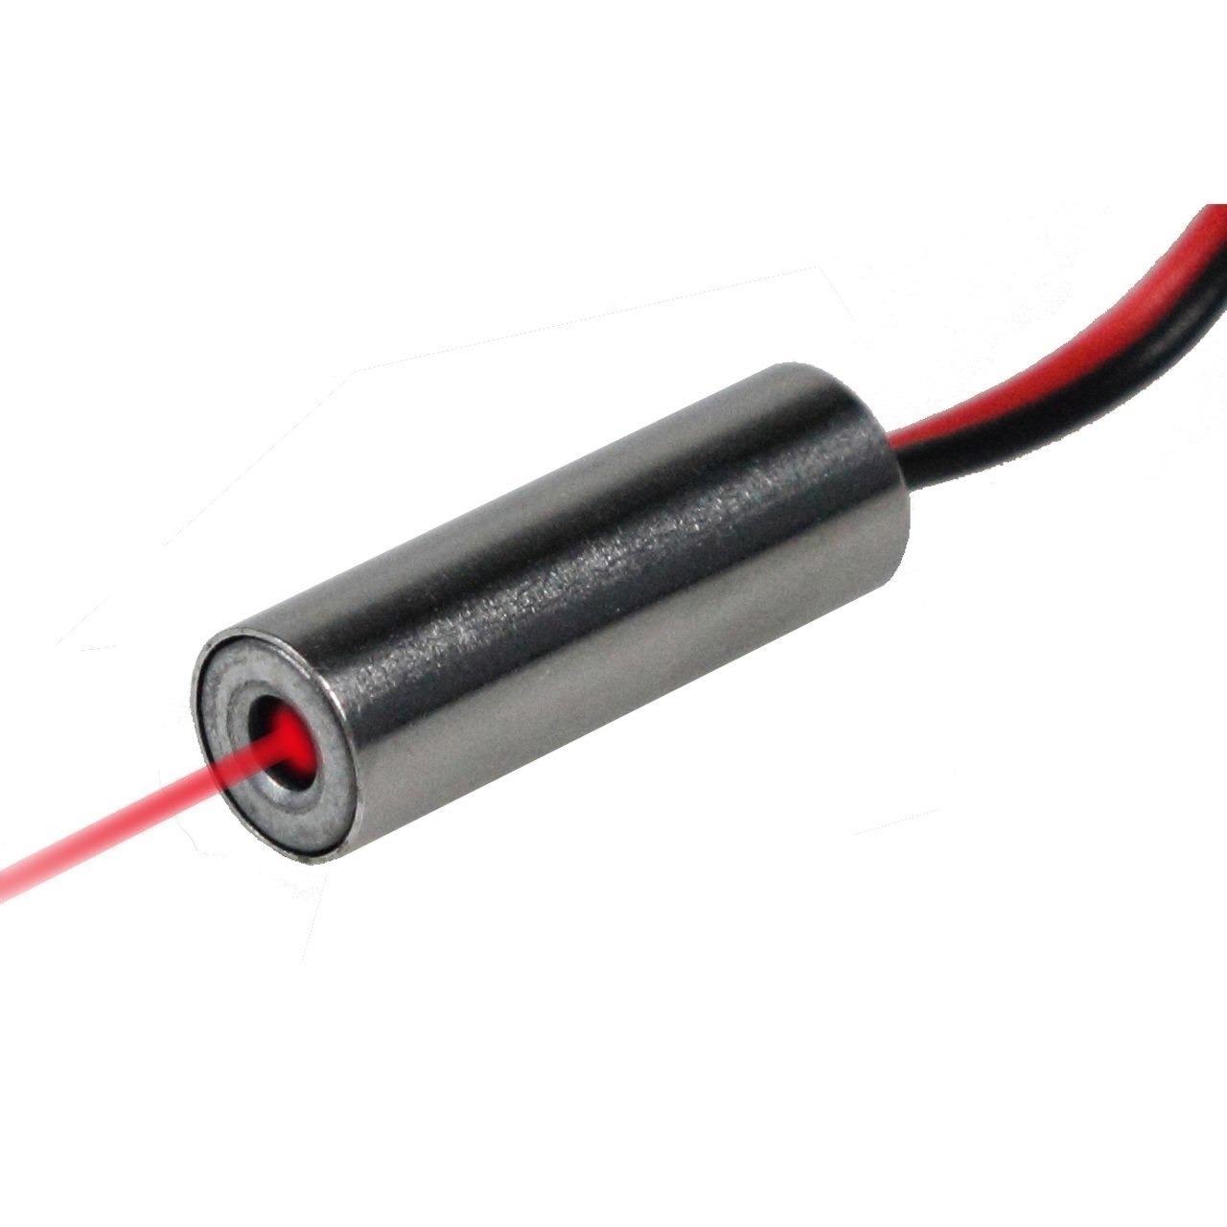
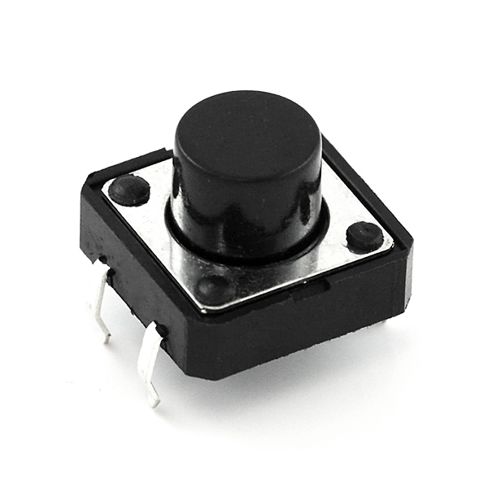
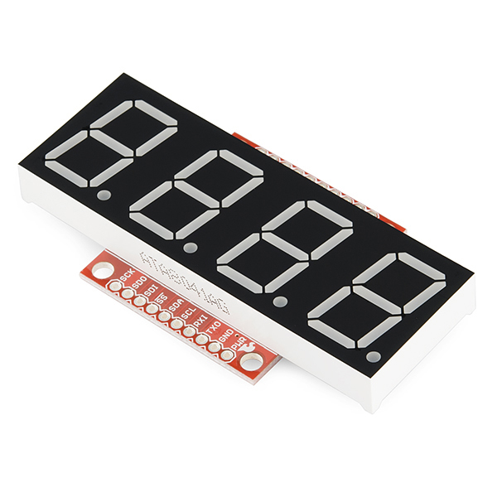
Photodetector: large linear range to provide high precision and accuracy
650nm laser for a bright concentrated light source
Single large button for user input
Four digit seven segment display capable of displaying three signed digits
Notes:
Brian

Slide 7
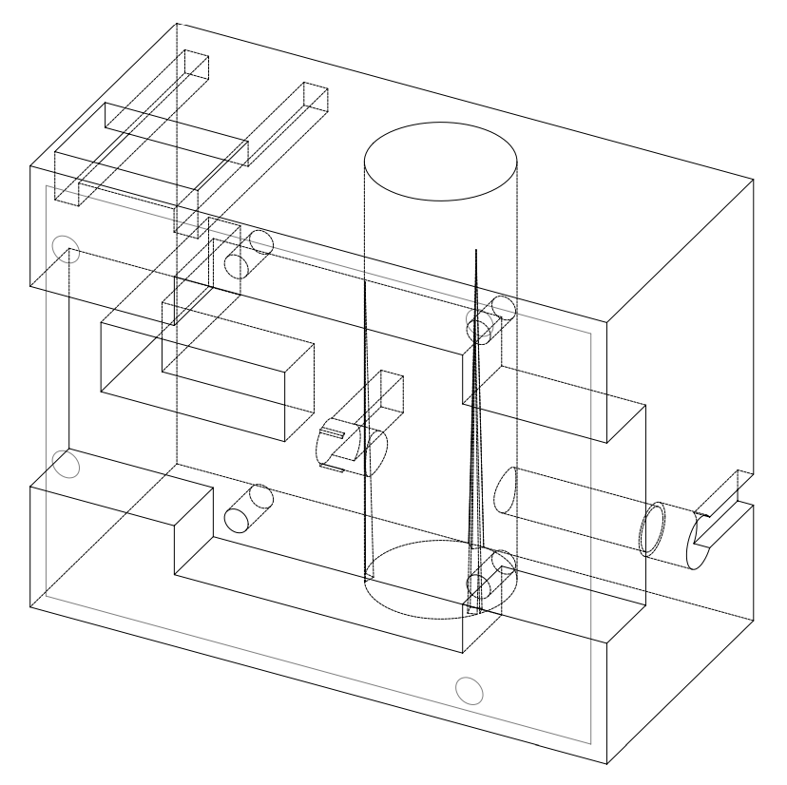
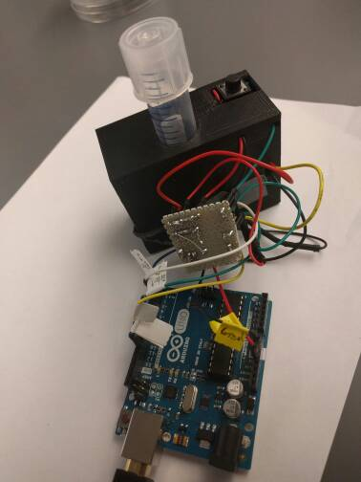
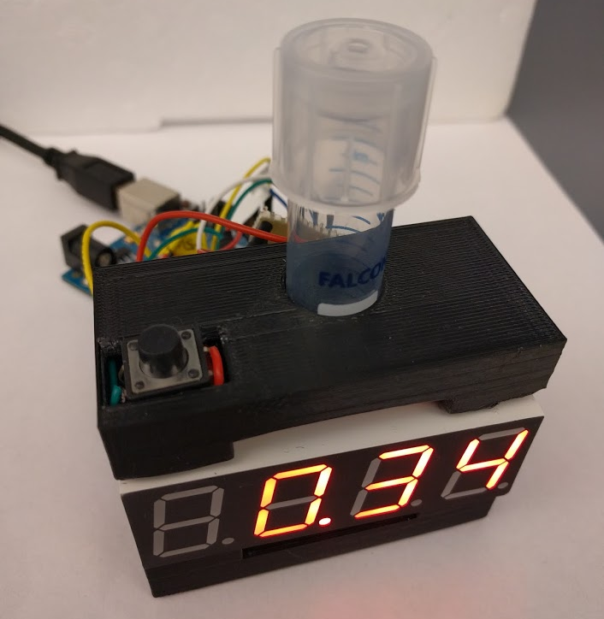
Construction of the RODD
Notes:
Brian

Slide 8
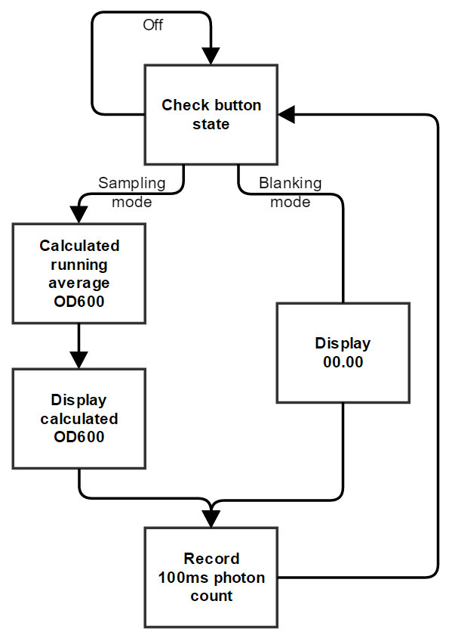
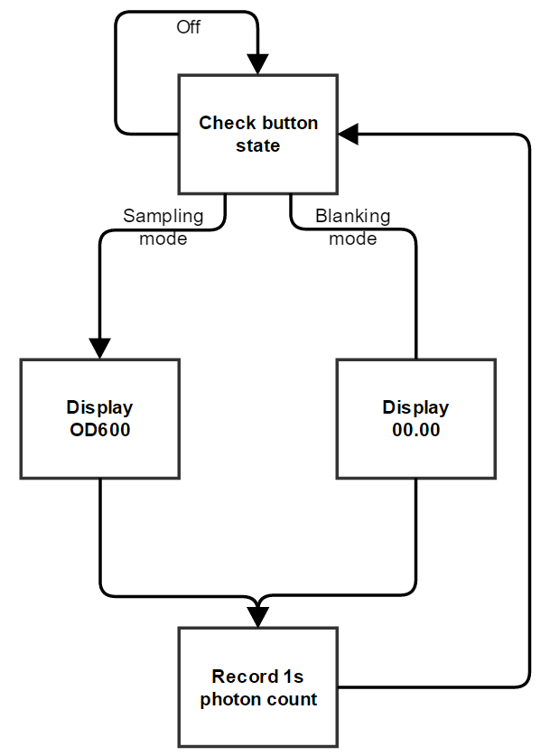
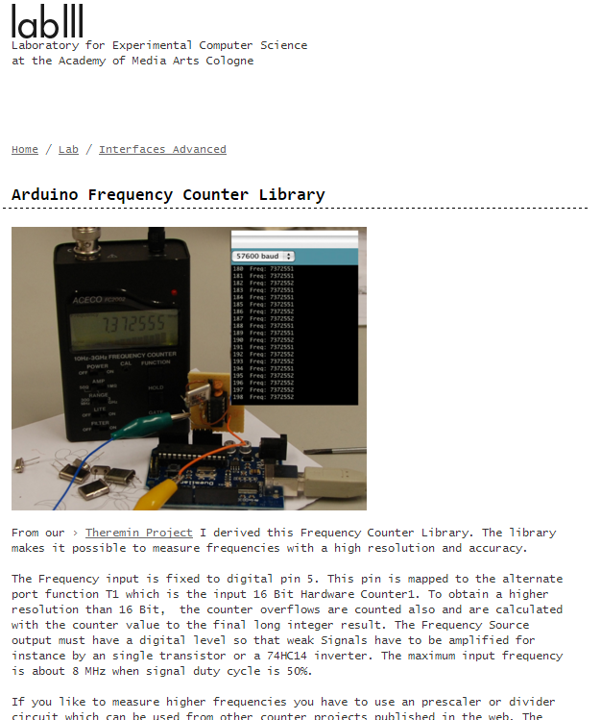
Engineering Challenge: A responsive program
Notes:
Brian

Slide 9
Engineering Challenge: A responsive program
Notes:
Brian

Slide 10
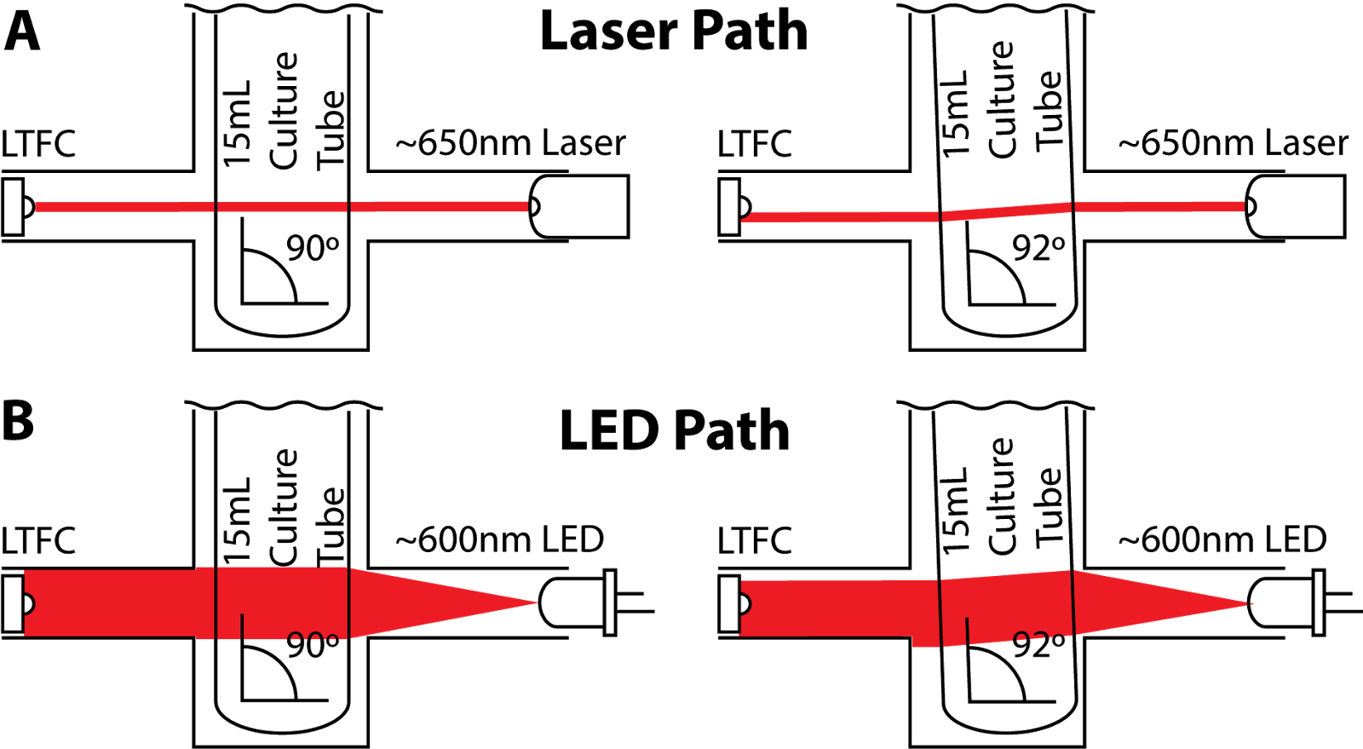
Engineering Challenge: Laser deflection
Notes:
Felix

Slide 11
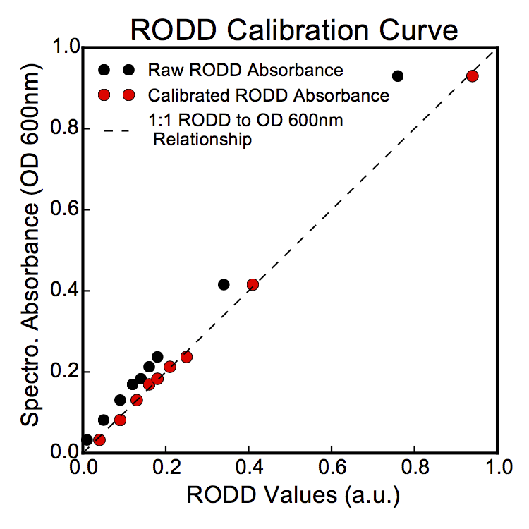
Performance Analysis
Property | Specification | Achieved Value
Measurement Range | 0.05-0.5 OD600 | 0.05-1.0 OD600
Precision | <0.02 OD600 | +/- 0.01 OD600
Portability | Can be located next to an incubator but can still use a wall outlet for power | Achieved specification
Measurement rate | > 10 Samples/minute | 30 samples/minute
Visual Readout | Contains at least 2 significant figures | Contains 3 significant figures and a sign
Durability | Capable of being roughly handled and occasionally dropped | Survived testing and simulated dropping
Ease of use | Requires minimal interaction and promotes quick use | A single button press activates the machine which then has continual readout to the user
Cost | <$50 | Total = $46.31
Notes:
Felix

Slide 12
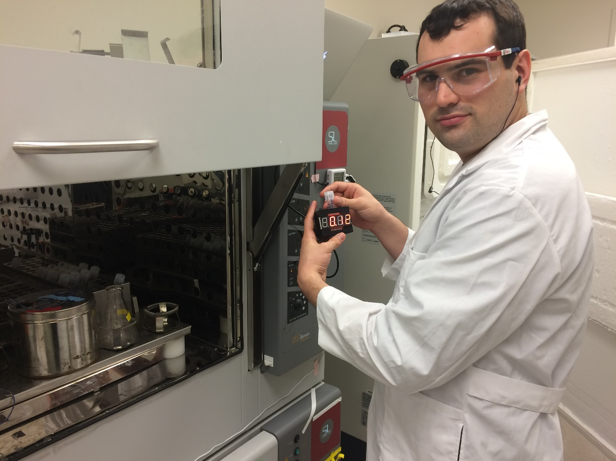
Documentation and Deployment
Report, code, 3D models and parts are available via github
Well annotated code and structured code
Began trial usage in lab
Future work
Fully enclosed Arduino
Raspberry pi connected cloud storage of OD600 measurements
Notes:
Felix

