Slide 1

QC and pre-assembly analyses
Henrik Lantz, Mahesh Panchal - BILS/SciLife/Uppsala University

Slide 2
Important organism specific properties
Genome size
Repeat content
Heterozygosity

Slide 3
Important organism specific properties
Genome size - Large genomes require more data whoch requires more time and is more complex to analyse
Repeat content - Reads from different repeats are identical and confound the algorithms
Heterozygosity - Assemblers usually try to create a haploid consensus assembly but will create double assemblies of heterozygotic regions

Slide 4
The devil is in the repeats
Mathematically best result:
C
R
A
B

Slide 5
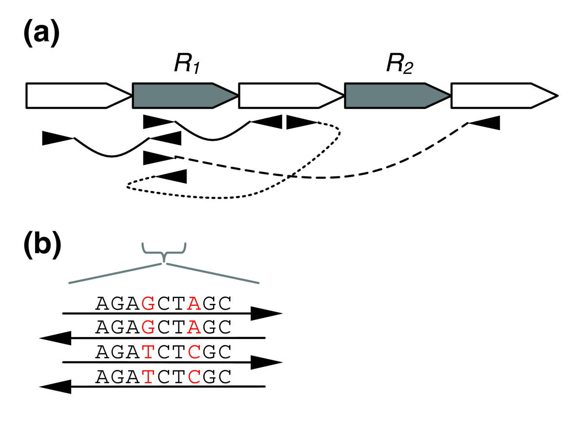
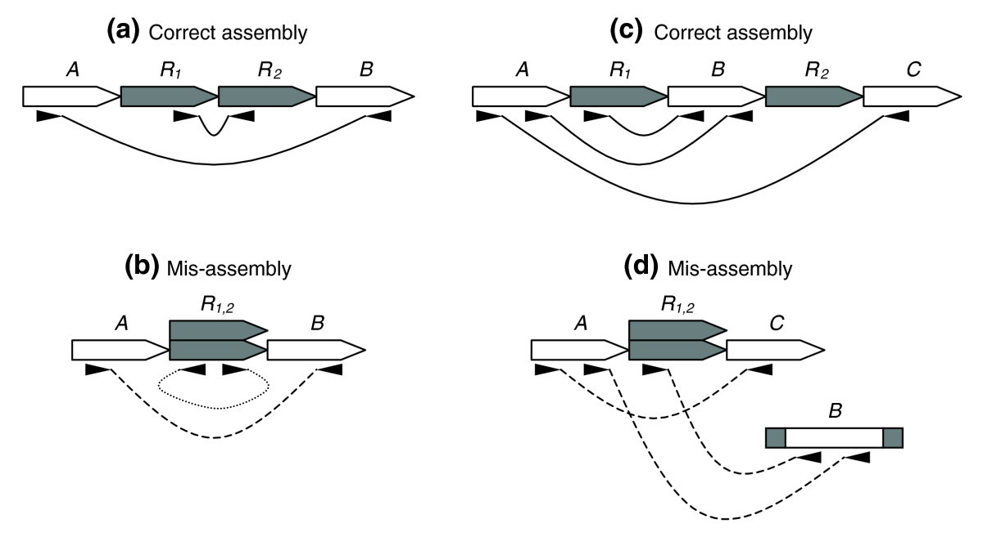
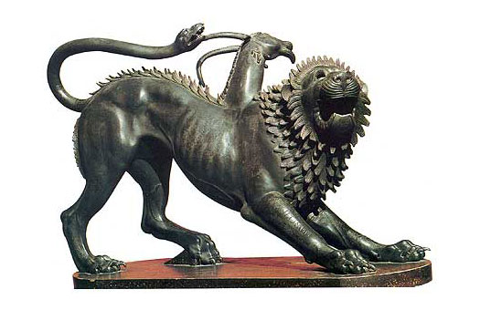
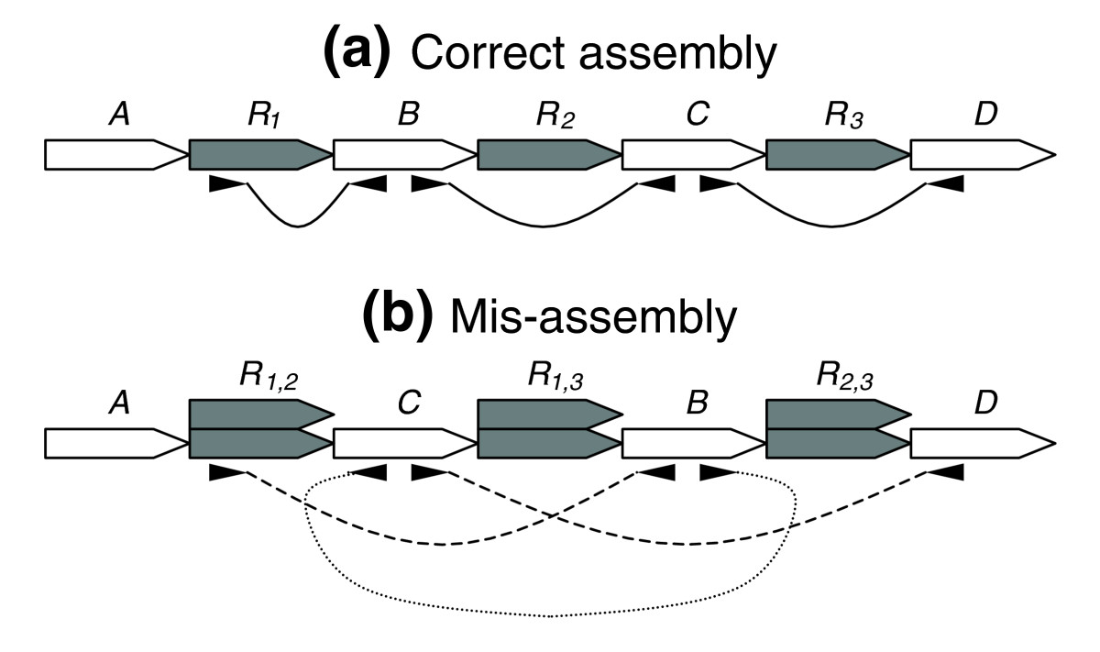
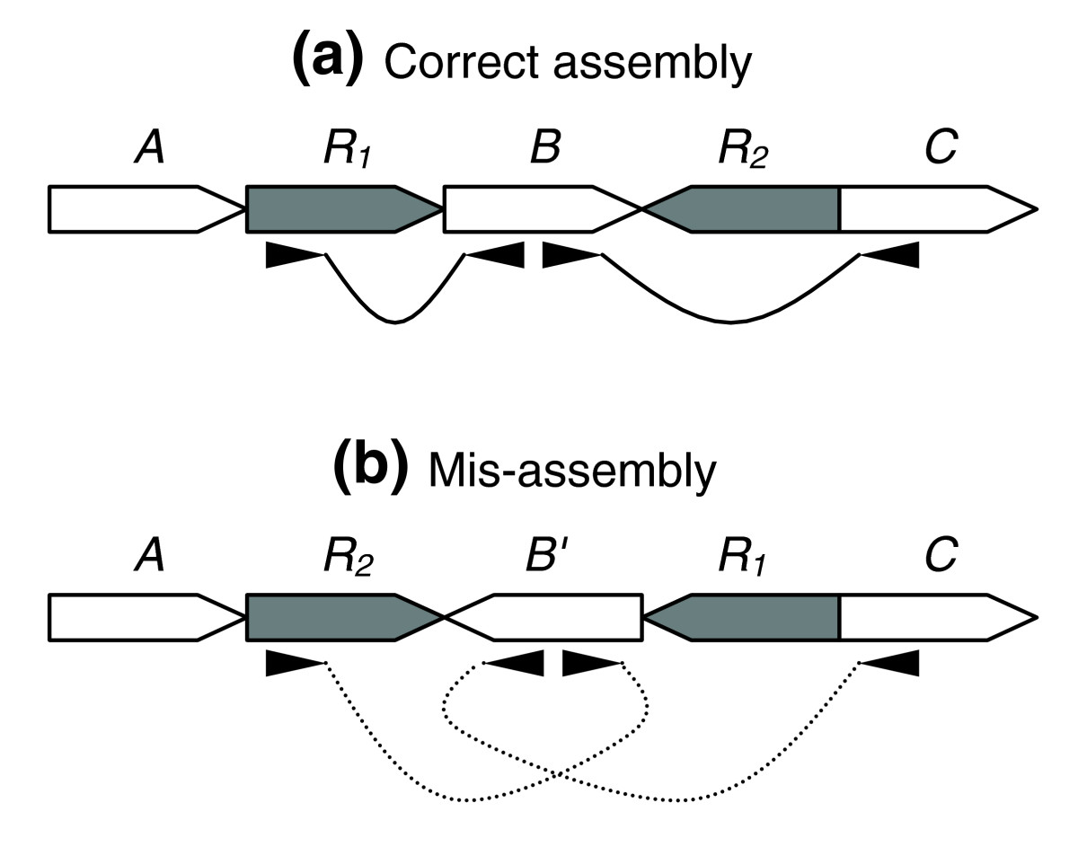
Repeat errors
Overlapping non-identical reads
Collapsed repeats
and chimeras
Wrong contig order
Inversions

Slide 6
Preparing reads for assembly
Integrity and format validation
Adapter removal
(Error correction)
Kmer analysis
Contamination removal

Slide 7
Data integrity and format
Many tools cannot tell if the data is complete.
Transferred data should have checksums e.g MD5.
823fc8b0ca72c6e9bd8c5dcb0a66ce9b file1.fastq.gz
$ md5sum -c md5.txt file1.fastq.gz: OK file2.fastq.gz: OK file3.fastq.gz: FAILED md5sum: WARNING: 1 of 3 computed checksums did NOT match

Slide 8
Data integrity and format
Inspect your fastq files
$ zcat file1.fastq.gz | head @HWI-ST486:212:D0C8BACXX:6:1101:2365:1998 1:N:0:ATTCCT CTTATCGGATCGATCCCAGTTTGGGCTTGTAAACGGTGAATCCTCAAAGACCACCAATGTTG + CCCFFFFFHHHHHJJJJJJHIJIIJGGJGFEGIGHIBFGHJIJIICHIIIDHGGIGIGHEFG @HWI-ST486:212:D0C8BACXX:6:1101:2365:1998 2:N:0:ATTCCT TAACCGAGCAAACAAAAGTTGGTTGTCACAAATTGTAATGACCTGATTAAACTTGATTTTTT + CCCFFFFFHHHHHJIIIJHIJJHIJJJJJJJJJJJIJJJIJJJJJIIIJJIJJJJGIJJJJH
zcat lets you look at gzip compressed files and bzcat at bzip2 compressed files.

Slide 9
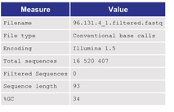
Basic inspection
FastQC is a first step to diagnose major errors.
$ module load bioinfo-tools FastQC/0.11.2
$ fastqc -t 6 *.fastq.gz
Zhou and Rokas, 2014: Mol. Ecol.

Slide 10
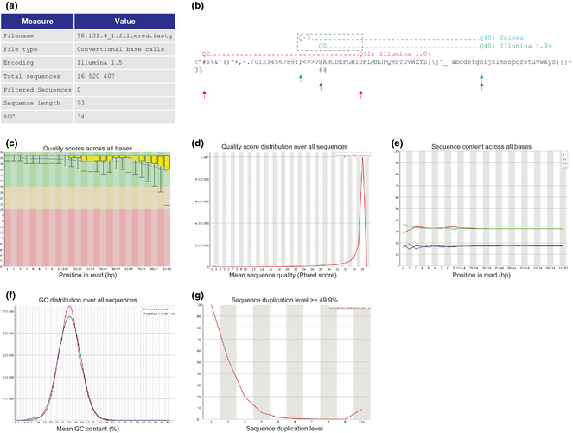
FastQC
Zhou and Rokas, 2014: Mol. Ecol.

Slide 11
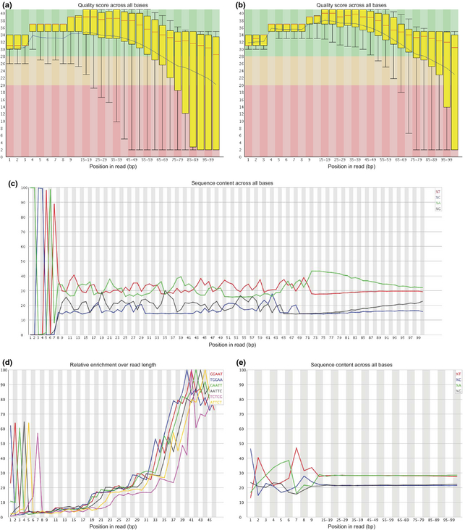
FastQC
Zhou and Rokas, 2014: Mol. Ecol.

Slide 12
Trimming adapters
Adapter read-through is common.
$ module load bioinfo-tools trimmomatic/0.32
$ TRIMAPP=/sw/apps/bioinfo/trimmomatic/0.32/milou/trimmomatic.jar
$ ADAPTERFILE=adapters.fasta
$ java -jar $TRIMAPP PE –threads 16 \ Sample034_Lane1_R1.fastq.gz \ Sample034_Lane1_R2.fastq.gz \ Sample034_Lane1_R1.clean.fastq.gz \ Sample034_Lane1_R1.unpaired.clean.fastq.gz \ Sample034_Lane1_R2.clean.fastq.gz \ Sample034_Lane1_R2.unpaired.clean.fastq.gz \ ILLUMINACLIP:$ADAPTERFILE:2:30:10 \ LEADING:3 TRAILING:3 MINLENGTH:50

Slide 13
Detecting biases
Do your fastq files contain the same information?
Biases come from many sources
Library preparation
Contamination
Machine error

Slide 14
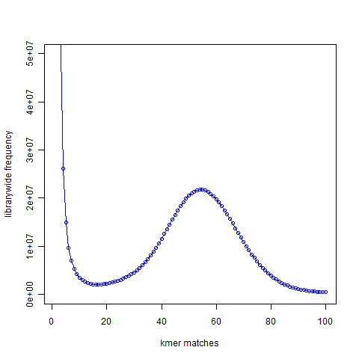
Kmer analyses
Compute the frequency of each kmer in the dataset
Note: RAM-intense!

Slide 15
Kmer analyses
module load bioinfo-tools KAT/2.0.6 gnuplot/4.6.5
OUTPUTDIR=$SNIC_TMP/kat_qc
PROJDIR=$(pwd)
mkdir -p $OUTPUTDIR
cd $OUTPUTDIR
for FASTQ in $( find $PROJDIR -name “*.fastq.gz”); do
gzip -c $FASTQ > $(basename ${FASTQ%.gz})
done
kat hist -t 32 -C -o all_data_hist *.fastq
rm *.fastq
cd $PROJDIR
rsync -av $OUTPUTDIR .

Slide 16
Reads vs kmers
1 read:
100 bp
Kmers:
k=21bp
N= (L – k + 1)
(100bp – 21 bp + 1)
80
……..
Base coverage * (L-k+1) = Kmer coverage
L
Ex: 50X * (100-21+1) = 40X (i.e. kmer coverage is 80% of base coverage)
100

Slide 17
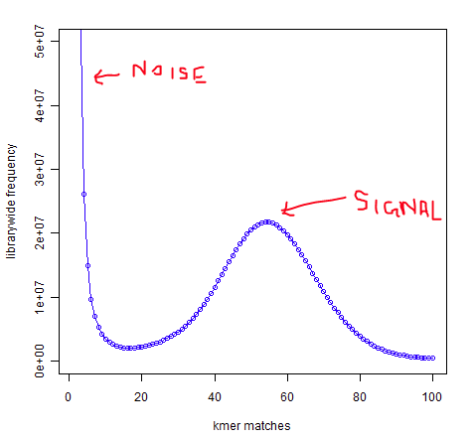
Digging into the kmers
Genome size
Remove low-copy kmers
Identify the coverage peak
Divide total nb of kmers by peak
“Cpeak
20 million distinct kmers occure
55 times in all reads combined”
Genome size = Ktot/Cpeak
Here:
1.4 Gbp = 80 G / 55
Note: Ktot = Nb reads * (L-k+1)
Base coverage = Cpeak
(L-k+1)/L
Here:
69X = 55
(100 – 21 +1)/100

Slide 18
Repeats: first shot
The nb of distinct kmers in the single-copy peak corresponds roughly to the single-copy genome size
Single-copy
Example
Beetle: 0.75 Gbp is single-copy, so almost 40% of the 1.2 Gbp genome is repeated (kmer=27)
Repeats

Slide 19
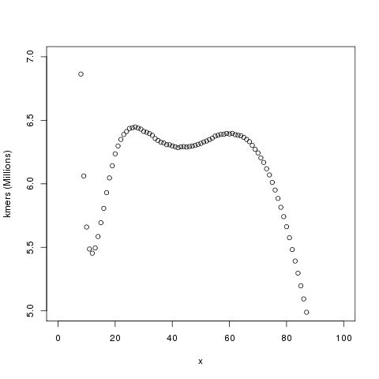
Heterozygosity
Double peak in the kmer histogram; clear indication of heterozygosity
Not entirely easy to quantify (although attempts have been made)

Slide 20
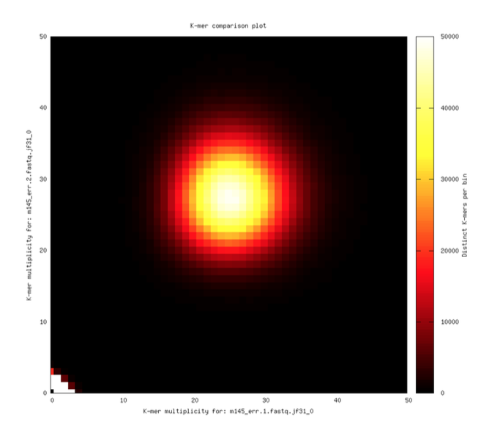
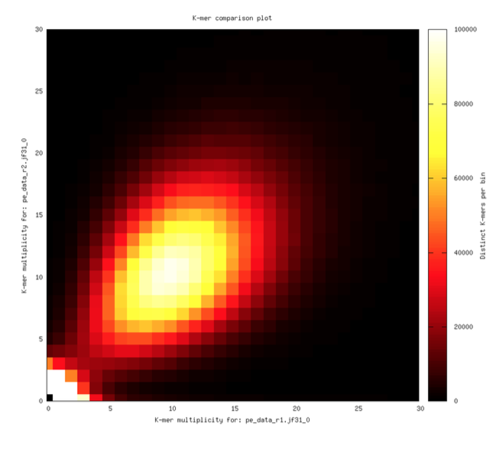
Back to biases
Do read 1 and read 2 have the same bias?
Kmer Analysis Toolkit: A short walkthrough

Slide 21
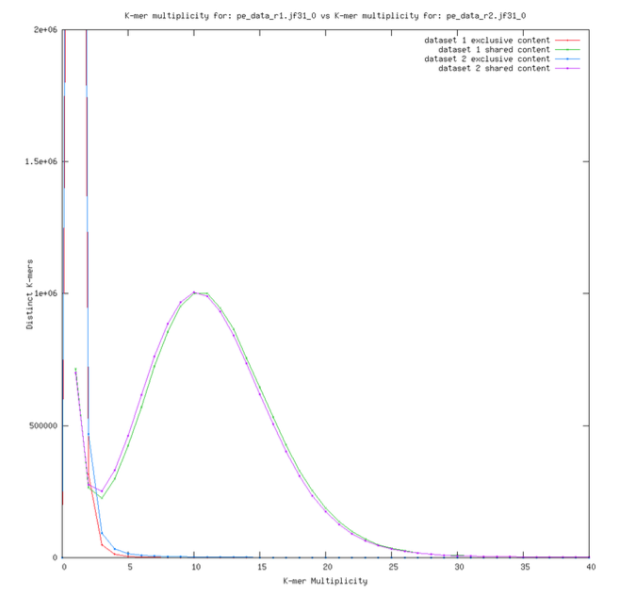
Bias detection and kmer analyses
Do read 1 and read 2 have the same content?

Slide 22
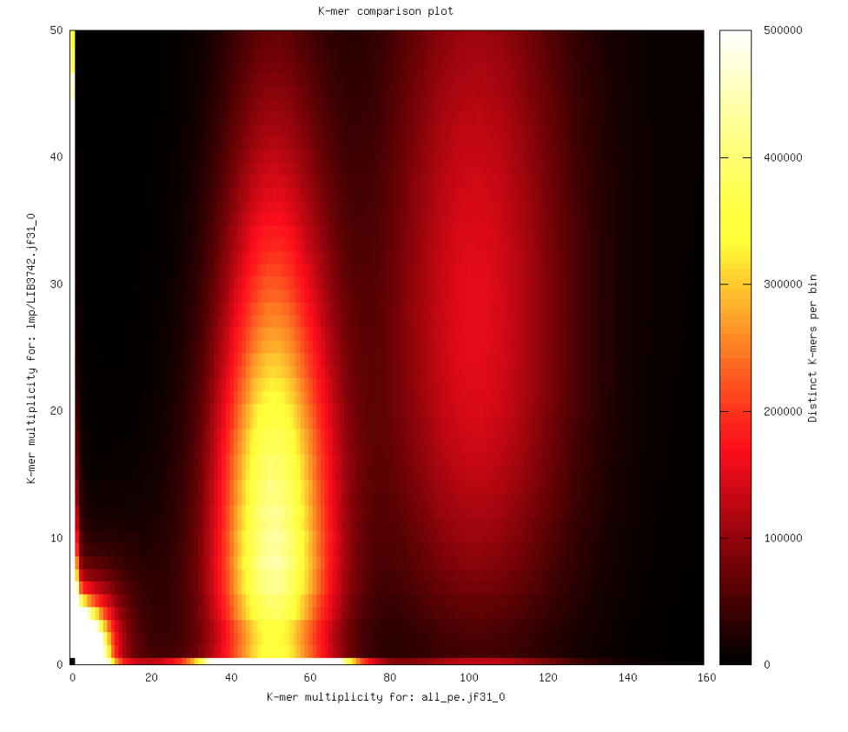
Bias detection and kmer analyses
Are all your runs/libraries affected in the same way?

Slide 23
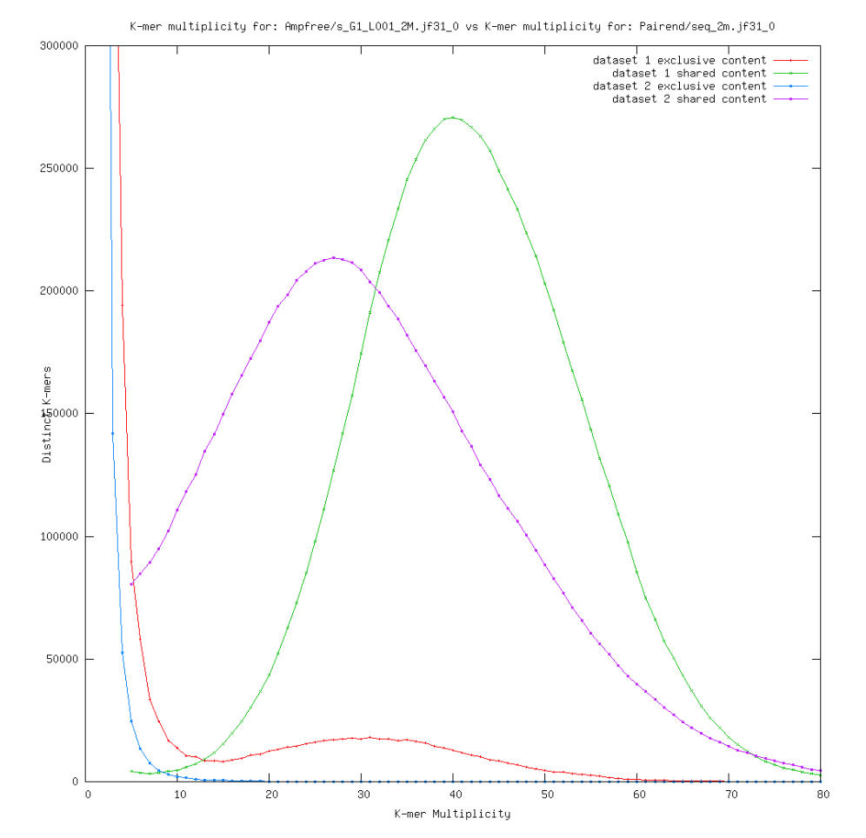
Bias detection and kmer analyses
Do your runs/libraries contain the same data?

Slide 24
Kmer analyses
# compare read 1 vs read 2 or lib A vs lib B
# Density plot
kat comp -p -t 16 -C -D -o $OUTPUT $FWDREAD $REVREAD
# Spectra plot (must run density computation first)
kat plot spectra-mx -n -o ${OUTPUT}_s.png $OUTPUT-main.mx
# Compare GC content
kat gcp -t 16 -C -o $GCOUT $ALLREADS

Slide 25
Error correction and digital normalization
Digital normalization removes high frequency reads
Error correction removes low frequency reads

Slide 26
Estimating repeat content
Create a de novo repeat library
Run a low-coverage (e.g. 0.1X) assembly (e.g. RepeatExplorer or Trinity)
Filter contaminants and mito/chloro
[ Make non-redundant (e.g. Cdhit) ]
Quantify the (high) repeat content by an independent subset of reads
Mapping (e.g. bwa), or
Mask with RepeatMasker

Slide 27
Repeat library from low coverage data
R
R
R’
R
R’’
Sparse
seq data
Overlaps?

Slide 28
Repeat library from low coverage data
R
R
R’
R
R’’
Sparse
seq data
Overlaps?
Assembled contigs

Slide 29
Repeat library from low coverage data
R
R
R’
R
R’’
Sparse
seq data
Overlaps?
Assembled contigs
Warning! Beware of contaminations, plastids etc

Slide 30
Quantify your repeat seqs
R
R
R’
R
R’’
Independent
set of sparse
data
Screen reads with repeat seqs
33% of all bases in the reads are covered by repeat seqs
⬄
33% of the genome is “repeated”
Warning! The quantification depends heavily on the size of the original read set

Slide 31
Classifying repeats
LTR Gypsy/Copia
LINE/SINE
DNA elements
…
Getting tricky…
Classifying the repeat library directly
RepeatMasker
Repeat protein domain serach (http://www.repeatmasker.org/cgi-bin/RepeatProteinMaskRequest)
Problems
No close homologs in databases
Rapid evolution of repeats (like transposable elements)
Non-autonomous TE:s do not contain proteins
Solutions
Fetch intact ORF:s from hits in assembly
Extend assembly matches and get more complete elements
Check match alignment profiles in assembly (LINES conserved at 3’ end but not at 5’..)
=> Often slow, manual, species-specific solutions

Slide 32
Take home
Genome assembly is sometimes reasonably easy, if you are lucky and not too picky. There are tools to indicate which one you are up against.
Filtering data is generally a necessity, but steps depend highly on input. Unless you use ALLPATHS-LG, filter your data.
Genome size and repeat content can (often better!) be estimated without an assembly

Slide 33

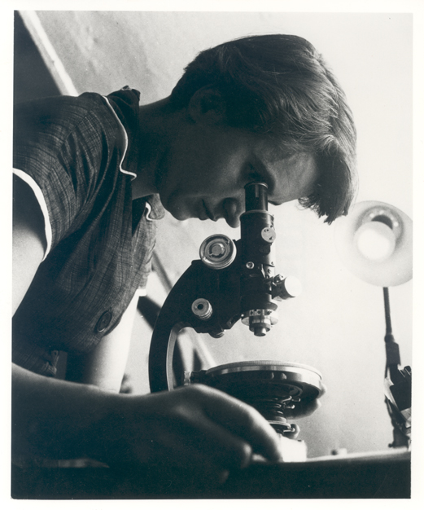
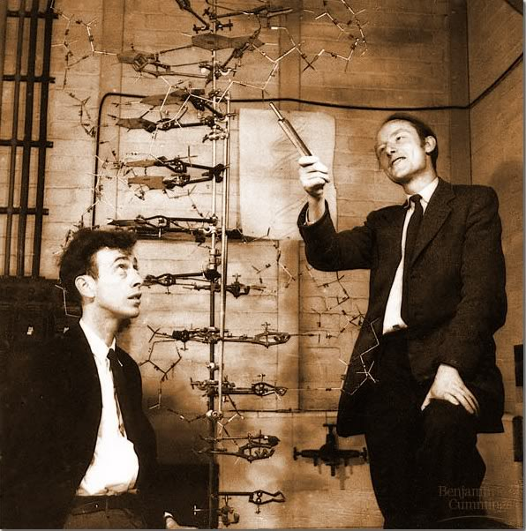
Thanks

