Slide 1
Mutation calling – wrap up

Slide 2
Part one
Where do we find info about alternative allele frequencies based on read depths for a given mutation?

Slide 3
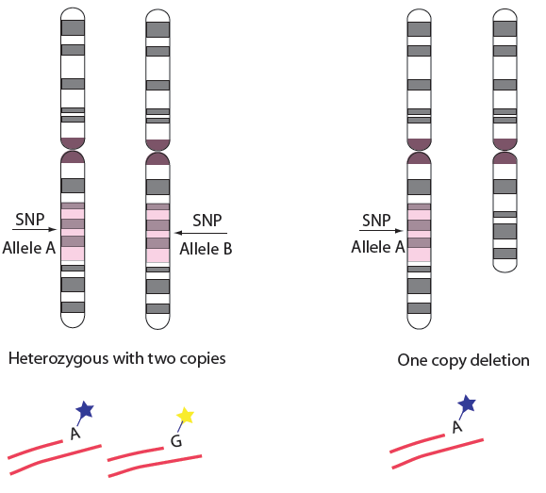
Alternative Allele Frequency
Reference
C
Mutation
A
SNV
Reference: ACGGCTAGCGTAGCAT
C
A
C
C
C
A
# reads A
AF =
= 0.33
# reads A + # reads C

Slide 4
Look in the mutect.vcf file
#CHROM POS ID REF ALT QUAL FILTER INFO FORMAT HCC1143.normal HCC1143.tumor
17 1001315 . C T . REJECT . GT:AD:BQ:DP:FA 0:51,3:.:54:0.056 0/1:29,2:23:33:0.065
17 1001331 . G T . REJECT . GT:AD:BQ:DP:FA 0:30,3:.:33:0.091 0/1:15,2:34:17:0.118
17 1003390 . G A . REJECT . GT:AD:BQ:DP:FA 0:17,2:.:18:0.105 0/1:16,1:28:17:0.059
17 1004967 . A T . REJECT . GT:AD:BQ:DP:FA 0:28,1:.:29:0.034 0/1:16,4:15:20:0.200
17 1004974 . C T . REJECT . GT:AD:BQ:DP:FA 0:27,2:.:29:0.069 0/1:11,3:13:14:0.214
17 1024903 . C T . PASS SOMATIC GT:AD:BQ:DP:FA:SS 0:106,0:.:102:0.00:0 0/1:84,6:34:90:0.067:2
17 1277664 . C A . PASS SOMATIC GT:AD:BQ:DP:FA:SS 0:59,0:.:59:0.00:0 0/1:41,25:34:66:0.379:2
1527066 . C G . PASS SOMATIC GT:AD:BQ:DP:FA:SS 0:35,0:.:31:0.00:0 0/1:26,5:29:31:0.161:2
FORMAT (Each code is described in VCF header)
GT:AD:BQ:DP:FA
GT=Genotype
AD=Allelic depths for the ref and alt alleles in the order listed
BQ=Average base quality for reads supporting alleles
DP=Approximate read depth
FA=Allele fraction of the alternate allele with regard to reference
SS=Variant status
(0=wildtype,1=germline,2=somatic,3=LOH,4=post-transcriptional modification,5=unknown”)

Slide 5
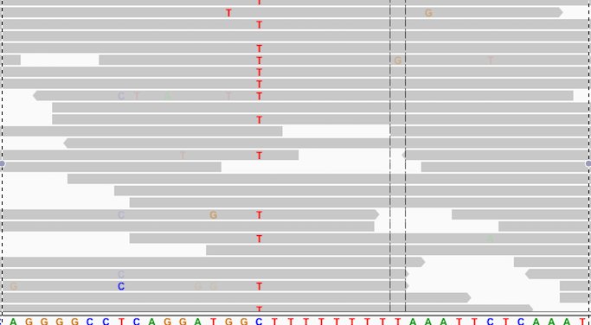
Allelic depths in IGV
AD=Allelic depths for the ref and alt alleles in the order listed
Reference = C Alternative = T
AD=13,13

Slide 6
Todays Practical part two
Analyze how various degrees of normal contamination of the tumor sample affects allele frequencies
Do the alternative allele frequency distributions for the different tumor/normal muxtures “fit” with what you would expect?
Normal
tumor
20/80
40/60
60/40
80/20

