Slide 1
Science for Life Laboratory
Eva Molin
Project coordinator

Slide 2
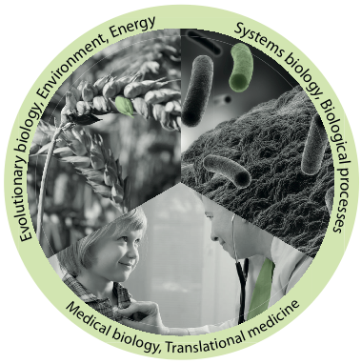
Develops, offers and applies
advanced technologies for molecular biosciences with a focus on health and environment
Joint Uppsala – Stockholm center with two nodes
Hosted by four universities
Official start, 1 July 2013
Approximately 1500 researchers by mid 2014
Infrastructure for molecular bioscience

Slide 3
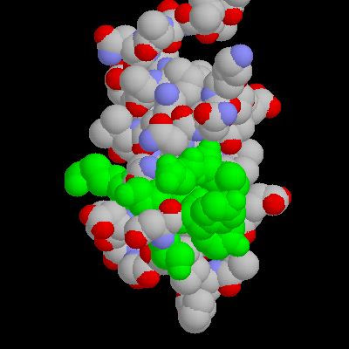
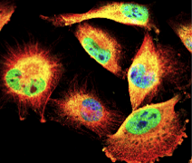

DNA/RNA
Proteins
Cells
Organism
Health
Environment

Slide 4
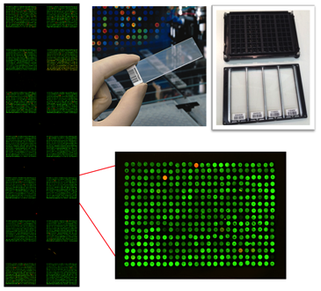
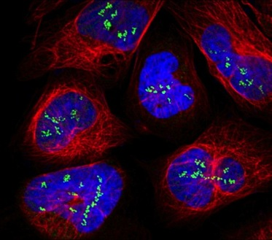
SciLifeLab mission
Technology platforms for national use
Service
Technology Development
Analytical support
Courses and workshops
Generate a strong research environment
Affiliated faculty
SciLifeLab Fellows Program
National projects
International collaborations

Slide 5
Upcoming courses
Date | Course
April 12-14 | RNA-seq
April 26-27 | Introduction to Genome Annotation
May 23-27 | Perl Programming with Application to Bioinformatics
October 10-14 | Perl Programming with Application to Bioinformatics
October 25-27 | RNA-seq
November 15-16 | De novo Genome Assembly
November 22-23 | Metagenomics
Application Nov/Dec | The Swedish Bioinformatics Advisory Program

Slide 6
Upcoming courses
Date | Course
April 12-14 | RNA-seq
April 26-27 | Introduction to Genome Annotation
May 23-27 | Perl Programming with Application to Bioinformatics
October 10-14 | Perl Programming with Application to Bioinformatics
October 25-27 | RNA-seq
November 15-16 | De novo Genome Assembly
November 22-23 | Metagenomics
Application Nov/Dec | The Swedish Bioinformatics Advisory Program

Slide 7


Science & SciLifeLab Prize
A grand prize winner receives a prize of US $30,000; and each of the three category winners will receive US $10,000
The grand prize winning essay will be published in Science and essays from the three category winners will be published online
“to incent our best and brightest to continue in their chosen fields of research”
Notes:
Cell and Molecular Biology
Ecology and Environment
Genomics and Proteomics
Translational Medicine

Slide 8
www.scilifelab.se

