Slide 1
Simulating Open Quantum Dynamics
Problem: infinite nature of the baths (also at equilibrium)

Slide 2
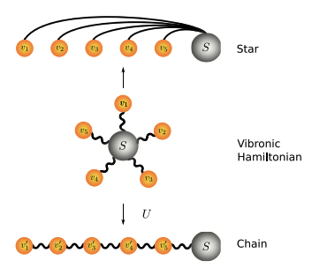
1. (a) Mapping techniques

Slide 3
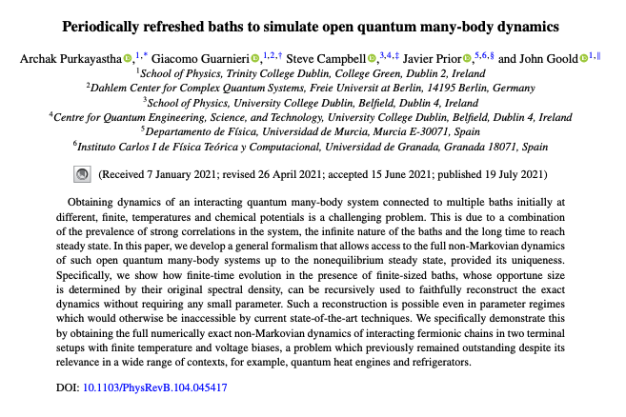
1. (b) Periodically Refreshed baths

Slide 4

Anharmonic->Harmonic Mapping

Slide 5
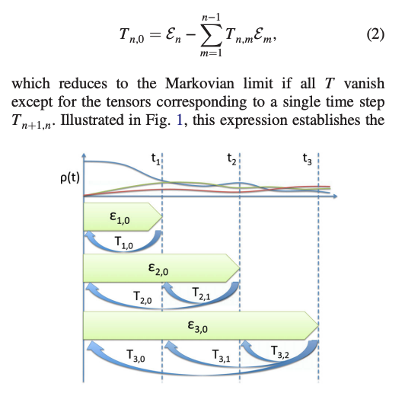
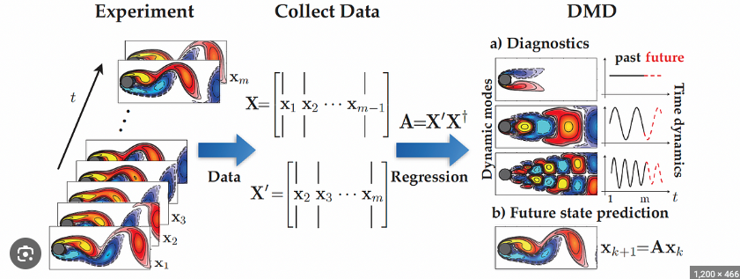
Data Driven

Slide 6
Interesting Phenomena

Slide 7
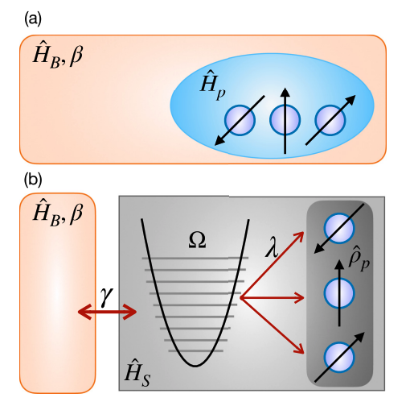
Quantum Sensing
Also, the work in progress with the GQME-PI method

Slide 8
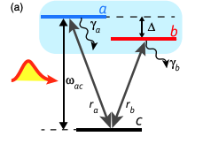
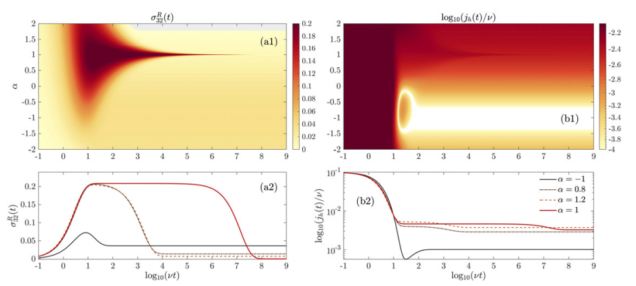
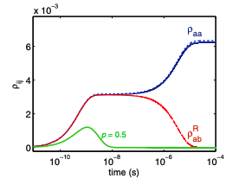
Long lived coherences (also NE coherences)

Slide 9
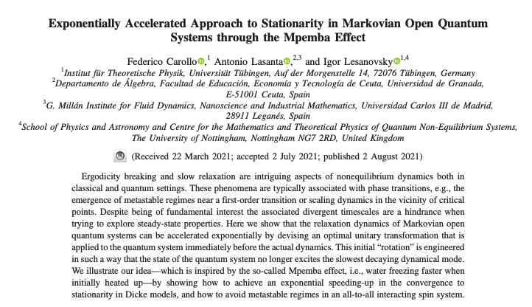
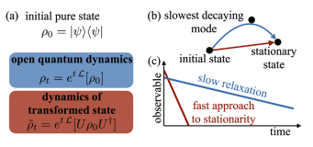
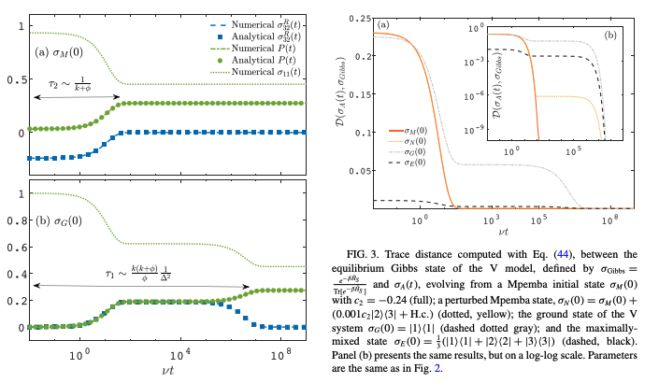
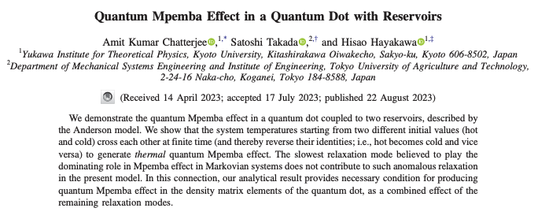
Dynamical Acceleration

Slide 10
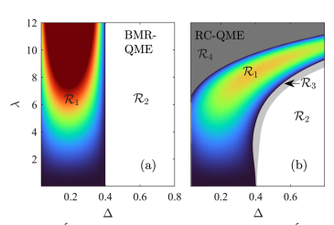
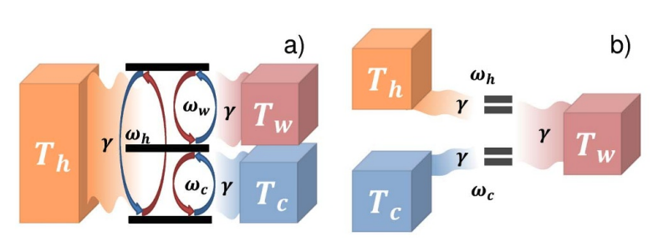
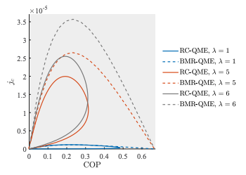
Quantum Thermal Machines

