Slide 1
Data Mining
Association Analysis: Basic Concepts and Algorithms
Lecture Notes for Chapter 6
Introduction to Data Mining
by
Tan, Steinbach, Kumar
Modified by
Longbiao CHEN
© Tan,Steinbach, Kumar Introduction to Data Mining 4/18/2004 <number>

Slide 2
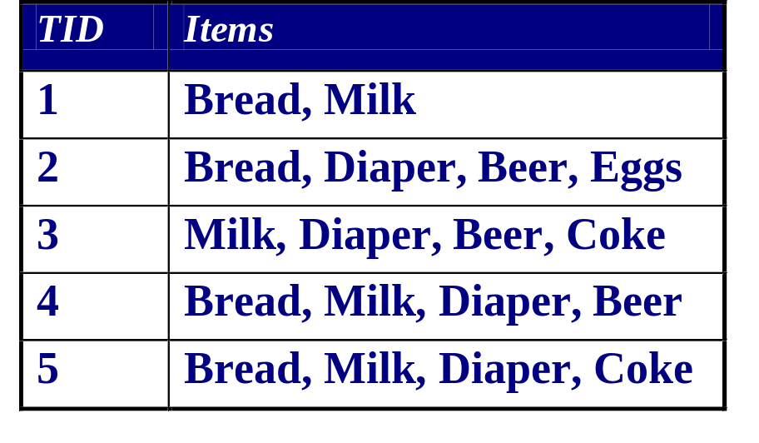
Association Rule Mining
Given a set of transactions, find rules that will predict the occurrence of an item based on the occurrences of other items in the transaction
Market-Basket transactions
Example of Association Rules
{Diaper} → {Beer},
{Milk, Bread} → {Eggs,Coke},
{Beer, Bread} → {Milk},
Implication means co-occurrence, not causality!

Slide 3
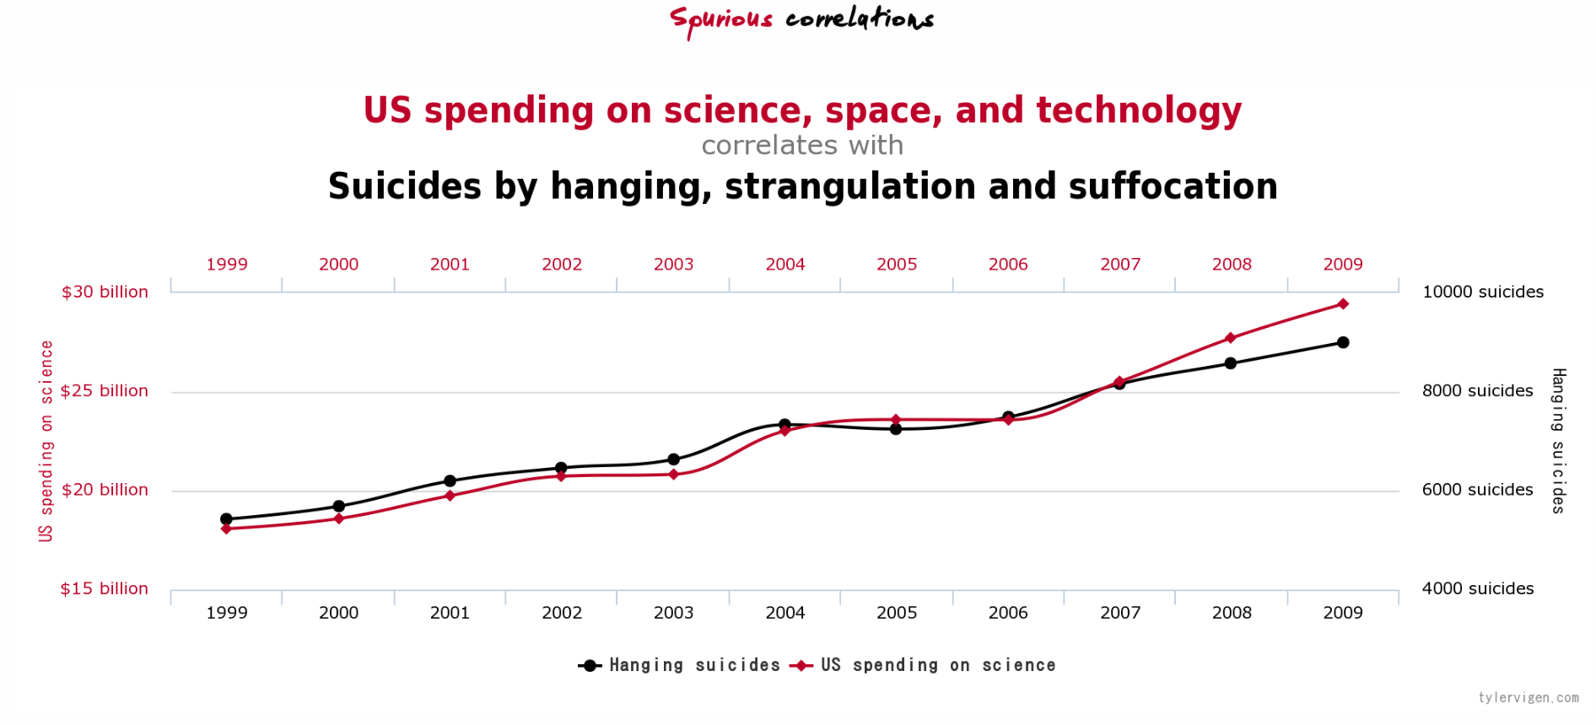
Correlation does not imply causation
As ice cream sales increase, the rate of drowning deaths increases sharply.
Therefore, ice cream consumption causes drowning.
Source: http://www.tylervigen.com/spurious-correlations

Slide 4
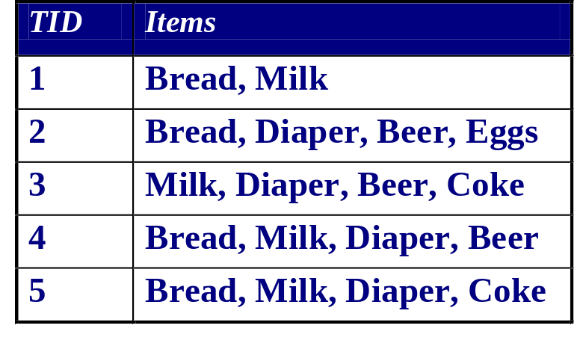
Definition: Frequent Itemset
Itemset
  A collection of one or more items
    Example: {Milk, Bread, Diaper}
  k-itemset
    An itemset that contains k items
Support count (σ)
  Frequency of occurrence of an itemset
  E.g. σ({Milk, Bread,Diaper}) = 2
Support
  Fraction of transactions that contain an itemset
  E.g. s({Milk, Bread, Diaper}) = 2/5
Frequent Itemset
  An itemset whose support is greater than or equal to a minsup threshold

Slide 5

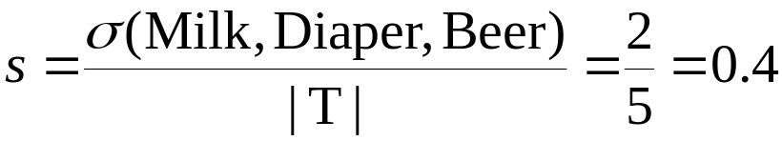
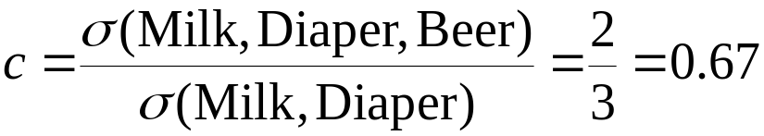
Definition: Association Rule
Association Rule
  An implication expression of the form X → Y, where X and Y are itemsets
  Example:
  {Milk, Diaper} → {Beer}
Rule Evaluation Metrics
  Support (s)
    Fraction of transactions that contain both X and Y
  Confidence (c)
    Measures how often items in Y
    appear in transactions that
    contain X
Example:

Slide 6
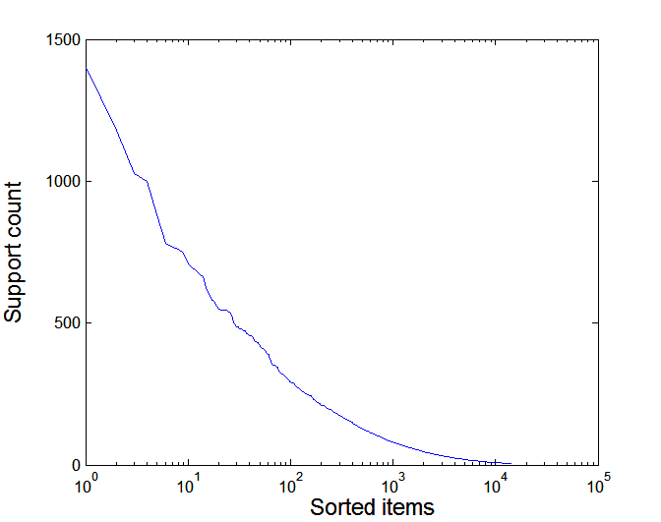
Example: Support Distribution
Many real data sets have skewed support distribution
Support distribution of a retail data set

Slide 7
Association Rule Mining Task
Given a set of transactions T, the goal of association rule mining is to find all rules having
  support ≥ minsup threshold
  confidence ≥ minconf threshold
Brute-force approach:
  List all possible association rules
  Compute the support and confidence for each rule
  Prune rules that fail the minsup and minconf thresholds
  ⇒ Computationally prohibitive!

Slide 8
Mining Association Rules
Example of Rules:
{Milk,Diaper} → {Beer} (s=0.4, c=0.67)
{Milk,Beer} → {Diaper} (s=0.4, c=1.0)
{Diaper,Beer} → {Milk} (s=0.4, c=0.67)
{Beer} → {Milk,Diaper} (s=0.4, c=0.67)
{Diaper} → {Milk,Beer} (s=0.4, c=0.5)
{Milk} → {Diaper,Beer} (s=0.4, c=0.5)
Observations:
All the above rules are binary partitions of the same itemset:
{Milk, Diaper, Beer}
Rules originating from the same itemset have identical support but
can have different confidence
Thus, we may decouple the support and confidence requirements

Slide 9
Mining Association Rules
Two-step approach:
  Frequent Itemset Generation
    Generate all itemsets whose support ≥ minsup
  Rule Generation
    Generate high confidence rules from each frequent itemset, where each rule is a binary partitioning of a frequent itemset
Frequent itemset generation is still computationally expensive

Slide 10
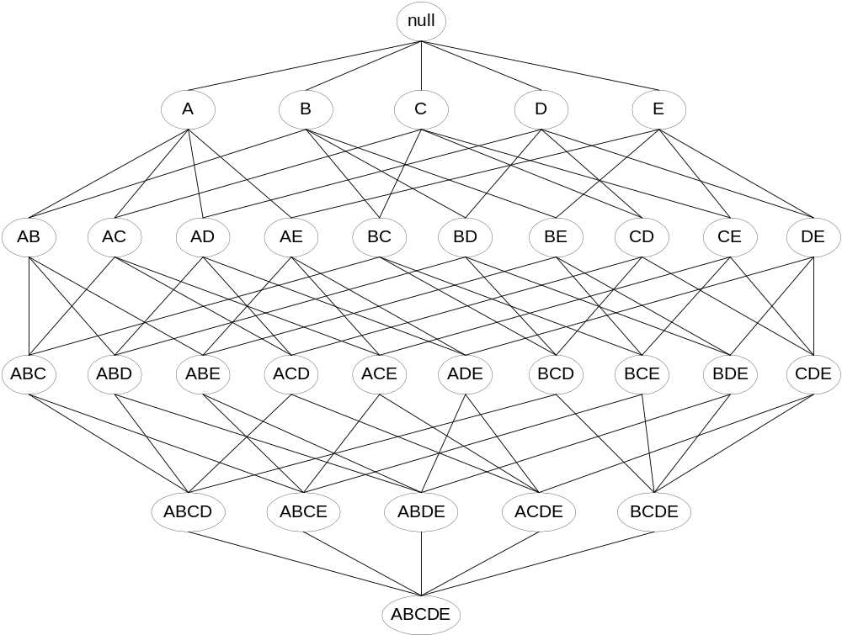
Frequent Itemset Generation
Given d items, there are 2^{d} possible candidate itemsets

Slide 11
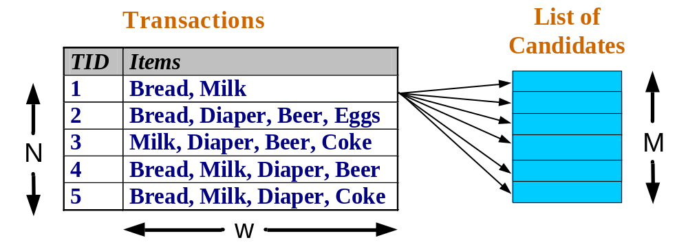
Frequent Itemset Generation
Brute-force approach:
  Each itemset in the lattice is a candidate frequent itemset
  Count the support of each candidate by scanning the database
  Match each transaction against every candidate
  Complexity ~ O(NMw) => Expensive since M = 2^{d} !!!

Slide 12
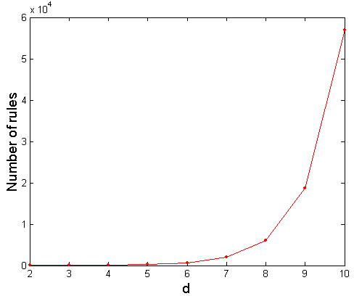
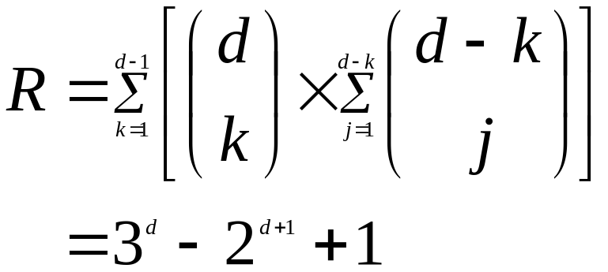
Computational Complexity
Given d unique items:
  Total number of itemsets = 2^{d}
  Total number of possible association rules:
If d=6, R = 602 rules

Slide 13
Frequent Itemset Generation Strategies
Reduce the number of candidates (M)
  Complete search: M=2^{d}
  Use pruning techniques to reduce M
Reduce the number of transactions (N)
  Reduce size of N as the size of itemset increases
  Used by DHP and vertical-based mining algorithms
Reduce the number of comparisons (NM)
  Use efficient data structures to store the candidates or transactions
  No need to match every candidate against every transaction

Slide 14
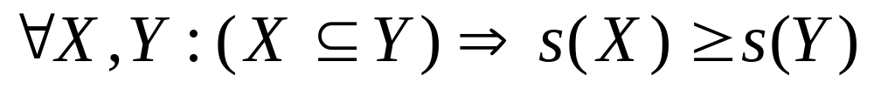
Reducing Number of Candidates
Apriori principle:
  If an itemset is frequent, then all of its subsets must also be frequent
Apriori principle holds due to the following property of the support measure:
  Support of an itemset never exceeds the support of its subsets
  This is known as the anti-monotone property of support

Slide 15
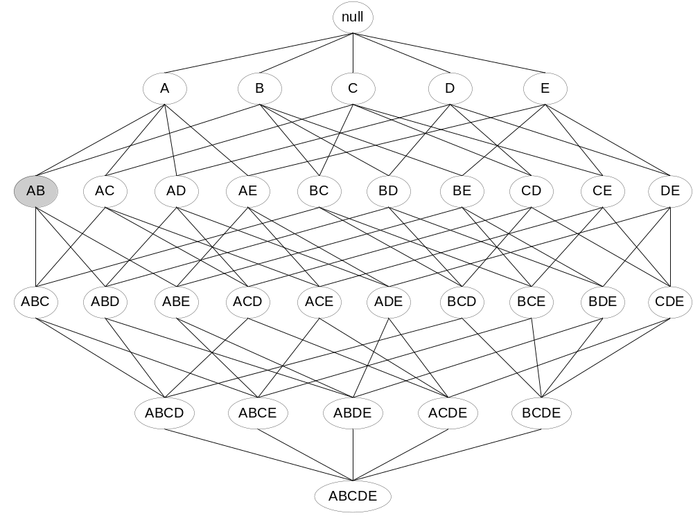
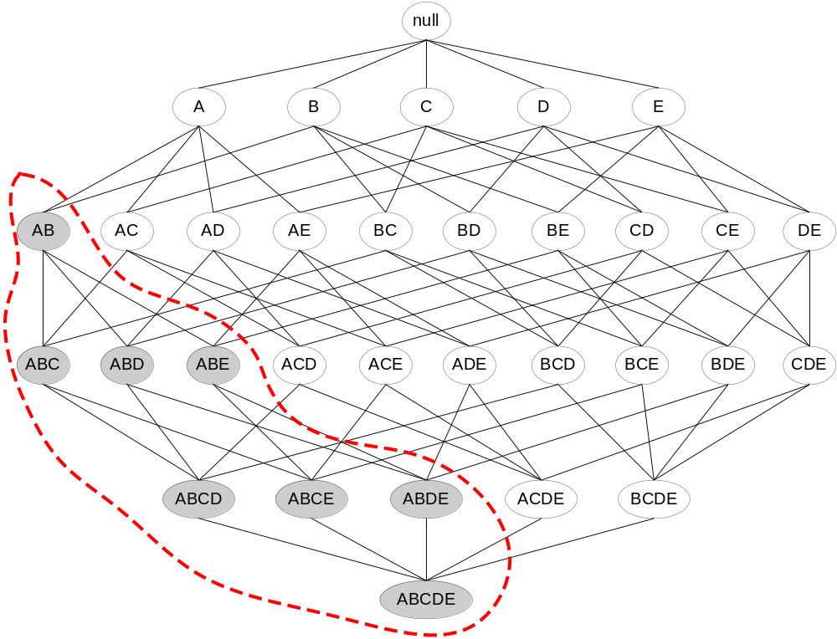
Illustrating Apriori Principle
Found to be Infrequent
Pruned supersets

Slide 16
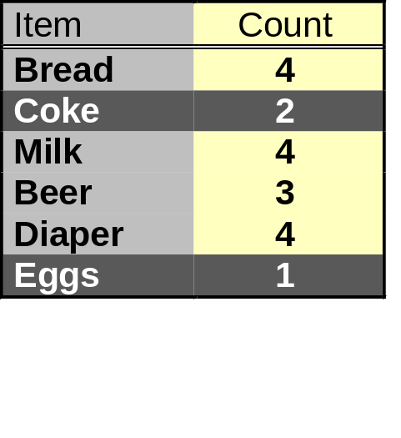
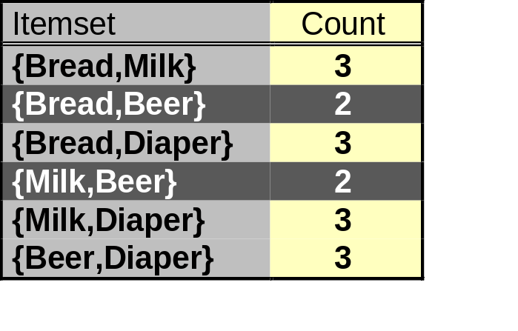
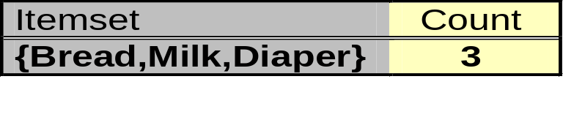
Illustrating Apriori Principle
Items (1-itemsets)
Pairs (2-itemsets)
(No need to generate
candidates involving Coke
or Eggs)
Minimum Support = 3
Triplets (3-itemsets)
If every subset is considered,
⁶C₁ + ⁶C₂ + ⁶C₃ = 41
With support-based pruning,
6 + 6 + 1 = 13

Slide 17
Apriori Algorithm
Method:
  Let k=1
  Generate frequent itemsets of length 1
  Repeat until no new frequent itemsets are identified
    Generate length (k+1) candidate itemsets from length k frequent itemsets
    Prune candidate itemsets containing subsets of length k that are infrequent
    Count the support of each candidate by scanning the DB
    Eliminate candidates that are infrequent, leaving only those that are frequent

Slide 18
Factors Affecting Complexity
Choice of minimum support threshold
  lowering support threshold results in more frequent itemsets
  this may increase number of candidates and max length of frequent itemsets
Dimensionality (number of items) of the data set
  more space is needed to store support count of each item
  if number of frequent items also increases, both computation and I/O costs may also increase
Size of database
  since Apriori makes multiple passes, run time of algorithm may increase with number of transactions
Average transaction width
  transaction width increases with denser data sets
  This may increase max length of frequent itemsets and traversals of hash tree (number of subsets in a transaction increases with its width)

Slide 19
Rule Generation
Given a frequent itemset L, find all non-empty subsets f ⊂ L such that f → L – f satisfies the minimum confidence requirement
  If {A,B,C,D} is a frequent itemset, candidate rules:
    ABC →D, ABD →C, ACD →B, BCD →A,
    A →BCD, B →ACD, C →ABD, D →ABC
    AB →CD, AC → BD, AD → BC, BC →AD,
    BD →AC, CD →AB,
If |L| = k, then there are 2^{k} – 2 candidate association rules (ignoring L → ∅ and ∅ → L)

Slide 20
Rule Generation
How to efficiently generate rules from frequent itemsets?
  In general, confidence does not have an anti-monotone property
    c(ABC →D) can be larger or smaller than c(AB →D)
  But confidence of rules generated from the same itemset has an anti-monotone property
  e.g., L = {A,B,C,D}:
  c(ABC → D) ≥ c(AB → CD) ≥ c(A → BCD)
    Confidence is anti-monotone w.r.t. number of items on the right hand side of the rule

Slide 21
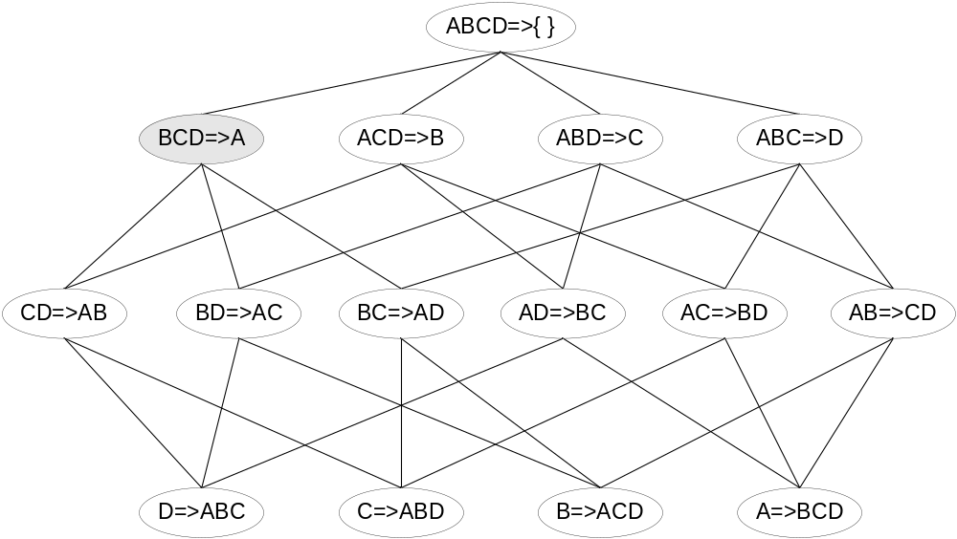
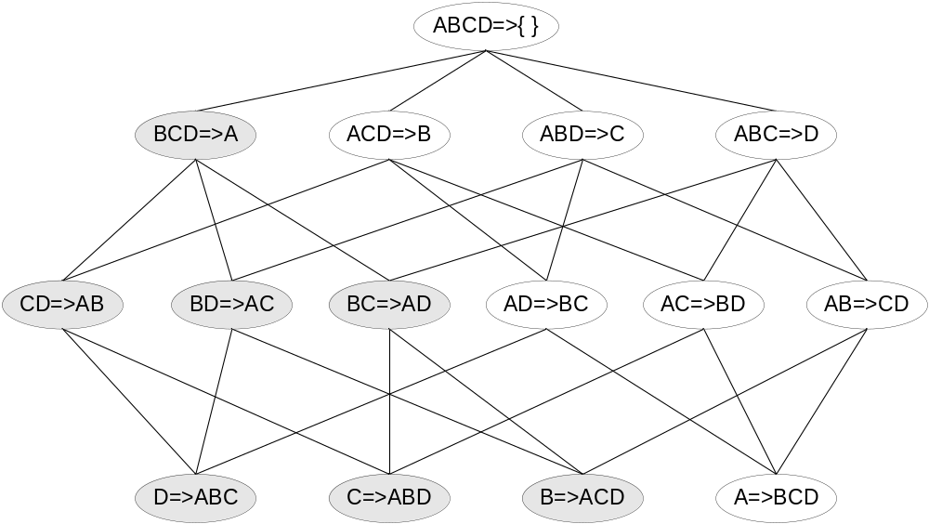
Rule Generation for Apriori Algorithm
Lattice of rules
Low Confidence Rule
Pruned Rules

Slide 22
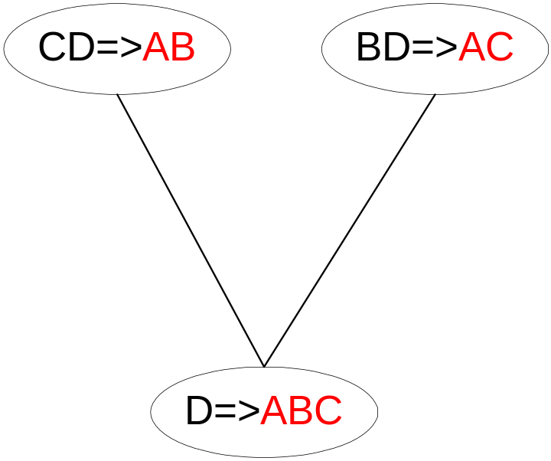
Rule Generation for Apriori Algorithm
Candidate rule is generated by merging two rules that share the same prefix
in the rule consequent
join(CD=>AB,BD=>AC)
would produce the candidate
rule D => ABC
Prune rule D=>ABC if its
subset CD=>AB does not have
high confidence

