Slide 1


When Does AI Apply Its Own Judgment to Stock Ratings?
Controlled S&P 500 Recommendation Experiment — Pilot Findings and Protocol Correction
Research question: Does an AI merely echo direct analyst ratings, or does its classification change systematically when its permitted evidence changes?
v1.2.0 live pilot completed 24 July 2026
Model snapshot: gpt-5.4-2026-03-05
Research classification — not investment advice.

Slide 2
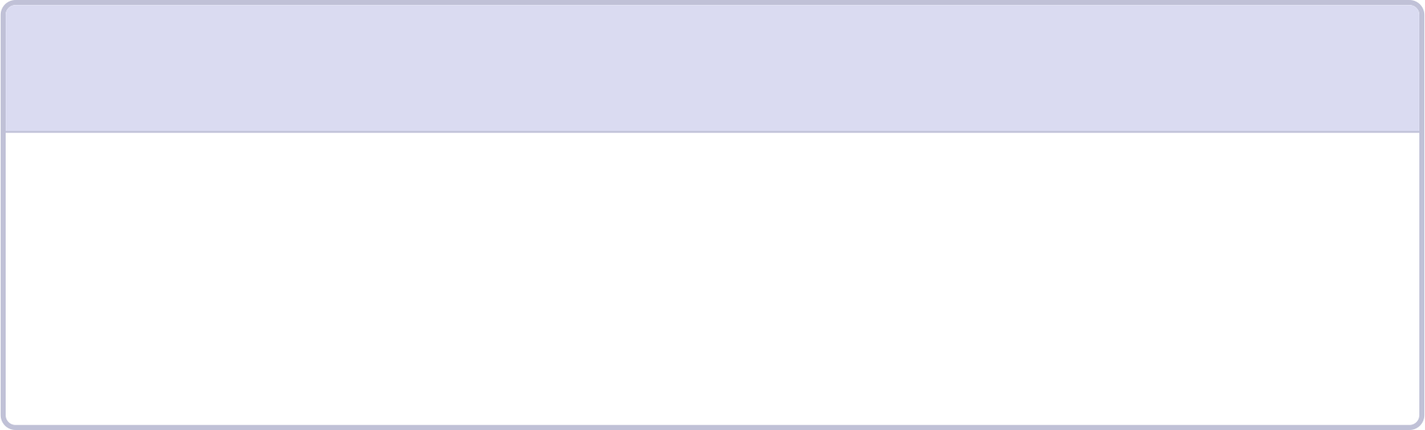

Four Controlled AI Environments
Held constant across all conditions: model, 12-month SPY-relative target, five-level rating scale, and output schema. Adjacent-condition differences isolate the effect of each added evidence layer.
1
2
A — Memory Only
B — Price History
Company identity and sector; no supplied dated evidence; no web access.
Condition A plus up to 24 monthly adjusted-price and volume observations; no web access.
3
4
C — Quantitative
D — Current Web
Condition B plus calculated technical, market-relative, sector-relative, and compact fundamental data; no web access.
The exact same packet as C plus web search through the cutoff date.
Key design principle: Adjacent-condition differences isolate the effect of each added evidence layer.

Slide 3
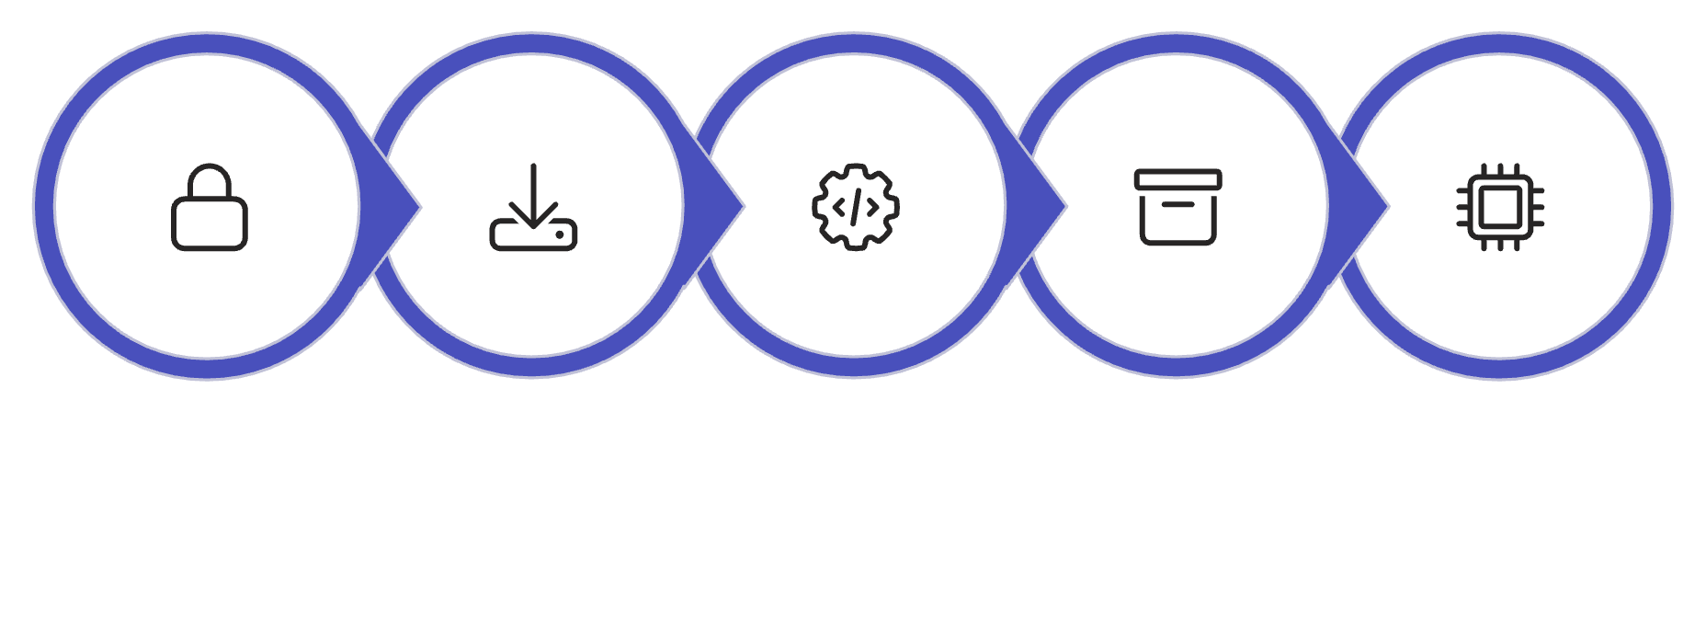
What Was Built and How It Is Controlled
Safeguards Implemented in v1.3.0
All 11 GICS sectors resolved from Yahoo metadata and mapped to sector ETFs.
Strict acquisition gate applies to every paid run.
No post-cutoff or malformed evidence accepted.
Web enabled only for Condition D.
C and D packet identity is hashed and checked.
Returned failure payloads and usage are retained when available.
Direct analyst rating baselines remain outside model packets.
Pipeline
Freeze Universe
Acquire Data
Compute Features
Build Packets
Call Model
v1.2.0 status: Completed pilot; results are immutable and final.
v1.3.0 status: Hardened code ready for the next run; not yet executed.

Slide 4
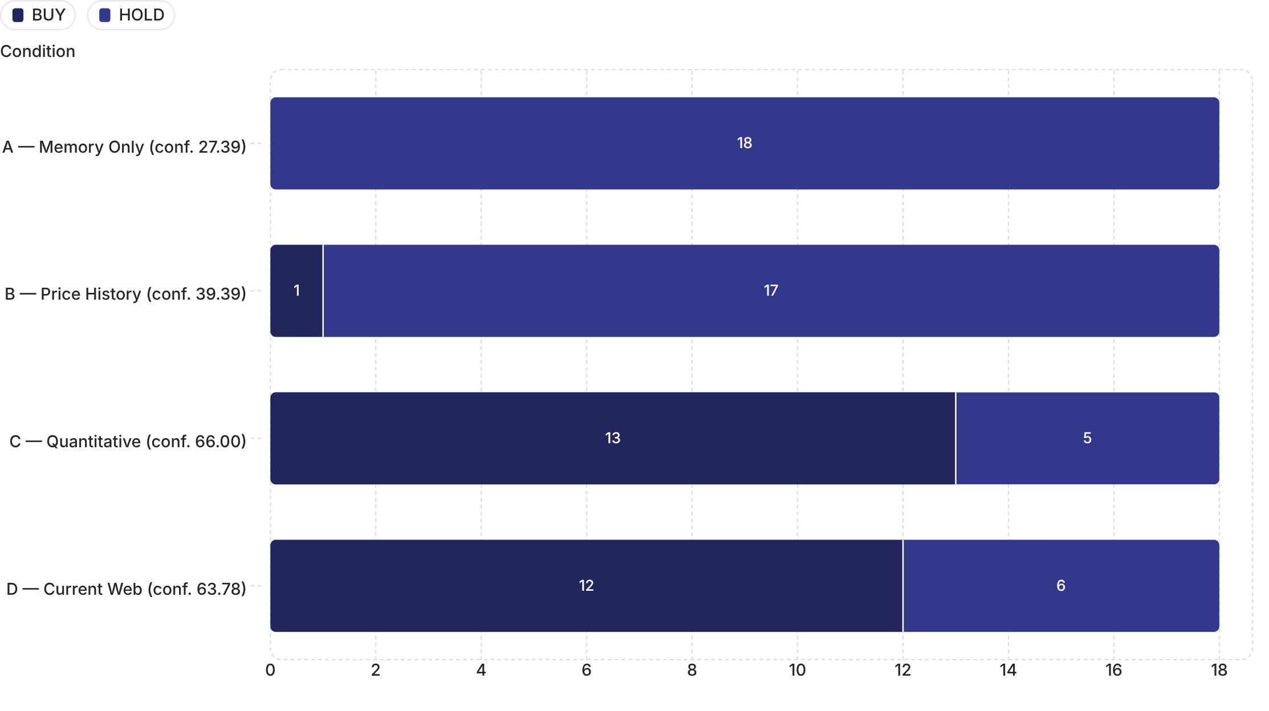

Live v1.2 Six-Stock Pilot: Main Result
Pilot: AAPL, JNJ, JPM, KO, MU, NEE × 4 conditions × 3 repetitions = 72 final cells. Two original D responses were truncated; only those exact prompts were retried. Final dataset: 72 valid cells after 74 API attempts.
BUY / HOLD Counts and Mean Confidence by Condition
Key finding: The largest shift occurred when structured quantitative evidence was introduced (A→B→C), not when web search was added (C→D).

Slide 5
Web Access and Direct Analyst-Rating Comparison
Incremental Web Effect (C vs. D)
Exact Matches with Analyst Baselines
C versus D changed in 9 of 18 matched repetitions — 5 BUY→HOLD and 4 HOLD→BUY. Mean signed ordinal change = −0.0556. Web access did not simply increase bullishness.
No final assessment reported analyst ratings as used; one D assessment reported analyst information encountered but not used.
Direct Rating Baselines
Direct rating baselines were withheld from all prompts. Yahoo count-normalized baseline = BUY for all six stocks. Yahoo portal label = BUY for five stocks and STRONG BUY for MU.
Condition C
Condition D
Count baseline: 72.2%
Portal baseline: 66.7%
Count baseline: 66.7%
Portal baseline: 50.0%
Research classification — not investment advice.

Slide 6


What the Pilot Can — and Cannot — Show
Observable behavior only, not access to private reasoning.
Supported by v1.2.0
Important Design Caveat
Ratings changed when evidence changed.
The v1.2.0 C/D packet included Yahoo forward P/E. Forward P/E can incorporate analyst forecast earnings. Therefore direct Buy/Hold/Sell baselines were withheld, but zero analyst-derived influence cannot be claimed.
C and D differed in both directions.
v1.3.0 Protocol Correction
Some sufficient-evidence ratings disagreed with direct analyst baselines.
Forward P/E is removed. Run a corrected six-stock pilot before the full universe.
16 of 24 stock-condition groups were unanimous; mean modal agreement = 88.9%.
Interpretation: the current pilot demonstrates information sensitivity and direct-rating disagreement. It does not prove independent internal reasoning or investment skill.

Slide 7
Validation, Cost, and Next Decision
Validation Summary
Next Decision Sequence
39 automated tests plus 32 subtests pass.
Credential-free artifact validator reports PASS_WITH_WARNINGS with zero hard failures.
All 72 final prompts and raw successful responses are present.
C and D packets are identical for each stock.
Web calls: 0 in A/B/C and 107 in D.
Evidence audit: 532 items, 0 invalid dates, 0 post-cutoff dates.
Two official PDF URLs remain flagged for manual trace review.
01
Approve Feasibility Boundary
Approve Yahoo's unofficial feasibility boundary and corrected-pilot budget.
02
Run Corrected Pilot
Cost
Run the v1.3.0 six-stock pilot without forward P/E.
Recorded v1.2 lower bound = $4.486485; usage for two failed original calls is unknown.
Current State Street snapshot = 504 securities dated 23 July 2026.
Pilot-average planning estimate: approximately $126 for one full-universe repetition or $377 for three. Not a budget guarantee.
03
Approve Full-Universe Run
Approve full-universe repetitions, retry headroom, and budget.
04
Execute and Evaluate
Run all 504 rows and later evaluate a timestamped portfolio prospectively against SPY.
The pilot is complete, the design limitation is disclosed, and the full paid run remains deliberately stopped. Research classification — not investment advice.

