Slide 1




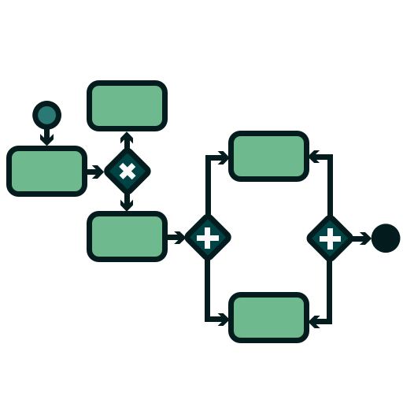





ActivitiesExtraction
Input
Plain Process Text & Model Choice
API Calls
ActorsExtraction
User
visualized
WorkflowModel
Prompt-Engineering-Templates

