Slide 1
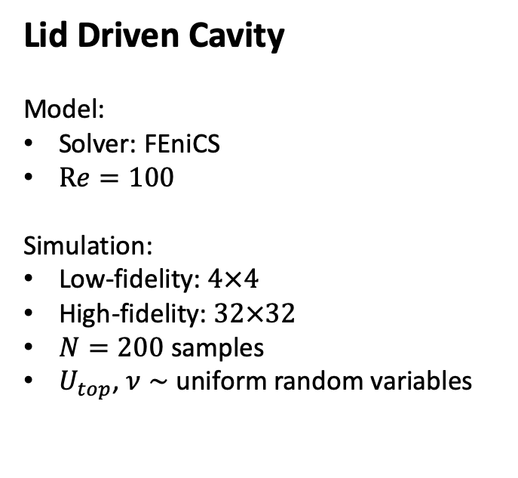
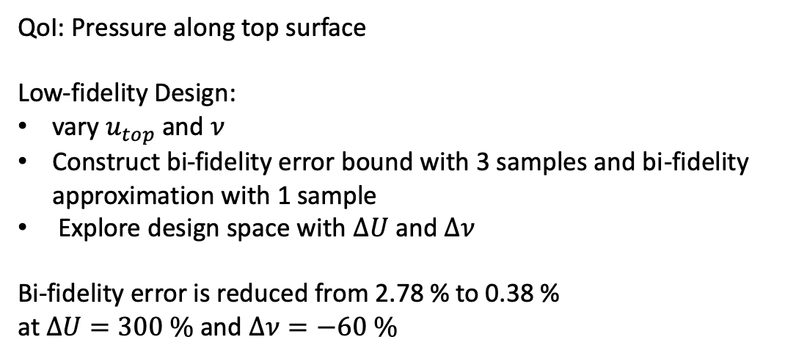
Lid Driven Cavity
Model:
Solver: FEniCS
$Re=100$
Simulation:
Low-fidelity: $4×4$
High-fidelity: $32×32$
$N=200$ samples
$U_{top}$, $ν∼$ uniform random variables
QoI: Pressure along top surface
Low-fidelity Design:
vary $u_{top}$ and $ν$
Construct bi-fidelity error bound with 3 samples and bi-fidelity approximation with 1 sample
Explore design space with $ΔU$ and $Δν$
Bi-fidelity error is reduced from 2.78 % to 0.38 %
at $ΔU=300 \%$ and $Δν=−60 \%$
Response surface generated from 100 samples via PCE with error of 0.17 %

