Slide 1
Enjoy-SQL
Enjoy learning SQL and have looooooots of fun

Slide 2

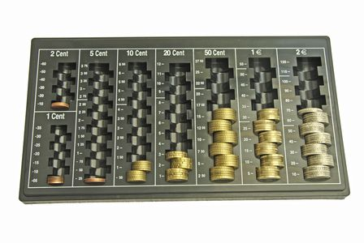
Organizing of data collections
SQL

Slide 3

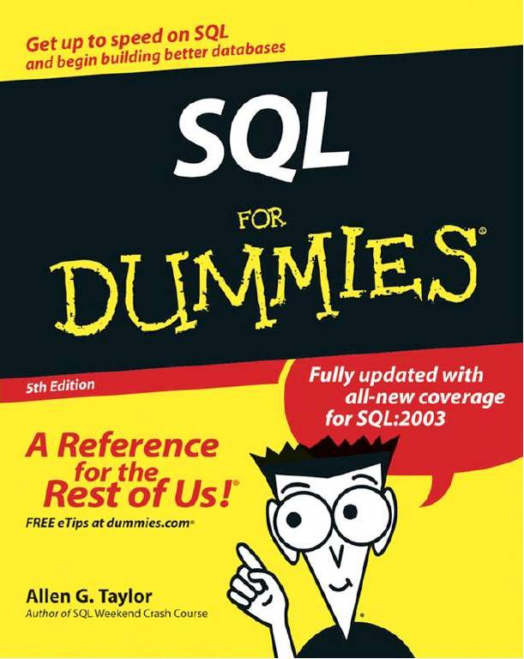
Learning is arduous

Slide 4
Playing instead of learning
Game
Assumption: Player doesn't know SQL
Gameplay is fun
Goal: Player improves SQL knowledge

Slide 5
Solution Approach

Slide 6
Gameplay

Slide 7

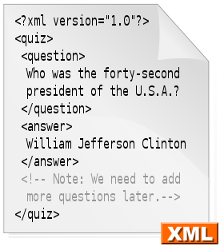
Background Logic
Data handling with databases
Using SQLite
Local data for the user progress
Servers to store the logic database of the game and the stories
User state can be stored to a file with value pairs
User doesn‘t lose the data from current view
Dynamically created stories with exercises
Stories can be uploaded from xml files with xml-loader

Slide 8
LIVE DEMO

Slide 9
Future Work

