Slide 1
Enjoy-SQL
Enjoy learning SQL and have looooooots of fun

Slide 2

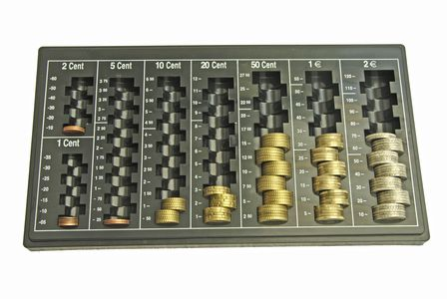
Organizing of data collections
SQL

Slide 3

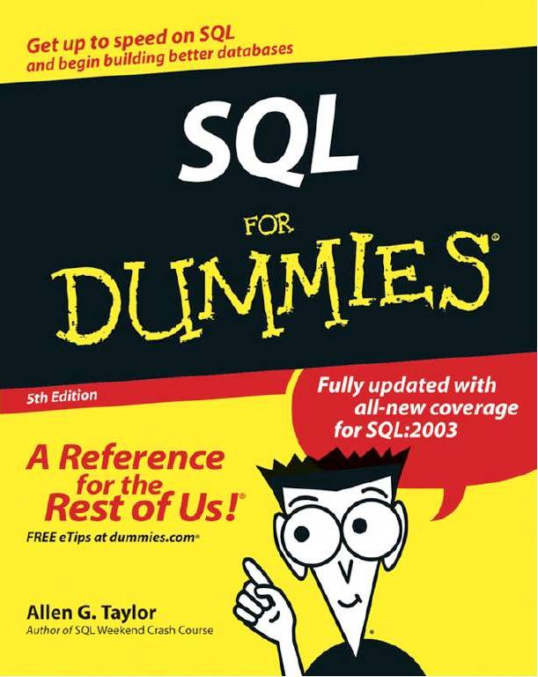
Learning is arduous

Slide 4
Playing instead of learning
Game
Assumption: Player doesn't know SQL
Gameplay is fun
Goal: Player improves SQL knowledge

Slide 5

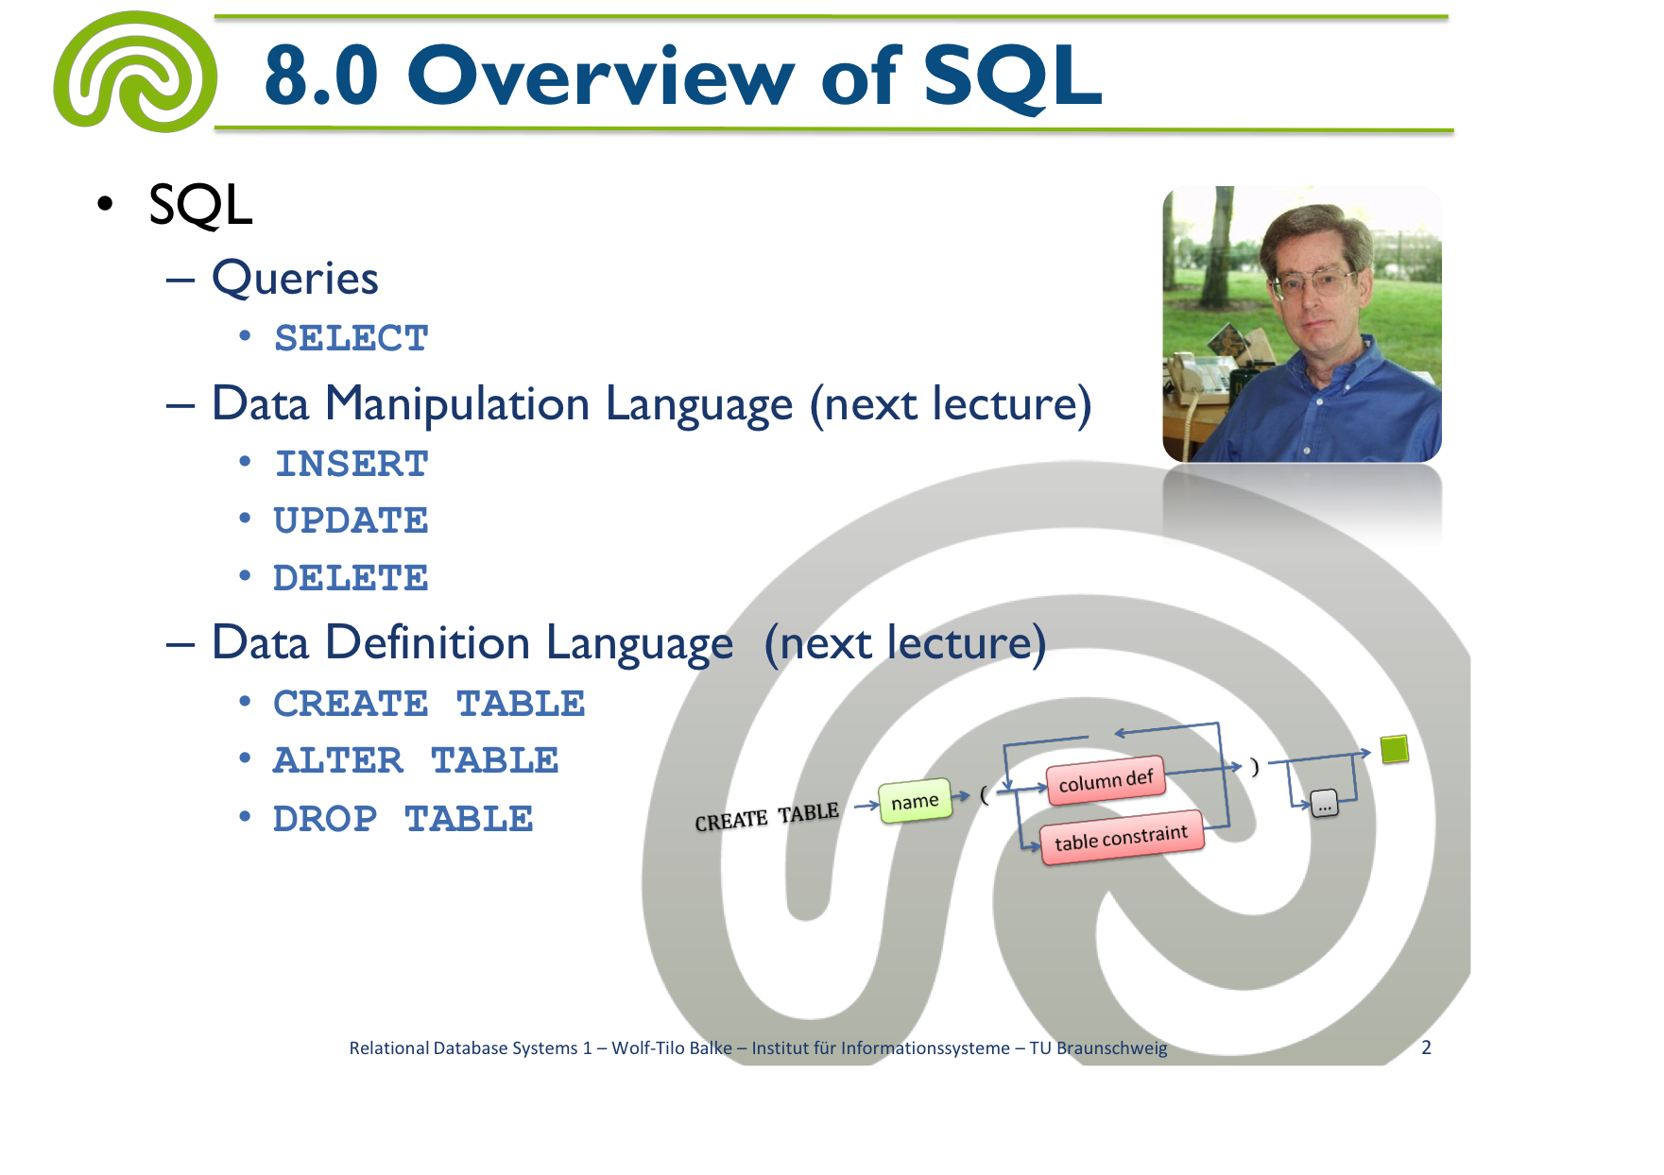
„Playing“ SQL like Mario is not that easy!

Slide 6
SELECT name
FROM SuperHero
WHERE powerlevel > 100;

Slide 7
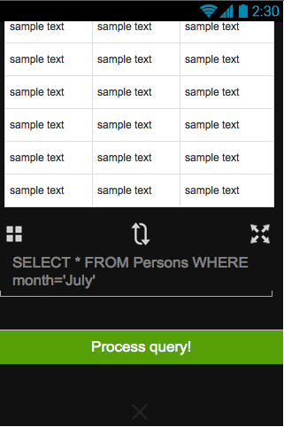
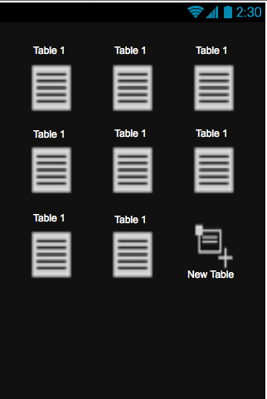

Slide 8


Slide 9


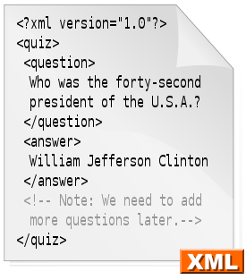

Request
Response
SQLite

Slide 10
LIVE DEMO

Slide 11
Future Work
Project is behind schedule
New structure for the team/programming
Functional Components
Game Elements (i.e. reward system)
Join view & activity logic

