Slide 1
Enjoy-SQL
Enjoy learning SQL and have looooooots of fun

Slide 2

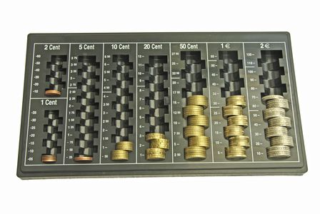
Organizing of data collections
SQL

Slide 3

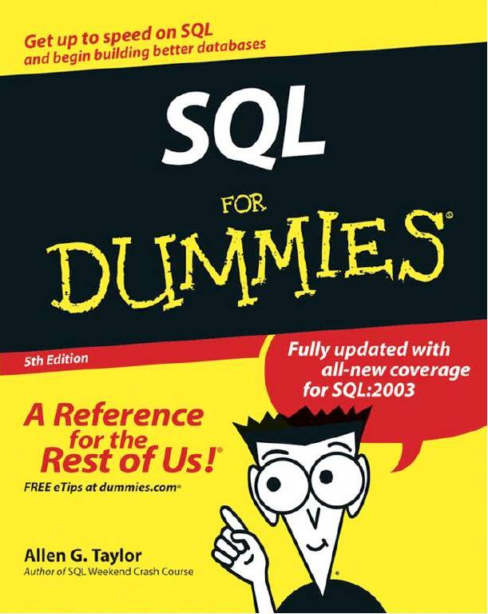
Learning is arduous

Slide 4
Playing instead of learning
Game
Assumption:Player can´t SQL
Gameplay is fun
Goal: Player improves SQL knowledge

Slide 5
Solution Approach

Slide 6
Gameplay

Slide 7
Background Logic

Slide 8
LIVE DEMO

Slide 9
Future Work

