Slide 1
Sound Cloud Snap Shot
A tool that brings music to your offline devices
But only in theory because: you may not use this tool for illegal activities such as downloading streams without permission!

Slide 2
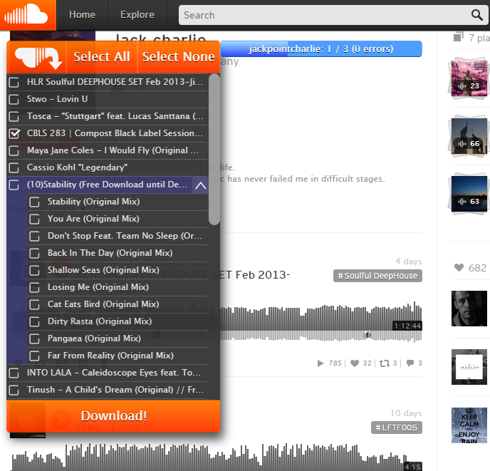
Integration concept
Toggle menu
View progress
View playlist
Download button

Slide 3
Retrieving the url
Get user-id of the current view (per tab):
Whenever there are original xmlHttpRequests: retrieve userId, save request headers + associate with url
Whenever there is tab url update: lookup userId
When there is a userId change message tab‘s content script
When ever there is a Request with scss_sent_from equals „cs“: Paste saved request headers.
2. Request https://api-v2.soundcloud.com/profile/soundcloud%3Ausers%3A<user-id>?limit=50 → JSON-response with all tracks + playlists
3. Build tracklist
4. In queue Call: https://api.soundcloud.com/i1/tracks/<track-id>/streams?client_id=b45b1aa10f1ac2941910a7f0d10f8e28&app_version=d5f2cbe → URL with track-.mp3 5. Make chrome save track-.mp3 as <track-name>.mp3 in extension-globally specified download folder
General:
- Maximum x downloads in parallel (e.g. x = 5)
- Automatically pause and retry on server error

