Slide 1
Big Bird is Watching You
Design Memo
Felix Peng • April 2026 • Harvey Mudd College
The Game of Democracy • Instructors: H. Nembhard & K. Fandell

Slide 2
TEAM PROBLEM STATEMENT
People trust machines to be objective—even when they’re not. Across hiring, policing, credit scoring, and content curation, opaque algorithms classify people by demographic proxies and produce authoritative-feeling numbers built on bias.
Big Bird is Watching You makes that dynamic visible. An AI classifies participants by race, gender, age, and socioeconomic status, runs theatrical “calculations,” then delivers a meaningless score—a random expression like “√−7” or “ℵ₀.” Demographics have zero weight. The score is pure noise.
The piece succeeds when participants question whether any algorithmic score they’ve received was more meaningful than this one.

Slide 3
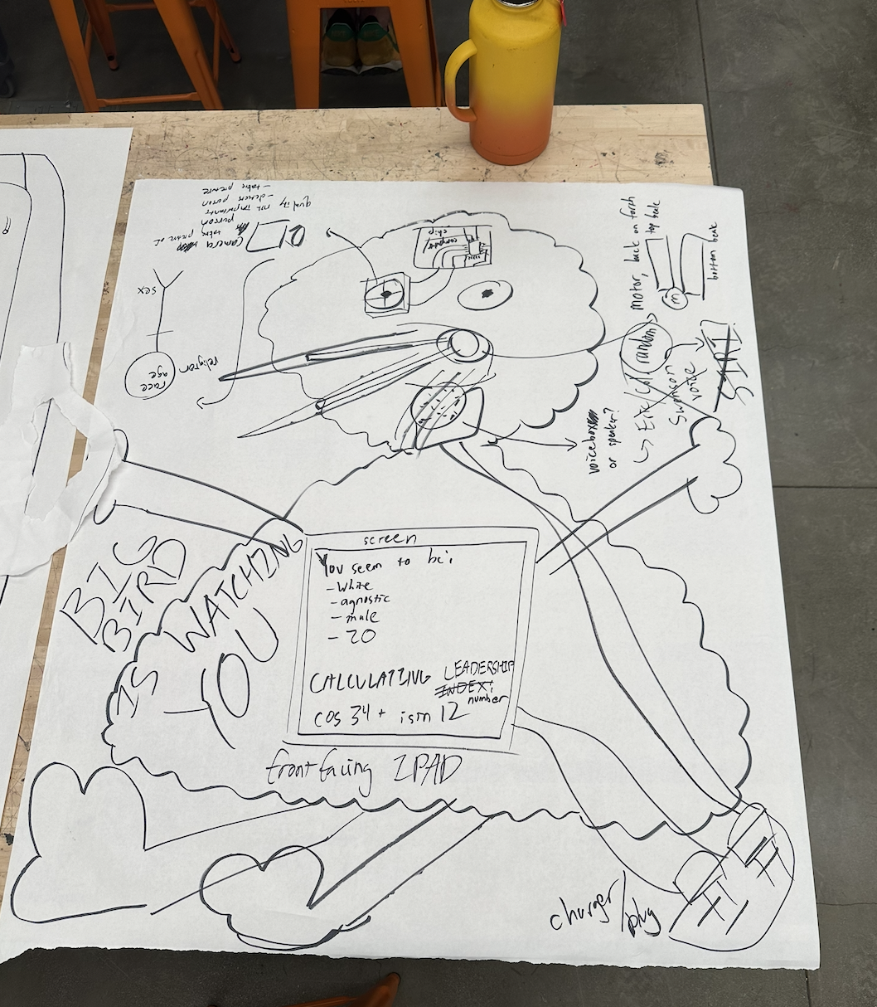
REPRESENTATION
Modified 22″ Big Bird plush with Pi 5, camera (eye), speaker (throat), 7″ display (chest)
100mm red arcade button on wooden podium
Button → photo → AI demographics → calculation theater → Leadership Index (~30s)
Phase Flow:
IDLE → CAPTURING → ANALYZING → CALCULATING → REVEALING → IDLE

Slide 4
GOALS & OBJECTIVES
Feel:
Learn:
Discomfort wrapped in fun — cheerful aesthetic, then classified by a children’s character
Urge to compare, then can’t — “negative pi” vs. “ℵ₀” is structurally impossible
Self-interrogation — did the machine judge me? It didn’t. Every weight is zero.
Algorithmic demographic judgments are pervasive and often just as arbitrary
Being “scored” is a political experience, not a neutral one
Randomness can be more honest than biased systems pretending to be objective

Slide 5
THEMATIC INTEGRATION — DEMOCRATIC CONCEPTS
Manin — The Logic of Lot
Volić — Broken Mechanisms
Athenians used sortition because it was more democratic than election—the kleroterion gave every citizen equal probability of serving.
Big Bird treats every participant equally via random output. Unlike the kleroterion, it wraps randomness in pseudoscientific authority—exposing how easily we accept machine judgment.
Democratic mechanisms are “broken at a fundamental level”—mathematical structures that look fair but produce disconnected outcomes.
The “Leadership Index” looks like a real calculation, but the math is theater. Participants experience what Volić describes: a mechanism that appears rigorous but produces meaningless outputs.

Slide 6
THEMATIC INTEGRATION — DEMOCRATIC CONCEPTS
Allen — Political Equality as Flourishing
Allen: flourishing requires non-domination, epistemic egalitarianism, and reciprocity.
Big Bird inverts all three. The machine classifies you by categories you didn’t choose and issues a score you can’t contest. No reciprocity. The “epistemic” process is fake. Allen’s “difference without domination”—Big Bird shows what violation looks like.

Slide 7
THEMATIC INTEGRATION — AESTHETIC CHOICES
Dunne & Raby — Speculative Design
Flanagan — Critical Play
A “physical fiction”—nobody believes it’s real, but being classified and scored produces genuine discomfort. The puppet’s absurdity makes the viewer do the interpretive work.
Participants press the button, stand for evaluation, hear demographics aloud. Game-show framing makes it feel fun while forcing engagement with uncomfortable ideas.
Scale & Color — After Taryn Simon’s Kleroterion
Intimate scale (child-height puppet, 7″ screen, small podium) vs. the kleroterion’s monumental civic presence. Black-and-gold palette from Big Bird’s plumage; clay-textured swirl inspired by Quiplash.

Slide 8
MECHANICS
Rules
Score Generation
One participant at a time; button locks during eval
Press red button = only input
Camera → AI demographics → theater → Leadership Index
Demographics have zero weight; score is random
Scores are incomparable (irrational, imaginary, transfinite)
No debrief—ambiguity is the art
50% Normal reals (347.29, −14.6, 7/83)
25% Irrational compositions (5π, φ + √3)
25% Wild (14 + 37i, ℵ₀ + 42, det|M|)
generate_score() takes zero arguments. Demographics have no code path to the score.

Slide 9
FUNCTIONAL BREAKDOWN
Enclosure: 22″ Big Bird plush (seam-cut cavity) + pine wood podium
Compute: Raspberry Pi 5 (8GB), Flask + Chromium kiosk
Camera: Pi Camera Module 3 (IMX708) via CSI cable
Audio: USB audio → 3W speaker; TTS via Web Speech API
Input: 100mm arcade button on GPIO 17 (debounce, locks during eval)
Display: 7″ IPS HDMI, 1024×600
Network: Wi-Fi for OpenAI API; everything else localhost
Aesthetic Force
Jackbox/Quiplash UI: gold-on-black, chunky type, playful animations
Live camera feed on idle with surveillance corners + REC
Demographic readout shifts to clinical monospaced layout
Camera-flash on capture; bouncy scale-up on score reveal

Slide 10
Limit: $333 | Estimated: $215 | Remaining: ~$118
BUDGET
Category | Item | Qty | Cost
Hard Goods | Big Bird Plush (22″) | 1 | $30
 | Pine Wood Box (podium) | 1 | $10
Electronics | Raspberry Pi 5 (8GB) | 1 | Owned
 | Pi Camera Module 3 | 1 | Owned
 | 7″ IPS Display | 1 | $37
 | Arcade Button (100mm) | 2 | $18
 | Speaker + USB Audio | 2 | $20
 | Active Cooler | 1 | $9
Cables | HDMI, CSI, Audio, USB, Jumpers | — | $43
Misc | Finishes, consumables, adhesives | — | $23
Power | Surge Protector Power Strip | 1 | $15
Services | OpenAI API (gpt-4o-mini) | est. | ~$5
 | ESTIMATED TOTAL |  | $215

Slide 11
ANALYSIS
Independence from Demographics
Resilience
generate_score() takes zero arguments. No access to demographic data. Completely separate code paths, no shared state.
demographics = _call_vision_api(img) score = generate_score() # purely random
API down: skip demographics, deliver random score
Camera covered: “SUBJECT DEFIES CLASSIFICATION”
Button spam: locked during eval
Speaker fails: visual display still works
Overheating: active cooler, stays <56°C
Power: ~13–20W total within 27W PSU (Pi 5: 5–12W | Display: 2.5W | Camera: 1.5W | Audio: <3W)

Slide 12
REFERENCES
Manin, B. (1997). "Direct democracy and representation." The Principles of Representative Government, pp. 8–41.
Volić, I. (2024). "Americans agree politics is broken." The Conversation.
Allen, D. (2023). Justice by Means of Democracy, Ch. 2. U of Chicago Press.
Dunne, A. & Raby, F. (2013). Speculative Everything, Ch. 6. MIT Press.
Flanagan, M. (2009). Critical Play, Ch. 8. MIT Press.

