Slide 1
What’s New in ASP.NET 5 and Visual Studio 2015
Spencer Schneidenbach
Gadellnet Consulting Services

Slide 2
About Me
Senior Software Engineer at GadellNet
ASP.NET and related technologies
C#
AngularJS
Twitter: @schneidsDotNet
Blog: http://schneids.net
Notes:
Senior software engineer at GadellNet
Responsible for architecting and building out the Ryvit integration platform
Background is in ASP.NET and web technologies including AngularJS
Mostly work in C#, though have worked in VB.NET in past
Word about GadellNet – we’re an IT consulting company that serves small business. Looking for a wide spectrum of IT professionals including developers, so if you’re thinking about making a change, come talk to me or Jenn [point Jenn out.]

Slide 3

The new Microsoft
ASP.NET 5 – open source
.NET Core – open source
Visual Studio Community – free
Change in thinking
Open source
Going where the devs are
Projects are all on GitHub
Notes:
Microsoft is really changing how they approach development.
For example, ASP.NET started out as Web Forms, backed by System.Web, was designed to abstract the web away from the developer as much as possible, probably to increase adoption by WinForms users to give them a more comfortable and familiar development experience.
Today, they have really embraced open web and have built their technologies to support this ideal.
the
ASP.NET 5 is totally open source – MVC, SignalR (their real time web framework)
.NET core is open source as well – this is a subset of the larger .NET framework designed to run cross-platform

Slide 4

Overview of Current ASP.NET (pre-5)
ASP.NET is Microsoft’s web framework
Built on the .NET Framework
Three major technologies
MVC
Web API
Web Forms

Slide 5
ASP.NET 5 Goals
Aims to be the best web stack for any platform
Host agnostic
Provide cross-platform development experience
Faster, more scalable than current ASP.NET
System.Web requests take ~30kb of memory per request
ASP.NET 5 – around ~2kb

Slide 6
Let’s talk .NET Framework
.NET Core – open source, lightweight subset of .NET Framework
Needed components delivered via NuGet
More iterative updates
Deployed with your app
Aims to be pure re-implementation of .NET Framework…someday
Cross-platform
.NET Framework
You can still use full .NET Framework if you need stuff like System.Drawing or other full-framework specific libraries
Requires Windows

Slide 7
The times, they are a’changing’ ASP.NET 5 Current ASP.NET
What’s The Same
What’s Different
C#
.NET Framework
No VB.NET
No Web Forms
.NET Core
Roslyn compiler
Cross-platform
Slightly different APIs
No Web.config
No Global.asax
No dependency on MSBuild

Slide 8
Web Forms
Web Forms isn’t a technology in ASP.NET 5
It’s still being updated and supported
Still needs System.Web
Still needs IIS
Still needs Visual Studio

Slide 9
Current MVC 5/Web API 2 Apps
No direct upgrade path
Create new project and copy over code
APIs between the two differ slightly
Otherwise, it’s a very familiar experience

Slide 10
What’s New?

Slide 11
Cross-platform
Run ASP.NET from…
IIS
In-process
Linux
Mac
Develop using… whatever
VS still provides the best development experience
But you can still use Sublime, Atom, Emacs, even Vim
More information: http://omnisharp.net

Slide 12
Roslyn in-memory compiler
Compiles and runs all code from memory
This includes server code
In development, you can simply Edit and Continue… anytime

Slide 13
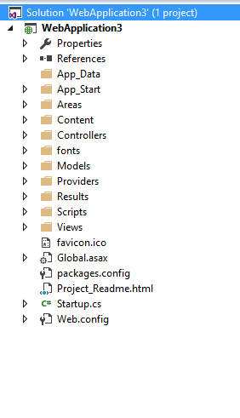
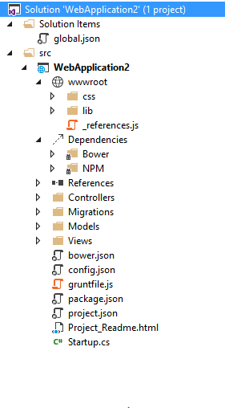
Let’s create a new project
Notes:
Left: Static files mixed with code files, Web.config, packages.config, Global.asax
Right: Static files in wwwroot, config.json

Slide 14
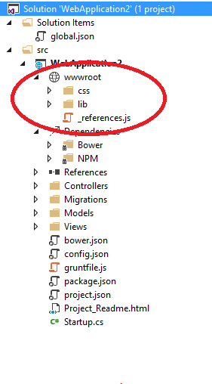
wwwroot
Where all static files go
No longer mixed into the root of the project
A welcome change!

Slide 15
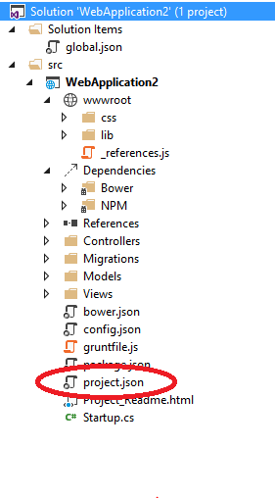
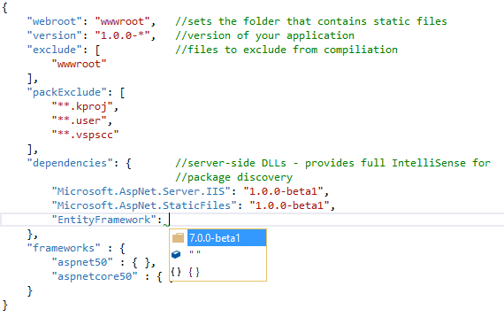
project.json
Replaces packages.config
General project configuration
Server-side dependencies

Slide 16
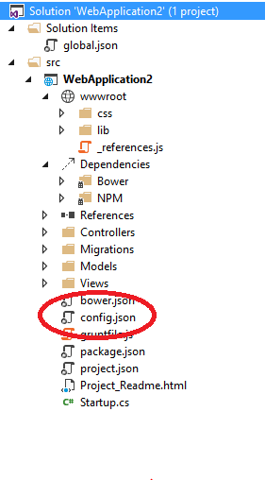
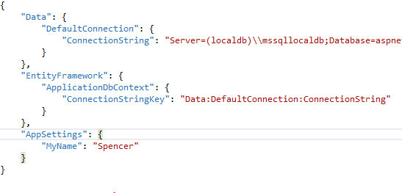
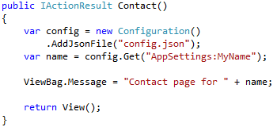
config.json
Replaces Web.config
Lightweight config file

Slide 17
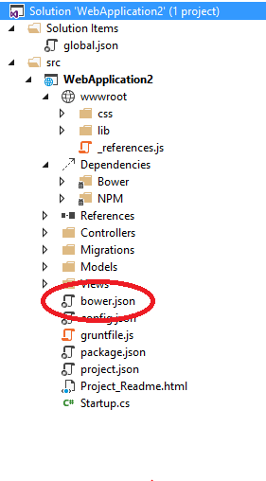
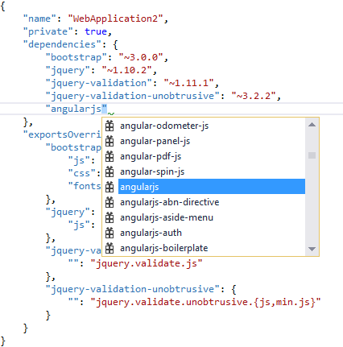
Bower
Client-side package manager
Like project.json, gives you full Intellisense

Slide 18
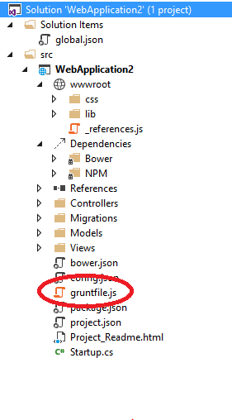
GruntJS
JavaScript/Node-based task runner
Used to run pre/post-build tasks
Runs bower
LESS/SASS compilation
TypeScript to JavaScript
More info: http://gruntjs.com/

Slide 19
Demo
Cause that’s what you all really want anyways

Slide 20
Questions?

