Slide 1

Real Time Mobile Apps using Xamarin and SignalR
Spencer Schneidenbach

Slide 2


Slide 3

About Me
Senior Software Engineer at GadellNet/Ryvit
ASP.NET and related technologies
C#
AngularJS
Xamarin
Twitter: @schneidsDotNet
Blog: http://schneids.net
GitHub: schneidsDotNet

Slide 4
Why?
Client needed a mobile app that could text leads
Would not use actual employee’s number
Had to work for Android and iOS
Combination of technologies
Xamarin – mobile framework
SignalR – communication framework
Twilio – texting platform

Slide 5
What is SignalR?
Real-time bi-directional communication framework for ASP.NET
Utilizes WebSockets to communicate
Falls back to other methods automatically for older browsers
Hosted on IIS, OWIN, etc.
Clients can call functions on the server…
…Server can call functions on the client
Browser context uses JavaScript

Slide 6

Xamarin
Mobile framework for C#
Has bindings to Cocoa Touch, Android APIs
Native mobile experience
Shared code across platforms
Lots of development tools
Xamarin Studio
Xamarin + Visual Studio

Slide 7
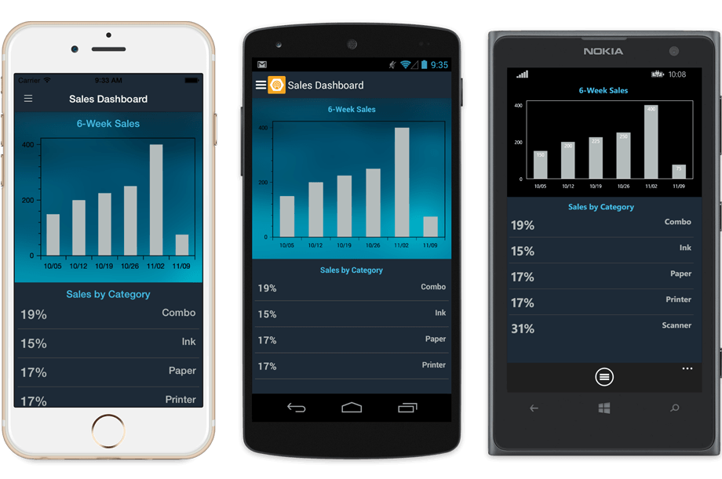
Xamarin.Forms
Abstraction over common iOS/Android/Windows Phone controls
A lot more shared code between platforms
(Somewhat) customizable

Slide 9
Why Xamarin.Forms?
Simple: it was the most straightforward way to demonstrate the main star, SignalR
The most cliché way to demonstrate SignalR: a chat app

Slide 10
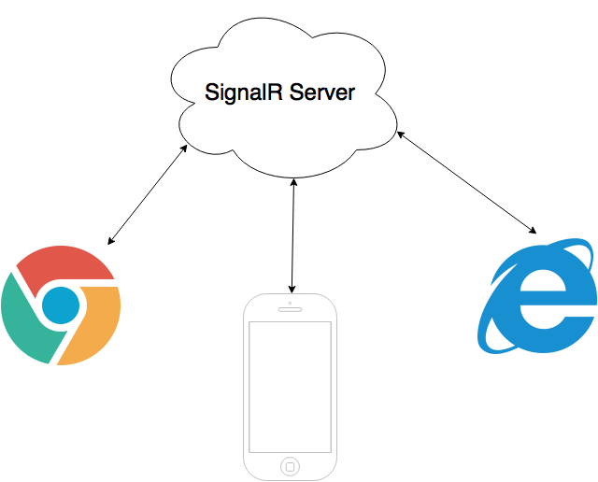
2. SignalR server sends the message back to all clients
1. Messages are sent to the SignalR server

Slide 11
Let’s see some code
Cause that’s all you really want anyways
Goals
1. Setup our SignalR server
2. Setup mobile client with SignalR
Messages go back and forth
Display a persistent connection status

Slide 12
The end
Other resources
http://www.xamarin.com
http://asp.net/signalr
https://github.com/schneidsDotNet/Xamarin-Forms-and-SignalR-Example
I will post this slide deck to my blog, tweet a link, etc.
http://schneids.net
Thank you!

