Slide 1
Intro to Angular 2 and TypeScript
Nebraska.Code() 2016
Spencer Schneidenbach
Ryvit

Slide 2

About Me
Platform Architect at Ryvit
Consultant
Web developer
AngularJS 1/2, ASP.NET, C#
Twitter: @schneidenbach
Github: schneidenbach
Email: sas.projects@me.com
Website: schneids.net

Slide 3
Who are you to tell me?
Building SPAs for 4 years
Started with Angular 1 and ASP.NET Web API
Using Angular 2 in production today

Slide 4




Setting the stage
Building SPAs (single page apps) has never been easier
Lots of framework choices!
(yes, I know React is not a framework!)

Slide 5

Why Angular 2?
Great SPA framework curated by Google
Over Angular 1?
Simpler
Faster
Lots of lessons learned from Angular 1
Angular 2 embraces the web

Slide 6

Angular 2 + TypeScript = <3
De facto language for Angular 2
Documentation
Code examples
Great, but not required!
In the end, choose the language you’re comfortable with

Slide 7
What is TypeScript?
A superset of JavaScript created by Microsoft
Transpiles into JavaScript
Focuses on:
Application-scale language which adds type safety
Modern features
ES6 – classes, arrow functions
ES7 – async/await
ES?

Slide 8
Why TypeScript?
Lots of neat features
The future of JavaScript, today

Slide 9
Why not TypeScript?
Yet another layer on top of JavaScript
May not be around forever

Slide 10
Main reason why TypeScript is great
“TypeScript doesn’t try to NOT be JavaScript – it just tries to make JavaScript better”
–Spencer

Slide 11
So, let’s go over some TypeScript basics!

Slide 12
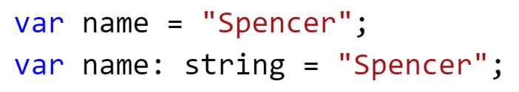
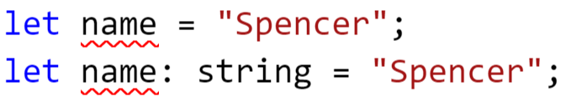
Variables
Same as JavaScript… with a twist!
Yes, it’s declared twice – and that’s totally valid
Use let instead – it’s safer

Slide 13
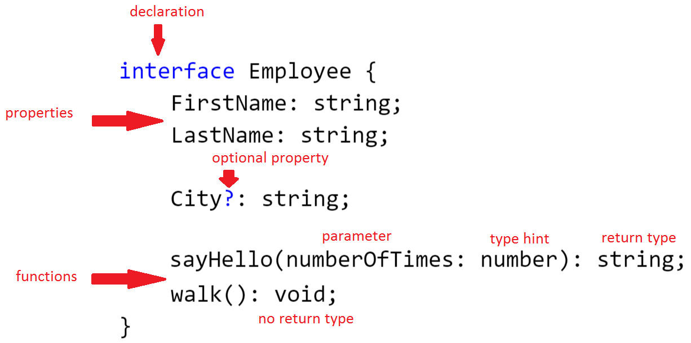
Interfaces
Classes without functionality – just like C#

Slide 14
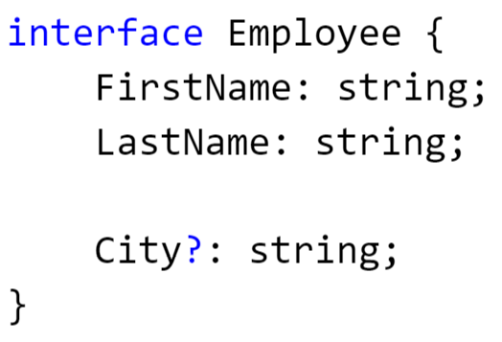
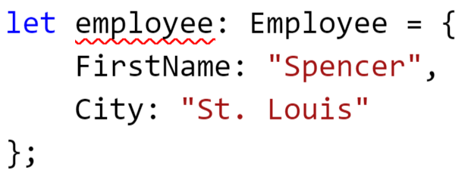
Interfaces, cont’d
Won’t let you compile with this type hint if you don’t fulfill the entire contract!

Slide 15
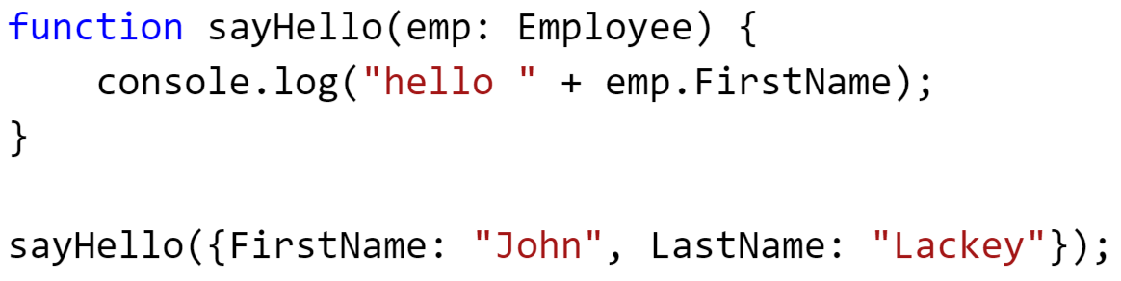
More interfaces
Duck typing: “If it walks like a duck and quacks like a duck… it’s a duck”
This is valid! And good! Respects JavaScript while adding safety

Slide 16
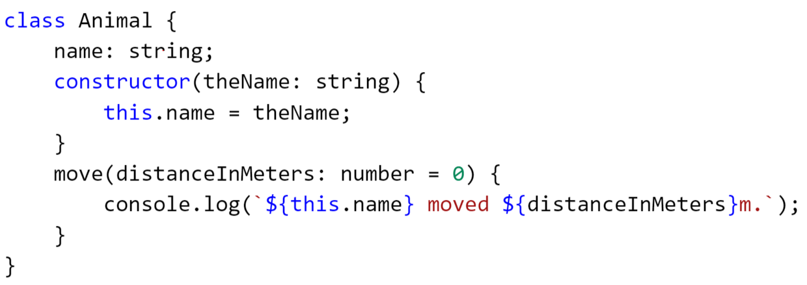
Classes
Classes can define behaviors AND properties
Notes:
Source: http://www.typescriptlang.org/docs/handbook/classes.html

Slide 17
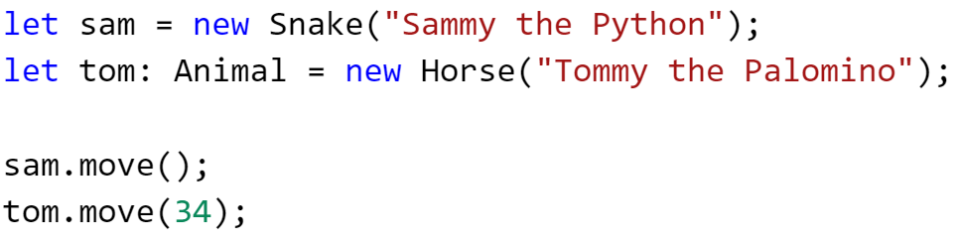
Using classes
Notes:
Source: http://www.typescriptlang.org/docs/handbook/classes.html

Slide 18
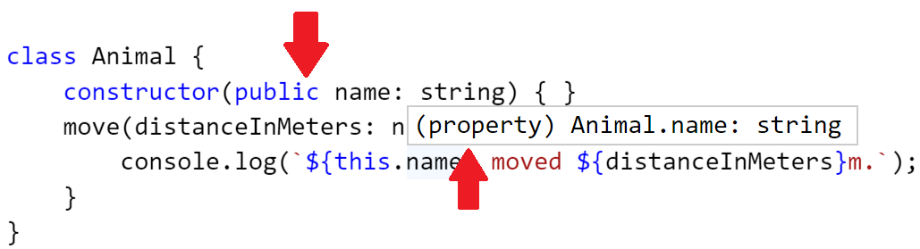
Constructor/property shorthand
Adding an accessibility modifier to a parameter in the constructor automatically converts it to a property

Slide 19
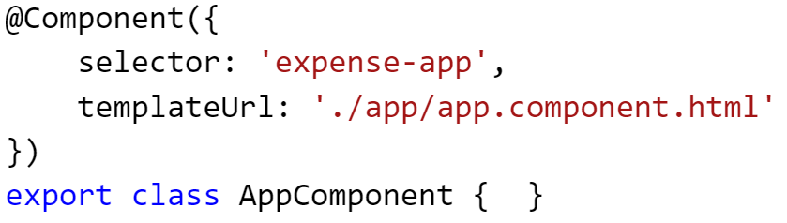
Decorators
Basically, attributes in C#/VB.NET
Considered experimental feature – can only be turned on with compiler option

Slide 20
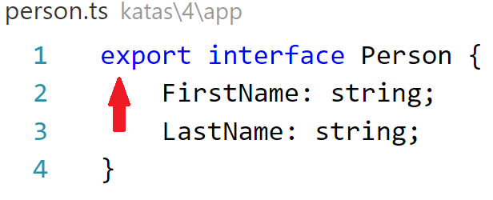
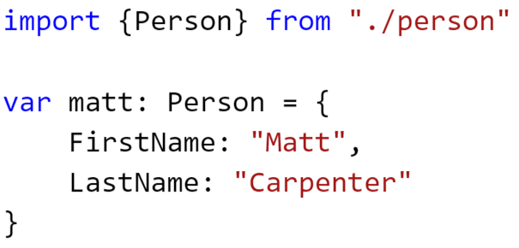
import/export
Like using statements in C#/VB.NET
import statements allow us to reference code from other TypeScript files
export simply means public

Slide 21
Enough TypeScript! Angular 2 Time!

Slide 22
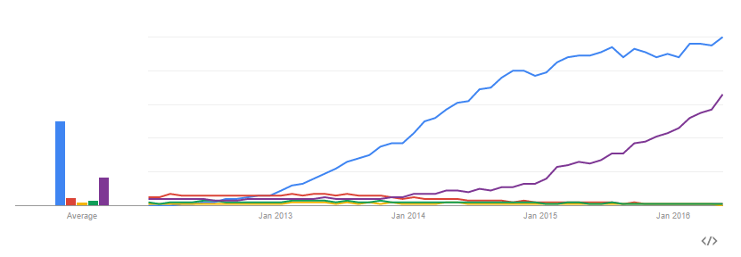

History lesson
Angular 1 – started in 2009
Hugely popular – won the initial “SPA war”

Slide 23
Angular 1 to 2 - What’s changed?
Controllers to components
No more $scope! Yay!
Digest loop to unidirectional data flow
Native event/property binding
Way fewer custom directives
Binding directly to DOM properties/events
Simplified service model
Easier to understand. Flatter learning curve.

Slide 24
Angular 1 to 2 – What stayed the same?
Template syntax is very similar
One-way data binding via interpolation {{ }}
Still use directives in the same way
Dependency injection is still used
Directives and components… kinda

Slide 25
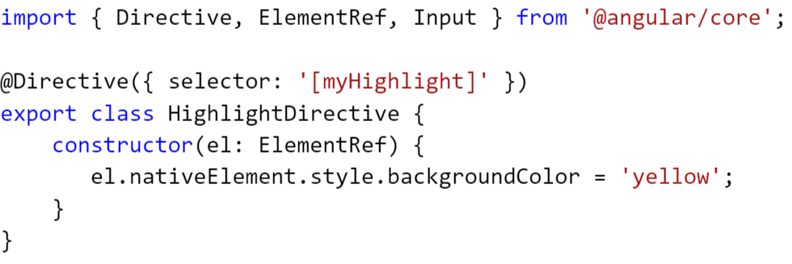
Directives
Used to modify behavior of DOM elements
Here is an attribute directive (from angular.io)

Slide 26
Components
Components are directives with a template
Angular 2 apps are built with components
No more $scope, no more controller
Functions/properties are bound directly from component

Slide 27
Components, cont’d
Component scope is much easier to understand
No more transclusion, isolate scope, etc.
Functions/properties are bound directly from component
Lots of smaller components > Fewer big components

Slide 28
Declaring a component
Create your class
Import the Component decorator
Add a template and a selector

Slide 29
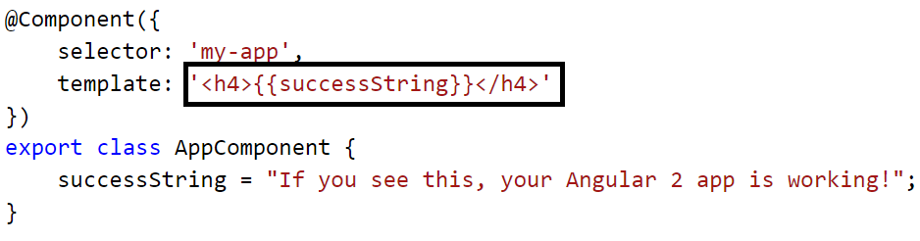
Templates in your component
Templates contain the HTML that is rendered by your component
Can be placed inline inside of Component declaration OR in a separate file

Slide 30
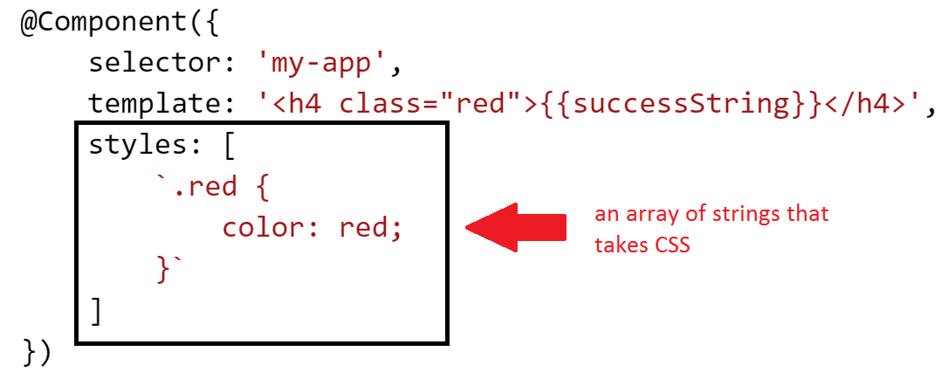
Styling a component
You can add CSS directly to a component! Demo

Slide 31
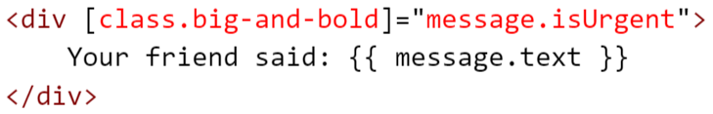
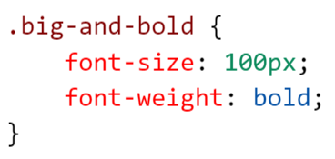
Styling a component, cont’d
Bind CSS classes to an element like this
If message.isUrgent is truthy, then the big-and-bold CSS class will be applied to the element

Slide 32
Ways to bind component to template
Interpolation expressions
Property binding
Event binding
ngModel

Slide 33
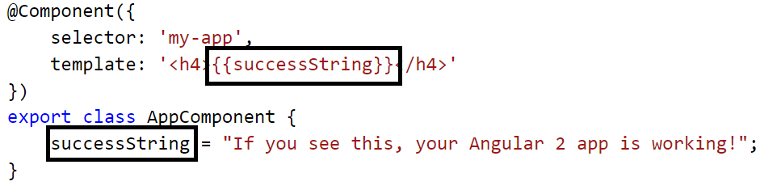
Interpolated expressions
{{ }} syntax
Put your expression inside the brackets
Accepts non-side-effect-JavaScript (no new, assignments, etc.)
Best use case – bind pure properties to it when possible

Slide 34
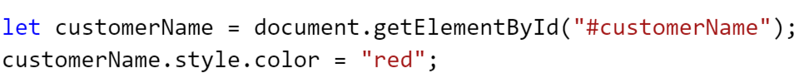
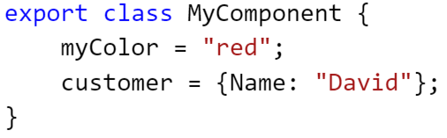
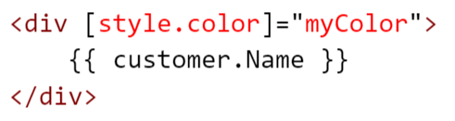
Property binding
Bind directly to properties on the DOM model using []
The power and convenience of this cannot be understated!
Allows something like this:
To become this:

Slide 35
Property binding, cont’d
Property binding means that all sorts of previous built-in directives in Angular 1 go away
Ng1 Directive | Functionality | Replaced with
ng-disabled | Disables the control – used on inputs, selects, textareas | [disabled]=“expression”
ng-src/ng-href | Replacement for src/href properties since interpolation didn’t play well with them | [src]=“expression” [href]=“expression”
ng-show/ng-hidden | Hides/shows an element based on the truthiness of an expression | [hidden]=“expression”

Slide 36
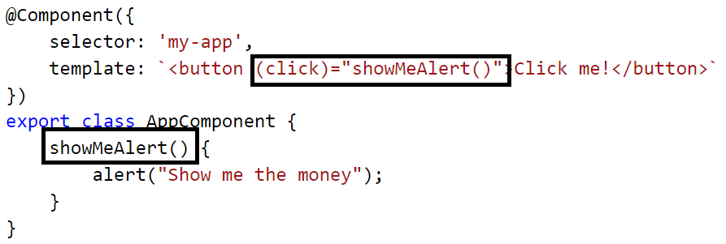
Event binding
Bind directly to events on the DOM model using ()
Again, the power and convenience cannot be understated
Support for custom events

Slide 37
Event binding, cont’d
Property binding means that all sorts of previous built-in directives in Angular 1 go away
Ng1 directive | Functionality | Replaced with
ng-click | Binds an expression to the click event | (click)=“doSomething()”
ng-change | Binds an expression to the input changed event | (change)=“prop = $event” (ngModelChange)=“”
ng-dblclick | Binds an expression to the double click event | (dblclick)=“onDoubleClick()”
ng-mouseover | …mouse over event
ng-mousemove | …mouse move event
…you get the idea

Slide 38
ngModel
Allows two-way binding
Follows unidirectional data flow concepts
Demo

Slide 39
Child components
A child component is a component that exists within a component
I know, pretty stunning right?
Steps
Easy: you make a component, then…
Tell the parent about the component!

Slide 40
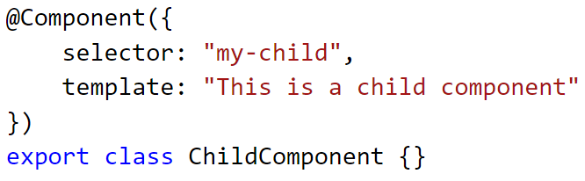
Step 1: Declare your component

Slide 41
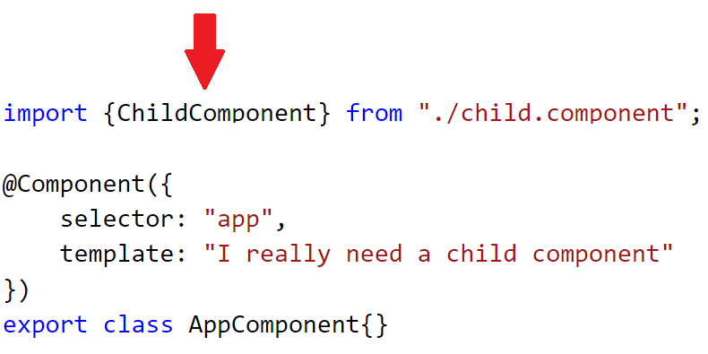
Step 2: Import it to your parent component

Slide 42
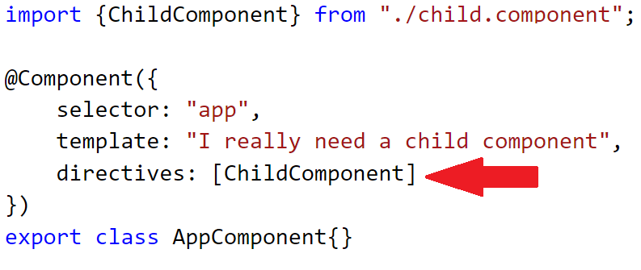
Step 3: Register it with your parent component
New @Component property: directives
You must register the component’s type with the parent component!

Slide 43
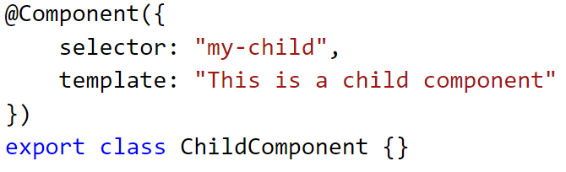
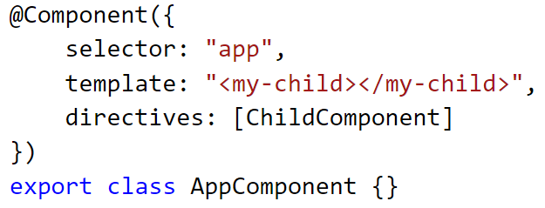
Step 4: Add child selector to markup

Slide 44
Binding parent to child via @Input properties
Means of binding data from the parent to the child
Requires two steps
Add property to child and decorate it with @Input
Bind the parent property to the child using [] syntax

Slide 45
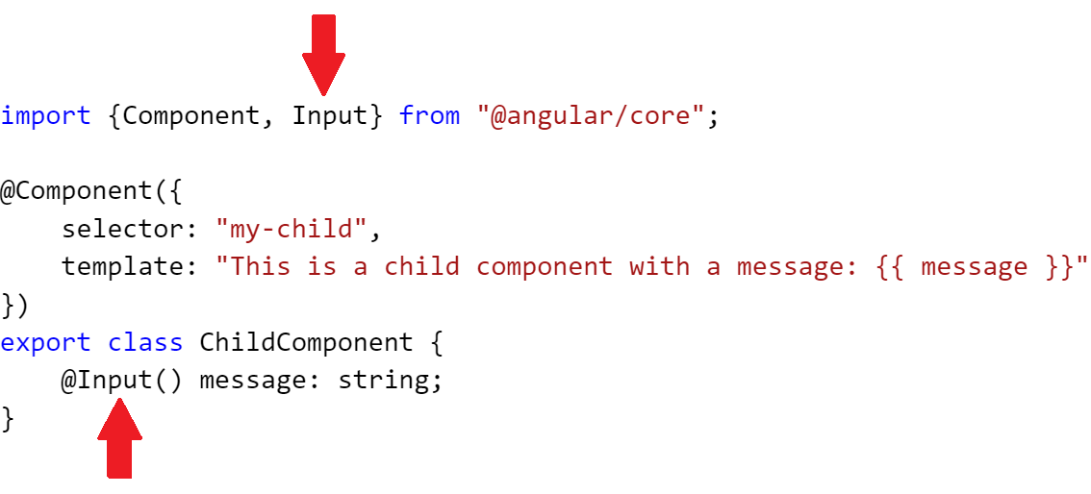
Step 1: Add the input property

Slide 46
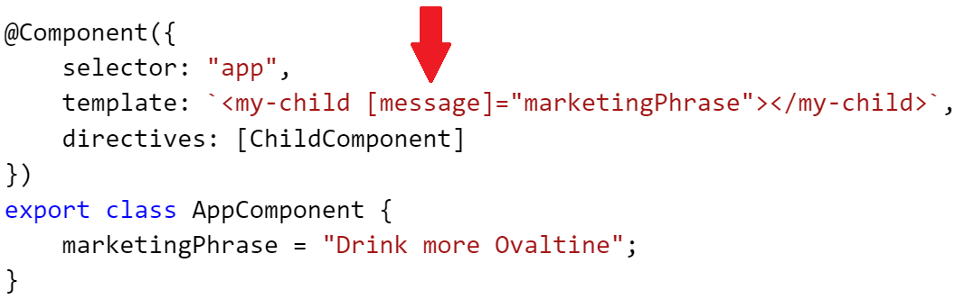
Step 2: Bind the parent property to that property

Slide 47
Event emitting and @Output
Parents can communicate with child components easily via input properties
How does the child communicate with its parent?
Simple: @Output properties and EventEmitter!
A little more to it than @Input properties, but very easy

Slide 48
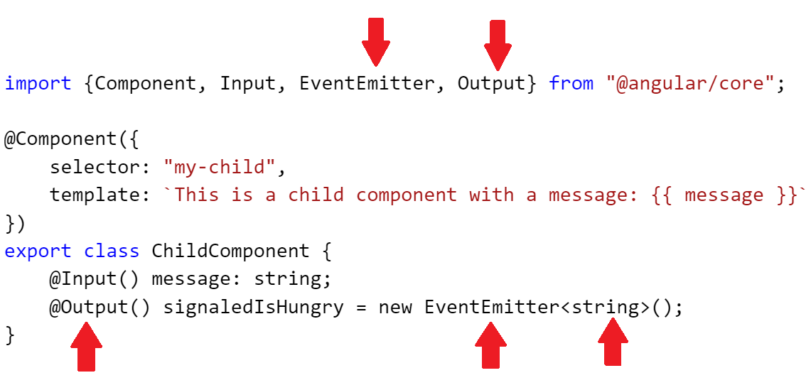
Import and implement

Slide 49
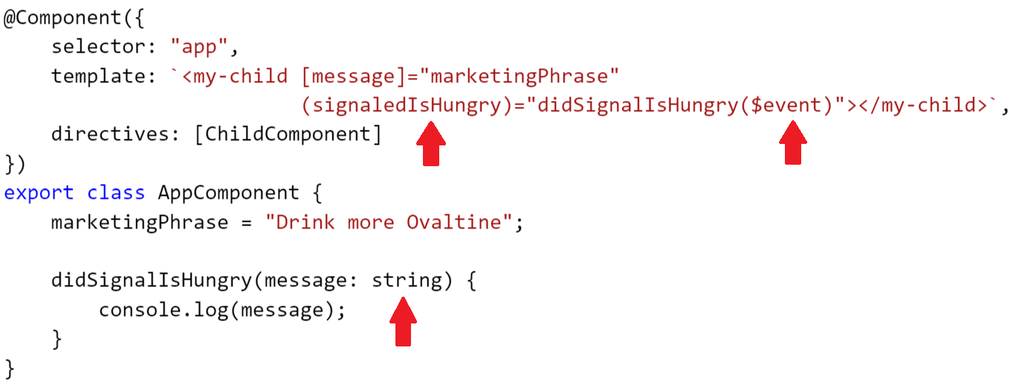
Add subscribing function

Slide 50
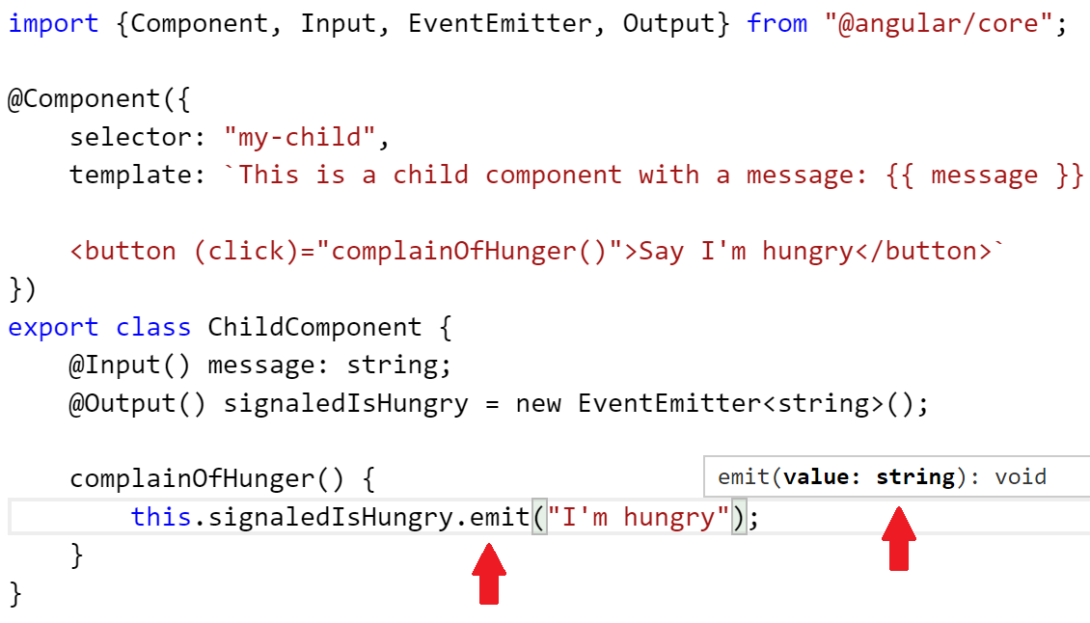
Step 5 – Emit your event

Slide 51
What are Services?
Services are best used to create, read, update and delete data
Enforces separation of concerns
Think of it like this: you don’t want your database in your view!

Slide 52
Services in Angular 1
In Angular 1, we had 5 different kinds of services:
Provider
Service
Factory
Value
Constants
In Angular 2, we have 1 kind of service:
Service
Which do you prefer?

Slide 53
Guess what? A service is just a class
Are you surprised?

Slide 54
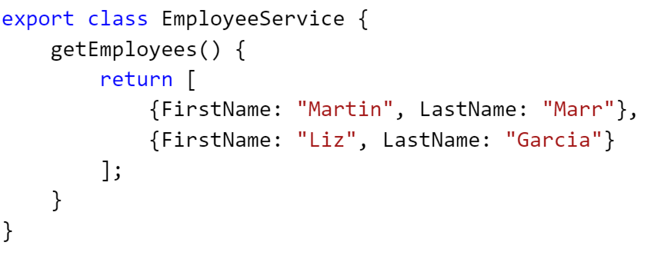
Step 1 – Make class with data

Slide 55
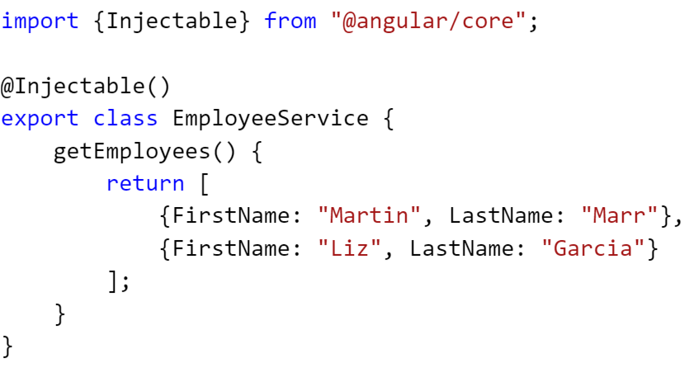
Step 2 – Import @Injectable and decorate

Slide 56
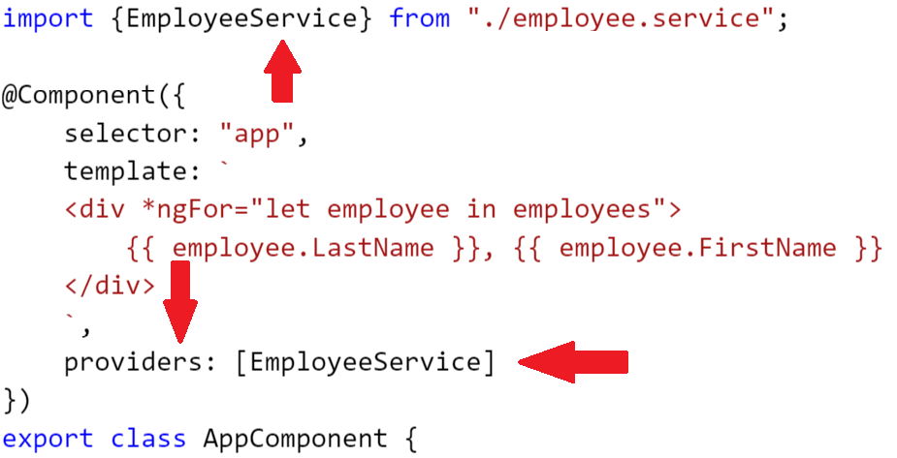
Steps 3 and 4 – Import and register

Slide 57
Things we couldn’t cover
Pipes
Http service
RxJS
Forms
Routing
So much more!

Slide 58
There is lots more!
angular2.schneids.net
All code samples and code exercises from my workshop!
Twitter: @schneidenbach
Github: schneidenbach
Email: sas.projects@me.com
Website: schneids.net

