Slide 1
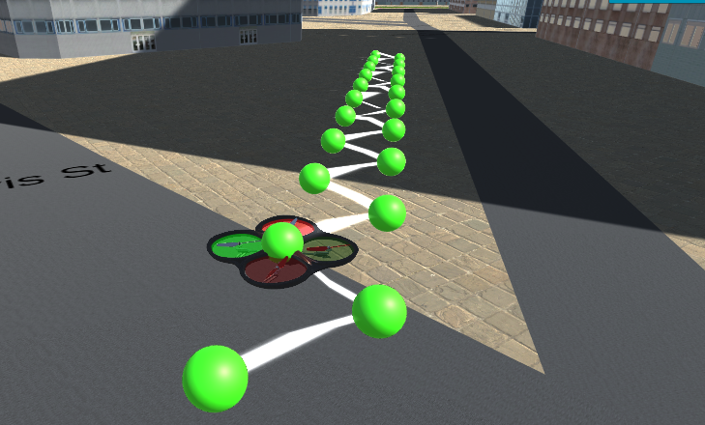
Zigzag movement due to a lack of diagonal movements in the action space when A* is applied to get a diagonal goal on a grid map representation

