Slide 1
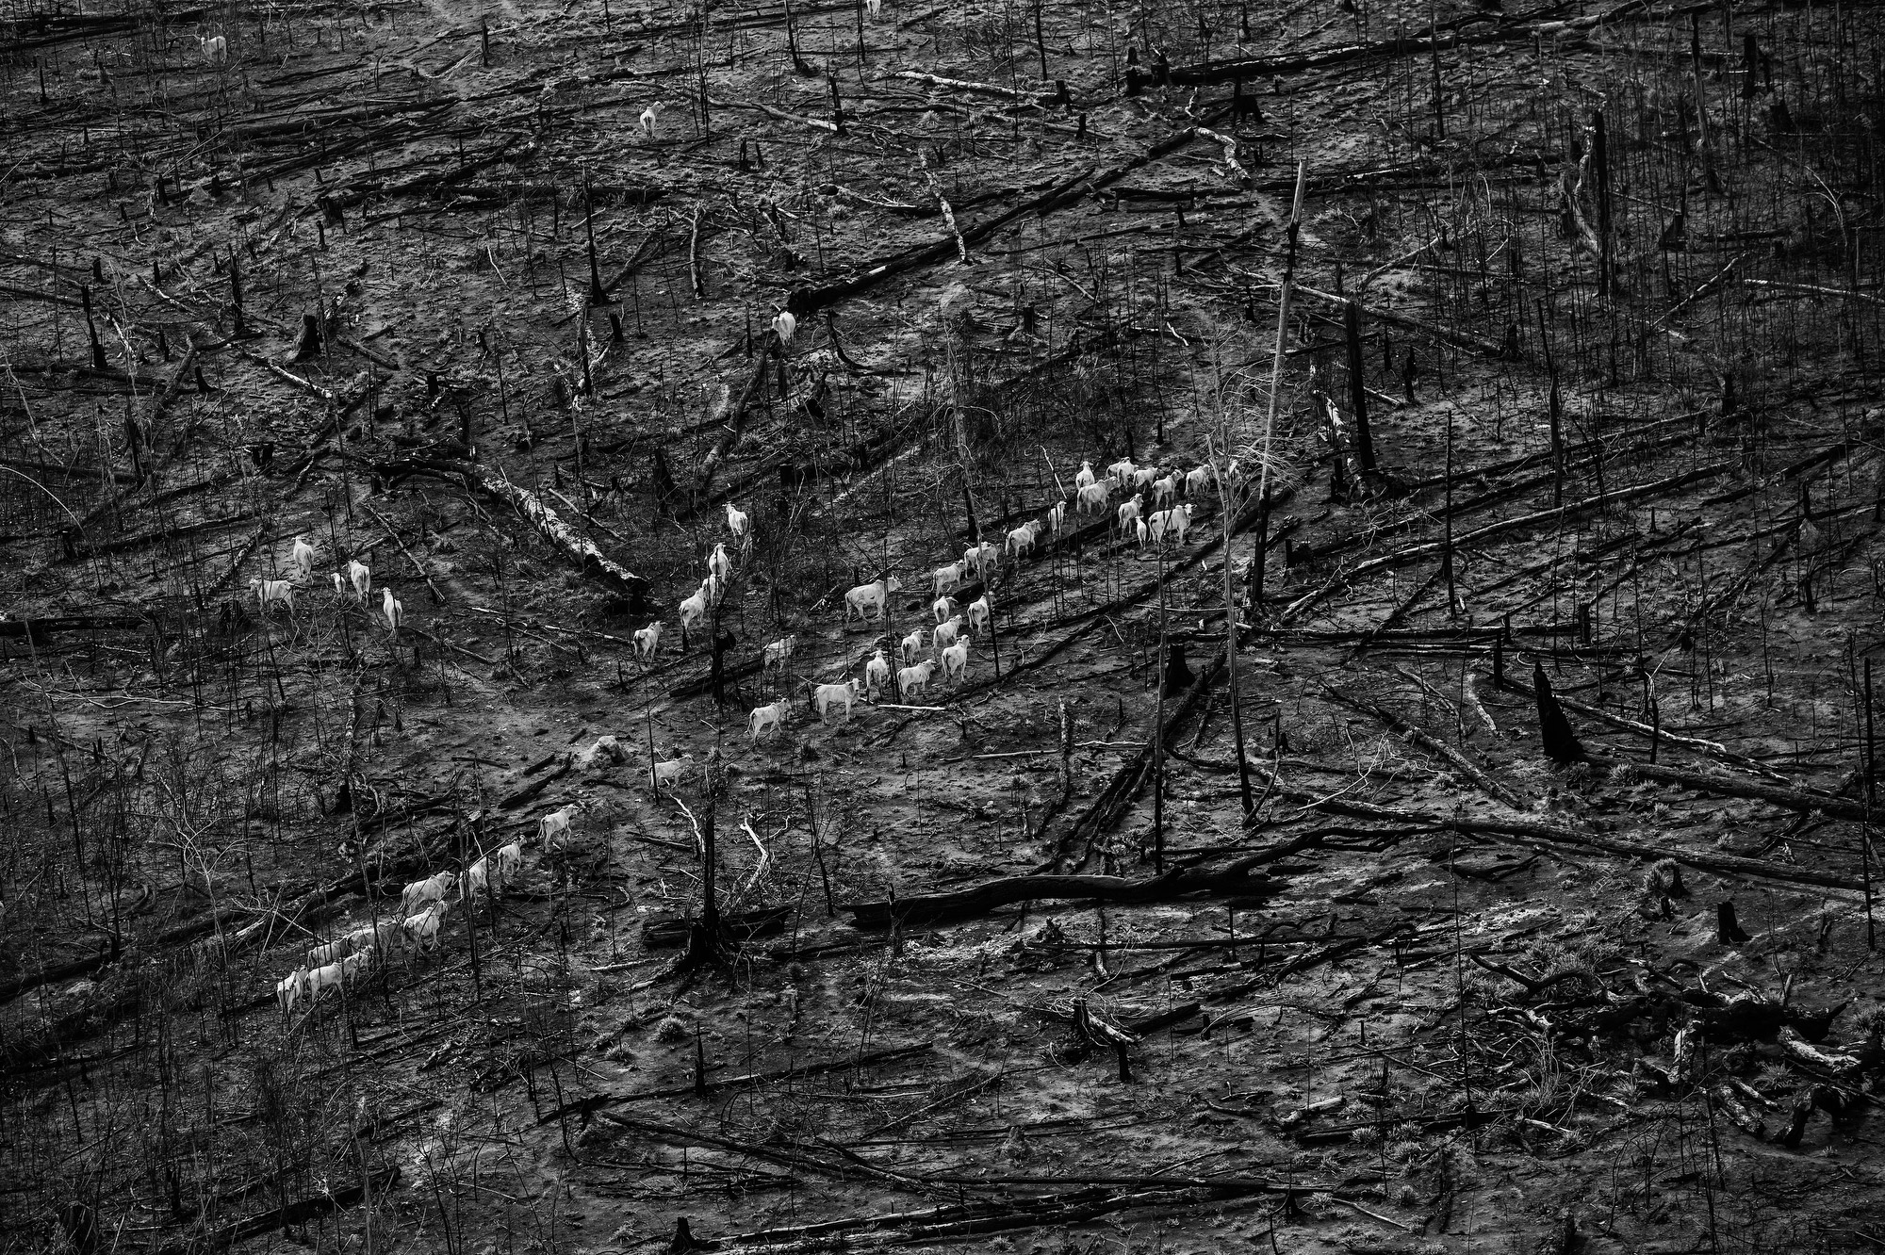
The negative external effects of deforestation on downstream populations in Brazil
Felix Schulz
Master’s Thesis

Slide 2
The Burden of the Amazon
The Amazon rainforest is under severe danger of deforestation
Between 2002 and 2022, 8.6% of primary forests in Brazil were cleared (World Resources Institute 2023)
Land is mainly converted for agriculture, lifestock or mining (Barona et al. 2010; Sonter et al. 2017)
Opinions in Brazil diverge widely:
Let’s use the riches that God gave us for the wellbeing of our population.
Jair Bolsonaro, President of Brazil (2019)
We will do whatever it takes to have zero deforestation and degradation of our biomes.
‘Lula’ da Silva, President of Brazil (2022)

Slide 3
Main relationship
River Pollution
Deforestation
Health Outcomes
Cloud Cover

Slide 4
General Progress
Established theoretical evidence for the central relationship
Collected complete data set
Complete, comprehensive river model
Exact attribution of deforestation to rivers
Health outcomes
Control variables
Estimated models

Slide 5
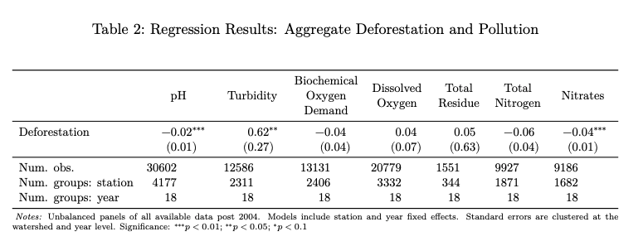
Sensor Data
Data from 4,522 stations across all of Brazil
Regress upstream deforestation on pollution

Slide 6
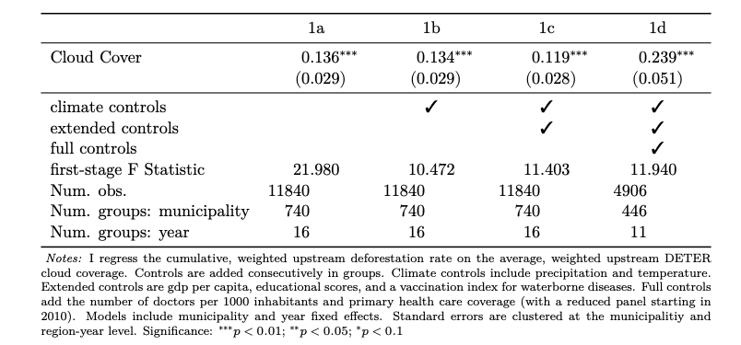
Health Outcomes
In the Amazon, DETER fights deforestation
No surveillance without satellite imagery
Instrument exogenous (similar to Assunção et al. (2023)) and relevant:

Slide 7
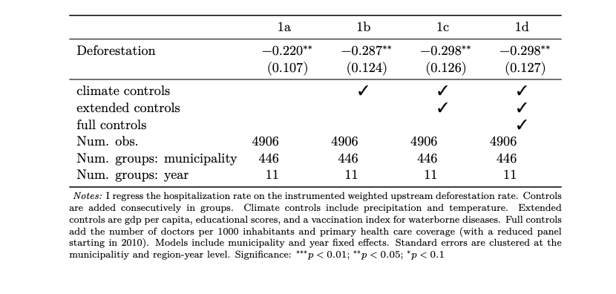
Health Outcomes (contd.)
There appears to be no impact on the mortality rate
I observe that deforestation in upstream municipalities decreases hospitalizations c.p.

Slide 8
Upcoming Weeks
Complete the economic manuscript
Explain central elements of code (>70% of workload)
More detailed hospitalization cases?
DDD comparing deforestation in and out of the Amazon before and after 2005
A similar placebo test for the validity of the instrument

