Slide 1
WiHF: Enable User Identified Gesture Recognition with WiFi
Chenning Li, Manni Liu, Zhichao Cao
Michigan State University.
April 27, 2020 @ IEEE INFOCOM’20
1

Slide 2



Motivation: Gesture Recognition
Smart Home Virtual Reality Security Surveillance
The Robots of Dawn :
“Every time I lift my arm, it distorts a small electromagnetic field that is maintained continuously across the room. Slightly different positions of my hand and fingers produce different distortions and my robots can interpret these distortions as orders. I only use it for simple orders: Come here! Bring tea! and so on.”
--- Isaac Asimov, 1983
It brings security concerns without the performer’s identify.
2
Notes:
We human beings always want to talk, especially during the quarantine. And Interacting with machines is an interesting thing for social distancing. For example, gesture recognition
It sparks an easy way to interact with the machines, the gesture recognition, which is the core enabler for a wide range of applications, such as the smart home, the VR, and security surveillance.
Actually, such a scenario has been already dictated in 1983. A famous science fiction, the robots of Dawn, written by Isaac Asimov.
As it mentions, the introduced distortions on the electromagnetic waves by the arm motion can be sensed by the machines.
However, What if the machine doesn’t know who he serves for? That means he cares for your home and serves for anyone that performs the predefined gestures.

Slide 3
Motivation: User identification
User identified gesture recognition.
The semantic meaning of diverse gestures & who I am?
3
Notes:
Thus we wanna ask can we do the user identified gesture？
Besides the semantic meaning of diverse gestures passing to the machine, we also want them know who we are.

Slide 4
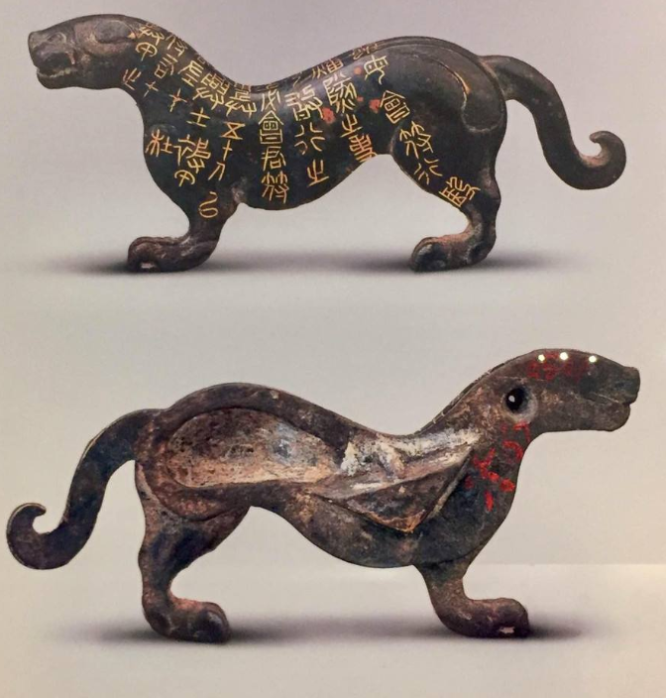
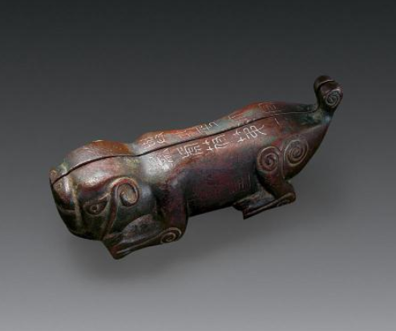
Hufu – Authorization of the Troop
Military messages
Authenticate the holder
4
Notes:
Just like HuFu used in ancient Chinese military. On one hand, it can convey the military message, such as deploy the force.
On the other hand, we can also authenticate the holder’s identity by putting the two pieces of Hufu into a whole.

Slide 5
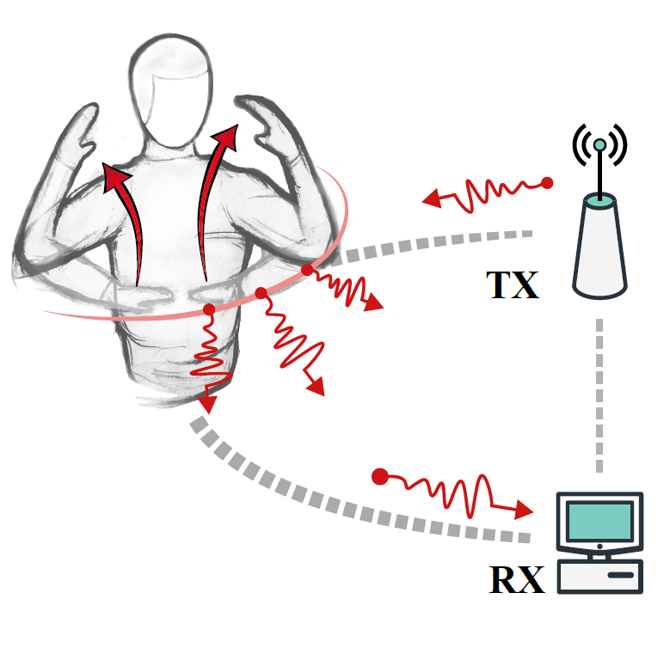
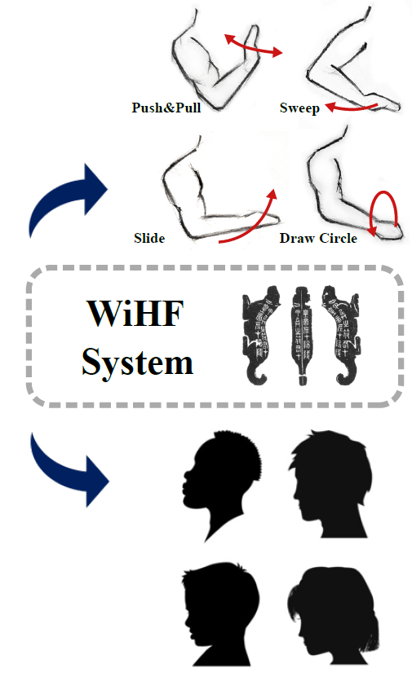
Motivation: Applications
User identified gesture recognition:
Access control
Content recommendation
VR customization
5
Notes:
Just imaging you perform some gestures, with the reflected WiFi signals,
our system can recognize the gesture as well as your identity simultaneously, rendering the true potential of WiFi based gesture recognition.
since many applications usually require user identities for access control and content customization, VR customization.
For example, smart home devices can only be controlled by family members but the guests or strangers. Moreover, when the identity of children or parents can be known, it can recommend different contents when they are watching TV or listening to music.

Slide 6
WiFi based User Identification
User identification
The human gait:
WifiU UbiComp '16
Wiwho IPSN 16’
AutoID AAAI 18’
The location-oriented activities:
WiPIN GLOBECOM '19
Cong Shi et MobiHoc 17’
Comparable work
WiID
ACM IMWUT '18 & UbiComp '18
known gesture information
cumbersome for cross-domain scenarios
6
Notes:
Generally, it’s always a hot topic to identify users.
For example,, inspired by the CV, which proves the gait can be utilized as a biometry feature. Some researches verify the feasibility of user identification with gait while maximizing the advantages of the wireless signals, such as through the wall and no requirements for the light conditions.
Besides, the location-oriented activities can also be used for user identification. However, both cannot convey the extra semantic meaning like diverse gestures.
Of course, someone tried to do the user identified gesture recognition, like WiID publish in UbiComp ’18, However, it has two drawbacks:
First it only functions with the WiFi based gesture recognition system as an add-on module and requires the known gesture information.
Moreover, it suffers when we leverages it in a new domains, including the location, orientation and environments, due to the variance of the domains.
To the best of our knowledge, none of the existing works can do the user identified gesture recognition in real time while considering the cross-domain scenarios.

Slide 7
WiHF: Problem Statement
Can we identify the performers while conveying the semantic meaning simultaneously?
Feature design: Recognize gestures while identifying users simultaneously.
7
Notes:
Thus we propose the problem.
And the first challenges is

Slide 8
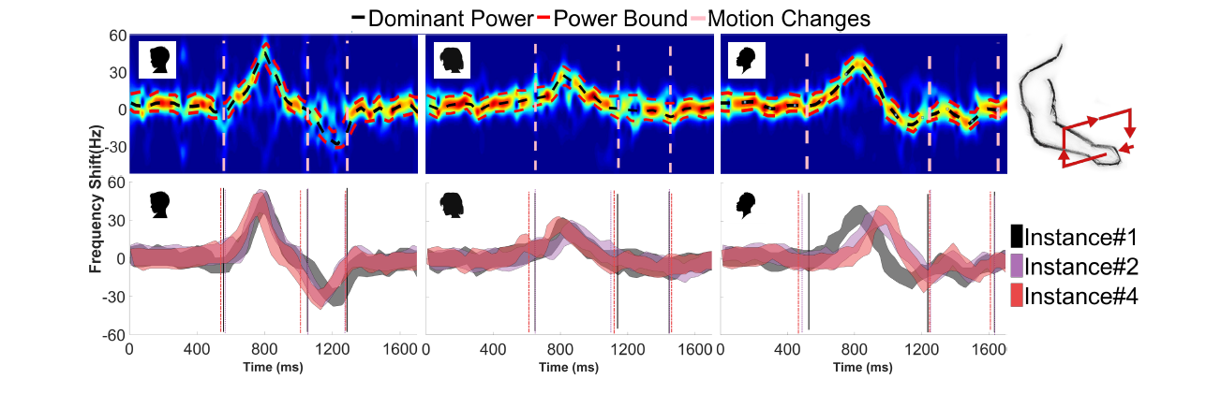
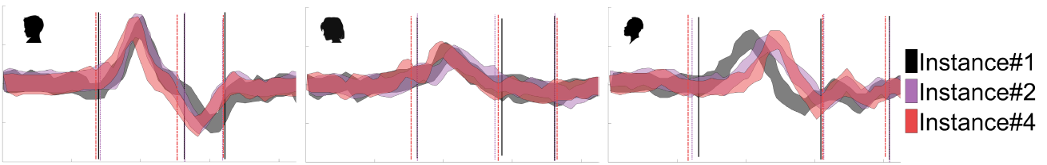

Preliminary and Observation
Theoretical support:
The arm gestures are representative for user identification. --- WiID, Ubicomp 18’
A domain-independent feature for cross-domain scenarios.
--- Widar3.0, Mobisys 19’
Experimental observations:
Motion changes, such as pause and restart abruptly
Power-based paths:
Dominant power & power bound
Largest period < 70ms
Temporal shift
Cluster 1 2 3
8
Notes:
First, we do a survey and has some theories.
To verify the feasibility of the feature design, we do some observation using the public Widar3.0 dataset.
With the spectrogram of the collected WiFi signals, as shown in the three top sub-figures, we plot three carving paths of three different users while performing the same gesture (e.g., drawing the rectangle).
Specifically, the black and red dashed lines denote the carving paths of dominant power and power bound.
The pink dashed lines which are distributed along the axis of frequency shift indicate the motion changes. With the visualization of all carving paths, we can observe both power based features and the motion change pattern varies among different users. Intuitively, different users perform the same gesture with the personalized action understanding and performing style.
Further, we collect three instances of the same gesture from all three users and superpose their carving paths for each user in the bottom three sub-figures.
We can see the power based carving paths of different instances may shift along the time axis, especially for the third user.
In contrast, for all users, their motion changes can be grouped into three clusters which correspond to the three pauses during drawing the rectangle.
In all clusters, the largest period between two motion changes across different instances is less than 70ms (the first cluster of the third user appeared at about 500ms), which demonstrates its consistency of the motion change pattern for each user across instances. The reason behind this is the inevitable noise (e.g. multi-path, body motion) has a significant influence on the power based carving paths, but motion changes are less affected.

Slide 9
WiHF: Problem Statement
Can we identify the performers while conveying the semantic meaning simultaneously?
Feature design: Recognize gestures while identifying users simultaneously.
Cross-domain: Unnecessary extra efforts when gestures are performed in new domains.
9
Notes:
And the second challenges is

Slide 10
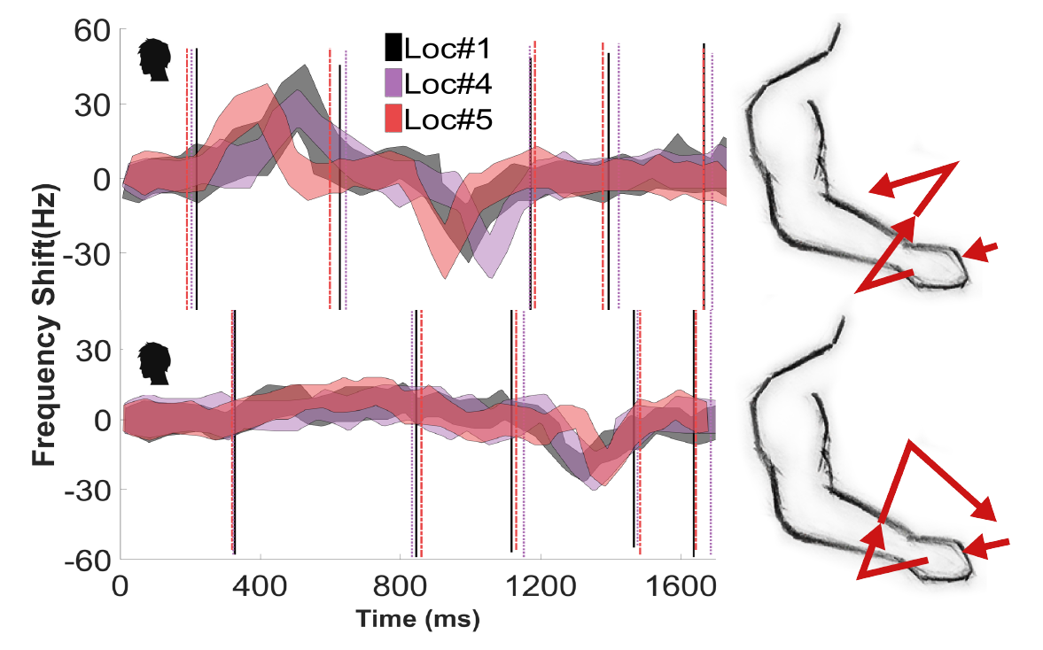
Preliminary and Observation
The stability across domains:
Largest period < 70ms
Temporal shift
10
Notes:
To verify the stability of different carving paths across domains,
a user performs two gestures (e.g., drawing the zigzag and triangle) at three different locations.
For each gesture, we plot the distribution of the derived carving paths again. And we can see the motion change pattern is consistent across locations for both gestures.
The largest period between two motion changes in a cluster is 50ms (the second cluster in the top sub-figure for drawing the zigzag).
Meanwhile, the power based carving paths exhibit noticeable dynamics when a gesture is performed in different locations. The reason is the motion change pattern reflects the rhythm of the arm motion and the temporal characteristic is only related to the user performing style and gesture composition, but not where the user performs the gesture. And the diverse arm shapes and sizes of users reinforce the impacts on WiFi signals. In contrast, in the view of WiFi transceiver pairs, the velocity components of the detected arm motion vary with the location changes so that incurs spectrogram power dynamic since the human body is best modeled as a quasi-specular reflector.

Slide 11
WiHF: Problem Statement
Can we identify the performers while conveying the semantic meaning simultaneously?
Feature design: Recognize gestures while identifying users collaboratively.
Cross-domain: Unnecessary extra efforts when gestures are performed in new domains.
Computation efficiency: Efficient enough to be running in real time.
11
Notes:
Thus we propose the problem.
And the first challenges is

Slide 12
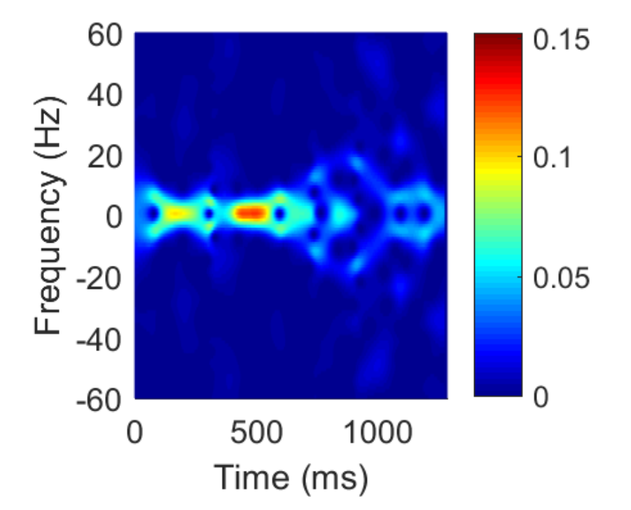
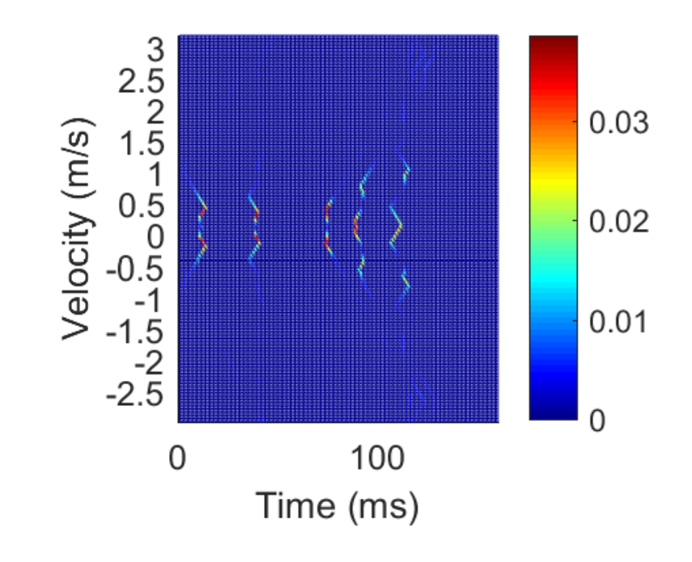
Pattern Extraction
To obtain motion change pattern efficiently :
Derive the spectrogram of denoised WiFi signals using STFT
Associate the derivative of the spectrogram with motion changes
Derivative derivation of the spectrogram is computation-intensive
Frequency bins (Hz)
Velocity (m/s)
Sampling points
Sampling points
12
Notes:
(the power distribution of spectrograms changes as reflection areas S vary for specific DFS at instance t.)
We first leverage the STFT for the denoised WiFi singals to get the spectrogram.
Then we can derive the motion change pattern by computing the derivative of the spectrogram.
However, it’s computation-intensive for the derivative derivation .
Thus we decide to carve the spectrogram selectively, as the figure shown.

Slide 13


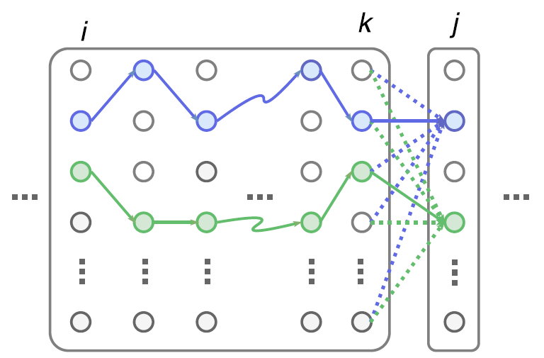

Pattern Extraction
Borrow the idea of Seam Carving Problem in computer graphics for content-aware image resizing.
13
Frequency bins (Hz)
Velocity (m/s)
Sampling points
Sampling points
13
Notes:
To optimize the selection of the dominant carving path for the motion change pattern, we borrow the idea of Seam Carving Problem in computer graphics for content-aware image resizing.
The basic idea is to formulate an optimization problem considering the continuity and consistency of arm moving velocity distribution. Thus we can select the dominant motion changes for all potential carving paths.

Slide 14
WiHF: Problem Statement
Can we identify the performers while conveying the semantic meaning simultaneously?
Feature design: Recognize gestures while identifying users collaboratively.
Cross-domain: Unnecessary extra efforts when gestures are performed in new domains.
Computation efficiency: Efficient enough to be running. in real time.
Dual tasks: bootstrap each other by learning collaboratively.
14
Notes:
The final problem is how to optimize the output of the dual tasks
And we want to bootstrap each other by learning collaboratively

Slide 15
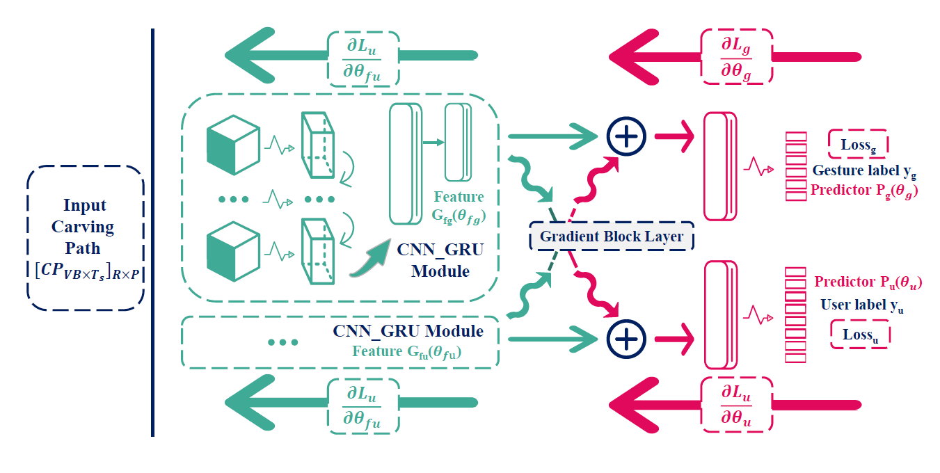
Collaborative Dual-task
Collaborative learning for dual tasks:
Feature splicing using the gradient block layer (slicing factor = 0)
Predict collaboratively while avoiding the loss propagations.
15
Notes:
The basic idea is the design of the gradient block layer, with which we can splice the features from respective feature extractors for the final outputs while avoiding the influence of each other for back-propagation.
Note that the network can be used for multi-task learning with a positive slicing factor while
for cross-domain adaptive with a negative one. We also validate its effectiveness in the paper.

Slide 16
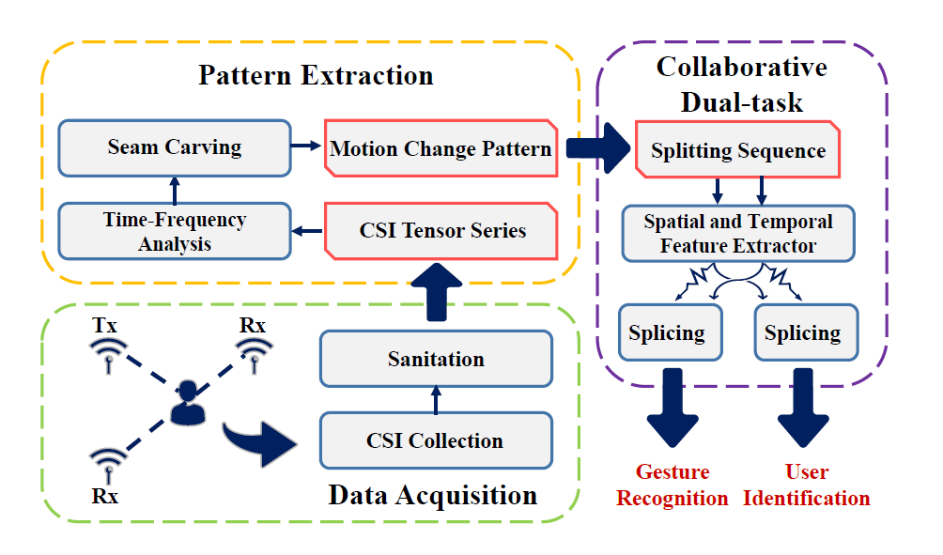
WiHF: Pipeline
Channel State Information (CSI) Preprocessing.
Motion change pattern extraction.
Collaborative dual-task Deep Neural Network (DNN).
16

Slide 17

Dataset
Widar3.0 public dataset:
The dataset can be found in http://tns.thss.tsinghua.edu.cn/widar3.0/index.html.
9 gestures x 16 users x 75 domains (3 environments x 5 locations x 5 orientations).
In use: 9 gestures x 9 users x 75 domains .
Feature Dataset | Comment
HuFu Mini (HuFuM) | Compare the cross-domain gesture recognition with Widar3.0
HuFu Extend (HuFuE) | Explore the impact of gesture duration on user identification
HuFu | Explore the impact of gesture complexity on user identification
17
Notes:
To validate the effectiveness of our system, we do the evaluation on the public dateset published by widar3.0.

Slide 18
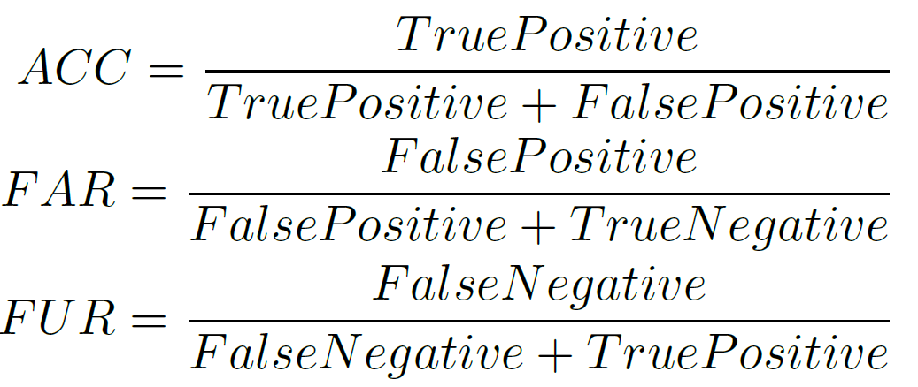
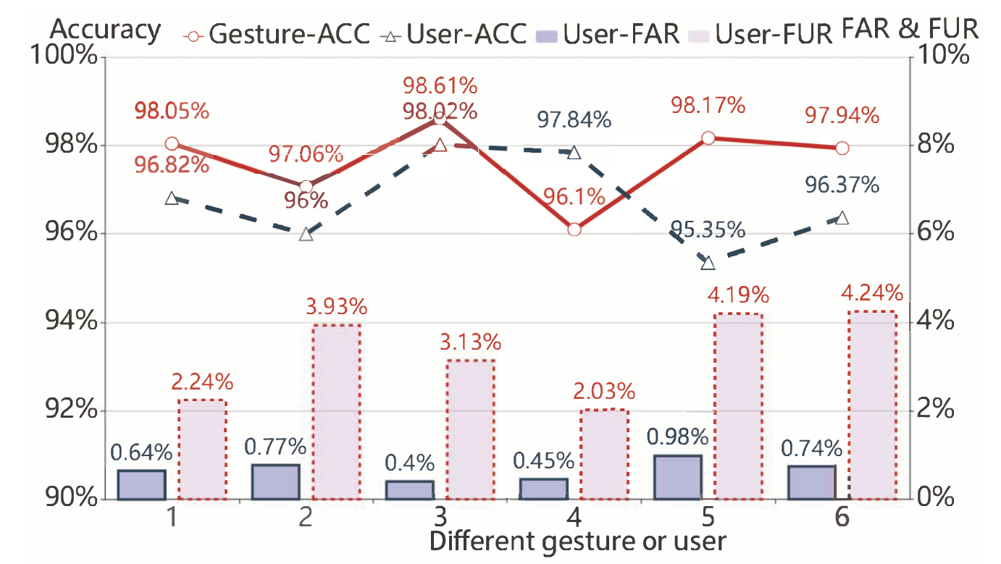
Evaluation
Metric:
A
A
B
Accuracy (in-domain):
User identification: 96.74%
Gesture recognition: 97.65%
18

Slide 19
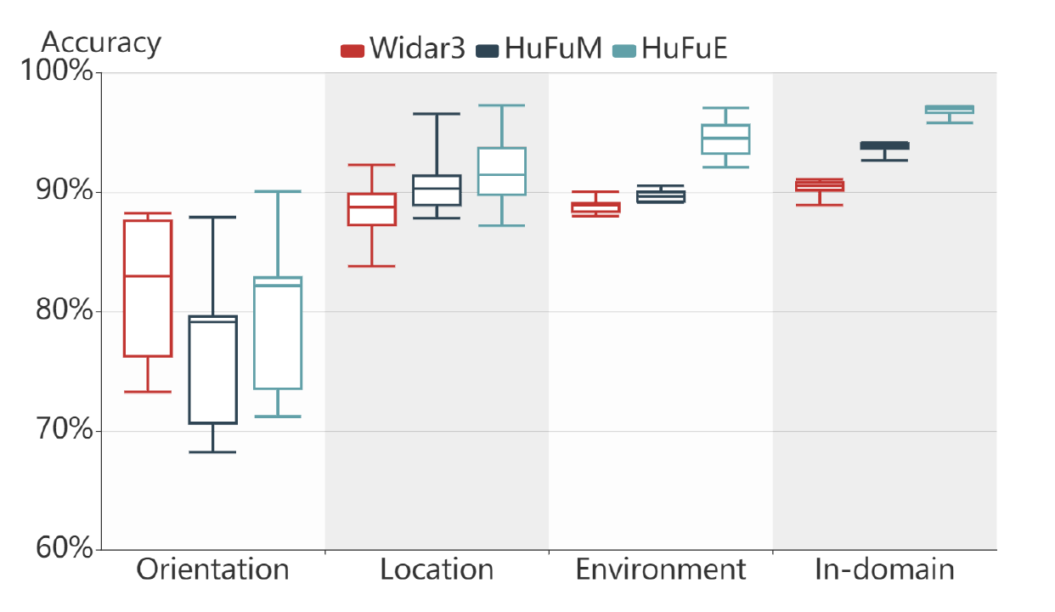
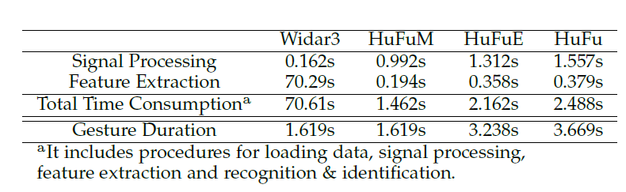
Evaluation
Cross-domain gesture recognition:
WiHF achieves comparable performance with the-state-of-the-art work (Widar3.0 Mobisys19’) across domains.
Latency:
The processing time of WiHF is reduced by 30x.
19

Slide 20
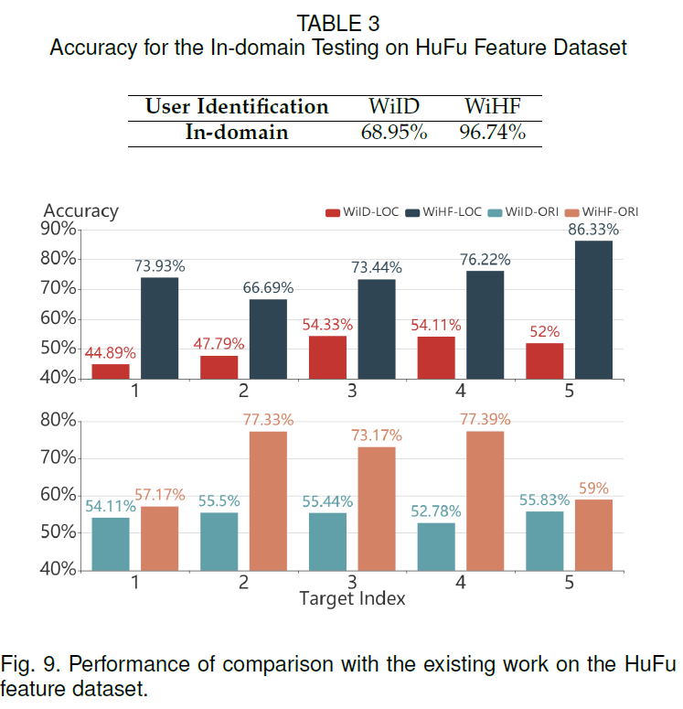
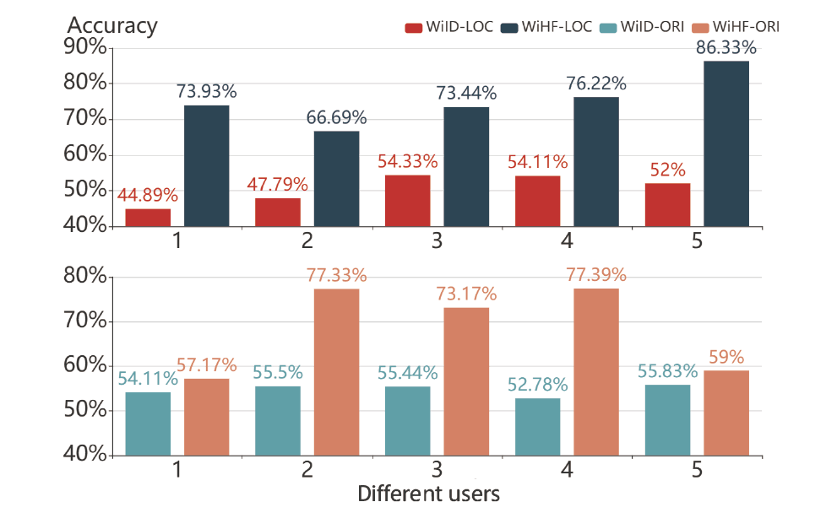
Evaluation
Comparative study:
WiHF outperforms WiID for
in-domain user identification.
Cross-domain user identification:
Consistent performance with the observation.
WiHF suffers severely for edge orientations.
20
Notes:
using the same dataset
The performance is consistent with the observation on the power based feature and the motion change pattern
The cross-domain ability of designed feature.

Slide 21
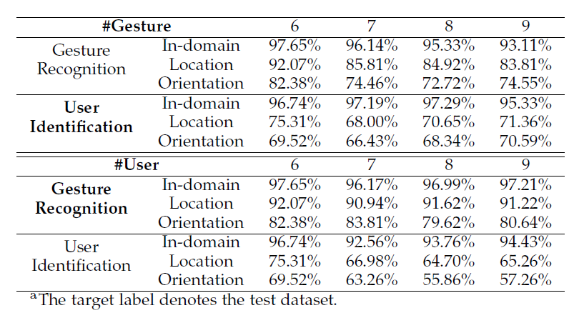
Evaluation
WiHF satisfies the requirements of the smart home scenario.
21
Notes:
WiHF demonstrates accessible performance when the number of users or gestures is up to 9

Slide 22
Conclusions
WiHF designs a domain-independent motion change pattern of arm gestures and a dual-task network that can recognize gestures and identify users collaboratively.
WiHF achieves the comparable cross-domain gesture recognition with the state-of-the-art method, but the processing time is reduced by 30×.
WiHF demonstrates the feasibility of cross-domain user identification but requires sophisticated gesture design.
22

Slide 23
Thanks!
Q&A
Chenning Li
chenningli2019@gmail.com
“We can only see a short distance ahead, but we can see plenty there that needs to be done.”——Alan M. Turing
23
Notes:
WiHF suffers severely for some orientations in the cross-domain testing due to the shadow effect :
The complexity and duration of for motion change pattern to capture the personalized performing style (Drawing the rectangle vs. Clapping).

Slide 24
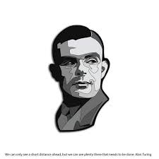
We can only see a short distance ahead, but we can see plenty there that needs to be done.
—— Alan M. Turing ——
24
Notes:
WiHF suffers severely for some orientations in the cross-domain testing due to the shadow effect :
The complexity and duration of for motion change pattern to capture the personalized performing style (Drawing the rectangle vs. Clapping).

