Slide 1
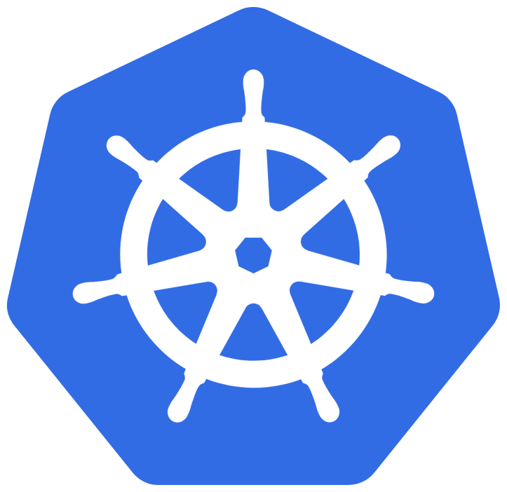
Presentation: Proof of Concept – Kubernetes Cluster with Hello World

Slide 2
Objective of the Test
Create a local Kubernetes cluster using Minikube
Deploy a static "Hello World" web app
Expose the service via a web browser
Verify that the app is working correctly
Notes:
The objective of this test is to set up a local Kubernetes cluster using Minikube, deploy a static "Hello World" web app, expose the service so that it can be accessed via a web browser, and verify that everything works correctly and simply. This process will help demonstrate the workflow of container-based deployments in Kubernetes, providing a basic but functional implementation of a real-world scenario.

Slide 3
Prerequisites
Docker Desktop
Minikube
Kubectl
A text editor like Visual Studio Code
Notes:
Before we start, it's important to have a few essential tools installed in our development environment. First, Docker Desktop, which allows us to build container images. Second, Minikube, which helps us create and manage a local Kubernetes cluster. Third, Kubectl, the command-line tool used to interact with Kubernetes. And finally, a text editor such as Visual Studio Code or any editor of your choice, which we’ll use to create the necessary files like HTML, the Dockerfile, and Kubernetes manifests.

Slide 4
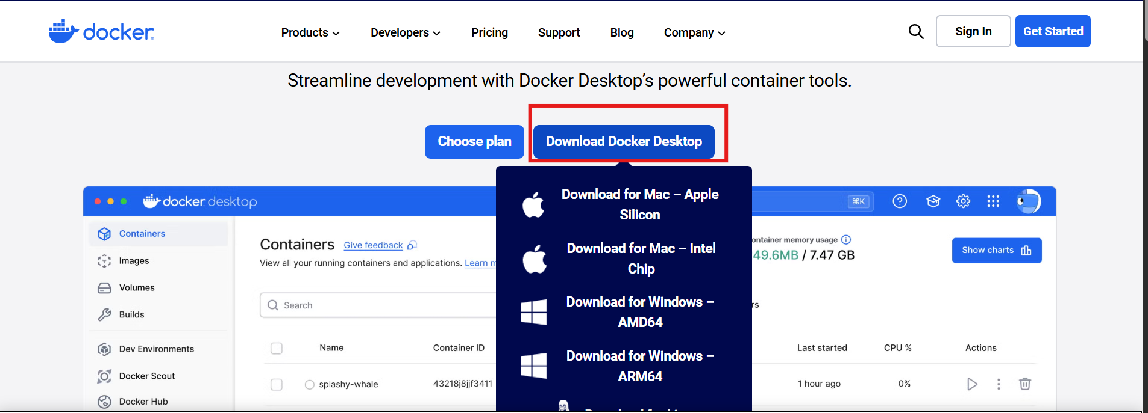

Docker Desktop Installation
Go to: https://www.docker.com/products/docker-desktop/
Run the installer
Verify the installation: docker --version
Notes:
Before working with containers, we need Docker Desktop installed on our machine. Docker allows us to build, run, and manage containerized applications locally. Simply go to the official Docker website, download the installer for your operating system, and follow the installation steps. Once installed, we can verify everything is working by running docker --version in the terminal.

Slide 5
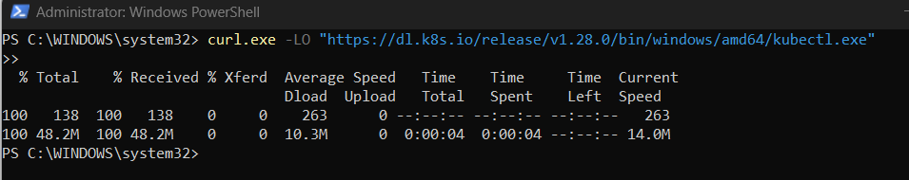
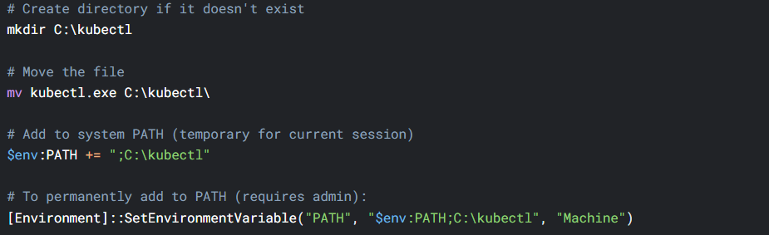

Installing kubectl
Run the following in PowerShell (as Administrator):
Add kubectl to PATH
Verify installation
Notes:
Kubectl is the command-line interface tool used to communicate with Kubernetes clusters. We’ll need it to deploy our application, inspect resources, and manage the cluster. To install kubectl, download the binary from the official Kubernetes website, move it to a known directory, and add it to your system PATH. Finally, verify the installation by running kubectl version --client.

Slide 6
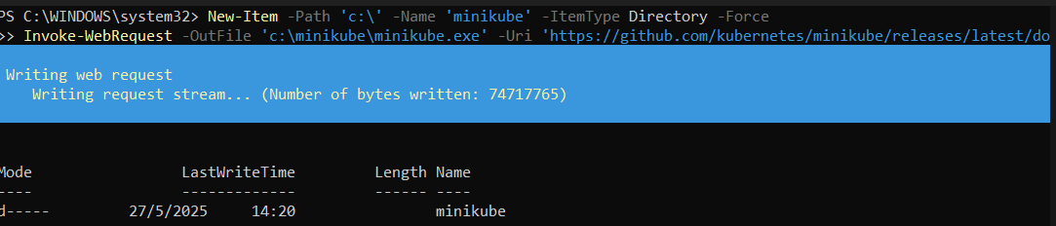
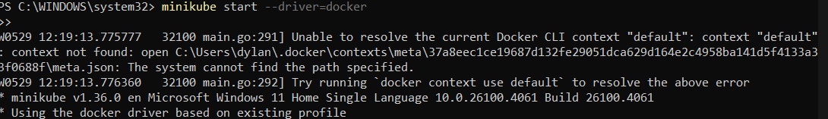
Minikube Installation
Download Minikube (PowerShell as Administrator)
Add Minikube to System PATH
Start Minikube (after restarting PowerShell)
Notes:
Minikube allows us to create a local Kubernetes cluster for testing and development purposes. To install Minikube, download the executable from the official Minikube website and place it in a directory included in your system’s PATH. Once installed, you can start your local cluster by opening a terminal and running minikube start. This command sets up a single-node Kubernetes cluster on your machine.

Slide 7
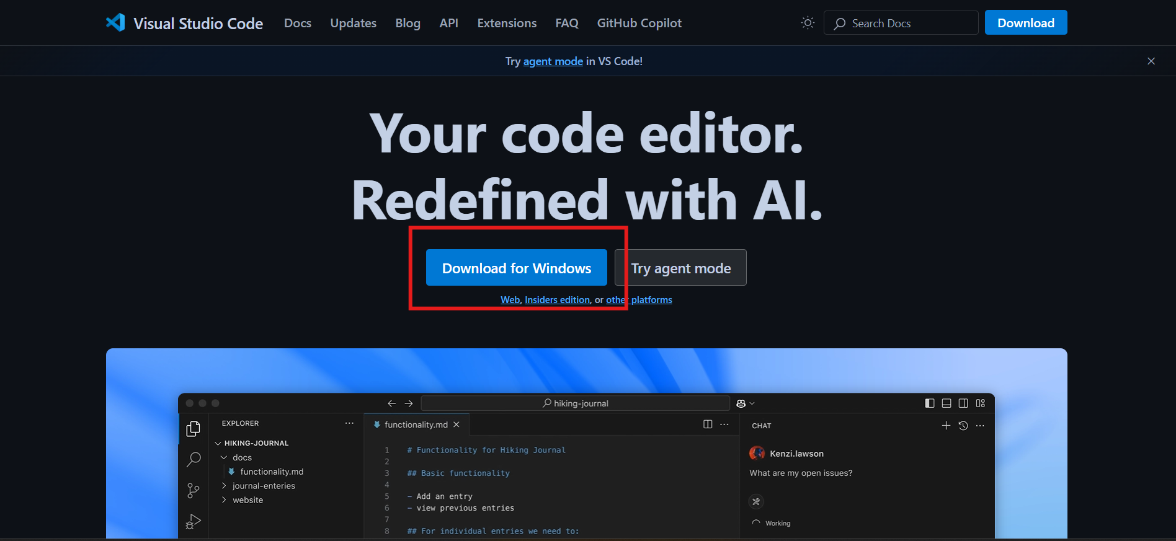
VS Code Configuration
Notes:
Visual Studio Code is a lightweight yet powerful text editor, perfect for our development needs. We’ll use it to write HTML, Dockerfiles, and Kubernetes manifests. You can download it from the official site. Once installed, it’s a good idea to add helpful extensions such as Docker, YAML, and Kubernetes to enhance your development workflow.

Slide 8
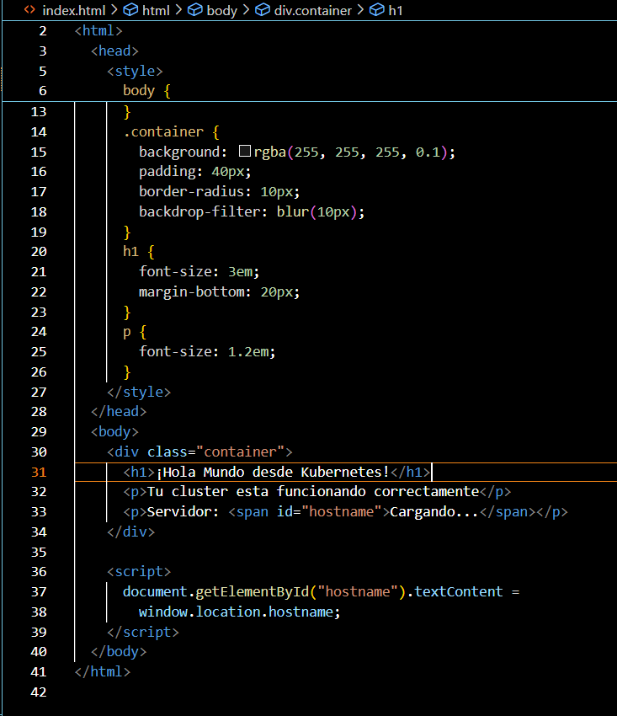
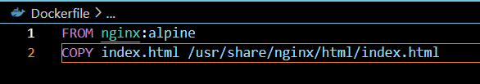
Step 1 – Create HTML and Dockerfile
Notes:
The first step is to create the base files for our application. We’ll start with a simple HTML file that displays "Hello World", and a Dockerfile that packages this HTML page into a container image. The HTML can be a very basic structure with a heading that says "Hello World". The Dockerfile will use a base image like nginx or httpd, copy our HTML file into the appropriate directory, and expose the necessary port. This image will later be used to deploy our pod inside the cluster.

Slide 9
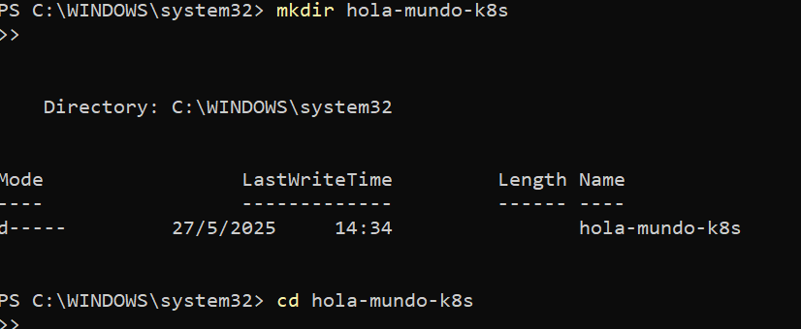
Slide: Step 2 – Create the Working Directory
mkdir hola-mundo-k8s
cd hola-mundo-k8s
Notes:
Once we know which files we’ll be working with, the next step is to organize our project structure. Open a terminal and run the command mkdir hola-mundo-k8s, which creates a new directory named hola-mundo-k8s. Then, navigate into it using cd hola-mundo-k8s. This directory will hold all the files for our application and the Kubernetes manifests we’ll define and use later.

Slide 10
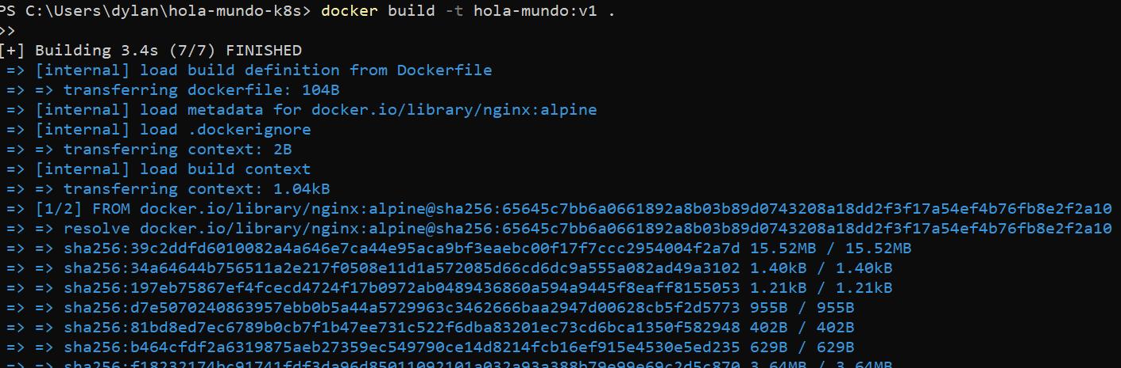
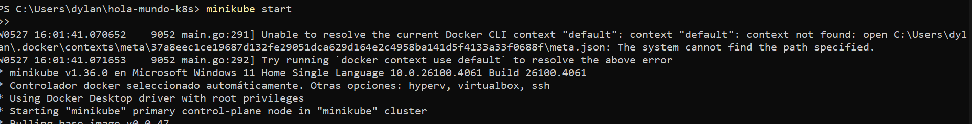
Slide: Step 3 – Configure Docker for Minikube and Build the Docker Image
docker build -t hola-mundo:v1 .
minikube start
Notes:
Now we’ll set up Minikube and prepare Docker to build our image in the right context. Start the local Kubernetes cluster by running minikube start. This may take a few minutes if it’s the first time. Then, ensure Docker is using the Minikube environment if needed. After that, run docker build -t hola-mundo:v1 . in the root directory of your project. This command builds a Docker image named hola-mundo with the tag v1, using the Dockerfile we previously created.

Slide 11
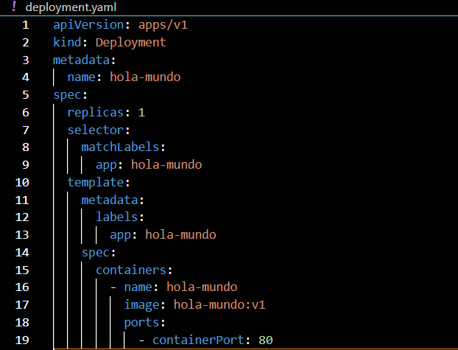
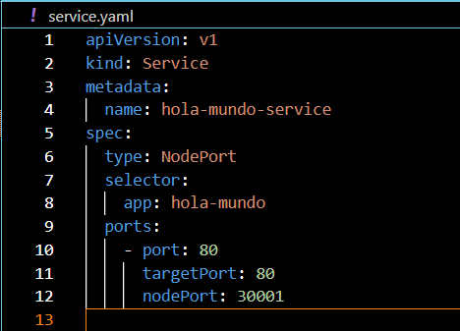
Step 4 – Create deployment.yaml and service.yaml
Notes:
Next, we need to define how our app will be deployed in the cluster using two Kubernetes manifest files:
deployment.yaml: This file describes the Deployment resource. It specifies the image to use, the number of replicas, and the pod configuration.
service.yaml: This file defines a Service of type NodePort, which exposes our app to be accessible from outside the cluster. These YAML files should be saved in the project directory so they can be applied using Kubectl in the next steps.

Slide 12
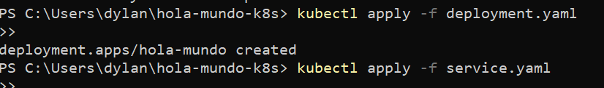

Step 5 – Apply Kubernetes Manifests and Verify Pod Execution
kubectl apply -f deployment.yaml
kubectl apply -f service.yaml
kubectl get pods
Notes:
With our manifests ready, we can now apply them to the cluster using the following commands: Run kubectl apply -f deployment.yaml to create the deployment, and kubectl apply -f service.yaml to create the service. Then, execute kubectl get pods to check if the pod is running. If everything is configured properly, you should see your pod in a "Running" state, meaning your app has been deployed successfully inside the cluster.

Slide 13
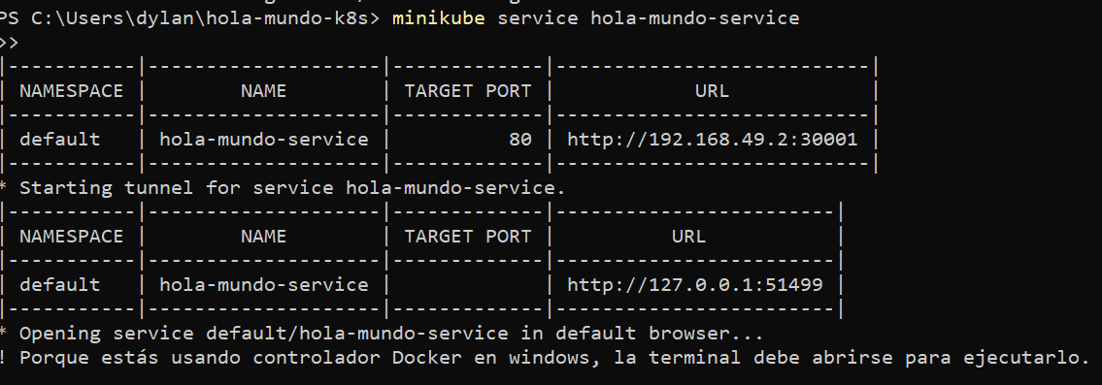
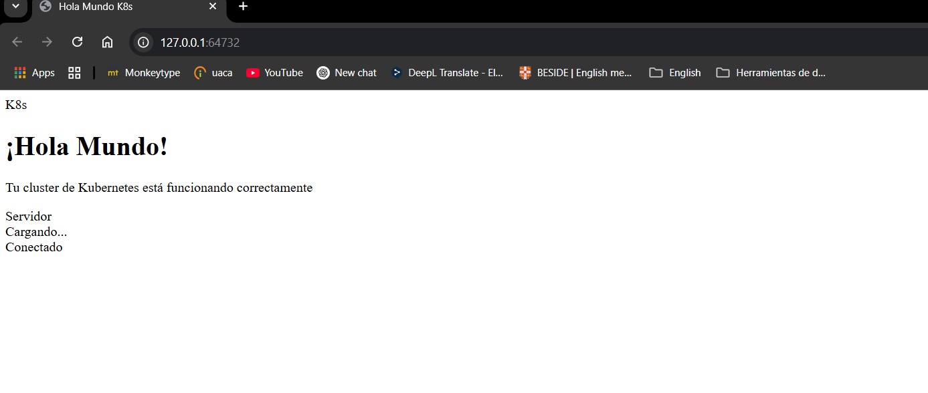
Step 6 – Access the Web Application
Notes:
Finally, we’ll access our deployed web application.Since the service is exposed via a NodePort, we can retrieve its URL by running the command minikube service hola-mundo-service.This command will open your default web browser and display the HTML page with the "Hello World" message.This confirms that the application has been deployed correctly and is accessible through the browser, completing our proof of concept.

