Slide 1
Speech Recognition with Fast-Whisper
Félix Suárez

Slide 2
Introduction
Explore Whisper Transcription, a Python script utilizing faster-whisper, a reimplementation of OpenAI's Whisper model using CTranslate2. This tool enables users to transcribe audio files into text directly or via Docker containers.

Slide 3


Prerequisites
Python 3.8 or higher required.
Docker (optional for containerization).
https://www.python.org/downloads/
https://docs.docker.com/desktop/install/windows-install/

Slide 4
Using Python Script
1. Set up a virtual environment:
python -m venv venv source venv/Scripts/activate
2. Install the necessary Python dependencies:
pip install faster-whisper
3. Run the Python script transcribe_audio.py:
python transcribe_audio.py

Slide 5
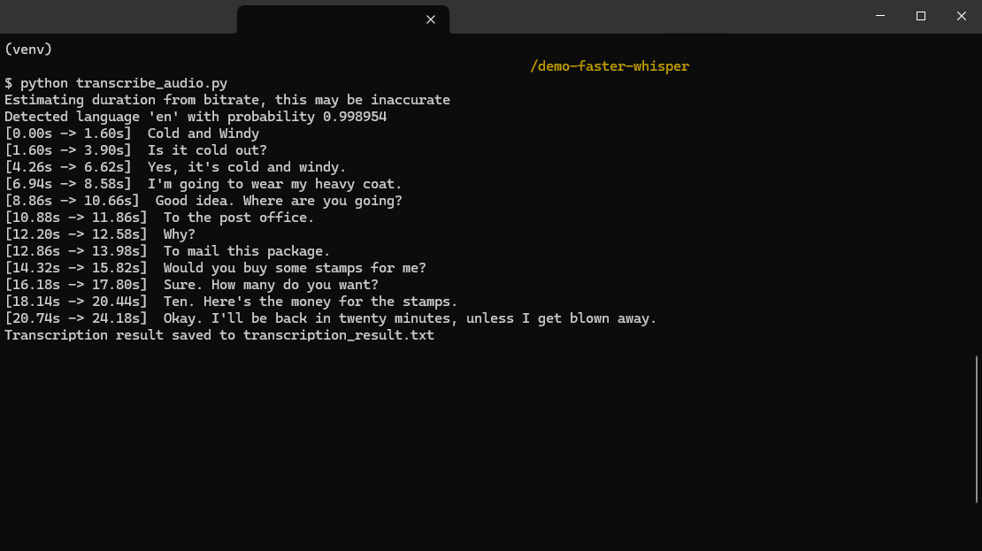
Using Python Script
Example Results:

Slide 6
Using Docker
1. Build the Docker image inside the dockerfile_script folder:
docker build -t whisper_transcription_container .
2. Execute the python container from outside it:
docker run whisper_transcription_container
3. Or Get into the docker container and execute the python script inside the container:
docker run -it --rm whisper_transcription_container bash python transcribe_audio.py

Slide 7
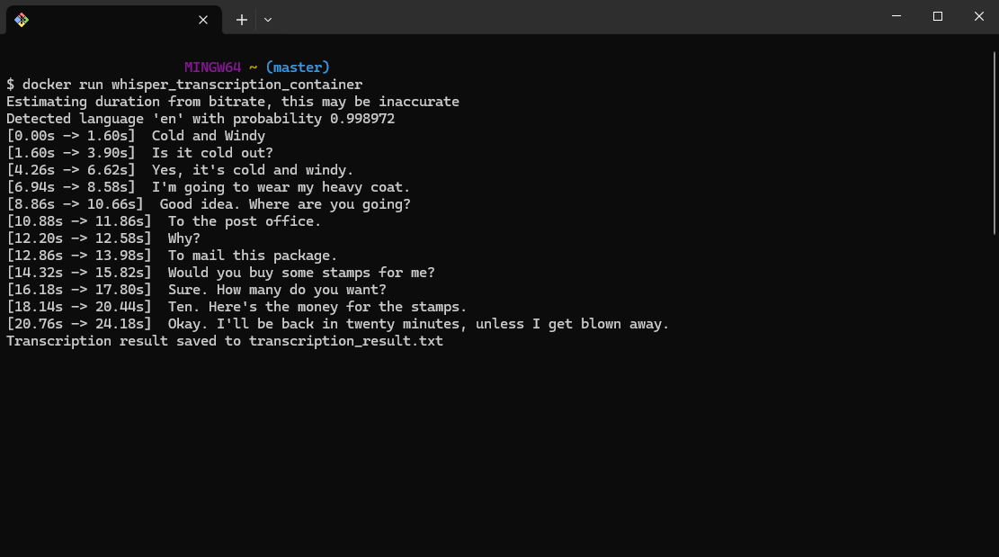
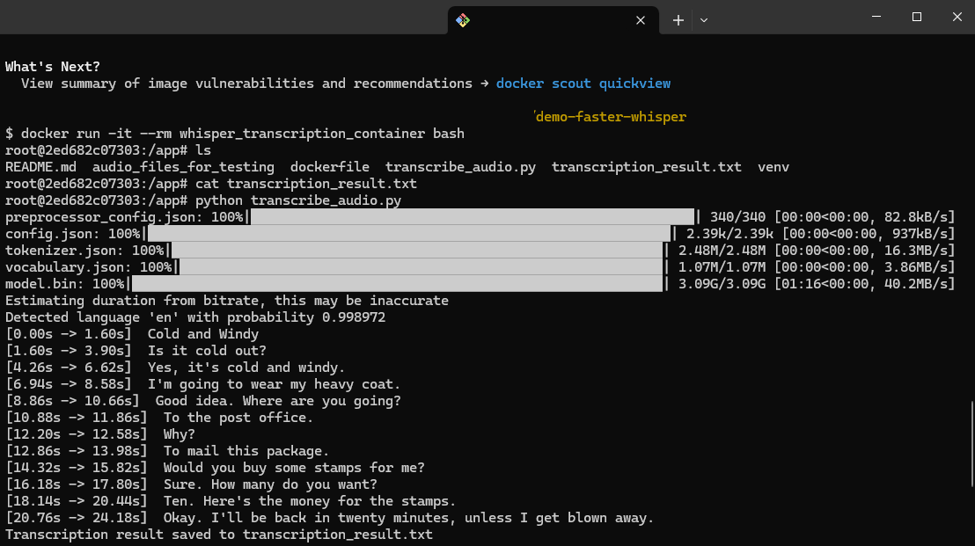
Using Docker
Example Results:
2
3

Slide 8
Using Fast API Endpoint
1. Set up a virtual environment:
python -m venv venv source venv/Scripts/activate
2. Install the necessary Python dependencies:
pip install faster-whisper
3. Run the Fast API application:
uvicorn transcription_endpoint:app --reload

Slide 9
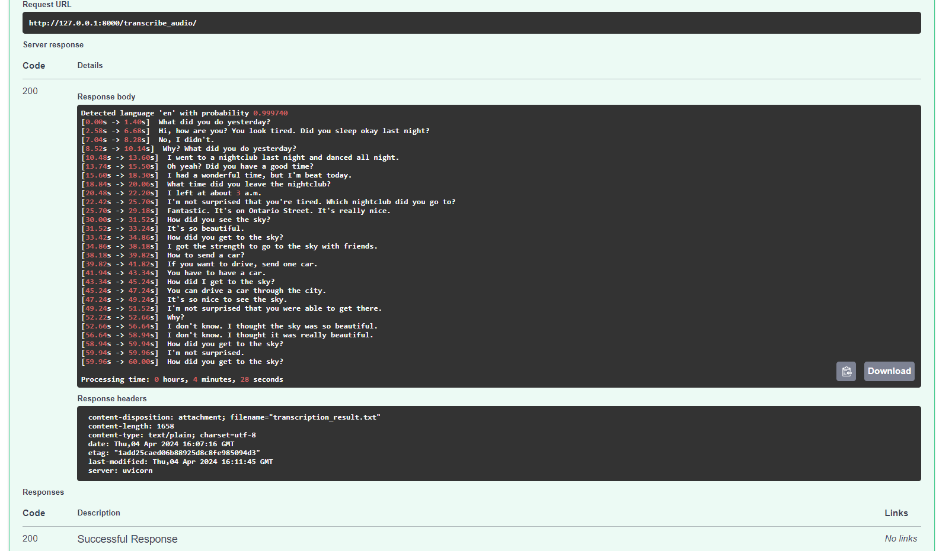
Using Fast API Endpoint
Example Results: Access the endpoint via
http://127.0.0.1:8000/docs#/default/transcribe_audio_transcribe_audio__post

Slide 10
Using Docker for the FastAPI Endpoint
1. Build the Docker image named Dockerfile:
docker build -t dockerfile_endpoint .
2. Run the Docker Container:
docker run -p 80:8000 dockerfile_endpoint

Slide 11
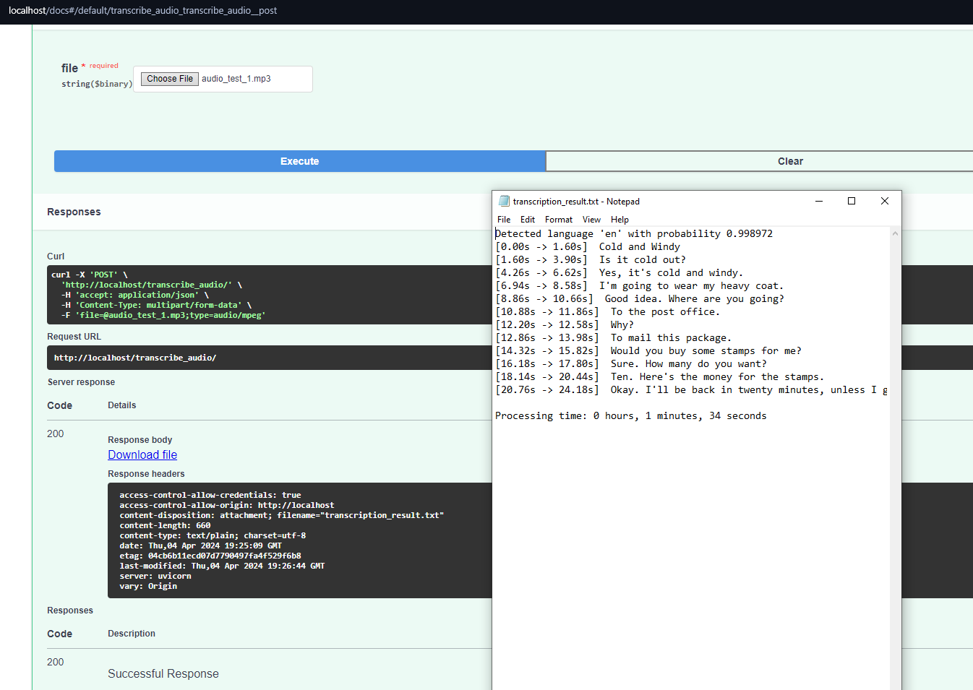
Using Docker for the FastAPI Endpoint
Example Results: Access the endpoint via
http://localhost/docs#/default/transcribe_audio_transcribe_audio__post

Slide 12
Audio File Testing on GCP Instance
Through an experimental run on a Google Cloud Platform (GCP) instance equipped with 4 CPU cores and 4GB RAM, four audio files were tested to assess processing times. The resulting data offers insights into the transcription times for each audio file.

Slide 13
Audio File Testing on GCP Instance
Results of processing times for four audio files:
Audio File | Hours | Minutes | Seconds
gb0.wav | - | - | -
gb1.wav | 0 | 4 | 5
hp0.wav | 0 | 12 | 41
mm0.wav | 0 | 0 | 53
Total | 0 | 22 | 34
1
Note: 4 CPU cores processor and 4GB RAM

Slide 14
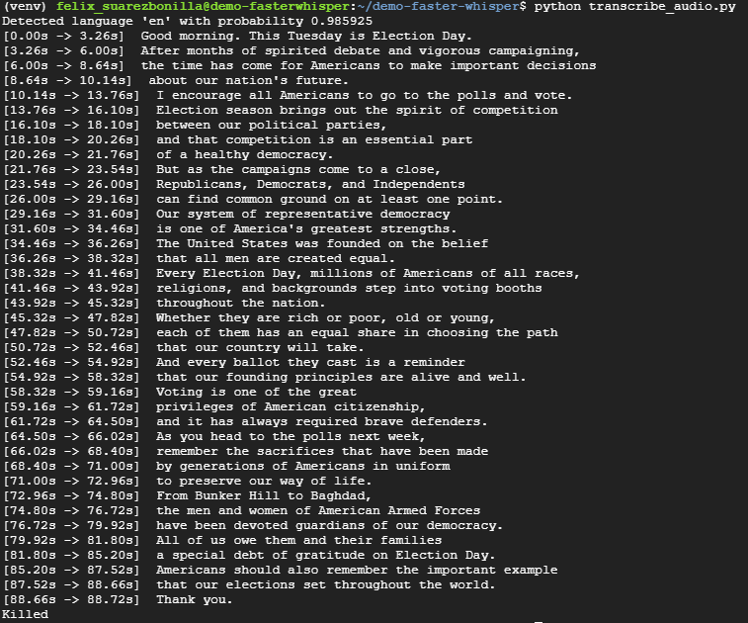
Audio File Testing on GCP Instance
1
Problem Description: When attempting to run the audio file gb0.wav on the Google Cloud Platform (GCP) instance, the process consistently terminates, likely due to insufficient memory. The GCP instance is configured with 4 CPUs and 4GB of RAM.

Slide 15
Audio File Testing on Local Machine
Through an experimental run on a local machine equipped with 6 CPU cores and 16GB RAM, four audio files were tested to assess processing times. The resulting data offers insights into the transcription times for each audio file.

Slide 16
Audio File Testing on Local Machine
Results of processing times for four audio files:
Audio File | Hours | Minutes | Seconds
gb0.wav | 0 | 4 | 25
gb1.wav | 0 | 4 | 5
hp0.wav | 0 | 12 | 41
mm0.wav | 0 | 0 | 53
Total | 0 | 22 | 34
Note: 6 CPU cores processor and 16GB RAM

Slide 17
Conclusion
In conclusion, Whisper Transcription using faster-whisper, a reimplementation of OpenAI's Whisper model offers provides users with the ability to transcribe audio files. Whether utilized directly through the provided Python script or deployed via Docker containers, results can be achieved with high output text accuracy. Furthermore, experimental runs conducted on both a Google Cloud Platform instance and a local machine provide valuable insights into processing times.

